Slide 1
Programming and Instructional Contest Organizer
Jamel Charouel, Jason Deng, Vivian Liu, Derek McMahon, Austin Petrie, Nathan Williams

Slide 2
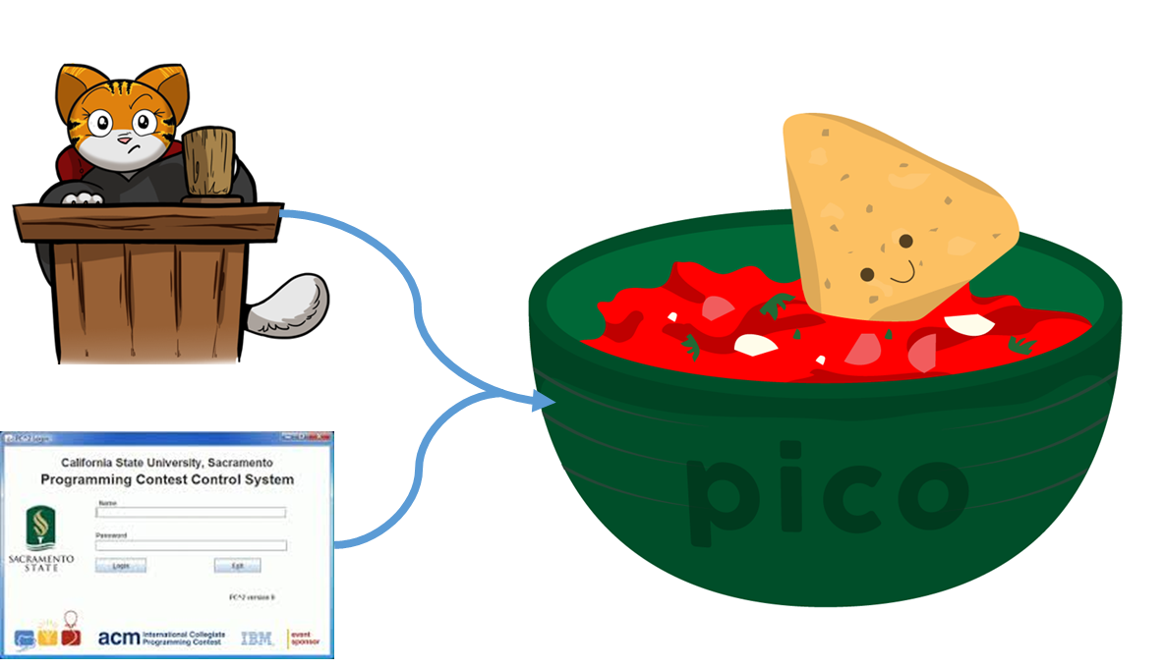
What is PiCO?
Notes:
ACM International Collegiate Programming Contest
Kattis is quality but expensive. Only feasible to use in large competitions like ICPC world finals. (starting price is $900 per month)
PC^2 is open source but extremely buggy. There was an issue with it just last month during UVa’s annual High School Programming Contest.
PiCO is our attempt at the best of both worlds: and open source system that is also high quality.

Slide 3







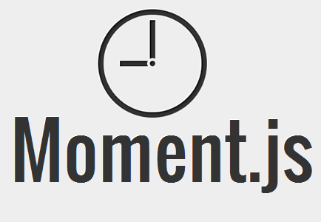
Technologies Used
Notes:
Jquery, bootstrap
Docker

Slide 4







Tools Used
Notes:
JetStrap Wireframing
Sphinx to help create overall documentation
MIT License for open source software
Significant for the following reason:
As Vivian explained, ICPC has a long history of grappling with PC^2 on competition days. As issues arise, the community is powerless. Without access to the source code, they cannot contribute improvements or changes. With PICO released under an open source license, we can allow our tech savvy community members to continue helping our software system evolve.

Slide 5
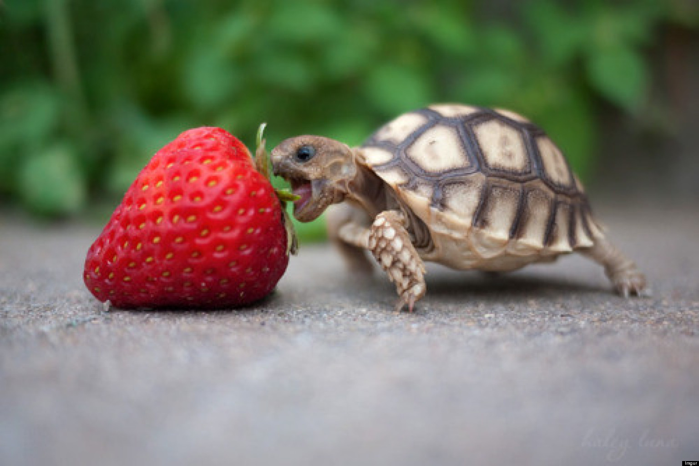
Challenges Faced
Testing code run in Docker
Separate code into small units
Use dependency injection
Handling authorization
Authorization changes with contest state
Inactive
Active
Past
Authorization changes between contests
Intelligent diffing
Placing the burden of computation
Not all white space is created equal
Notes:
Burden of computation: backend.
Emptylines and whitespace had to be distinguishable in the judging interface. To avoid regenerating the entire diff when changing whitespace settings, whitespace was classified and labeled in the diff generation using CSS classes after which whitespace could be toggled on and off from the client side.

Slide 6

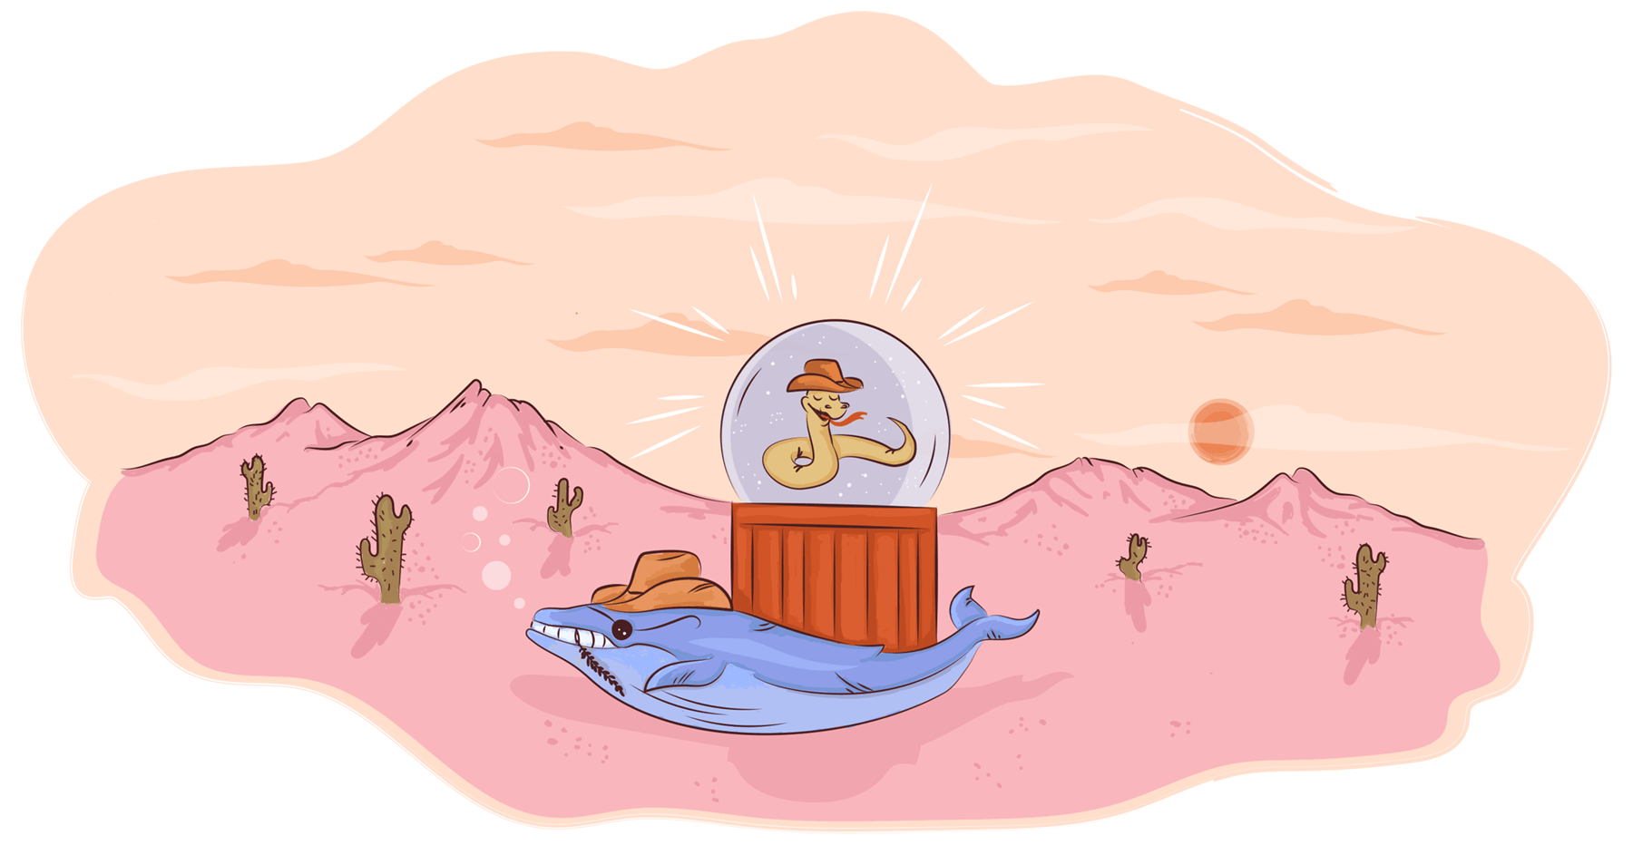
Future Improvements
Classroom functionality
Dockerize entire web app
Add Anti-Plagiarism functionality
Notes:
Dockerize web app
Enhance pico past only contest creation/running application. Allow people to practice contest questions
Anti-plagiarizing code

Slide 7
DEMO!

Slide 8
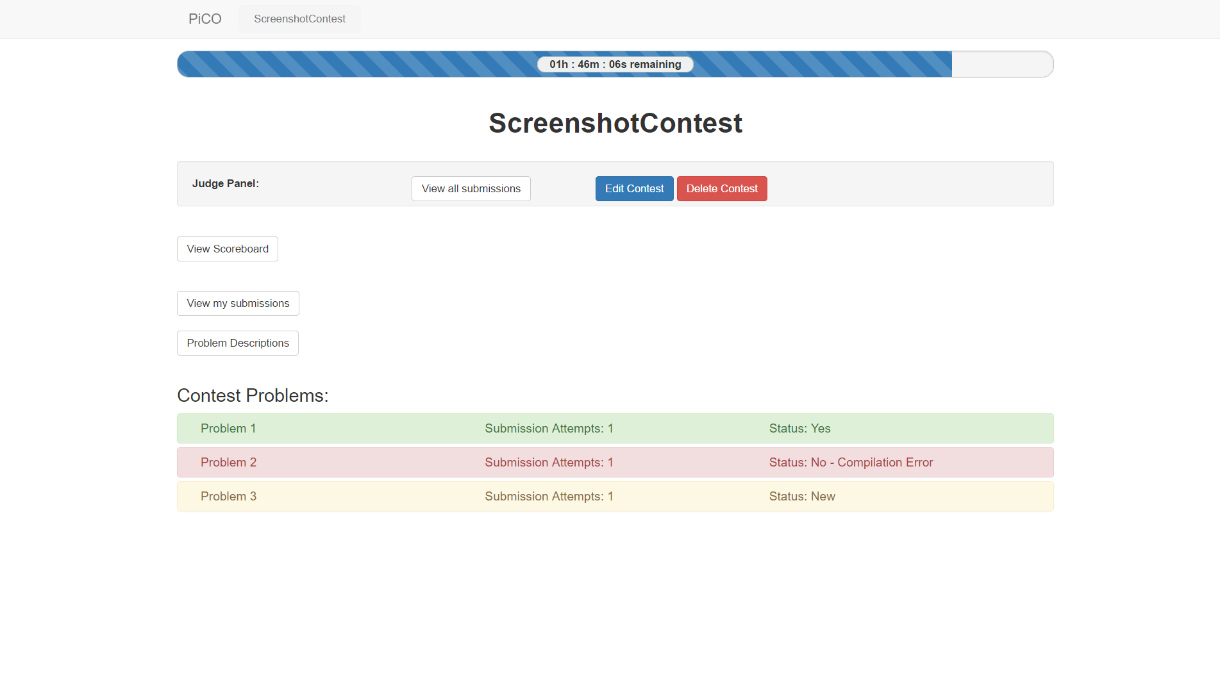
Screenshots: Main Contest Page

Slide 9
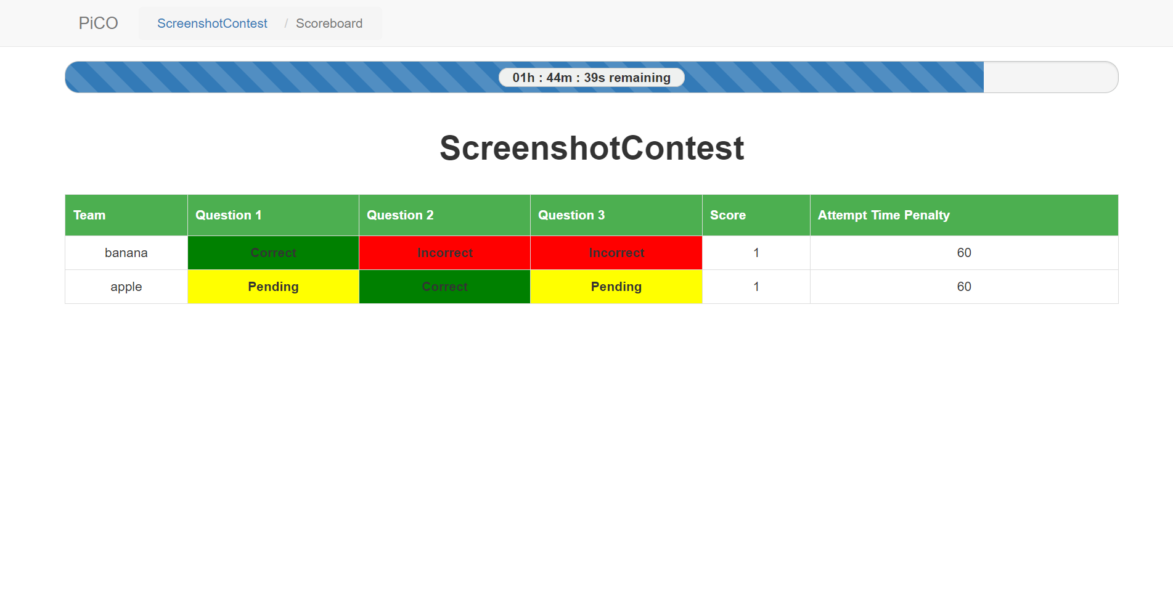
Screenshots: Contest Scoreboard

Slide 10
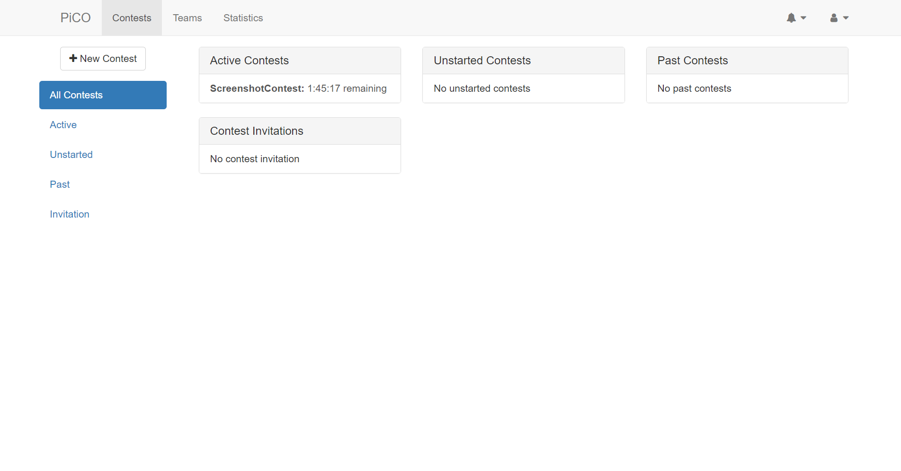
Screenshots: Main PiCO Page

Slide 11
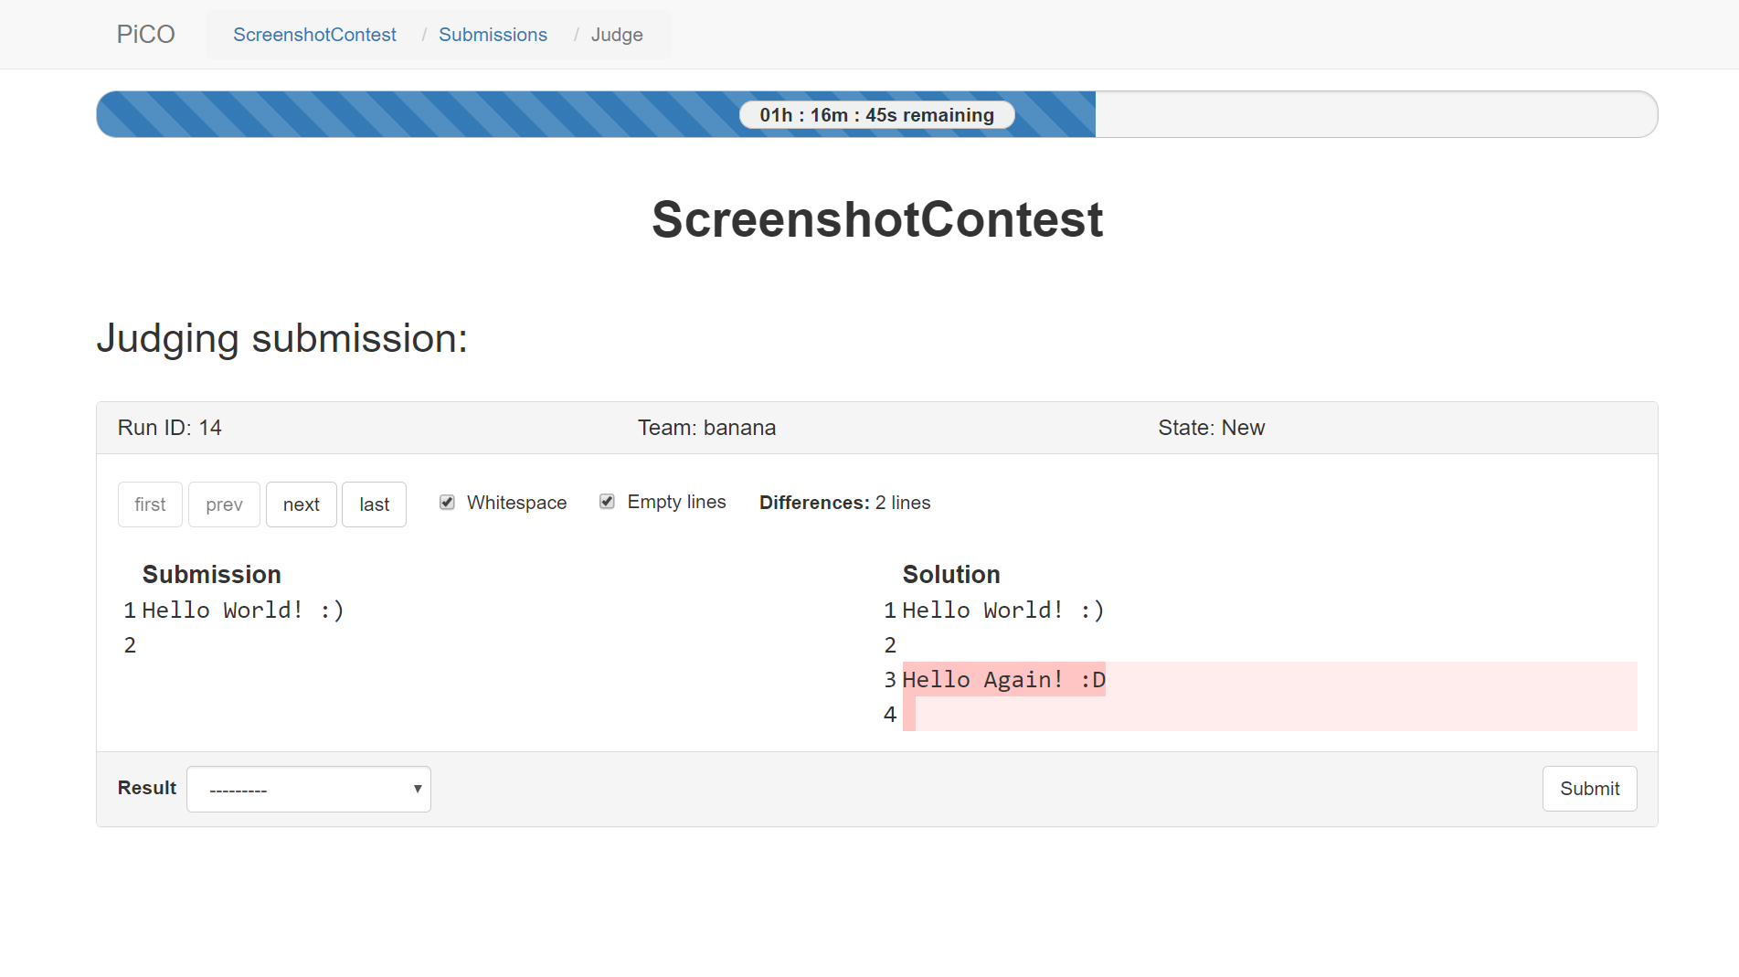
Screenshots: Judge Diff Page

