Slide 1
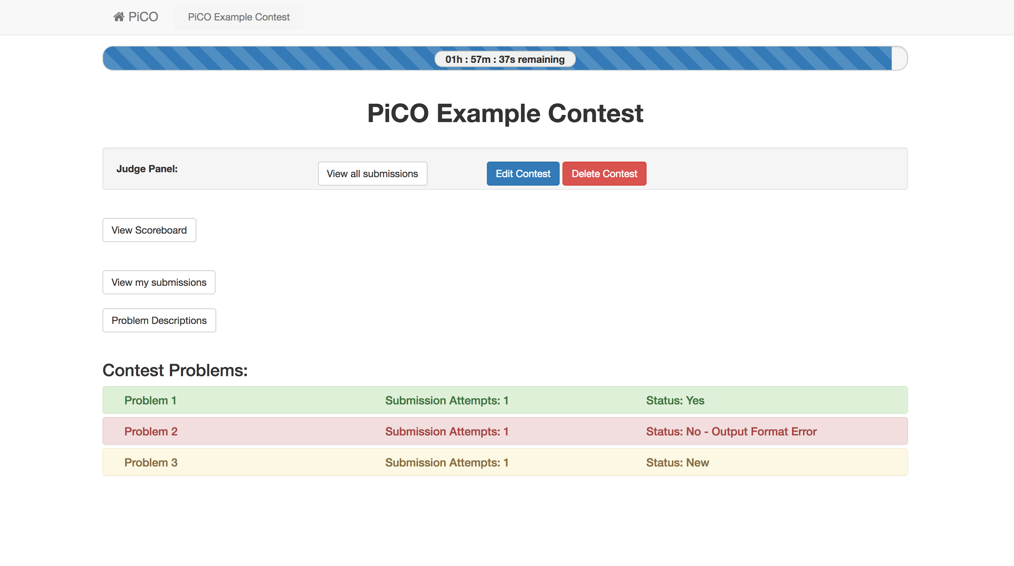

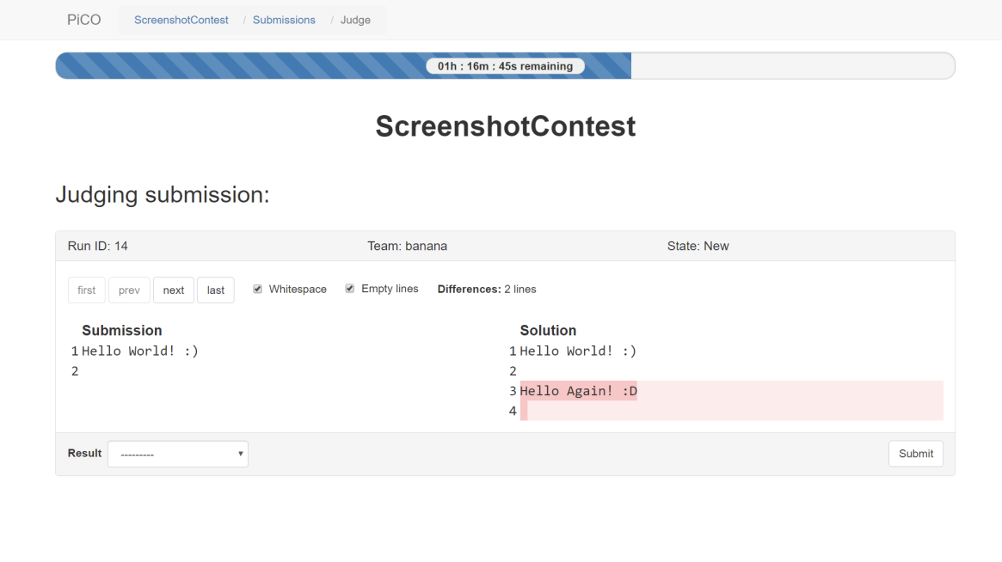
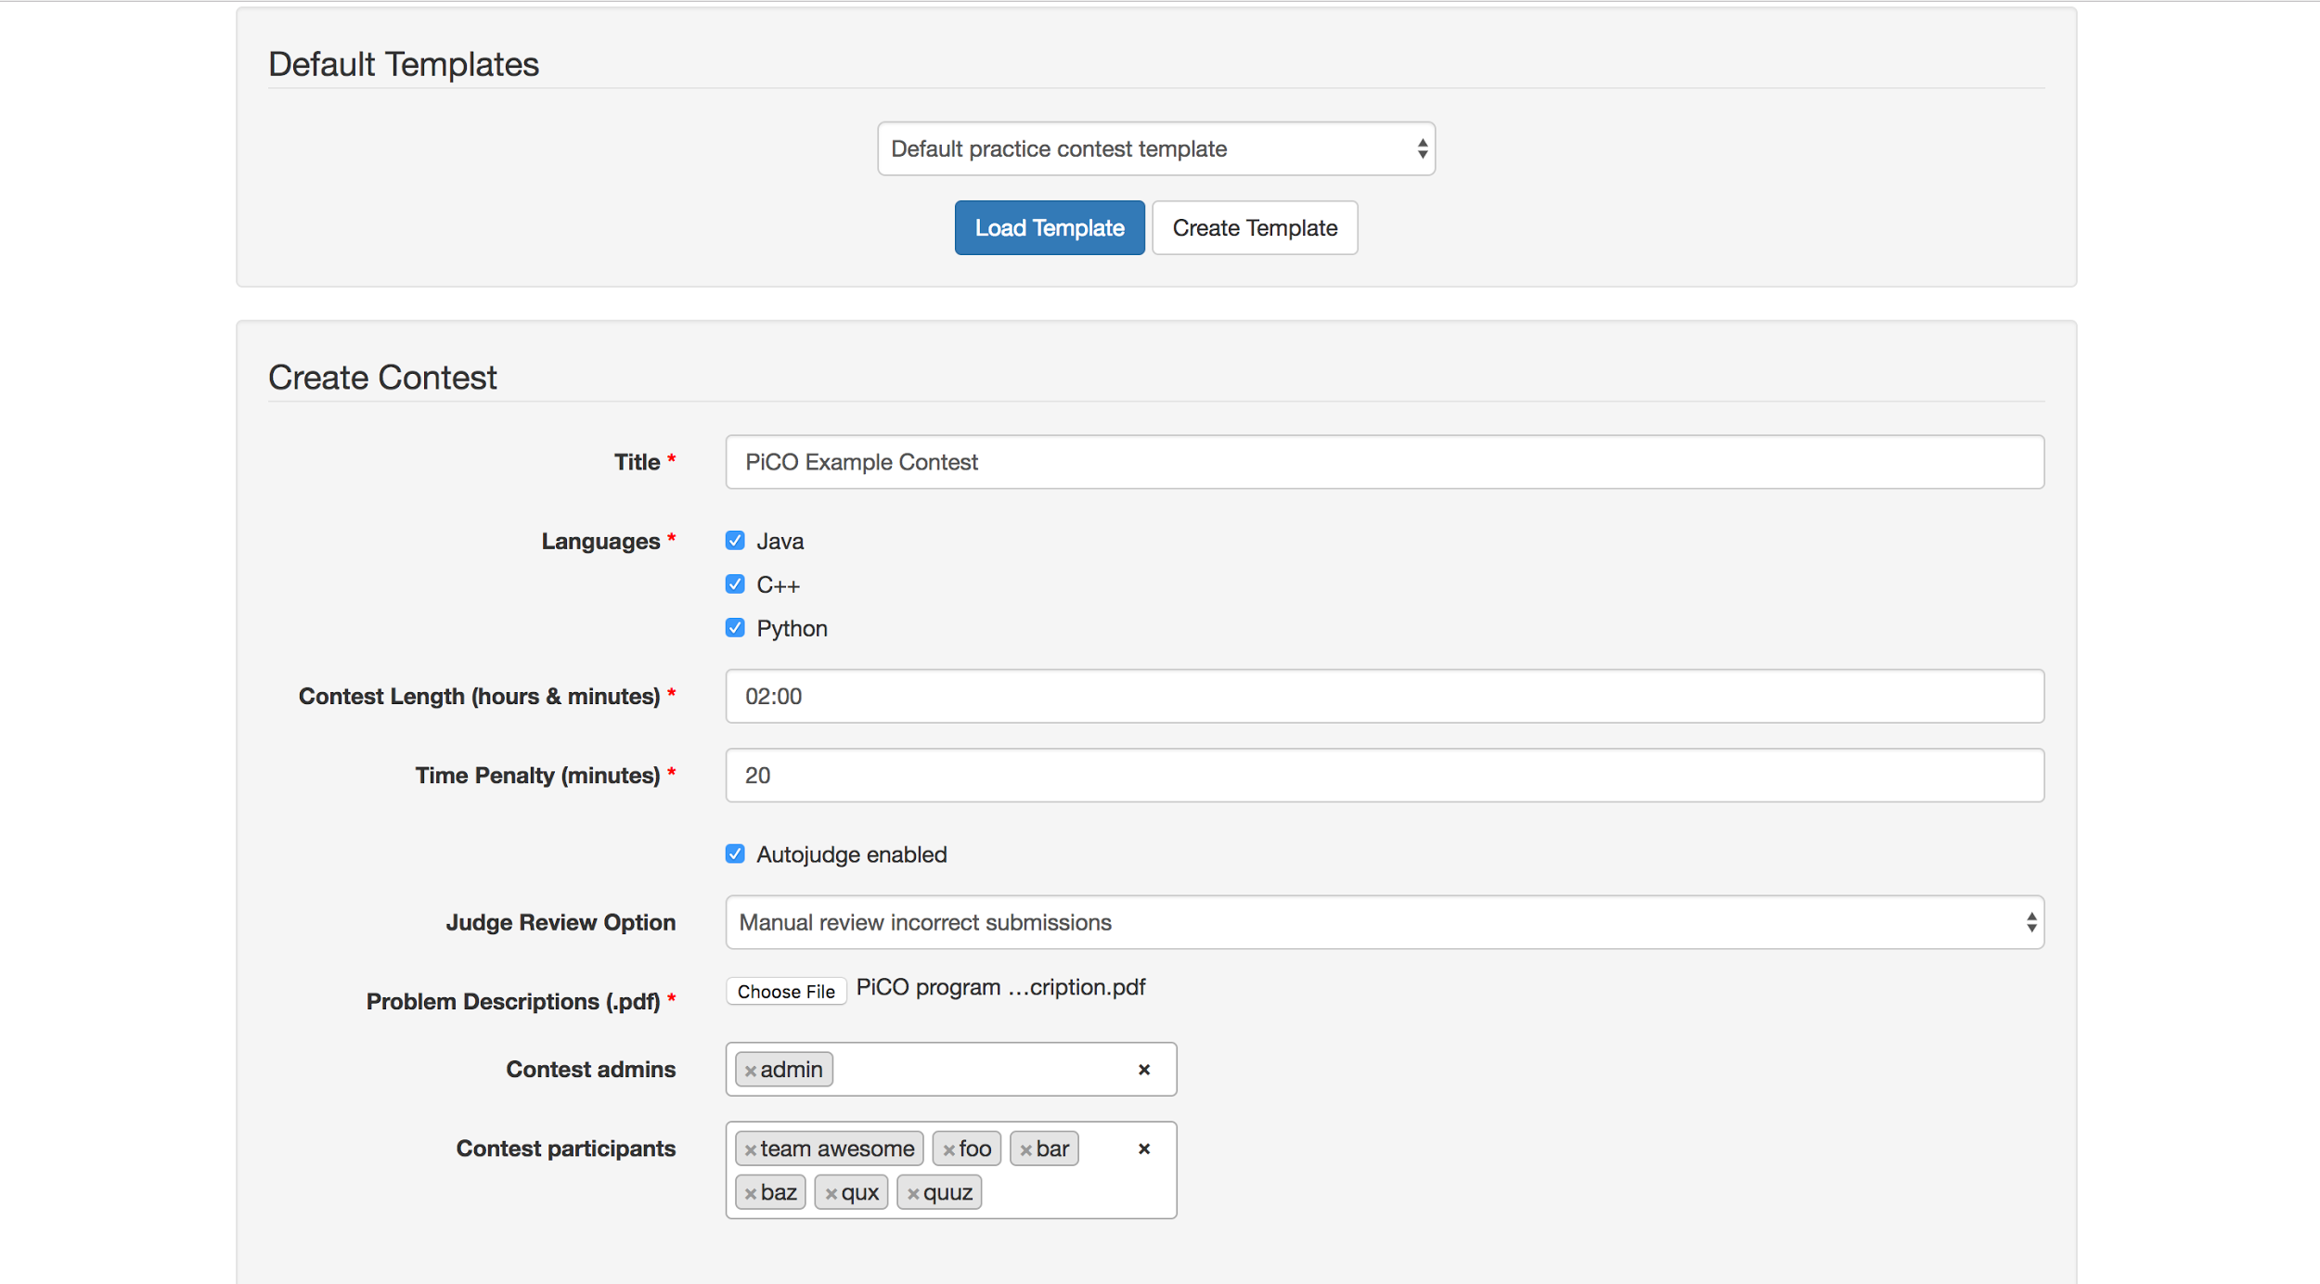
PiCO team (Jamel Charouel, Jason Deng, Vivian Liu, Derek McMahon, Austin Petrie, Nathan Williams)
for
UVA Programming Contest
Programming and Instructional Contest Organizer
Best open-source web-application available free for the programming contest community
get

