Slide 1
Miloš Stanojević
Evaluating MT output

Slide 2
Why do we need to evaluate MT output automatically?
Rapid system development
Tuning MT system
Comparing different systems
Ideally we would use humans but they are too expensive.

Slide 3
So what is an evaluation metric?
Basically a similarity function between the output of our system (“system translation”) and human translation (“reference translation(s)”)
Similarity can be interpreted in different ways:
  Overlap of sys and ref translation (precision, recall...)
  Edit distance (insert, delete, move operations)
  ...
Different metrics make different choices on this matter

Slide 4
What kind of metric is the best?
No consensus on that.
Metrics make a good debating topic
BLEU is de facto standard
and everybody hates it
Many alternatives but except METEOR and TER none gained popularity
We will explain briefly BLEU and METEOR and then see everything from bigger picture
In the end conclude with BEER (yet another metric)

Slide 5
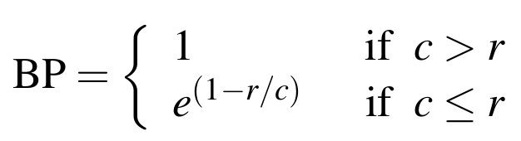
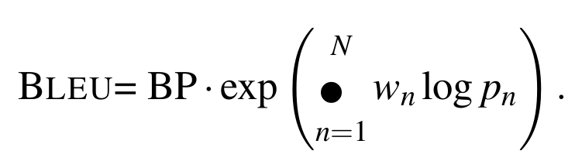
BLEU
Corpus level
On sent level it's really bad
Smoothing needed
Plays the role of recall
Prevents too short translation
What would happen if we had no brevity penalty? Any weird cases of translation that would be considered good but are actually bad?
What could be the problem with geometric mean?
Why use only precision explicitly and recall implicitly?

Slide 6
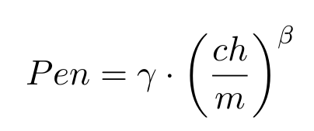
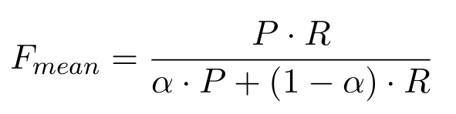
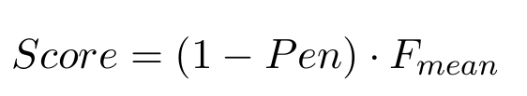
METEOR
3 5 4 1 2
1 2 3 4 5
Jump of an eye
Score 1/4
Some tunable parameters estimated with hill climbing for correlation with humans
Additional resources (paraphrases, function words, word net, stemmers)

Slide 7
More linguistics needed?
Characters
  More robust BEER
Words
  We saw already few examples
Syntax (dependency and constituency)
  Dependency arcs matched, treelets matched...
Semantics (semantic roles and paraphrases)
  MEANT, SemPOS, Meteor (paraphrases), TERp
Question: Are higher levels of linguistic analysis necessarily better?

Slide 8
Weighting precision and recall
All metrics have precision and recall in some way and they might weight them differently.
  Ref: David Byrne is burning down the house.
  Sys1: David Byrne is down the house.
  Sys2: David Byrne is burning up and down the house.
Do you prefer longer or shorter translation?
Is that precision or recall?
Imagine optimizing your system for precision/recall. What could get wrong?

Slide 9





The task
Human
evaluator
Evaluation
metric
Professional
translator
MT
system 1
MT
system 2
MT
system 3
Input sentence

Slide 10
The task
Human
evaluator
Evaluation
metric
Professional
translator
MT
system 1
MT
system 2
MT
system 3
Input sentence

Slide 11
The task
Human
evaluator
Evaluation
metric
Reference
translation
System translations
System
translation 1
System
translation 2
System
translation 3
Professional
translator
MT
system 1
MT
system 2
MT
system 3
Input sentence

Slide 12
The task
Word order
Precision/Recall
Semantics...
Human
evaluator
Evaluation
metric
Reference
translation
System translations
System
translation 1
System
translation 2
System
translation 3
Professional
translator
MT
system 1
MT
system 2
MT
system 3
Input sentence

Slide 13
The task
Word order
Precision/Recall
Semantics...
Human
Ranking:
1. MT system 2
2. MT system 3
3. MT system 1
Metric's
Ranking:
1. MT system 3
2. MT system 2
3. MT system 1
Human
evaluator
Evaluation
metric
Reference
translation
System translations
System
translation 1
System
translation 2
System
translation 3
Professional
translator
MT
system 1
MT
system 2
MT
system 3
Input sentence

Slide 14
The task
Word order
Precision/Recall
Semantics...
Human
Ranking:
1. MT system 2
2. MT system 3
3. MT system 1
Metric's
Ranking:
1. MT system 3
2. MT system 2
3. MT system 1
?
==
Human
evaluator
Evaluation
metric
Reference
translation
System translations
System
translation 1
System
translation 2
System
translation 3
Professional
translator
MT
system 1
MT
system 2
MT
system 3
Input sentence

Slide 15
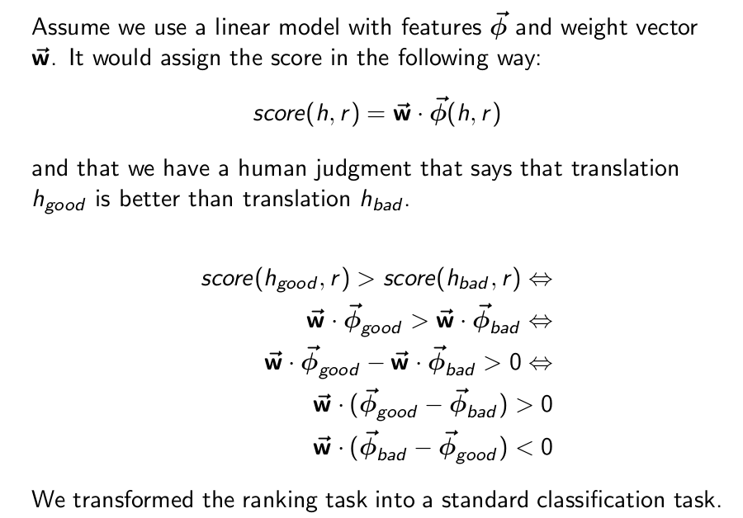
BEER an example of a trained metric

Slide 16
Lexical component
Precision, recall, f-score on char n-grams
Synonyms, paraphrases, function words...

Slide 17
Reordering component
this is an example sentence
Reference translation
example sentence this an is
System translation

Slide 18
Reordering component
1. Find the alignments
this is an example sentence
Reference translation
example sentence this an is
System translation

Slide 19
Reordering component
2,1
1,2
1,2
2,1
2. Build a HAT structure
1. Find the alignments
this is an example sentence
Reference translation
example sentence this an is
System translation

Slide 20
Reordering component
2,1
3. evaluate from bottom up
punish where order is wrong
1,2
reward where order is right
1,2
take children into account
2,1
2. Build a HAT structure
1. Find the alignments
this is an example sentence
Reference translation
example sentence this an is
System translation

Slide 21
Reordering component
2,1
3. evaluate from bottom up
punish where order is wrong
1,2
reward where order is right
1,2
take children into account
2,1
2. Build a HAT structure
1. Find the alignments
this is an example sentence
Reference translation
example sentence this an is
System translation

Slide 22
Reordering component
2,1
3. evaluate from bottom up
punish where order is wrong
1,2
reward where order is right
1,2
take children into account
2,1
2. Build a HAT structure
1. Find the alignments
this is an example sentence
Reference translation
example sentence this an is
System translation

Slide 23
Reordering component
4. final score is
on the top of the HAT
2,1
3. evaluate from bottom up
punish where order is wrong
1,2
reward where order is right
1,2
take children into account
2,1
2. Build a HAT structure
1. Find the alignments
this is an example sentence
Reference translation
example sentence this an is
System translation

Slide 24
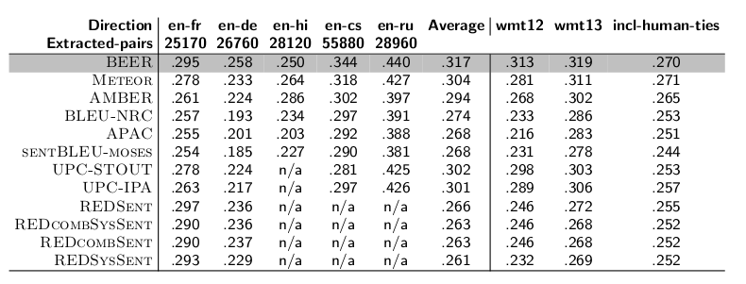
Some results

Slide 25
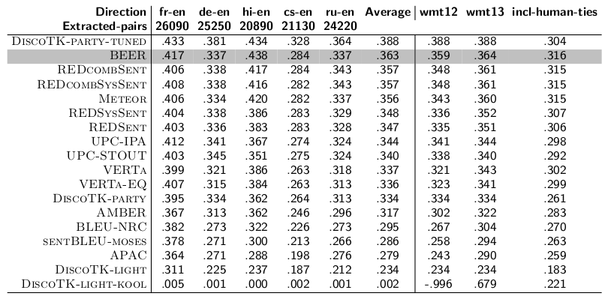
Some results

Slide 26
Many other things to talk about
Quality estimation (evaluation without references)
Statistical testing
Corpus vs. sentence level metrics
Why metrics that are good for correlation with humans are not good for tuning?
But we can talk about them some other time

