Slide 1
Discussion of six degrees of separation theory using induction
Fan Feng (ff9sd)

Slide 2

I read somewhere that everybody on this planet is separated by only six other people. Six degrees of separation between us and everyone else on this planet. The president of the United States, a gondolier in Venice, just fill in the names. I find that extremely comforting that we're so close, but... I also find it like Chinese water torture that we're so close, because you have to find the right six people to make the connection. It's not just big names, it's anyone. A native in a rainforest, a Tierra del Fuegan, an Eskimo. I am bound - you are bound - to everyone on this planet by a trail of six people. It's a profound thought. Six degrees of separation between us and everyone else on this planet.
---Six Degrees of Separation
Notes:
The video is the trailer of a movie called Six Degree of Separation, in which the six degrees of separation theory was introduced to the audience. That is also how I heard about it.

Slide 3
Upon learning about this theory, I think it is just absurd. Either the introducer to this theory was unaware of how big this world is, or he is just making up a theory to deceive us because none of us know the person who is “6 people from ourselves” (Otherwise they would not be 6 people away!) so we cannot disprove it. However, after doing researches on it, I found that there are some experimental results that in some degree support this theory. (Milgram, Stanley (1967). "The Small World Problem".Psychology Today. 2: 60–67)
But I still can not accept it in my head, not because I think the number six is less than expected, but because I don’t believe any two person in this world can be connected by people they know. However, if this theory is true, my belief is wrong, and even the Queen of England and your neighbor next door will have be connected! At that time, I just could not think this through.
But the CS 2102 class helps me
understand it !

Slide 4

Learning the idea of induction in 2102 is probably my biggest reward in this class. To put it in simple word, induction means by proving the trueness of progressive propositions and verifying a very fundamental case, we can prove a very broad and general statement. A simple example, using induction to understand Domino Effect, is as follows:
Consider a half line of dominoes each standing on end, and extending. If we can make sure that:
1. The first domino falls.
2. If a (fixed but arbitrary) domino falls, then its next neighbor domino also falls.
Instead of showing all the dominos in the sequence, one can conclude (using induction) that all of the dominoes will fall simply based on these assumptions .

Slide 5
Although induction does not help me understand the Six Degrees of Separation completely, it does convince me that every 2 randomly chosen persons on the planet can be connected by the people they know. Although it might be a long list to go, they will surely be linked together eventually. You may find it hard to believe, but it is actually necessarily true.
To prove that every two persons on the planet can be “connected” using induction, we need a base case and an inductive step. But first, we make 2 clarifications:
Here, two persons are connected if they know each other mutually, so you know your roommate, but you do not know Donald Trump, since you may see Donald Trump on Television, but he (highly likely) doesn’t know you. Also, this discussion will only focus on people who are currently alive at this moment. So it is no surprise that you find yourself cannot be “connected” with Confucius, who lives more than two thousands years before us, and that doesn’t count as a counterexample.

Slide 6

Here by person I mean persons with social backgrounds, in other words, persons will have friends, or at least know other persons. I think most persons meet this definition, because even if one rejects to meet friends completely after he was born. He/she will still know his/her parents. However, there still can be some exception. One exception I can think of is an orphan was born in the jungle and got raised by animals without knowing any person ever (Basically if Tarzan doesn’t meet anyone in the story after he was raised by apes, he will become the exception of a person’s definition in our discussion because he does not know other person).
I am a counterexample!

Slide 7
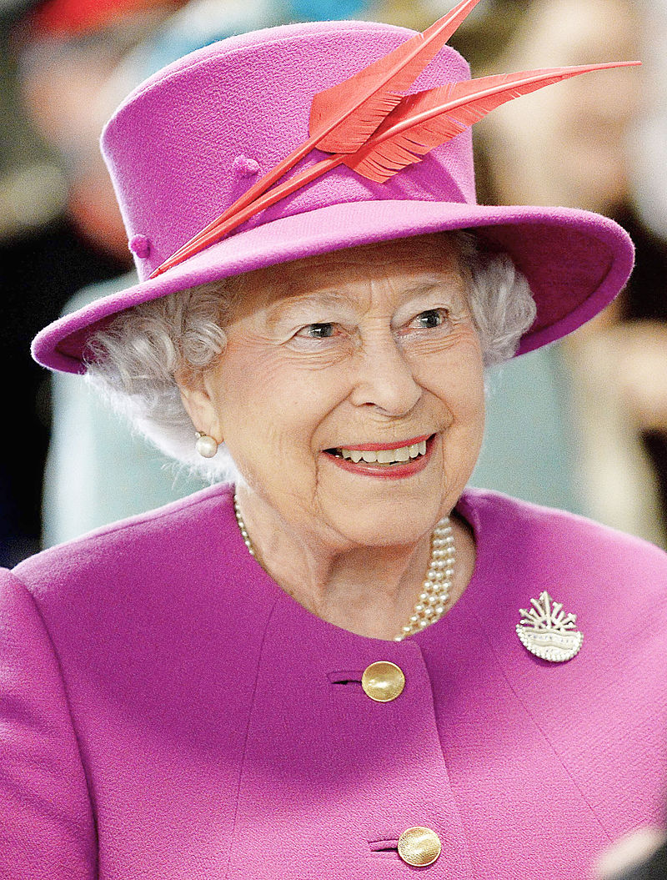
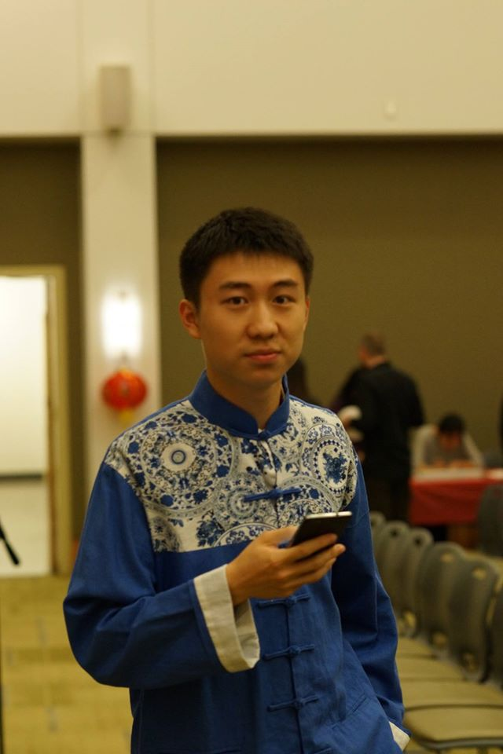
Now let’s move on to the actual induction proof!
To prove that person A (we’ll use Elizabeth II in our example) will eventually be connected to person B (we’ll use my roommate David in the example), we ask two questions:
What is the base case (the first domino)?
What is the inductive step (the falling of one domino leads to its next falling)?
In this problem, the base case is:
i. Elizabeth II knows some person.
ii. David knows some person.
Since they both meet the definition of a person. It is very obvious that the base case is true!
Elizabeth II
David

Slide 8





For the inductive step, all we need to know that the person they know also know someone, too. Again, an obviously true statement.
End of our proof!
Elizabeth II
It’s a small world, huh?
......
David

Slide 9
Just as it is the theory of Six Degrees of Separation that tells us all the people are so connected, it is the study of induction proof that reminds me the completion of seemingly gigantic statements usually starts with finding the inner link between their sub-statements. I believe that is one of my biggest reward in this class.
Thank you for watching!

