Slide 1




Revisiting Square Root ORAM
Efficient Random Access in Multi-Party Computation
Samee Zahur
Jack Doerner
David Evans
Xiao Wang
Jonathan Katz
Mariana Raykova
Adrià Gascón
oblivc.org/sqoram

Slide 2
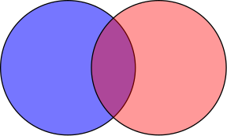
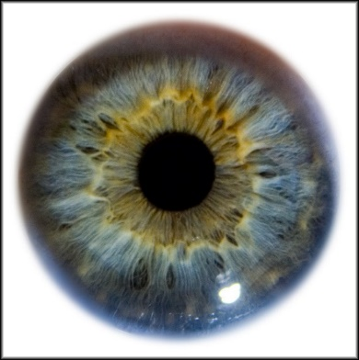
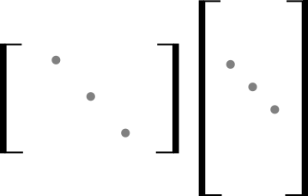
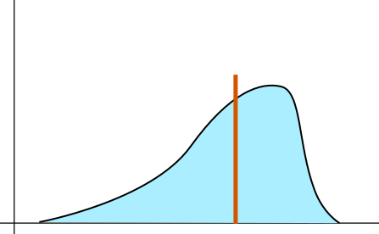
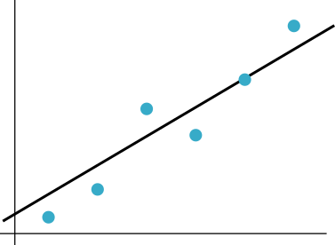
Secure multi-party computation applications
Set intersection [FNP04]
Iris code matching [LCPLB12]
Matrix factorization for recommendations [NIWJTB13]
Median computation [AMP04]
Linear ridge-regression [NWIJBT13]

Slide 3
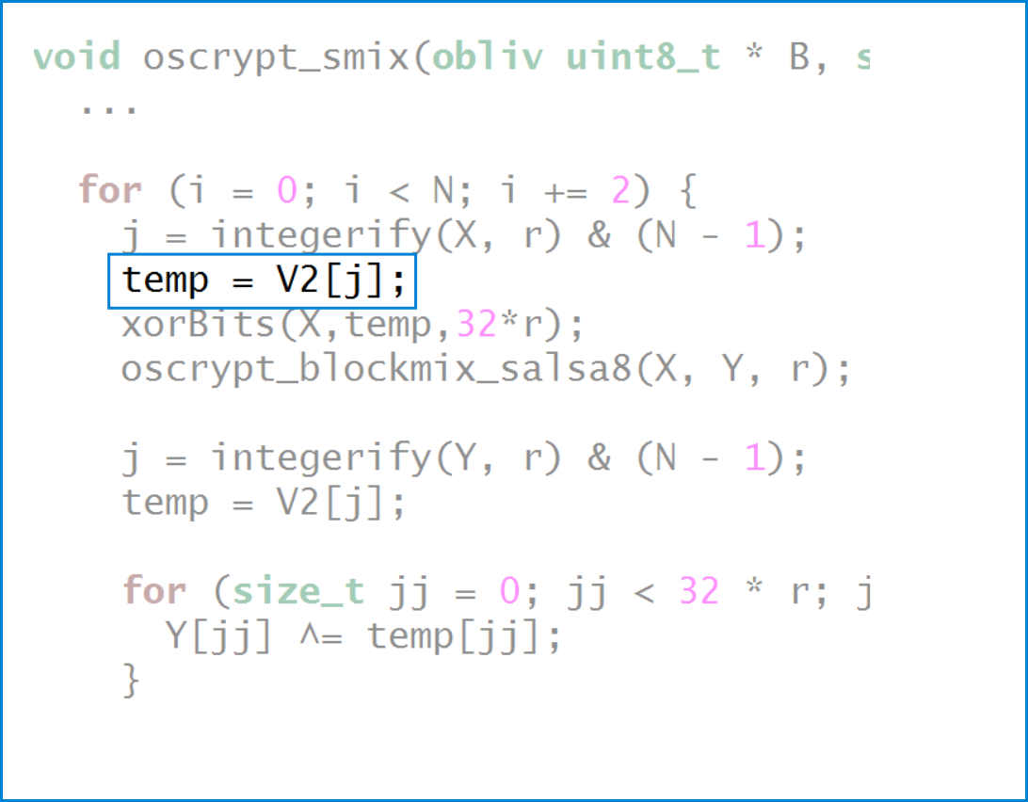
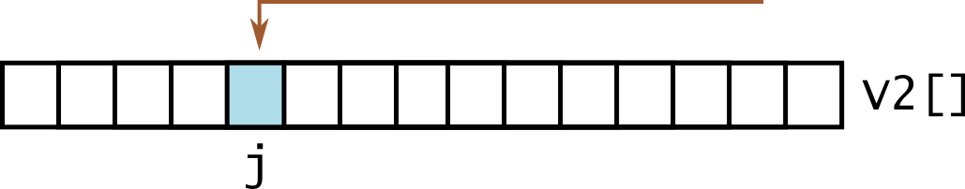
Random Access

Slide 4
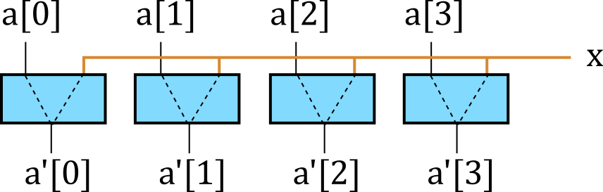
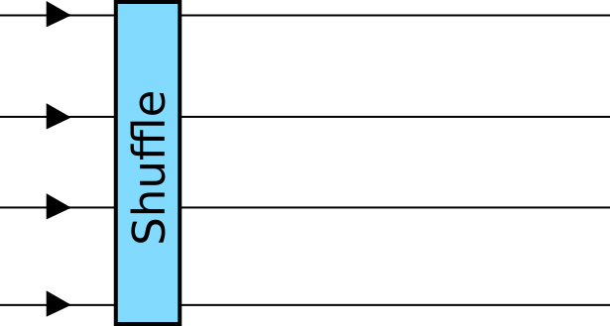
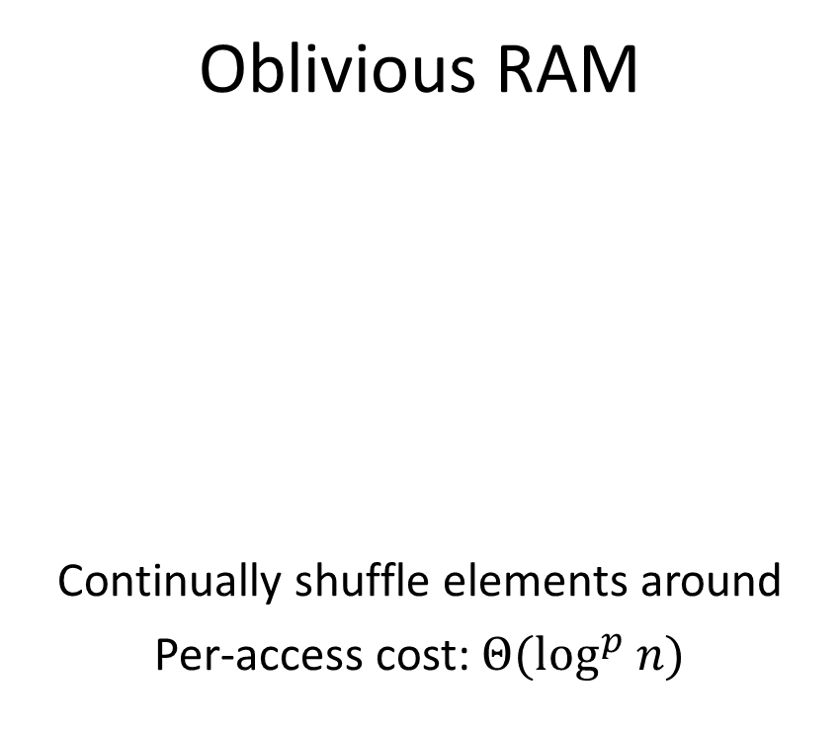
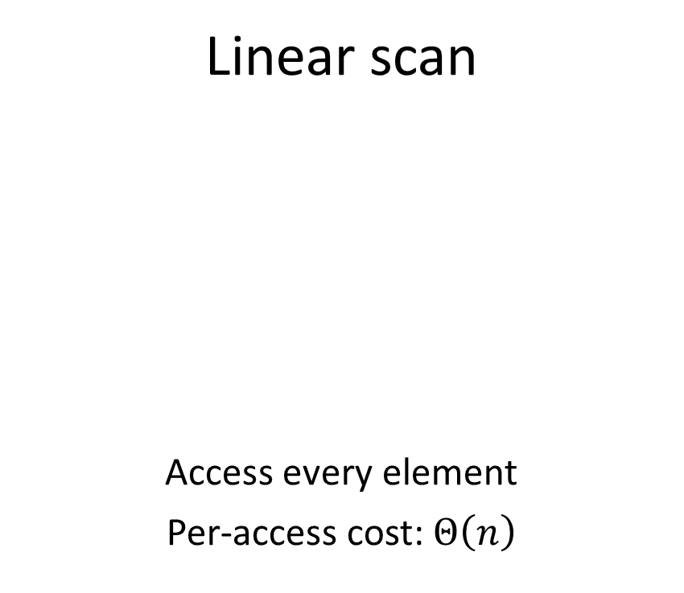
Hiding access pattern
Linear scan
Access every element
Per-access cost: $Θ\left(n\right)$
Oblivious RAM
Continually shuffle elements around
Per-access cost: $Θ(\log^{p} n)$

Slide 5
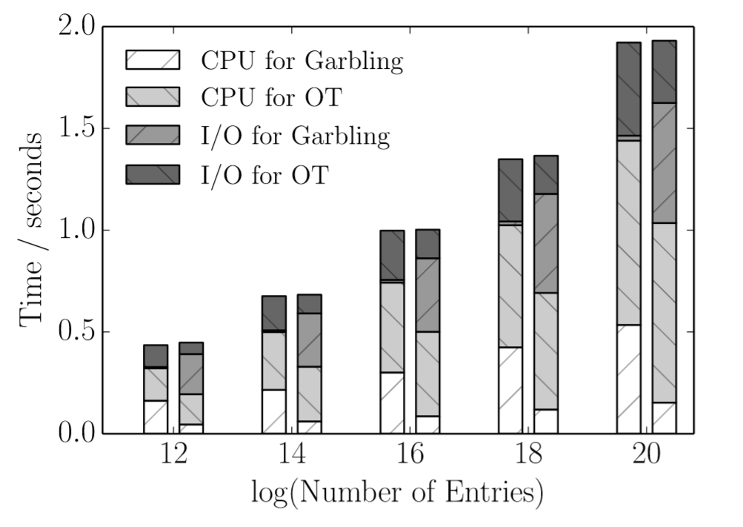
Linear scan
Figure from: Wang, Chan, Shi. Circuit Oram. CCS’15

Slide 6
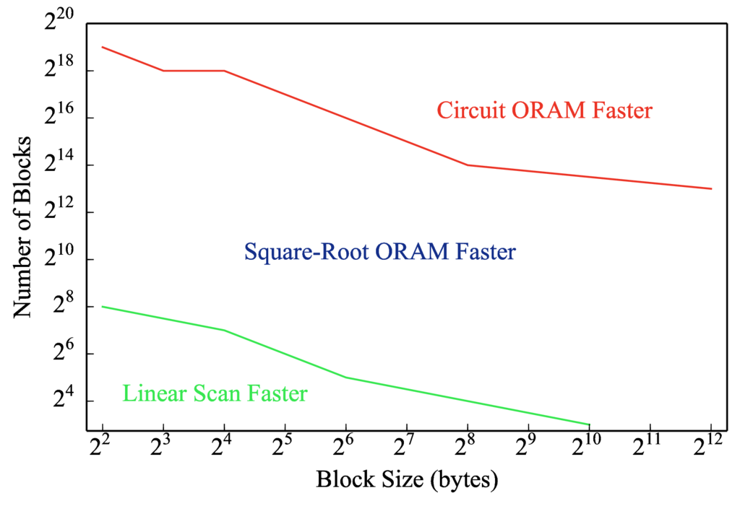
(our work)

Slide 7
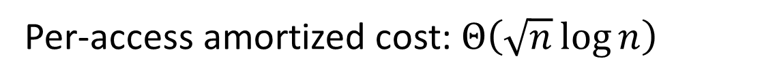
Approach: revisit old schemes
Classic “square root” scheme by Goldreich and Ostrovsky (1996).
Considered slow for MPC because of per-access hash evaluation.
Per-access amortized cost: $Θ\left(\sqrt{n}\log{n}\right)$

Slide 8
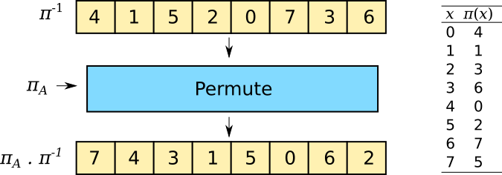
Four-element ORAM
Larger Sizes

Slide 9
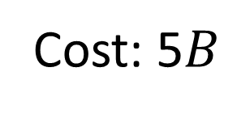
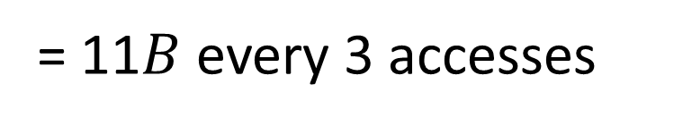
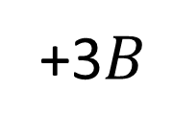
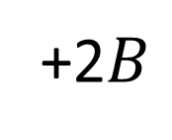
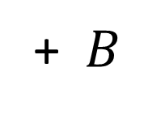
4-Block ORAM
Cost: 5$B$
+ $B$
+2$B$
+3$B$
+ …
= 11$B$ every 3 accesses

Slide 10
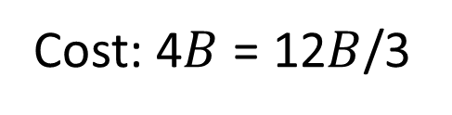
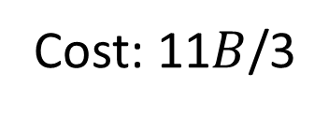
Comparison
Linear scan
Our scheme
Cost: 4$B$ = 12$B$/3
Cost: 11$B$/3

Slide 11
Four-element ORAM
Larger Sizes

Slide 12
Position map
0 | 1 | 2 | 3
0 | 1 | 2 | 3
3 | 0 | 2 | 1
1 | 3 | 0 | 2

Slide 13
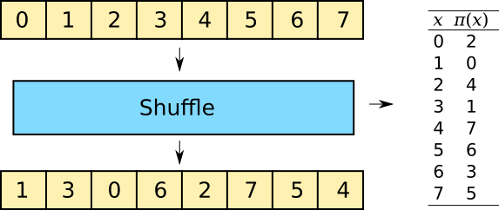
Creating position map

Slide 14
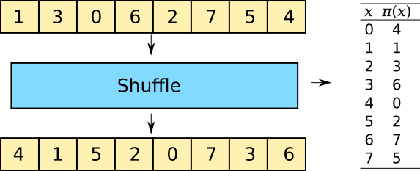
Creating position map

Slide 15






Inverse permutation
$$p$$
$$π_{A}⋅p$$
$$π_{B}=π_{A}⋅p$$
$$π_{A}$$

Slide 16
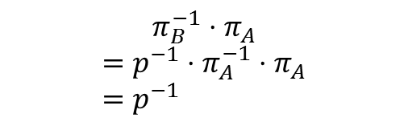

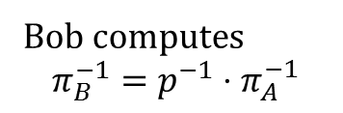

Inverse permutation
$$π_{A}$$
$$π_{B}$$
$$π_{B}=π_{A}⋅p$$
$$π_{A}$$
Bob computes
$$π_{B}^{−1}=p^{−1}⋅π_{A}^{−1}$$
$$π_{B}^{−1}⋅π_{A}$$
$$=p^{−1}⋅π_{A}^{−1}⋅π_{A} \\ =p^{−1}$$

Slide 17
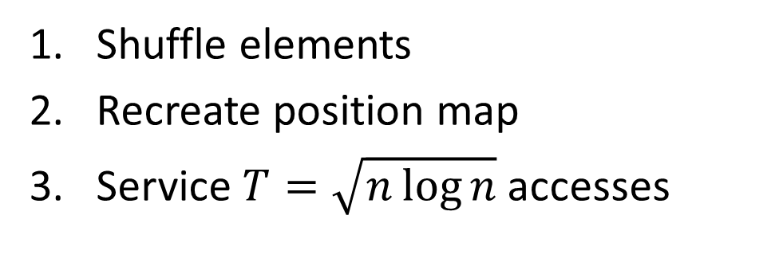
Rinse and repeat
Shuffle elements
Recreate position map
Service $T=\sqrt{n\log{n}}$accesses

Slide 18
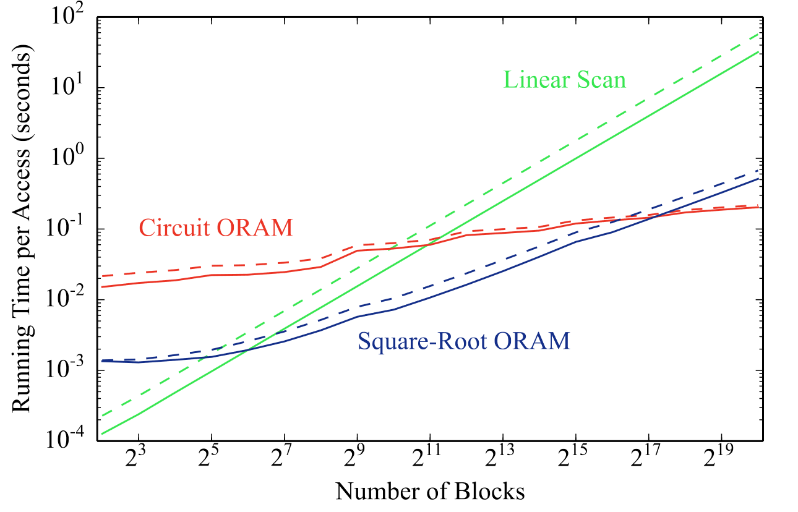
Access time

Slide 19
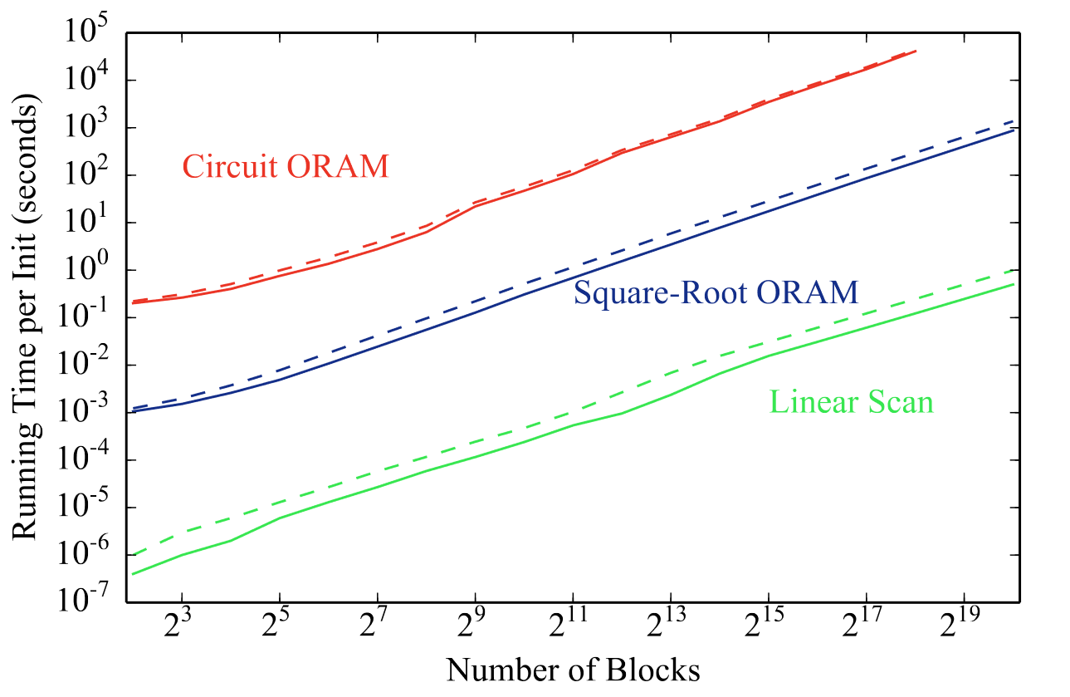
Initialization cost

Slide 20
Benchmarks
Task | Parameters | Linear scan | Circuit ORAM | Square-root ORAM
Binary search | 2¹⁰ searches 2¹⁵ elements | 1020 s | 5041 s | 825 s
Breadth-first search | 2¹⁰ vertices 2¹³ edges | 4570 s | 3750 s | 680 s
Stable matching | 2⁹ pairs | - | 189000 s | 119000 s
scrypt hashing | N = 2¹⁴ | ≈ 7 days | 2850 s | 1920 s

Slide 21
Conclusion
We revisited a well-known scheme and used it to
Lower initialization cost
Improve breakeven point
Shows that asymptotic costs are not the final word, concrete costs require more consideration.

Slide 22
Download
oblivc.org/sqoram
Contact for help:
Samee Zahur <samee@virginia.edu>

