Slide 1
computer ASSISTED IMAGE ANALYSIS ii
License plate identification and analysis
Team 5
Praveen Swamy
Uvais Karni

Slide 2
Agenda
What is the task?
Planned and achieved
Existing solutions
Implementation
Demo
Problems
Future improvements
Conclusions

Slide 3
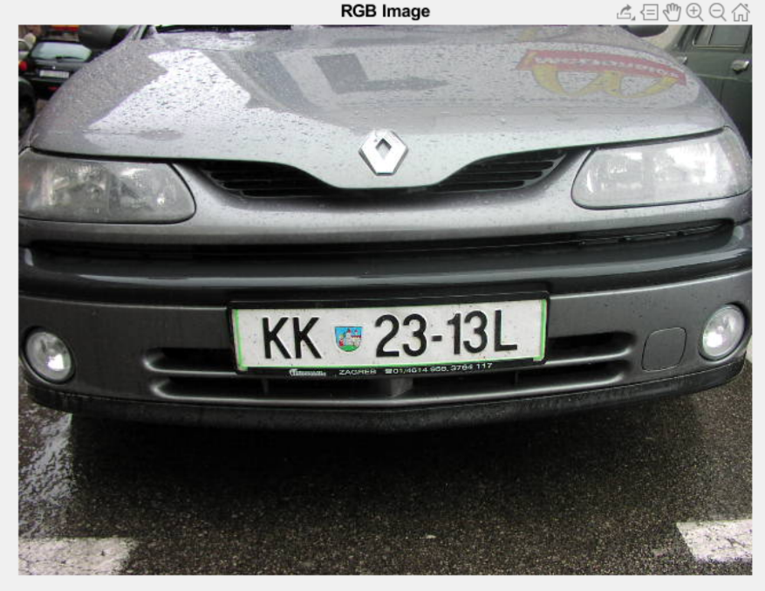
What is the task?
Localize the number plates from the rear/front view images of the vehicles and recognize the characters.
“KK2313L”
Output Label
Input Image

Slide 4
What we planned and achieved?
Planned –
Remove noise.
Deblur images.
Localize the region of interest.
Segment the characters from ROI.
Train a model to classify the characters.
Achieved –
Removed the noise.
Deblur images.
Localize the region of interest.
Segment the characters from ROI.
Train a model to classify the characters.

Slide 5
Existing solutions
Method 1
Edge detection → Region props → Optical character recognition (OCR)
Method 2
Vertical and horizontal histogram to locate the homogeneous region i.e. the number plate.

Slide 6
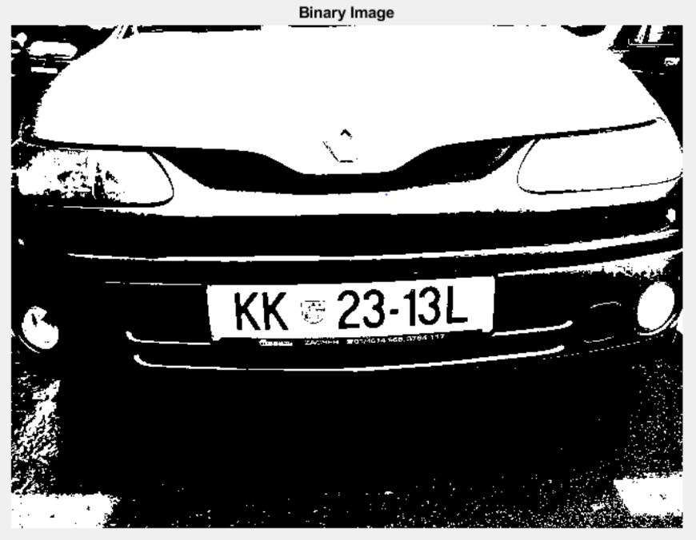
Localization
After grayscale conversion
RGB Image
Binary Image

Slide 7
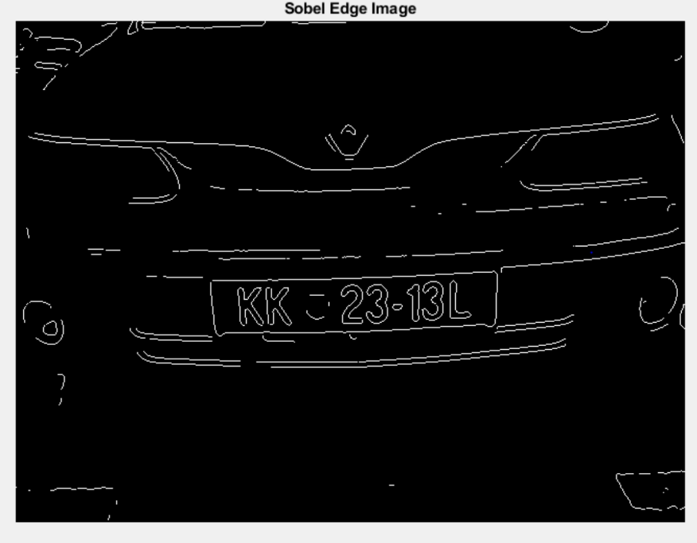
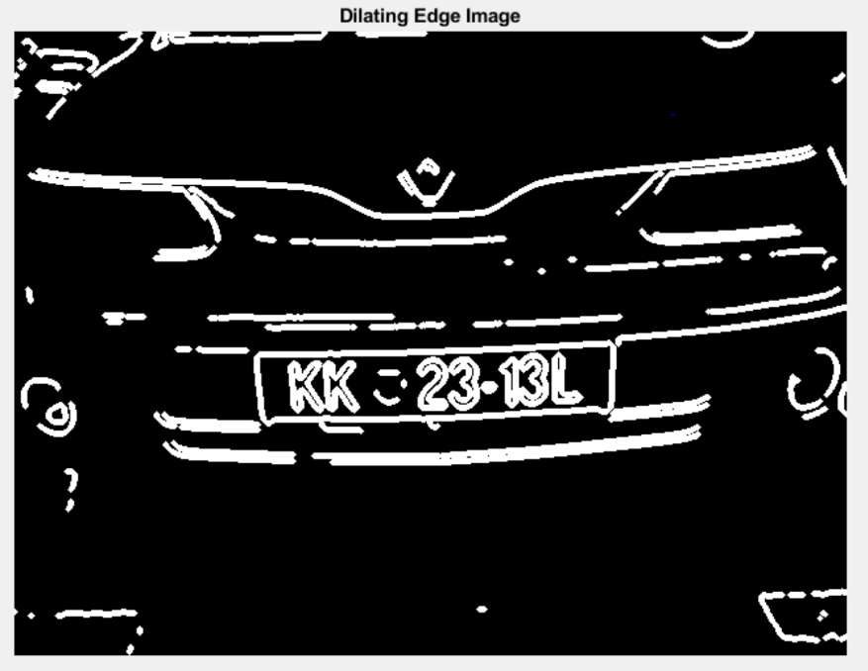
Sobel edge Image
Dilated Image

Slide 8
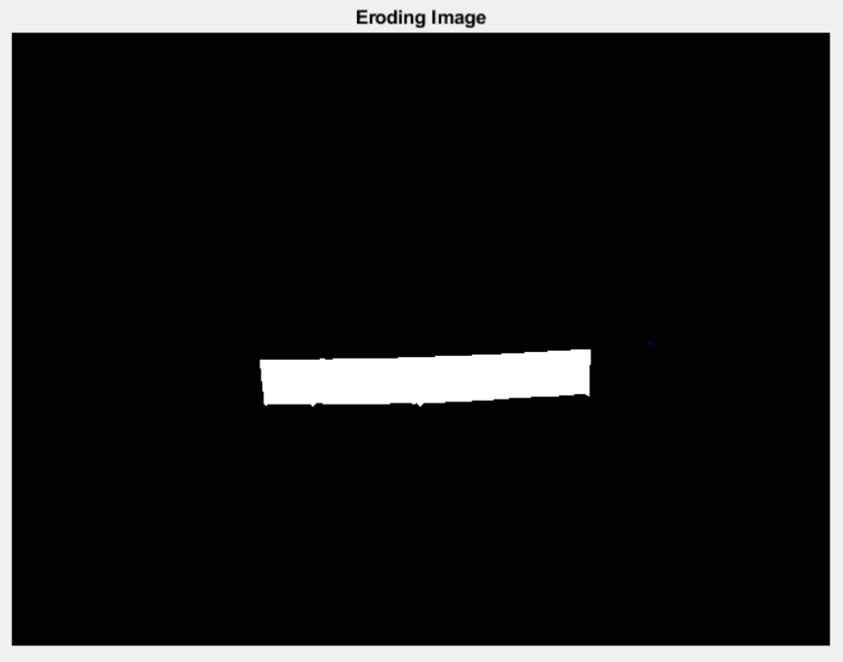
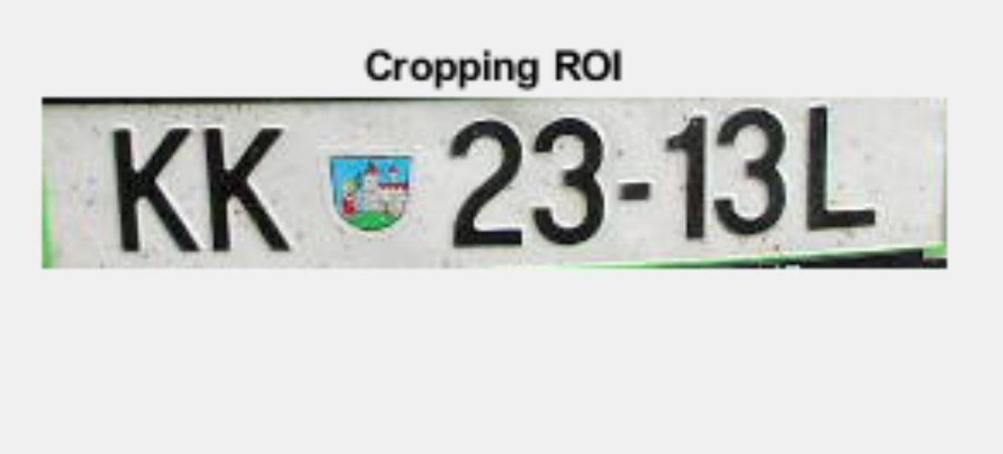
Localized ROI
Eroded Image

Slide 9
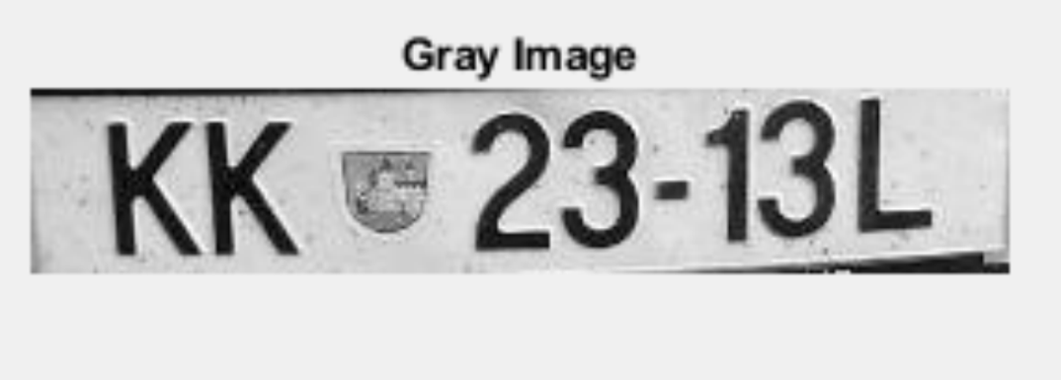
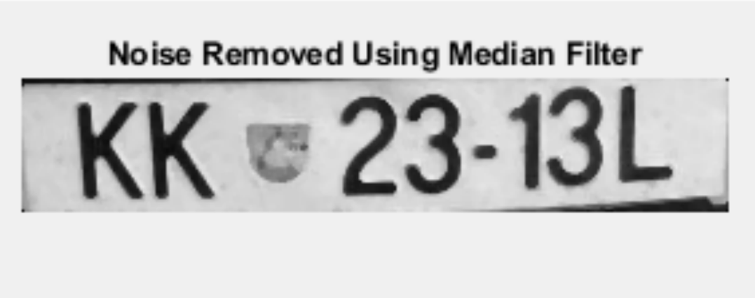
Pre-processing
Gray Image
Noise free Image

Slide 10
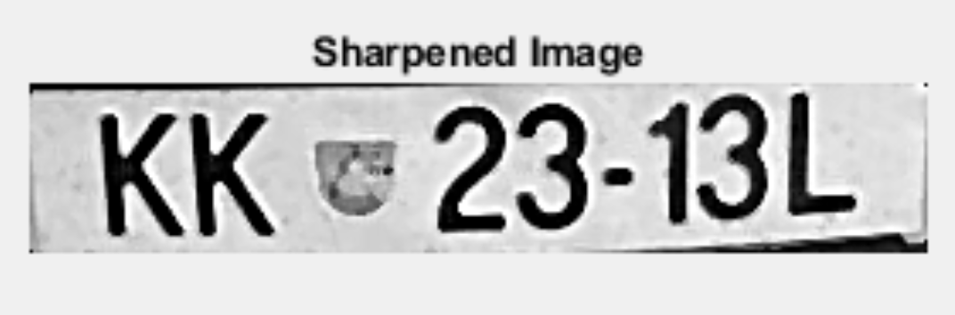
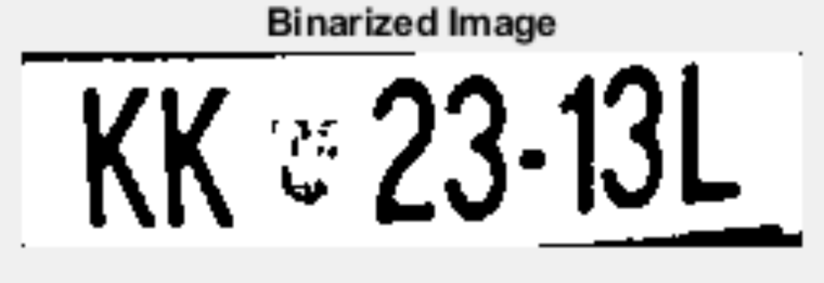
Sharpened Image
Binarized Image

Slide 11
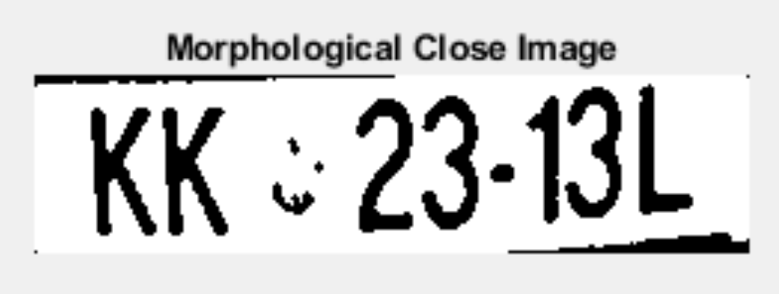
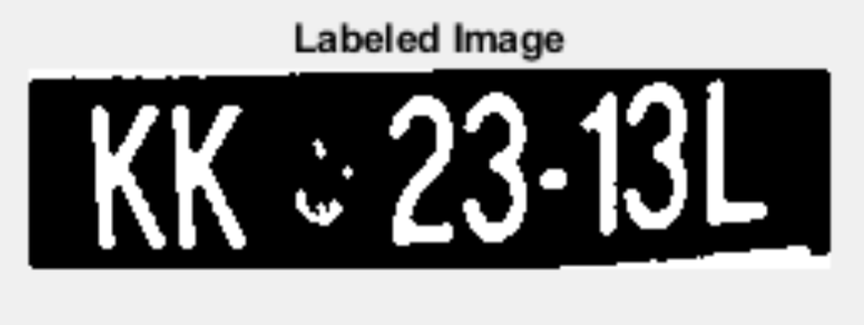
After closing operation
Labeled Image

Slide 12
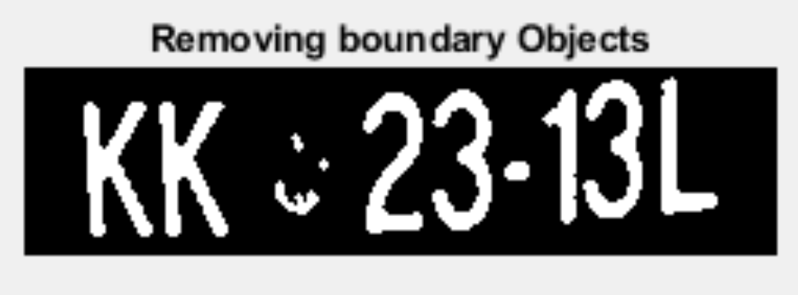
After removing boundaries

Slide 13
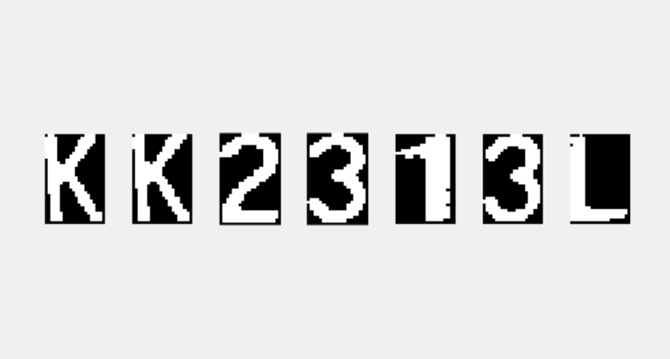
Character segmentation
We used the bounding box property of region props to segment the characters.
Segmented Characters

Slide 14
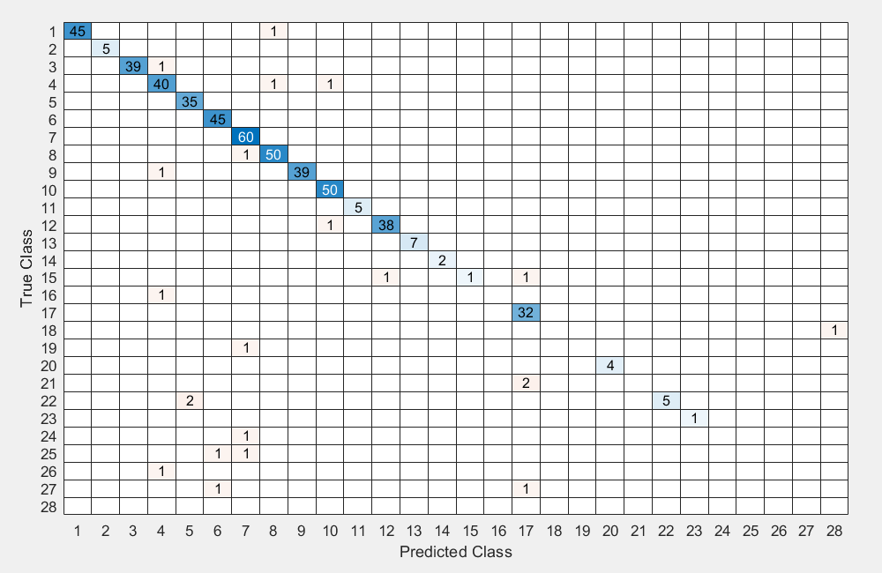
Character Identification
Confusion plot
SVM classifier as learning algorithm.
Accuracy for individual character classification : 95.81%
Accuracy based on number plate as a whole : 82.67%

Slide 15
Problems
The model resulted into misclassifications, because of limited dataset for each character and the images which were tested belonged to different fonts.
Localization failed for the images with varied lighting conditions.
As we used region props to segment the characters, we had to tweak the values for Area, equivdiameter and solidity to filter the regions.

Slide 16
Future improvements
Generalization of classification methods to be able to make it font invariant.
CNN Semantic segmentation.
Work more on blurred and noisy images.
Improvement on oriented license plates.

