Slide 1

Preservation Metrics Survey
https://www.surveymonkey.com/s/TMWW5W9
Kara M. McClurken
PARS Forum
June 28, 2015
Notes:
Sent a survey out to the PADG listserv mid-may 2015. Meant to be quick and easy.
Deliberately left term very broad with write-in fields so I could see specific examples.
Still open, so if you haven’t added your institution’s perspective and still want to, here is the link
38 respondents
33 Academic Libraries
2 independent research libraries
1 national library, 1 public library, 1 archives

Slide 2
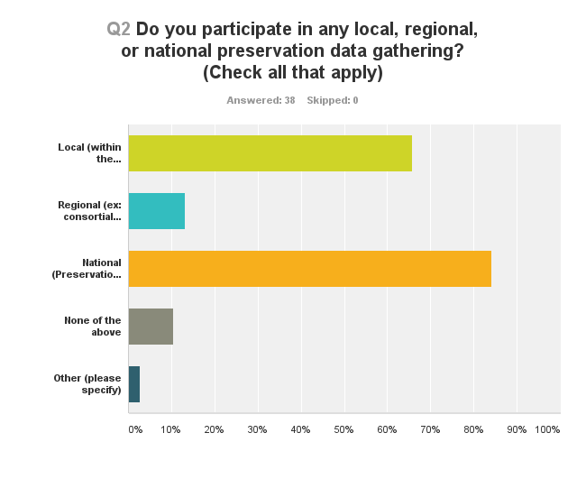
At what level are we collecting metrics
Notes:
90% gathered metrics at some level;
84% at national level
66% at local level
13% at regional level (didn’t get much data about what they are collecting or how they are using)
only 4 respondents said no

Slide 3
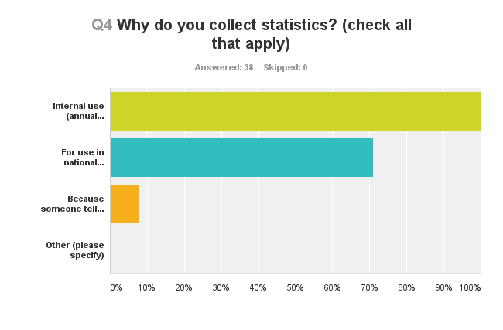
Why collect?
Notes:
Everyone uses for internal use and most use for national surveys
3 said they collect because they have to.

Slide 4
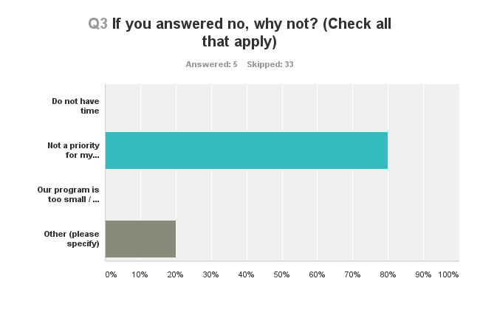
Why not collect?
Notes:
Interestingly enough, it was not lack of time or fear of program being too small, but lack of priority for administration that was the primary reason of those who didn’t collect data (remember only five folks here). (One person collected conservation data only, but admin wouldn’t support the gathering of the rest of the numbers)
I found it really interesting that one person responded that they had never been asked to collect data—I wonder, by whom? If they are on the PADG list-serv, then they have been “asked”…maybe we can be better about personal outreach.

Slide 5
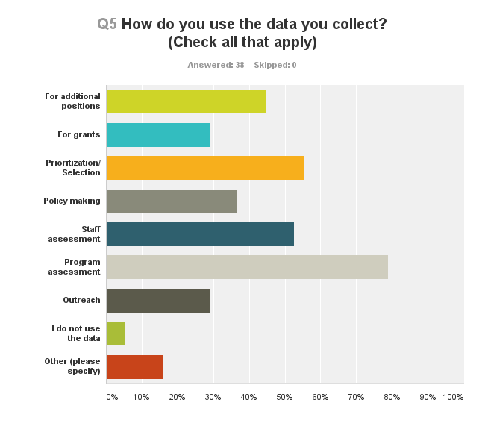
79%
Notes:
79% for program assessment
55% for prioritization/selection
45% use for additional positions
Other responses included things like research, dept/annual performance reports, prep for RFPs for vendors, justify spending on supplies

Slide 6
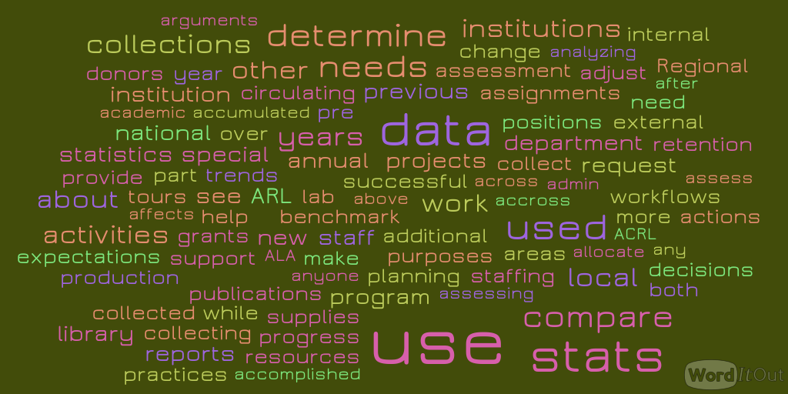
How are you using?
Notes:
Word cloud of the free text question about specific examples of how folks are using the data, some of which you will hear in the next few minutes.

Slide 7

Feedback or Questions?
Kara M. McClurken
Head, Preservation Services
Co-lead, Content Stewardship
University of Virginia Library
kmm6ef@virginia.edu
434-924-1055

