Slide 1

Multi-GPU LLM Inference
RC Workshop
Kathryn Linehan, Bruce Rushing
June 3rd, 2025

Slide 2

Workshop Overview
The first draft outline of this workshop was created by ChatGPT!
Introduction
UVA HPC
Multi-GPU Strategies
Accelerate
DeepSpeed
vLLM
Best Practices
Wrap Up

Slide 3
INTRODUCTION

Slide 4
Terminology
VRAM: Video RAM (GPU Memory)
Context window: the maximum number of tokens an LLM can keep “in-memory”
Precision: the amount of storage used for an LLM parameter
Examples: fp32 is 4 bytes/parameter, fp16 is 2 bytes/parameter
Quantization: technique to lower the amount of storage used by LLM parameters
Embedding Dimension: length of embedding vector
QKV Cache (Query Key Value Cache): short term memory of LLM

Slide 5
Why Multi-GPU LLM inference?
LLMs are getting larger and larger as are context windows
More recent LLMs generally do not fit in a single GPU due to VRAM limits
This is the case we will focus on today

Slide 6
GPU Memory Requirements for Google’s Gemma 3
Model | Context Window
 | 4K Tokens | 8K Tokens | 32K Tokens | 128K Tokens
4B @ FP16 | 11 GB | 12.4 GB | 20.8 GB | 54.4 GB
12B @ FP16 | 31.9 GB | 35 GB | 53.6 GB | 128 GB
27B @ FP16 | 70.3 GB | 75.8 GB | 108.8 GB | 241 GB
4B @ INT4 | 2.8 GB | 3.2 GB | 5.3 GB | 14 GB
12B @ INT4 | 8 GB | 8.8 GB | 13.6 GB | 32.8 GB
27B @ INT4 | 17.6 GB | 19 GB | 27.4 GB | 61 GB
Models given in parameter counts (billions) at specific precisions (i.e., floating point 16 or integer 4 quantization) and variable context windows.

Slide 7
UVA HPC

Slide 8

UVA HPC – H200 GPUs
More info: https://www.rc.virginia.edu/2025/05/new-nvidia-h200-gpu-node-added-to-afton/

Slide 9
UVA HPC - GPUs
GPU | HPC System | Partition | Memory
H200 | Afton and Rio | gpu* | 141GB
A100 | Afton | gpu | 40GB or 80GB
A40 | Afton | gpu | 48GB
A6000 | Afton | gpu | 48GB
V100 | Afton | gpu | 32GB
RTX3090 | Afton | Interactive | 24GB
RTX2080Ti | Afton | Interactive | 11GB
*Only available through batch job requests (not Open OnDemand)
More info: https://www.rc.virginia.edu/userinfo/computing-environments/,
https://www.rc.virginia.edu/userinfo/hpc/#system-details

Slide 10
GPU access on UVA HPC
**When you request memory for HPC, that is CPU memory.**
Open OnDemand (OOD)
Choose “GPU” or “Interactive” as the Rivanna/Afton Partition
Optional: choose GPU type and number of GPUs
Cannot use H200 GPUs
SLURM
Specify GPU partition: #SBATCH -p gpu
Request n GPUs: #SBATCH --gres=gpu:<optional_gpu_name>:n
Ex) Request 1 GPU: #SBATCH --gres=gpu:1
Ex) Request 4 A100s: #SBATCH --gres=gpu:a100:4
To request 80GB A100, additionally use:
#SBATCH --constraint=a100_80gb
More info: https://www.rc.virginia.edu/userinfo/hpc/slurm/#gpu-intensive-computation
Notes:
As of now: only one person can be using a GPU at a time. If you request a GPU, you will receive all of the GPU memory.

Slide 11
UVA HPC – NVIDIA DGX BasePOD on Rivanna/Afton
Cluster of high-performance GPUs that can be used for large deep-learning models
18 DGX A100 nodes with:
2TB of RAM memory per node
8 A100s per node
80 GB GPU memory per GPU device
Advanced Features (compared to regular GPU nodes):
NVLink for fast multi-GPU communication
GPUDirect RDMA Peer Memory for fast multi-node multi-GPU communication
GPUDirect Storage with 200 TB IBM ESS3200 (NVMe) SpectrumScale storage array
Ideal Scenarios:
Job needs multiple GPUs on a single node or even multiple nodes
Job (single or multi-GPU) is I/O intensive
If you have ever used an A100 with 80 GB on our system, you were using a POD node!
More info: https://www.rc.virginia.edu/userinfo/hpc/basepod/

Slide 12
POD access on UVA HPC
**When you request memory for HPC, that is CPU memory.**
Open OnDemand (OOD)
Choose “GPU” as the Rivanna/Afton Partition
Choose “NVIDIA A100” as GPU type and fill in number of GPUs
Select “Yes” for Show Additional Options and type “--constraint=gpupod” in the Slurm Option textbox
SLURM
#SBATCH -p gpu
#SBATCH --gres=gpu:a100:n n: requested # of GPUs/node
#SBATCH -C gpupod
More info: https://www.rc.virginia.edu/userinfo/hpc/basepod/#accessing-the-pod
Notes:
As of now: only one person can be using a GPU at a time. If you request a GPU, you will receive all of the GPU memory.

Slide 13
POD on UVA HPC
Before running a multi-node job, please make sure the job can scale well to 8 GPUs on a single node.
Multi-node jobs on the POD should request all GPUs on the nodes, i.e. --gres=gpu:a100:8.
More info: https://www.rc.virginia.edu/userinfo/hpc/basepod/#accessing-the-pod

Slide 14
GPU Limit on UVA HPC
The maximum number of GPUs you can request for a UVA HPC job is 32.
The maximum number of nodes is 4.
More info: https://www.rc.virginia.edu/userinfo/hpc/#job-queues

Slide 15
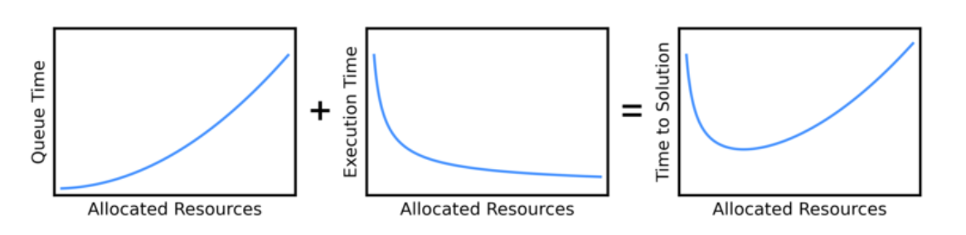
Wait Time in the Queue
You may not need to request A100(s)!
Requesting A100(s) may mean you wait in the queue for a much longer time than using another GPU,
This could give you a slower overall time (wait time + execution time) than if you had used another GPU.
Graphic Source: https://researchcomputing.princeton.edu/support/knowledge-base/scaling-analysis
Photo Source: https://researchcomputing.princeton.edu/support/knowledge-base/scaling-analysis

Slide 16
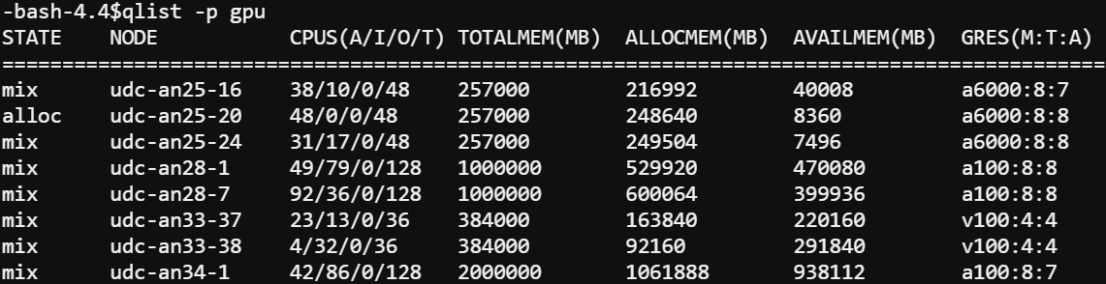
Viewing Available GPUs
The gpu partition can be very busy!
To view information about the gpu partition including total (T) and allocated (A) GPUs, type qlist –p gpu at the command line

Slide 17
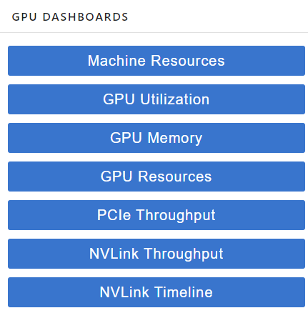
GPU Dashboard in OOD JupyterLab
This will be demoed during today’s workshop
Includes GPU and CPU memory and utilization tracking in real time
Helpful for GPU selection

Slide 18
GPU Dashboard: Memory Usage
PyTorch
Correct GPU memory usage will be reported
TensorFlow/Keras
By default, TF automatically allocates ALL of the GPU memory so GPU Dashboard may show that all (or almost all) of the GPU memory is being used
To track the amount of GPU memory actually used, you can add these lines to your python script:
import os
os.environ['TF_FORCE_GPU_ALLOW_GROWTH'] = 'true'
More Info: https://www.tensorflow.org/guide/gpu#limiting_gpu_memory_growth
Notes:
Homework for Keras users: try out GPU dashboard and see if it reports all of the GPU memory as used

Slide 19
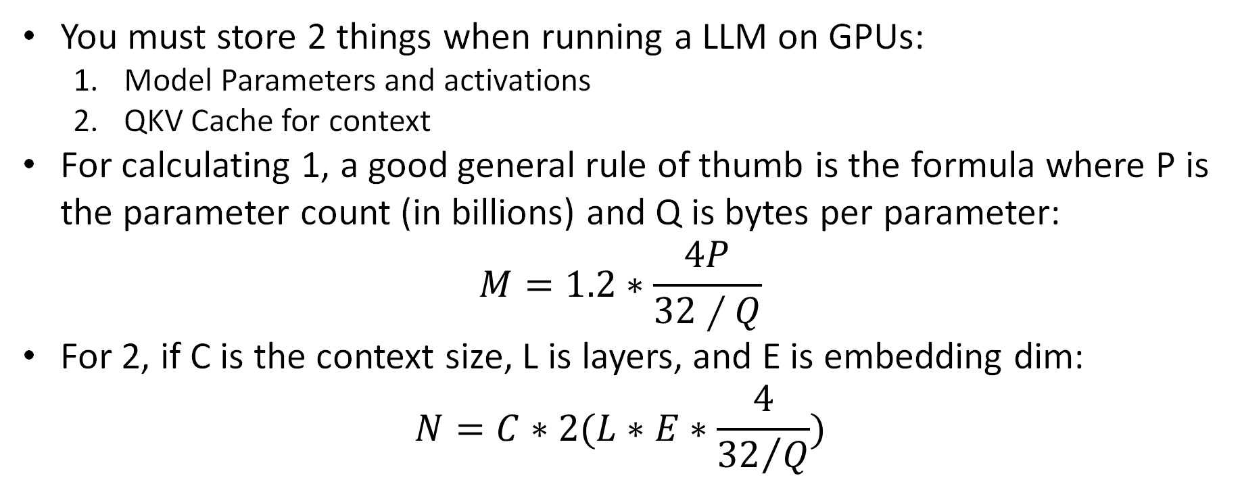
Calculating GPU Memory Requirements
You must store 2 things when running a LLM on GPUs:
Model Parameters and activations
QKV Cache for context
For calculating 1, a good general rule of thumb is the formula where P is the parameter count (in billions) and Q is bytes per parameter:
$$M=1.2∗\frac{4P}{32∕Q}$$
For 2, if C is the context size, L is layers, and E is embedding dim:
$$N=C∗2(L∗E∗\frac{4}{{32}/Q})$$

Slide 20
GPU Memory Requirements for Google’s Gemma 3
Model | Context Window
 | 4K Tokens | 8K Tokens | 32K Tokens | 128K Tokens
4B @ FP16 | 9.6 + 1.4 = 11 GB | 9.6 + 2.8 = 12.4 GB | 9.6 + 11.2 = 20.8 GB | 9.6 + 44.8 = 54.4 GB
4B @ INT4 | 2.4 + 0.4 = 2.8 GB | 2.4 + 0.8 = 3.2 GB | 2.4 + 2.9 = 5.3 GB | 2.4 + 11.6 = 14 GB
12B @ FP16 | 28.8 + 3.1 = 31.9 GB | 28.8 + 6.2 = 35 GB | 28.8 + 24.8 = 53.6 GB | 28.8 + 99.2 = 128 GB
12B @ INT4 | 7.2 + 0.8 = 8 GB | 7.2 + 1.6 = 8.8 GB | 7.2 + 6.4 = 13.6 GB | 7.2 + 25.6 = 32.8 GB
27B @ FP16 | 64.8 + 5.5 = 70.3 GB | 64.8 + 11 = 75.8 GB | 64.8 + 44 = 108.8 GB | 64.8 + 176 = 241 GB
27B @ INT4 | 16.2 + 1.4 = 17.6 GB | 16.2 + 2.8 = 19 GB | 16.2 + 11.2 = 27.4 GB | 16.2 + 44.8 = 61 GB
Models given in parameter counts (billions) at specific precisions (i.e., floating point 16 or integer 4 quantization) and variable context windows.
4B: 34 Layers, 2560 Embedding Dim
12B: 48 Layers, 3840 Embedding Dim
27B: 62 Layers, 5376 Embedding Dim
Notes:
Each calculation is a breakdown of M + N (from previous slide)

Slide 21
CPU Resource Allocation for LLM Inference
CPU memory
Have enough RAM to fit LLM
Accelerate will offload computations to the CPU after GPUs are full
CPU cores
Use enough cores for any data preprocessing
Use a GPU!
Source: https://timdettmers.com/2018/12/16/deep-learning-hardware-guide/
Notes:
Check your resource usage using GPU Dashboard, seff (completed jobs), or sstat (running jobs)
It may be the case that even if CPU Efficiency is a low percentage, you need all of the requested CPU cores for a specific part of the code, e.g., data preprocessing.
In this case, request the number of CPU cores that you need for the compute intensive part of the code.

Slide 22
MULTI-GPU STRATEGIES

Slide 23
Overview of Multi-GPU Parallelism Strategies
Data Parallelism: data is split across GPUs
Model Parallelism: model is split across GPUs
Pipeline Parallelism
Tensor Parallelism
Parallelism Type | What is Split? | When Used?
Data Parallelism | Input data | Long prompts/inputs
Pipeline Parallelism | Model layers | LLM exceeds single GPU memory: LLM is deep but not too wide
Tensor Parallelism | Inside model layers (tensors) | LLM exceeds single GPU memory: LLM layers are too large for one device

Slide 24
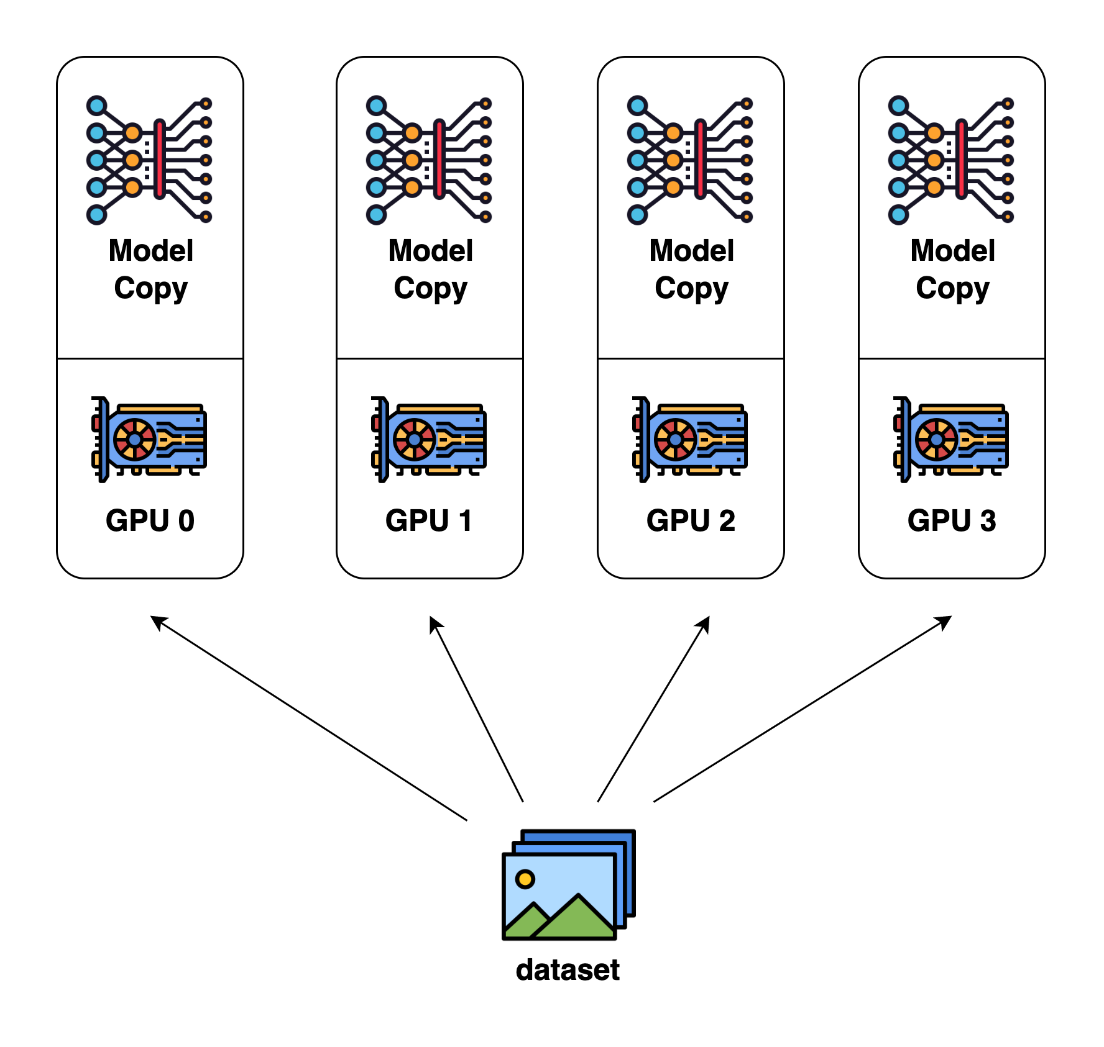
Data Parallelism
Each GPU contains the full model
Data is split across GPUs and inference is performed on GPUs in parallel
Provides inference speed up
Source: https://colossalai.org/docs/concepts/paradigms_of_parallelism/#data-parallel

Slide 25
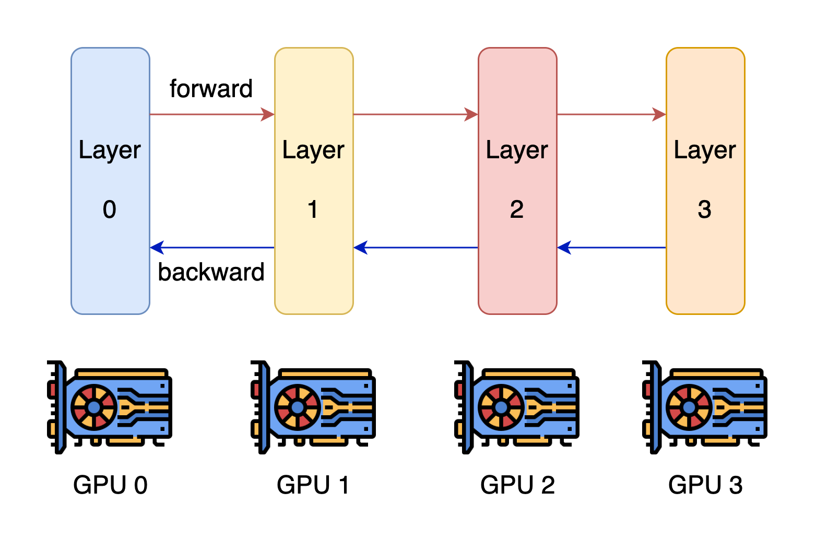
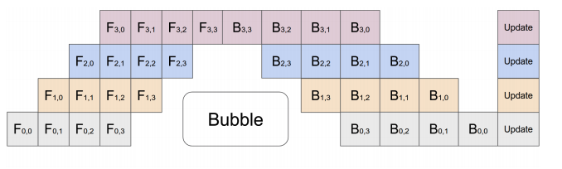
Pipeline Parallelism (Inter-Layer)
Inference
Each GPU contains a different model stage (1+ layers).
GPUs compute on batches of data in parallel but must wait for previous stage to complete.
Pros:
Reduces per-GPU memory use
Improves inference throughput
Con:
Adds inference latency
Inference
Source: https://colossalai.org/docs/concepts/paradigms_of_parallelism/#pipeline-parallel, https://arxiv.org/abs/1811.06965

Slide 26
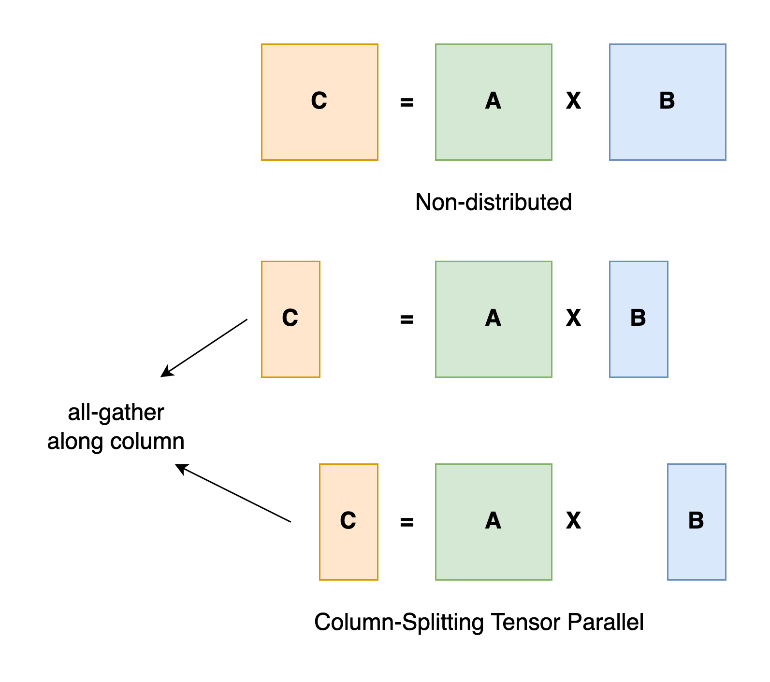
Tensor Parallelism (Intra-Layer)
Matrix Multiplication Example
Splits tensor computations across GPUs
Each GPU contains part of the tensor
GPUs compute on their part in parallel
Good for transformer layers
Frequent communication
Requires fast interconnect (e.g., NVLink, which UVA HPC has in the BasePOD)
Source: https://colossalai.org/docs/concepts/paradigms_of_parallelism/#tensor-parallel

Slide 27
Key Tools and Frameworks
Hugging Face Accelerate: easy interface with transformers and PyTorch.
DeepSpeed: good for large scale (thousand+ GPUs) well-optimized training and inference.
vLLM: focus on high-speed, efficient LLM inference.
Megatron: low-level, open source API for custom development frameworks.

Slide 28
Key Tools and Frameworks cont.
We will focus on Accelerate in this workshop.
RC’s resources are best used for Accelerate, unless there are specific inference/training-centric memory management or speed-ups required from DeepSpeed or vLLM.
Accelerate will set up model parallelism for you
Code examples will be provided
We will present some basic information about DeepSpeed and vLLM.
More information: https://huggingface.co/docs/accelerate/en/concept_guides/big_model_inference

Slide 29
ACCELERATE

Slide 30
What is Accelerate?
Popular, easy-to-use library built to work with PyTorch models.
Very straightforward API that wraps with PyTorch and transformers code.
Automatically can allocate GPU memory usage across nodes.
Used for both training and inference.
Built on top of Megatron and can interface with DeepSpeed.

Slide 31
Why use Accelerate?
If you need to prototype or are expecting to run models on “fewer” GPUs, Accelerate is the preferred framework.
It is mostly plug-and-play with existing code, with options already built-in to transformers and classes that easily wrap with torch.
You can use it both for inference and for training.
There is some fine-grained control of GPU and CPU usage, allowing a degree of customization for improved performance depending on your use case.

Slide 32
Accelerate Code Demo
The notebook is available on Rivanna/Afton in the folder /project/hpc_training/multigpu_llm_inf

Slide 33
DeepSpeed

Slide 34
What is DeepSpeed?
Microsoft’s open source that focuses on large-scale training and inference operation through efficient memory management for PyTorch.
Key components for inference are custom CUDA kernels for common LLM operations like attention and MLP and tensor parallelism for efficient memory usage and low latency.
Also has several architecture and quantization specific optimizations.
Upshot: allows you to load larger models that would not ordinarily fit within GPU memory, though your mileage may vary.

Slide 35
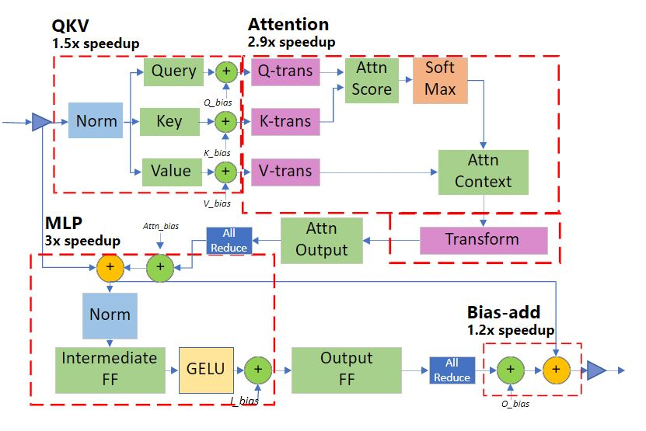
Transformer-specific Latency Advantages
Transformer module latency reductions per module

Slide 36
Why use DeepSpeed?
You should use DeepSpeed if you need to either perform large-scale inference (hundreds+ GPUs), you need fast service, or every MB in GPU memory counts.
Remark: the maximum number of GPUs you can request for a UVA HPC job is 32 (max number of nodes is 4).
The inference latency reductions can matter if you only have X amount of time for experiments.
DeepSpeed also offers very efficient large-scale training parallelism, which we won’t discuss here.
Source: https://www.rc.virginia.edu/userinfo/hpc/#job-queues
Notes:
For most users: accelerate is probably better due to ease of use. DeepSpeed does improve inference, but is mainly used for training. If serving an LLM, vLLM is a good choice.

Slide 37
vLLM

Slide 38
What is vLLM (Virtual Large Language Model)?
Open source from UC Berkeley.
Key innovation for inference is PagedAttention: an efficient virtual memory/page method for storing the KV cache, which in longer contexts can end up committing more memory than the models themselves.
Also allows continuous batching: a method for handling multiple requests to LLMs that enables less idle time.
Like DeepSpeed, also supports optimized CUDA kernels for lower latency inference.
Built on top of Megatron and can interface with DeepSpeed.

Slide 39
Why use vLLM?
You should use vLLM if you expect to serve lots of requests to LLMs for inference or if you have particularly long generated sequences.
Can cut memory usage in some applications by 60-80% compared to vanilla transformers, though your mileage may vary.
Compatible with most Hugging Face models.
Generally used for large-scale serving; benefits over Accelerate are likely to be less pronounced in small use-cases.
Notes:
Small: less than 1 million calls. Looking at number of calls and length of calls.

Slide 40
BEST PRACTICES

Slide 41
Best Practices
Plan first
Calculate how much GPU memory you will need to run inference
Check the gpu queue to see which GPUs are available
Determine how many GPUs and which types (A40, A100, etc.) you will need
Need fast GPU to GPU communication? Use the BasePOD
If you would like to use fewer GPUs, you can try using a quantized model, an LLM with a lower precision and/or a smaller number of parameters, etc. and see if performance is acceptable
Use a well-established framework such as Accelerate. If you need extra gains, you can try DeepSpeed or vLLM.

Slide 42
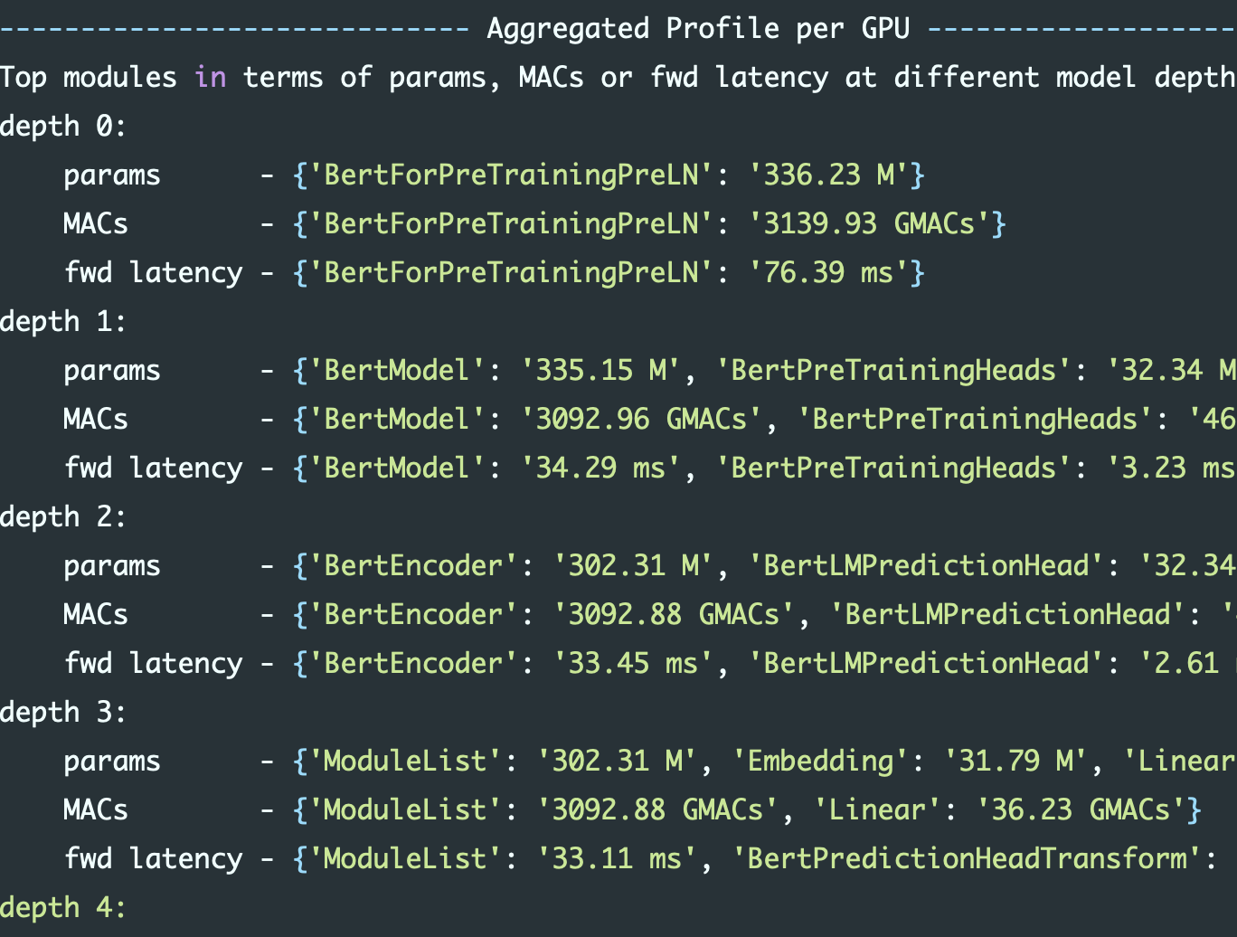
Identifying Bottlenecks
Accelerate and DeepSpeed offer methods for identifying GPU usage.
DeepSpeed’s tools are considerably more in-depth, so consider using it for real fine-grained monitoring of your code usage.

Slide 43
WRAP UP

Slide 44
Recap
Modern LLMs cannot fit into a single GPU and thus multi-GPU jobs are needed for LLM inference
UVA HPC provides a variety of GPUs as well as the NVIDIA BasePOD
H200s were recently added
Plan how many and which GPUs you will need before running your LLM inference job
Use a well-established framework to implement model parallelism

Slide 45
References
Hugging Face: https://huggingface.co/docs
Accelerate: https://huggingface.co/docs/accelerate
DeepSpeed: https://www.deepspeed.ai/inference/
vLLM: https://docs.vllm.ai/en/latest/
GPU Memory allocation: https://ksingh7.medium.com/calculate-how-much-gpu-memory-you-need-to-serve-any-llm-67301a844f21
QKV Cache Memory allocation: https://unfoldai.com/gpu-memory-requirements-for-llms/

Slide 46
Need more help?
Office Hours via Zoom
Tuesdays: 3 pm - 5 pm
Thursdays: 10 am - noon
Zoom Links are available at https://www.rc.virginia.edu/support/#office-hours
Website: https://rc.virginia.edu

