Slide 1
Large language models (LLMs) on HPC
Kathryn Linehan Computational Research Scientist E: kjl5t@virginia.edu
Angela Boakye Danquah Computational Scientist E: aab5zd@virginia.edu
Marcus Bobar Computational Scientist E: mb5wt@virginia.edu

Slide 2
Topics
Introduction
Set up/Installation
HPC resources for LLMs
Model selection
Inference
Fine-tuning
Slurm scripts
Wrap-up

Slide 3
introduction

Slide 4
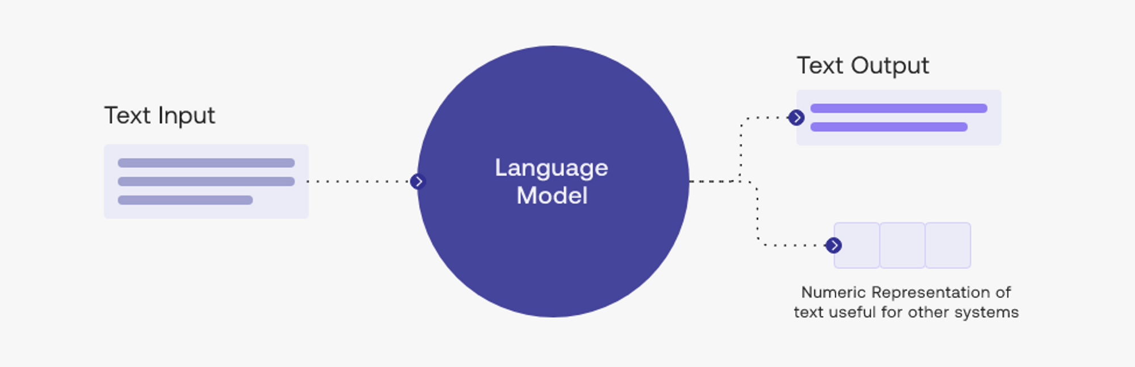
What is an LLM?
A Large Language Model (LLM) is a deep learning model that generally solves a natural language processing problem
Ex) ChatGPT
There are many different types of LLMs that are suited to particular tasks
Hubs such as Hugging Face provide many LLMs for download
Graphic Source: https://attri.ai/blog/introduction-to-large-language-models
Notes:
You may hear people talk about LLMs for image classification, computer vision, etc. These are also called VLMs (vision language models) and we are not covering those today.

Slide 5
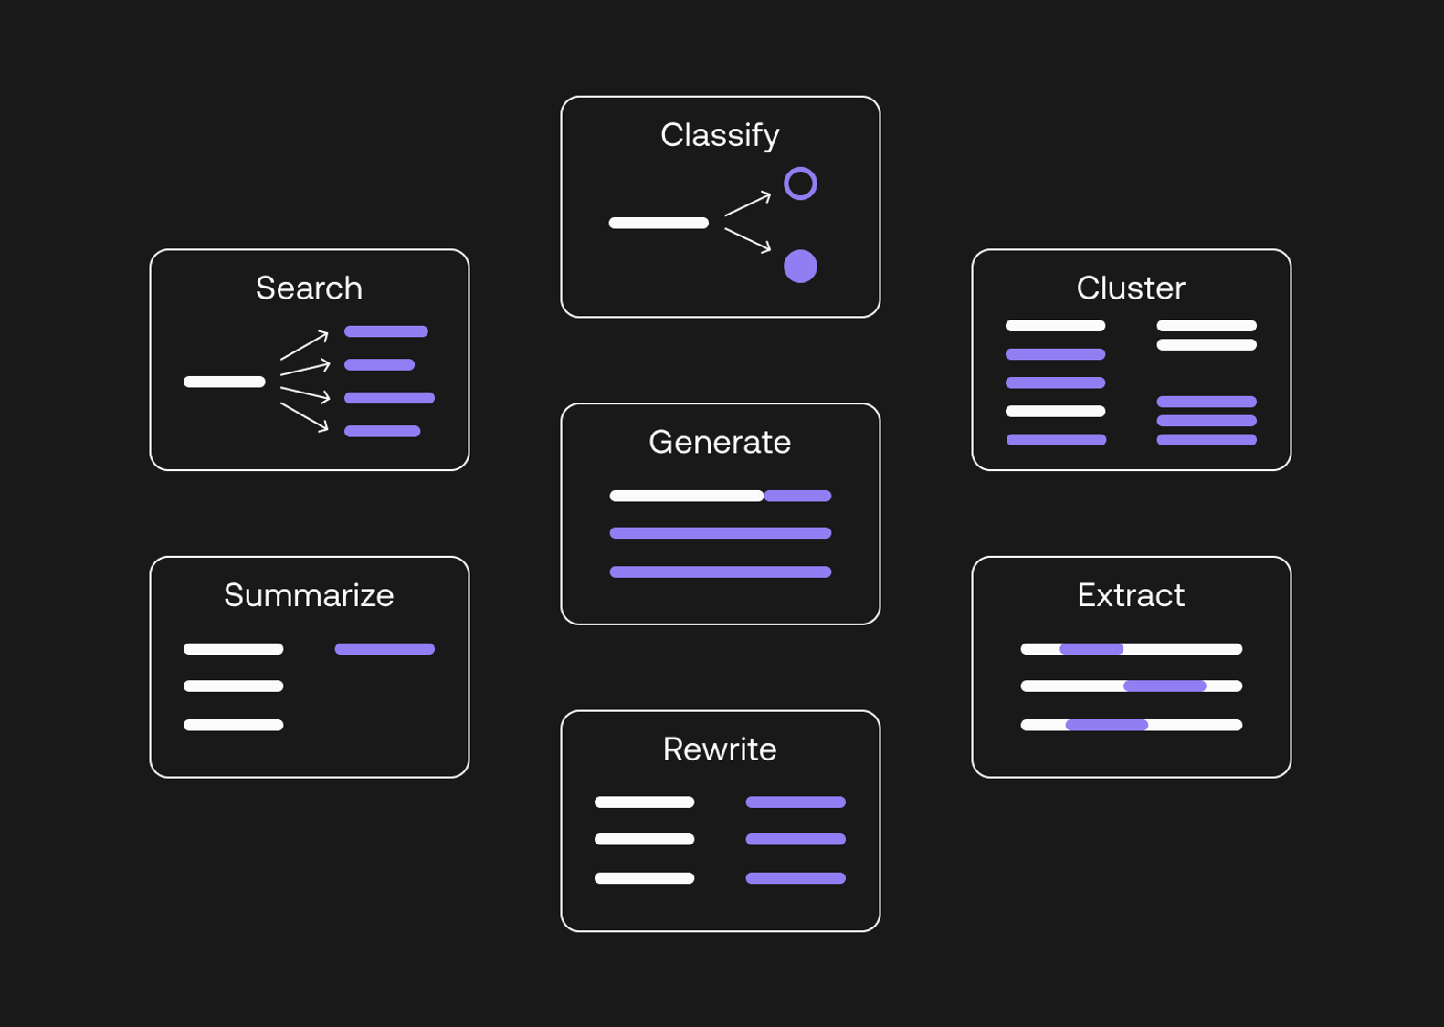
What types of NLP problems can LLMs solve?
Examples:
Classify: sentiment analysis of Tweets
Rewrite: text translation
Extract: find company names in news articles
Generate: create a story
Search: question answering from a text passage
Applications: chatbots, virtual assistants, recommendation systems
Source: https://attri.ai/blog/introduction-to-large-language-models

Slide 6
Terminology
LLMs can have billions of parameters (unknown quantities in the model)
An LLM is trained (model parameters are determined) using a very large amount of text data
A pre-trained LLM has already been trained. This process allows the model to “learn” the language.
A fine-tuned LLM is a pre-trained LLM that then is further trained on additional data for a specific task. Model parameters are updated in the fine-tuning process.
Inference is the process in which a trained (or fine-tuned) LLM makes a prediction for a given input
Notes:
Activations: intermediate model outputs

Slide 7
Terminology cont.
The input to an LLM is a sequence of tokens (words, characters, subwords, etc.)
The batch size for an LLM is the number of sequences passed to the model at once
Generally, raw text is passed through a tokenizer which processes it into tokens and sequences and then numerical data which can be sent to the LLM.

Slide 8
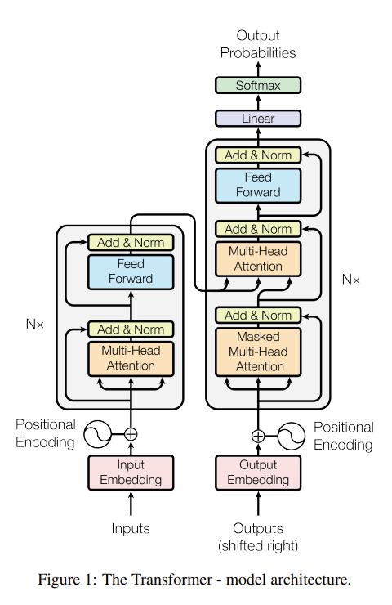
Theory Behind LLMs
LLMs are based on the transformer architecture
We are not covering this in today’s workshop
For more information:
Attention Is All You Need by Vaswani et al. (2017)
https://jalammar.github.io/illustrated-transformer/
Figure: https://arxiv.org/pdf/1706.03762 (Attention Is All You Need)

Slide 9
Set up/installation

Slide 10
Software for LLMs
We will use Python deep learning libraries to run and fine tune LLMs
PyTorch
TensorFlow/Keras
The transformers package:
Works with PyTorch and TensorFlow
“Transformers provides APIs and tools to easily download and train state-of-the-art pretrained models”
Natural Language Processing (our focus for today)
Computer Vision
Audio
Multimodal
Source: https://huggingface.co/docs/transformers/en/index
Notes:
- There are packages in R/Rstudio that can do deep learning and/or use LLMs. We are not using those in this workshop

Slide 11
Software Modules and Containers
“Software on Rivanna is accessed via environment modules or containers.”
Software Module:
Ex) R, Rstudio, JupyterLab, TensorFlow, PyTorch
List of software available on Rivanna: https://www.rc.virginia.edu/userinfo/rivanna/software/complete-list/
Container:
“Containers bundle an application, the libraries and other executables it may need, and even the data used with the application into portable, self-contained files called images.”
“Containers simplify installation and management of software with complex dependencies and can also be used to package workflows.”
Source: https://www.rc.virginia.edu/userinfo/rivanna/software/overview/

Slide 12
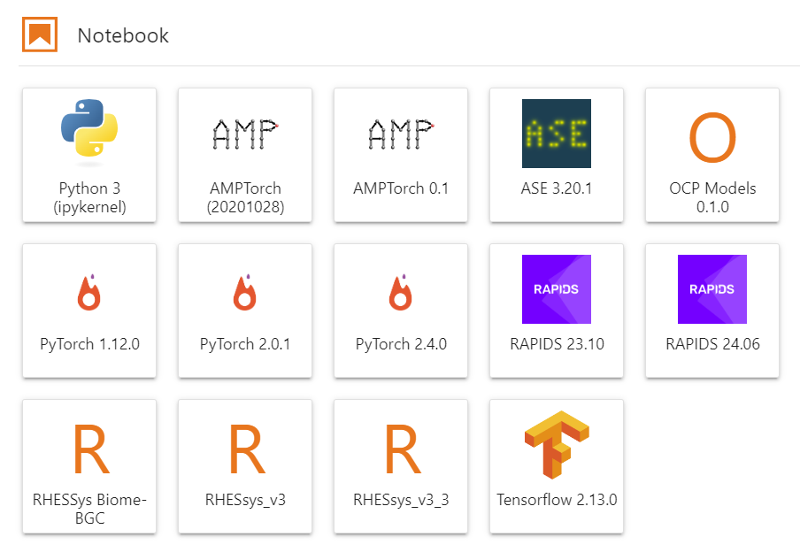
Open OnDemand – JupyterLab
Click on the kernel to open a Jupyter Notebook.
Packages from the selected kernel will be available for use in the notebook.

Slide 13
Exercise 1 – Log On, Copy Materials
Log in to Rivanna using the Interactive partition.
2 hours, 4 cores
Allocation: hpc_training
GPU: yes, 1
Show Additional Options: Yes, Optional: Slurm Option: --reservation=llm_workshop
Copy the workshop folder /project/hpc_training/llms_on_hpc to your home or scratch account.
cp –r /project/hpc_training/llms_on_hpc ~/<…>
OR
cp –r /project/hpc_training/llms_on_hpc /scratch/<ID>/<…>
Open a Jupyter Notebook for PyTorch 2.4.0.
In the first cell of the notebook run the command pip list to see a list of software (i.e., packages) available in the PyTorch 2.4.0 kernel.
Do you see a package called “transformers” or “datasets”?

Slide 14
Install transformers and datasets packages
Using the PyTorch container:
These packages are provided by Hugging Face (more details on Hugging Face in a bit)
For the fine-tuning example we will do later today, we will also need to install the accelerate and evaluate packages.
module load apptainer pytorch/2.4.0
apptainer exec $CONTAINERDIR/pytorch-2.4.0.sif pip install transformers datasets
apptainer exec $CONTAINERDIR/pytorch-2.4.0.sif pip install accelerate evaluate

Slide 15
Downloading LLMs on UVA HPC
When you use a transformers LLM for inference, it is downloaded to your home account
~/.cache/huggingface/hub
Datasets (from the datasets package) are also downloaded to your home account
~/.cache/huggingface/datasets
Make sure you have enough storage in your home account!
As of now, each user has 50GB of home storage. But after the October 15th maintenance, each user will have 200GB of home storage.

Slide 16
Exercise 2 – Installing LLM Software
Install the transformers and datasets packages in the PyTorch 2.4.0 container.
Open the ex2.ipynb file from the workshop folder.
Run each cell of this notebook.

Slide 17
Hpc resources for llms

Slide 18
HPC Resources Needed for LLMs
HPC Resources:
CPU memory
CPU cores
GPU
The resources you choose will depend on your LLM use
Inference
Fine-tuning
Training an LLM from scratch (we are not covering this today)

Slide 19
GPUs for LLMs (or Deep Learning)
Because LLMs involve a huge number of computations, we need a form of parallelization to speed up the process.
Ex) ChatGPT free version (based on GPT-3.5): 175 billion parameters,
ChatGPT paid version (based on GPT-4): over 1 trillion parameters
GPUs (graphics processing units) provide the needed parallelization and speed up.
All the major deep learning Python libraries (Tensorflow, PyTorch, Keras,…) support the use of GPUs and allow users to distribute their code over multiple GPUs.
New GPUs have been developed and optimized specifically for deep learning.
Notes:
NN calculations are very simple, but there are a lot of them!

Slide 20
Computations on the CPU or GPU?
Task | CPU or GPU
Tokenization | CPU
LLM Training/Fine-tuning | GPU
LLM Inference | Either, but GPU recommended
**When you request memory for HPC, that is CPU memory.**
If you request a GPU, you will receive all of that GPU’s memory.

Slide 21
General GPU workflow
Create data on the CPU
Send data from the CPU to the GPU (for DL this is done in batches)
Compute result on the GPU
Send the result back to the CPU
Depending on the DL framework/LLM pipeline you are using, some of these steps may be automatically done for you.
Notes:
High-level, skipping memory allocations

Slide 22
GPUs on UVA HPC
GPU | Full Name | Year Launched | Memory | # of Tensor Cores
A100 | NVIDIA A100 | 2020 | 40GB or 80GB | 432 (3rd gen)
A6000 | NVIDIA RTX A6000 | 2020 | 48GB | 336 (3rd gen)
A40 | NVIDIA A40 | 2020 | 48GB | 336 (3rd gen)
RTX3090 | NVIDIA GeForce RTX 3090 | 2020 | 24GB | 328 (3rd gen)
RTX2080Ti | NVIDIA GeForce RTX 2080 Ti | 2018 | 11GB | 544 (2nd gen)
V100 | NVIDIA V100 | 2018 | 32GB | 640 (1st gen)

Slide 23
UVA HPC - NVIDIA DGX BasePOD
10 DGX A100 nodes
8 NVIDIA A100 GPUs.
80 GB GPU memory options.
Dual AMD EPYC™ 7742 CPUs, 128 total cores, 2.25 GHz (base), 3.4 GHz (max boost).
2 TB of system memory.
Two 1.92 TB M.2 NVMe drives for DGX OS, eight 3.84 TB U.2 NVMe drives for storage/cache.
Advanced Features:
NVLink for fast multi-GPU communication
GPUDirect RDMA Peer Memory for fast multi-node multi-GPU communication
GPUDirect Storage with 200 TB IBM ESS3200 (NVMe) SpectrumScale storage array
Ideal Scenarios:
Job needs multiple GPUs on a single node or multi node
Job (single or multi-GPU) is I/O intensive
Job (single or multi-GPU) requires more than 40GB of GPU memory
Notes:
The POD is good if you need multiple GPUs and very fast computation.

Slide 24
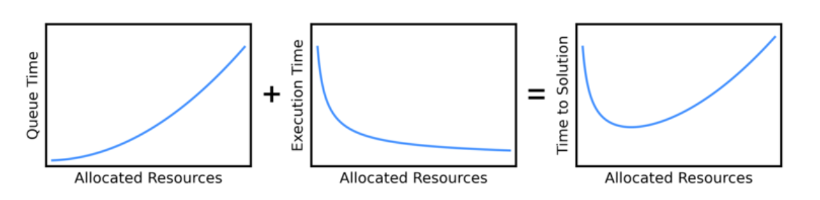
Wait Time in the Queue
You may not need to request an A100 GPU!
Requesting an A100 may mean you wait in the queue for a much longer time than using another GPU,
This could give you a slower overall time (wait time + execution time) than if you had used another GPU.
Photo Source: https://researchcomputing.princeton.edu/support/knowledge-base/scaling-analysis

Slide 25
GPU access on Rivanna
**When you request memory for HPC, that is CPU memory.**
If you request a GPU, you will receive all of the GPU memory.
General
Choose “GPU” or “Interactive” as the Rivanna Partition in OOD
Optional: choose GPU type and number of GPUs
POD nodes
POD nodes are contained in the gpu partition with a specific Slurm constraint.
Slurm script:
#SBATCH -p gpu
#SBATCH --gres=gpu:a100:X # X number of GPUs
#SBATCH -C gpupod
Open OnDemand:
--constraint=gpupod
Notes:
Only one person can be using a GPU at a time.

Slide 26
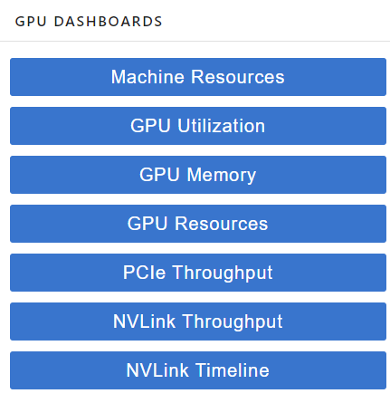
GPU Dashboard to Check CPU and GPU Efficiency
GPU Dashboard is included in OOD (Open On Demand)
This will be demoed during the exercises in today’s workshop
Includes GPU and CPU memory and utilization tracking in real time
Helpful for GPU selection in future OOD sessions

Slide 27
GPU Memory Usage
PyTorch
Correct GPU memory usage will be reported by GPU Dashboard
TensorFlow/Keras
By default, TF automatically allocates ALL of the GPU memory so GPU Dashboard may show that all (or almost all) of the GPU memory is being used
To track the amount of GPU memory actually used, you can add these lines to your python script:
import os
os.environ['TF_FORCE_GPU_ALLOW_GROWTH'] = 'true'
More Info: https://www.tensorflow.org/guide/gpu#limiting_gpu_memory_growth
Notes:
Homework for Keras users: try out GPU dashboard and see if it reports all of the GPU memory as used

Slide 28
Resource Allocation for LLMs
Resource needs will vary based on LLM use (inference, fine-tuning, etc.)
We will cover good starting choices in the Inference and Fine-Tuning sections of today’s workshop

Slide 29
MODEL SELECTION

Slide 30

Hugging Face
Hugging Face is a machine learning platform that includes
Models,
Datasets, and
Spaces (AI apps)
Information and/or code is provided to show how to use the models and datasets
Information on how the models were trained, benchmarked, etc. may also be provided
Models and datasets are filterable by task (e.g., text classification, question answering)
Some models may require you to sign an agreement before using them
Notes:
-Models and datasets include metrics such as number of downloads and date of last update

Slide 31
Planning to Choose a Hugging Face Model
What type of task will you do? (text classification, question answering, etc.)
What type of data will you work with? Is the text data from a specific domain (financial, scientific, Tweets, etc.)? What language is it in?
More specific text data will most likely need a fine-tuned model, otherwise a more general LLM may work better
If you need to fine-tune a model, do you have the computational resources to do so?
Larger models (i.e., models with more parameters) will need more resources
Source and more information: https://medium.com/@harshapulletikurti/choosing-the-correct-llm-model-from-hugging-face-hub-183fc6198295

Slide 32
Choosing a Hugging Face Model
Appropriately use model filters (task, language, license, etc.)
Select either a general LLM or a fine-tuned model
Check number of downloads
While a more popular model isn’t always better, it is good to know what models other people find useful
Check model size (how to examples on next slides)
Read model card (documentation), including
The datasets that the model was trained on and fine-tuned on (if applicable)
The model license (does this meet your needs?)
Any benchmarking results
Source and more information: https://medium.com/@harshapulletikurti/choosing-the-correct-llm-model-from-hugging-face-hub-183fc6198295

Slide 33
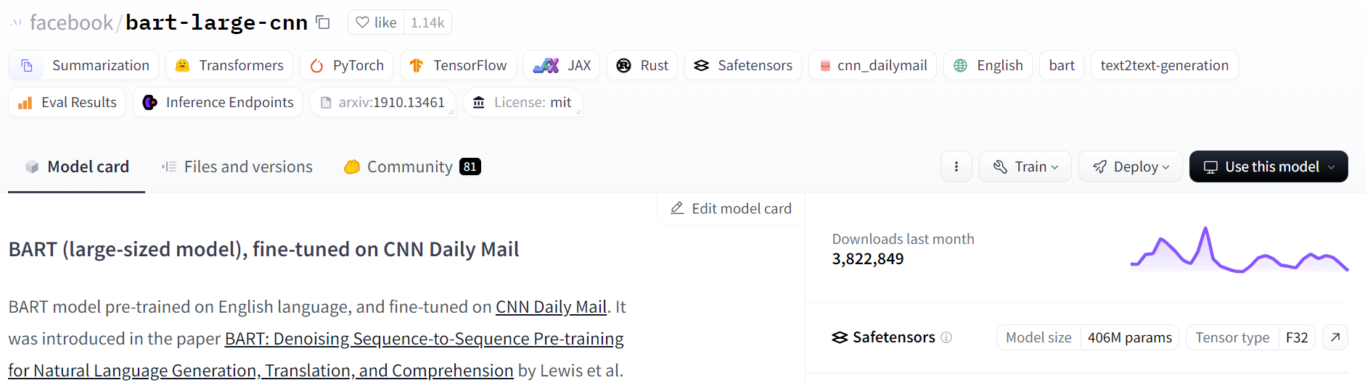
Finding Model Size on Hugging Face - 1
Use the information on the model card
Model size (B) = (# of parameters) * (bytes/parameter)
Source: https://huggingface.co/facebook/bart-large-cnn

Slide 34
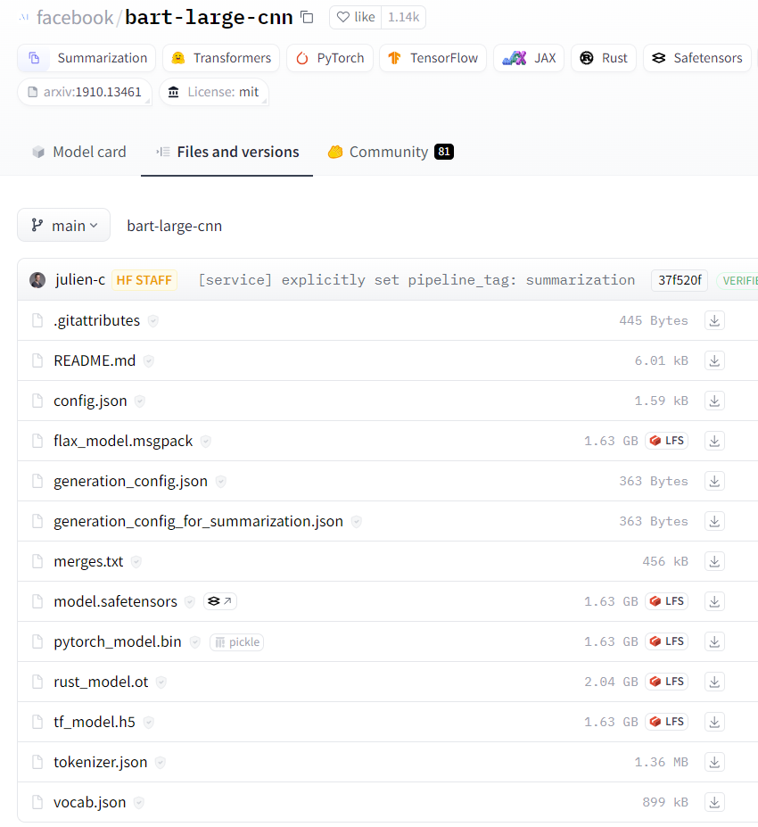
Finding Model Size on Hugging Face - 2
Use information on the Files and versions tab
Look for the pytorch model in the list of files. (It will have a .bin extension.)
The size of the model will be given
Source: https://huggingface.co/facebook/bart-large-cnn/tree/main

Slide 35
Benchmarking LLMs
Once you have narrowed down your choice of LLMs to a few, benchmarking can help you make a final decision on a model
Benchmarking results may be given in the model documentation on standard (or other) datasets.
It is always good to test models on your data!

Slide 36
INFERENCE

Slide 37
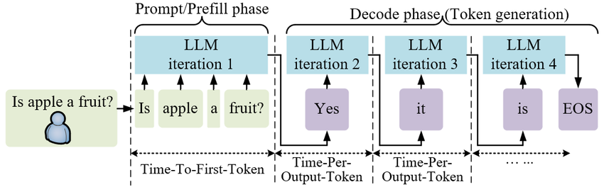
What is Inference?
Inference is the process in which a trained (or fine-tuned) LLM makes a prediction for a given input.
Graphic Source: Generative AI as a Service in 6G Edge-Cloud: Generation Task Offloading by In-context Learning by Zhou, et al.
Notes:
EOS: end of sequence

Slide 38
Using an LLM
LLMs can be used as-is (i.e., out-of-the-box) or after fine-tuning
Hugging Face model cards will generally provide code for how to get started
Code may be PyTorch or TensorFlow, “raw” (using the model directly), or pipeline code (using the pipeline from transformers library)
Ex 1: https://huggingface.co/distilbert/distilbert-base-uncased-finetuned-sst-2-english
provides “raw” PyTorch code
Ex 2: https://huggingface.co/facebook/bart-large-cnn
provides pipeline code
Code for at least loading the model (directly and using the pipeline) is provided by clicking the “Use this model” button on Hugging Face
You may have to dig through the links to find the code you need

Slide 39
Transformers Pipeline
Consists of a tokenizer, model, and post processing for getting model output
Pros
Easy to use
Efficiently manages data batching and gpu memory for you – good for HPC!
Cons
Harder to debug when something goes wrong
Recommendation:
Use pipeline first
If you get errors, you may have to use the model directly to diagnose the problem
Source and more information: https://huggingface.co/docs/transformers/pipeline_tutorial
Notes:
Pipeline “Hides” details from the programmer – good and bad
Tokenizer runs on CPU
Model runs on GPU

Slide 40
Exercise 3a – Direct LLM Usage vs Pipeline Text Summarization
Open the ex3a.ipynb file from the workshop folder.
Run each cell of this notebook and complete the EXERCISES as you go.
Watch the GPU memory using GPU Dashboard as you run the cells.

Slide 41
Pipeline Debugging Tips
Use the CPU: error messages for code running on the CPU tend to be more helpful than those for code running on the GPU.
Run the pipeline tokenizer and model separately to see where the error is being generated.
Check out the data you are feeding to the pipeline that is causing the error. Is it somehow different than other pieces of data?
If you get stuck, please submit a ticket to RC. We can help ☺

Slide 42
Ex 3b – Hugging Face Datasets & Debugging Text Summarization
Open the ex3b.ipynb file from the workshop folder.
We will go over this file together.

Slide 43
Pipeline Batching with GPU
Data (sequences) are passed in batches to the GPU, instead of one at a time
This allows the GPU to stay busy computing without waiting on more data to be passed from the CPU
Batching can be used if the pipeline is passed a list of data or a dataset from the datasets package
Batching may or may not speed up your code! You will need to test it.
The default batch_size for a pipeline is 1.
If a dataset from the datasets package is used, DataLoader is being called under the hood in the pipeline.
Use multiple CPU cores and set the num_workers parameter (default is 8).
Source and more information: https://huggingface.co/docs/transformers/en/main_classes/pipelines#pipeline-batching
Notes:
Do not use batching on cpu

Slide 44
Batch Size and GPU Memory
As batch_size increases, so does GPU memory usage
If you get an OOM (out of memory) error while using the GPU, try decreasing the LLM batch size.
Source and more information: https://huggingface.co/docs/transformers/en/main_classes/pipelines#pipeline-batching

Slide 45
Ex 3c – Batch Size and Num Workers Text Summarization
Open the ex3c.ipynb file from the workshop folder.
Run each cell of this notebook and complete the EXERCISES as you go.
Watch the GPU memory using GPU Dashboard as you run the cells.

Slide 46
CPU Resource Allocation for Inference
CPU memory
Interactive Partition: 6GB RAM per core requested
Standard Partition: 9GB RAM per core requested (no GPU)
GPU partition: you can select the amount of CPU RAM
“You should have enough RAM to comfortably work with your GPU.”
In other words, request at least as much RAM as the GPU you select.
If you are using a large dataset and/or want to do extensive preprocessing, more RAM is probably helpful
CPU cores
Use multiple cores - especially if you are using a dataset from the Datasets package and a GPU. (So that DataLoader can utilize multiple cores under the hood.)
I usually start with 8
Source: https://timdettmers.com/2018/12/16/deep-learning-hardware-guide/
Notes:
Check your resource usage using GPU Dashboard, seff (completed jobs), or sstat (running jobs)
It may be the case that even if CPU Efficiency is a low percentage, you need all of the requested CPU cores for a specific part of the code, e.g., data preprocessing.
In this case, request the number of CPU cores that you need for the compute intensive part of the code.

Slide 47
Selecting a GPU for Inference
Select a GPU based on how much GPU memory you will need.
The GPU memory will contain:
the LLM (i.e., the model weights),
input and output data, and
extra variables for the forward pass (about 20% of the LLM size).
LLM Memory (B): (# parameters) * (# bytes/parameter)
# bytes/parameter depends on the model’s precision, e.g., fp32 is 4 bytes/parameter
GPU Memory Estimate for Inference (B): 1.2 * (LLM Memory in B)
NOTE: I have found this formula to underestimate UVA GPU memory. It is most likely a ballpark estimate, but I recommend tracking GPU memory using the GPU Dashboard to make a more informed GPU selection.
Source: https://blog.eleuther.ai/transformer-math/
Notes:
B is for bytes

Slide 48
Exercise 4 – Select a GPU for Inference
Suppose you are going to run inference using the model google-bert/bert-base-uncased. Which UVA GPU would you select and why?
UVA GPU | Full Name | Year Launched | Memory | # of Tensor Cores
A100 | NVIDIA A100 | 2020 | 40GB or 80GB | 432 (3rd gen)
A6000 | NVIDIA RTX A6000 | 2020 | 48GB | 336 (3rd gen)
A40 | NVIDIA A40 | 2020 | 48GB | 336 (3rd gen)
RTX3090 | NVIDIA GeForce RTX 3090 | 2020 | 24GB | 328 (3rd gen)
RTX2080Ti | NVIDIA GeForce RTX 2080 Ti | 2018 | 11GB | 544 (2nd gen)
V100 | NVIDIA V100 | 2018 | 32GB | 640 (1st gen)

Slide 49
FINE-TUNING

Slide 50
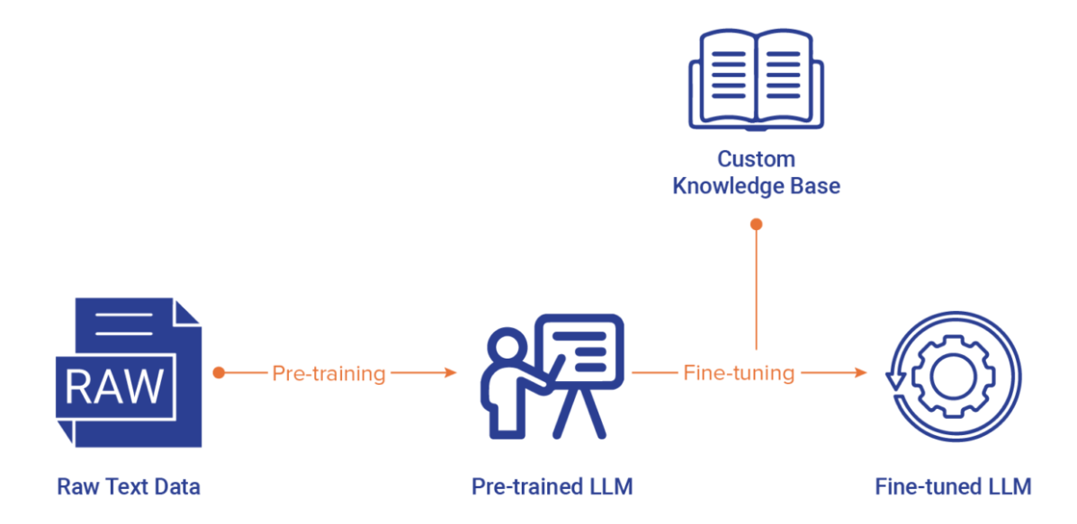
What is Fine-Tuning?
LLMs are pre-trained on huge amounts of text data to learn general language patterns
LLMs can be fine-tuned on a much smaller amount of data to excel at a particular task (e.g., classification of financial text)
Graphic Source: https://nexla.com/enterprise-ai/llm-fine-tuning/
Notes:
LLM pre-training is generally unsupervised

Slide 51
Types of Fine-Tuning
Fine-tuning can be a supervised or unsupervised process and involves:
Changing some of the LLM weights,
Changing all of the LLM weights (full fine-tuning), or
Parameter Efficient Fine-Tuning (PEFT), i.e., keeping the LLM weights the same but updating a small number of additional parameters that will adjust the LLM weights (e.g., LoRA).
The more weights you update, the more computational resources you need

Slide 52
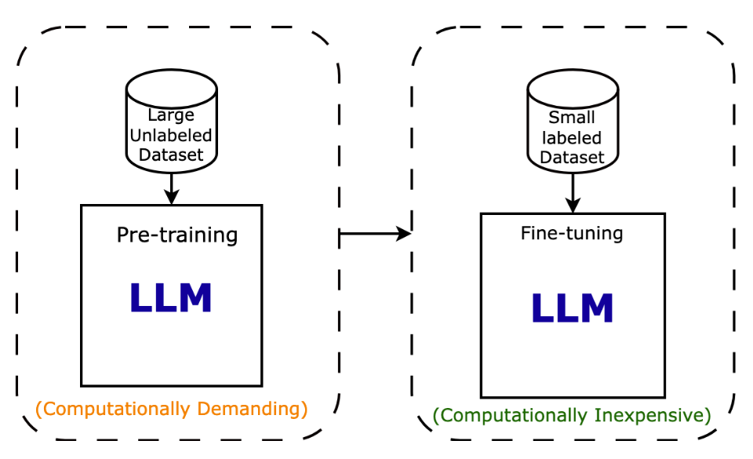
Why use Fine-Tuning?
Example:
distilbert/distilbert-base-uncased was pre-trained on BookCorpus and English Wikipedia, ~25GB of data
distilbert/distilbert-base-uncased-finetuned-sst-2-english was fine-tuned on Stanford Sentiment Treebank (sst2), ~5MB of data
Graphic Source: https://intuitivetutorial.com/2023/06/18/large-language-models-in-deep-learning/

Slide 53
Example - Supervised Full Fine-Tuning
The data for supervised learning includes labels, e.g., a text review and sentiment label (positive or negative).
An LLM is generally pre-trained for the task of masked language modeling
Through fine-tuning we can change the task to text classification
This means that the LLM head (the last layers) will change to text classification layers
There is a transformers function that will do this for us

Slide 54
Hugging Face Trainer Class
The Trainer class allows a user to train or fine-tune a model using a convenient function, rather than using native PyTorch.
When training, the Trainer will automatically use the GPU if one is present.
There are many options that can be set for the TrainingArguments (number of epochs, learning rate, save strategy, etc.)
https://huggingface.co/docs/transformers/main_classes/trainer#transformers.TrainingArguments
The Trainer will not automatically evaluate the LLM, so we will pass it an evaluation metric.

Slide 55
Ex 5 – Supervised Full Fine-Tuning Text Classification
Open the ex4.ipynb file from the workshop folder.
We will go over this file together.

Slide 56
CPU Resource Allocation for Fine-Tuning
CPU memory
Interactive Partition: 6GB RAM per core requested
Standard Partition: 9GB RAM per core requested (no GPU)
GPU partition: you can select the amount of CPU RAM
“You should have enough RAM to comfortably work with your GPU.”
In other words, request at least as much RAM as the GPU you select.
If you are using a large dataset and/or want to do extensive preprocessing, more RAM is probably helpful
CPU cores
Use multiple cores - especially if you are using a dataset from the Datasets package and a GPU. (So that DataLoader can utilize multiple cores under the hood.)
I usually start with 8
Source: https://timdettmers.com/2018/12/16/deep-learning-hardware-guide/
Notes:
Check your resource usage using GPU Dashboard, seff (completed jobs), or sstat (running jobs)
It may be the case that even if CPU Efficiency is a low percentage, you need all of the requested CPU cores for a specific part of the code, e.g., data preprocessing.
In this case, request the number of CPU cores that you need for the compute intensive part of the code.

Slide 57
Selecting a GPU for Fine-Tuning
Select a GPU based on how much GPU memory you will need.
But, it is a hard problem to determine how much GPU memory a LLM will need for training before training the model
A training iteration requires a forward and backward pass of the model. In addition to storing the LLM, training also requires additional storage space such as
Optimizer states
Gradients
Activations
Data (how much is determined by the batch size)
Source: https://blog.eleuther.ai/transformer-math/

Slide 58
Selecting a GPU for Fine-Tuning cont.
According to the Hugging Face Model Memory Calculator, for a batch size of 1, GPU Memory Estimate for Fine-Tuning (B): 4 * (LLM Memory in B)
While this formula can help ballpark an estimate, I recommend tracking GPU memory using the GPU Dashboard to make a more informed GPU selection.
For a more specific formula, see https://blog.eleuther.ai/transformer-math/
This blog requires some understanding of transformers
Determining LLM memory for fine-tuning is an active area of research. The paper LLMem: Estimating GPU Memory Usage for Fine-Tuning Pre-Trained LLMs by Kim, et al. (April 2024) presents a method for doing so within 3% of the actual memory required.
Notes:
B is for bytes

Slide 59
General Advice
If you are learning about LLMs and doing tutorials, choose a small LLM. The GPUs in the Interactive partition are probably ok to use.
You can leave the GPU choice as default on the GPU partition and work on whichever GPU you get or choose a GPU with a smaller amount of memory first.
Fine-tune your model for one epoch and monitor the GPU memory usage using GPU Dashboard.
If you are getting OOM (out of memory) GPU errors, try lowering the batch size.
There are other advanced techniques to reduce the amount of memory used in fine-tuning.

Slide 60
SLURM SCRIPTS

Slide 61
What is a Slurm Script?
HPC environments are generally shared resources among a group of users.
In order to manage user jobs, we use Slurm, a resource manager for Linux clusters.
This includes deciding which jobs run, when those jobs run, and which node(s) they run on.
A Slurm script gives Slurm the information it needs to run a job.
Computational resources
Necessary software
Command(s) to execute the code file
Source: https://www.rc.virginia.edu/userinfo/rivanna/slurm/
Notes:
From our website: “Jobs are submitted to the Slurm controller, which queues them until the system is ready to run them. The controller selects which jobs to run, when to run them, and how to place them on the compute node or nodes, according to a predetermined site policy meant to balance competing user needs and to maximize efficient use of cluster resources.”

Slide 62
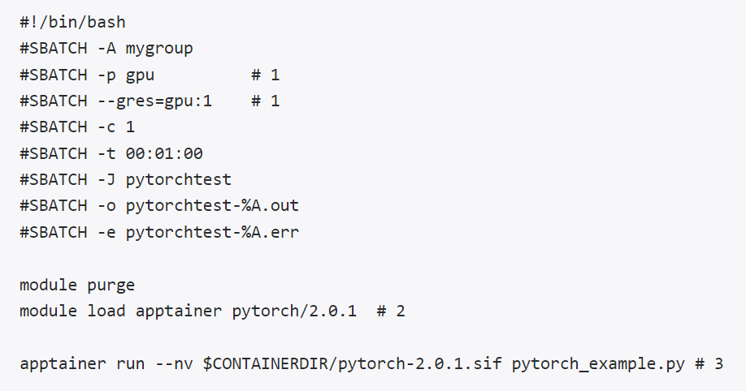
Example Slurm Script - PyTorch
Set Up Resources
-A: allocation
-p: partition
--gres=gpu:1 :use 1 gpu
-c: number of cores
-t: time limit
-J: job name
-o: standard output file (%A is the job #)
-e: standard error file (%A is the job #)
Load Software
$CONTAINERDIR/pytorch-2.4.0.sif
Run Code
Use GPU
Source: https://www.rc.virginia.edu/userinfo/rivanna/software/pytorch/#pytorch-slurm-jobs
Notes:
-The default command defined in each container is “python” so using “run” basically executes “python file_name.py”
- The load software and run code lines are what a user would use to run their script at the command line
- TF example: https://www.rc.virginia.edu/userinfo/rivanna/software/tensorflow/#tensorflow-slurm-jobs

Slide 63
More Slurm Options
To request a specific amount of memory per node:
Ex) --mem=64G
Units are given with a suffix (K, M, G, or T). If no unit is given, megabytes is assumed.
Other options available at https://slurm.schedmd.com/sbatch.html
For more information, see the RC tutorial Using SLURM from a Terminal.
Tip: if you have a Jupyter notebook file (.ipynb) that you would like to run using a SLURM script, first convert it to a .py file using the following command (make sure you are in the directory that contains the file): jupyter nbconvert --to python file_name.ipynb

Slide 64
WRAP-UP

Slide 65
Recap
We learned…
What an LLM is, the types of problems LLMs can solve, and LLM terminology
How to download and set up LLM software on UVA HPC
The HPC resources (CPU memory, CPU cores, GPU) needed for LLM inference and fine-tuning
How to use GPU Dashboard on UVA HPC
How to select an LLM from Hugging Face for a given task
LLM inference and supervised full fine-tuning on UVA HPC
How to write a Slurm script for LLM code using PyTorch

Slide 66

Research Computing Data Analytics Center
https://www.rc.virginia.edu/service/dac/

Slide 67
Need more help?
Office Hours via Zoom
Tuesdays: 3 pm - 5 pm
Thursdays: 10 am - noon
Zoom Links are available at https://www.rc.virginia.edu/support/#office-hours
Website:
https://rc.virginia.edu

Slide 68
Survey
https://virginia.az1.qualtrics.com/jfe/form/SV_a5INnAn5S8HAScC

