Slide 1
IntRo to High Security HPC (Rio)
Camden Duy
Computational Scientist
E: cmd7ag@virginia.edu
Paul Orndorff
Computational Scientist
E: egg3xa@virginia.edu

Slide 2
High Performance Computing (HPC) at UVA
HPC computing systems tailored to data sensitivity
Rivanna/Afton (Standard Security)
To process and store public data, internal use data, or sensitive data.
Highly Sensitive Data is not permissible
More information on the SSZ HPC can be found in our Intro to HPC slides.
Rio (High Security)
To process and store Highly Sensitive Data such as HIPAA, FERPA, Controlled Access Data (CAD), etc.
Not CUI certified yet, use Ivy VM
For more information, please see RC Systems Data Sensitivity

Slide 3
Highly Sensitive Data
Data that require restrictions on access under the law or that may be protected from release in accordance with applicable law or regulation.
Examples:
Personally identifiable information (PII) is any information that can be used to identify a person. Examples include social security number, passport number, driver’s license number, military identification number, or biometric records
Health information that reveals an individual’s health condition and/or medical history, including information defined by the Health Insurance Portability and Accountability Act (HIPAA)

Slide 4
Ivy and Rio (Overview)
Ivy
Secure computing environment, offering Virtual Machines (VM) with both Linux and Windows operating systems.
Ivy VM is designed for interactive and small-scale analysis of highly sensitive data, including HIPAA, FERPA, and CUI.
Access to the Ivy platform is project based. Each project gets a VM.
Project-specific storage volumes are mounted to the VM and available on the HPC system, enabling a seamless transition between tasks on VM and HPC environment.
Ivy Linux VMs can serve as a frontend for accessing the Rio HPC system (available upon request).
Rio
For large scale analysis of HIPAA, FERPA, and CAD

Slide 5
Terminology
Node
Nodes are a type of computer called a server
They generally have more power than a typical computer.
They may have specialty hardware like graphical processing units
Two types of Nodes:
Login node - a server used for logging in and submitting jobs.
Compute node - a server that carries out the computational work.
Core
An individual processor on a computer
Memory
The random-access memory on a node
Storage
Disk storage visible from a node

Slide 6
VM Request (PI)
VM & User Provisioning (RC)
Account (user)
Connection
Cluster Environment
Modules (software)
Partitions (hardware)
Slurm (scheduler)

Slide 7
Requesting Access to HSZ HPC (Rio)
Principal Investigators (PIs) can request access by submitting an Ivy Linux VM request through the services app
Research staff may apply for an exception.
Students must be sponsored by a faculty member or approved research staff.
In addition to being a login node to Rio, a Linux VM can be used for preliminary computations as well
VMs come in different sizes. Request a VM sized appropriately for your workflow. For larger groups or projects with computationally intensive tasks, choose a larger VM. We recommend Small and above.
VMs exist in a private, secure network and cannot reach outside resources on the Internet. Inbound and outbound data transfer is managed through the Data Transfer Node (DTN).
More information on requesting a VM can be found here on our website.

Slide 8
VM Provisioning
After access is requested, the Research Computing (RC) team will handle the provisioning of the Virtual Machine (VM).
The following steps are carried out by the RC team
RC will create a Grouper group for Rio access
RC will request access to the High Security VPN (HSVPN) on your group's behalf and provision 1 TB of High Security Research Standard storage for your project. This storage volume will also be available when using Rio HPC for your project.
The PI and researchers will be notified upon the completion of the VM provisioning, and the associated IP address and group name will be provided to them.

Slide 9
User Provisioning
Any users of the VM must be added to the project in the services app by the PI
Once a project is approved, a PI and her/his researchers must sign a RUDA (one for every researcher on each project).
Each researcher must also complete the High Security Awareness Training (HSAT)
This must be completed to permit each researcher access to the HSVPN filter

Slide 10
Connecting to the System
Before connecting to your VM, you must install the following on your workstation.
Cisco AnyConnect Secure Mobility Client.
Opswat.
Duo MFA on personal smartphone.
Details and links to each are on our website.
There are two ways to connect to your Linux VM:
Accessing the VM from a browser window
Using SSH (Secure Shell)
Use a terminal window with Mac/Linux
Windows users will need to install an SSH client application. We recommend MobaXTerm.
In either case, you need the IP address of your VM along with your Netbadge credentials to connect to the VM.

Slide 11
Accessing from SSH
Start the HSVPN
Open your SSH client and type: ssh mst3k@10.xxx.xxx.xxx, where mst3k is replaced with your user ID and the x's are replaced with your VM's IP address (given in the Services app).
When prompted for a password, use your EServices password.
This login method provides only command-line access to the VM. No graphical user interface (GUI) is usable.

Slide 12
SSH Clients
SSH clients mostly use instructions typed at the command prompt.
You will need to become familiar with Linux/Unix commands.
See our Command Line Tutorial to learn more
Some useful Unix/Linux commands:
$ ls
$ pwd
$ cd folder_name
$ cp file_1 file_2
$ rm file_1
$ cd ..

Slide 13
Accessing from a Browser
Start the HSVPN
Open a web browser and enter the IP address for your VM (e.g., https://10.xxx.xxx.xxx)
If you get a warning message, you may need to click on Advanced Settings and/or a Connect Anyway option, depending on your web browser.
Logging in will take you to a web application called Open OnDemand (OOD).

Slide 14
VM Storage
Storage is split across two sets of directories:
Personal directory for individual data storage
Mounted under /home/$USER
Little space is allotted for /home directories per VM
Individual home folders are personal, and not shareable
Shared storage space.
Mounted under /standard/ivy-hip-name where “ivy-hip-name” is replaced by the name of your Ivy project’s Grouper group name
Default of 1TB of Research Standard Storage. PIs can get more when first requesting the Ivy project.
Storage can be resized using our Storage Request Form.

Slide 15
Rio Caveat
One caveat to consider when working in the Rio environment is that /home is not mounted on Rio compute nodes.
This means that if your compute jobs references any files in your /home storage, they will not be found.
Ivy VMs not using Rio can ignore this condition.
We recommend working exclusively out of the VM's Research Standard storage directory for Rio.
Individual user subdirectories are automatically created under /standard to organize the space.

Slide 16
Transferring Data
Globus is the only permitted data-transfer protocol for highly sensitive data.
UVA IVY-DTN is the official collection for moving files into High-Security Research Standard Storage.
To transfer data to High-Security Research Standard Storage, please see our Globus instructions.
Ensure that you are NOT connected to the HSVPN. Data transfer will not work if you are connected to the HSVPN.
Additional instructions and information on using Globus can be found on our learning site.

Slide 17
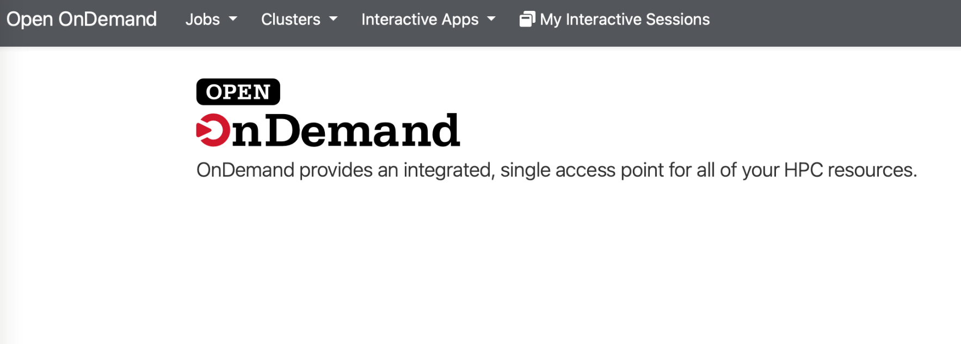
Open On Demand
Open OnDemand is a web application that allows for HPC access through a graphical browser window.
Features of the application are accessible using the top gray bar:
Jobs
Clusters
Interactive apps

Slide 18
Active Jobs
Under the jobs dropdown is the active jobs tab
This shows all jobs currently running or queued on all partitions for all users.
You can filter the search for All Jobs or Your Jobs.
The Filter search bar allows you to narrow jobs by either user, queue, job name, job ID, or job status (running, queued, completed).
More job details can be viewed using the dropdown to the left of a given job.
Completed jobs will be visible only for a short while as they are exiting.

Slide 19
Clusters
The Clusters tab on the menu bar opens a new browser tab with a Linux command line interface for shell access.
This gives you terminal access to the frontend Ivy VM, similar to logging in via SSH.
Here, you can manipulate files, install software packages for Python & R, and submit command line jobs. Running processes here does not utilize Rio compute node resources.

Slide 20
Interactive Apps
Open OnDemand offers GUI applications to interactively run jobs on Rio compute nodes.
Job submissions are managed by a resource manager called Slurm.
The following applications are available:
JupyterLab
Rstudio Server
FastX Desktop

Slide 21
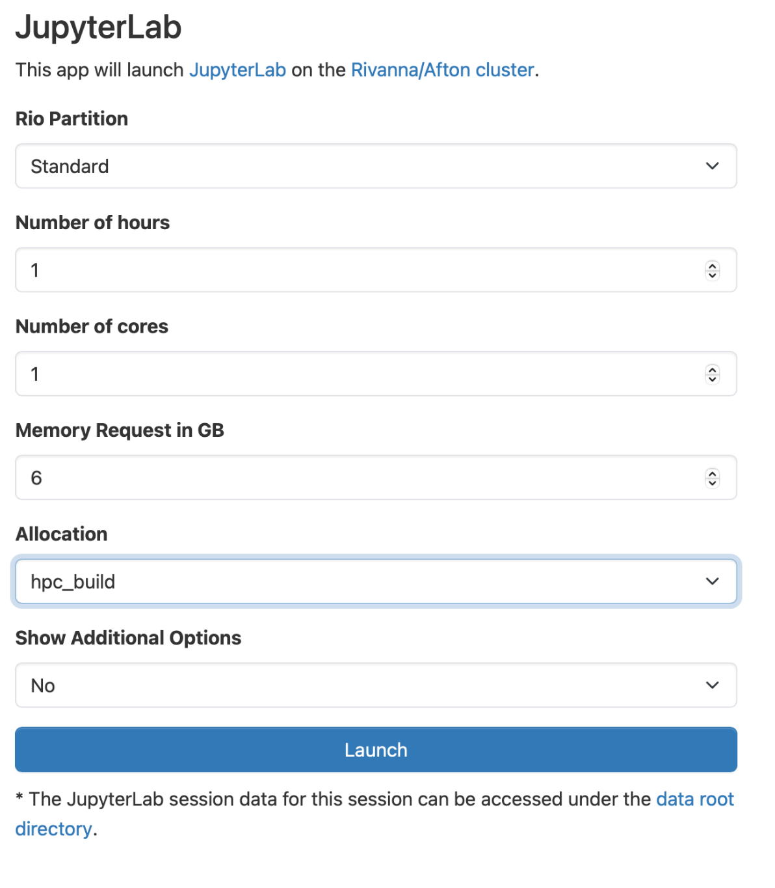
Requesting a Session
To request a session, select one of the applications from the dropdown. This will prompt you to fill in the desired resources for your interactive job.
The example to the right is for starting a JupyterLab session.

Slide 22
Choosing Resource Requests
Partition – Standard or GPU (only select GPU if you are using GPU-enabled code)
Time – Time limit for your session. Once reached, your session will terminate along with any running code. Cannot be adjusted.
Cores – Used in parallel processing. Your code must be modified to take advantage of using multiple cores.
Memory – A good rule of thumb is to request 2 to 3 times the size of the data that you are reading in or generating.
Optional: Slurm Option – Used to input one of the many other Slurm options.

Slide 23
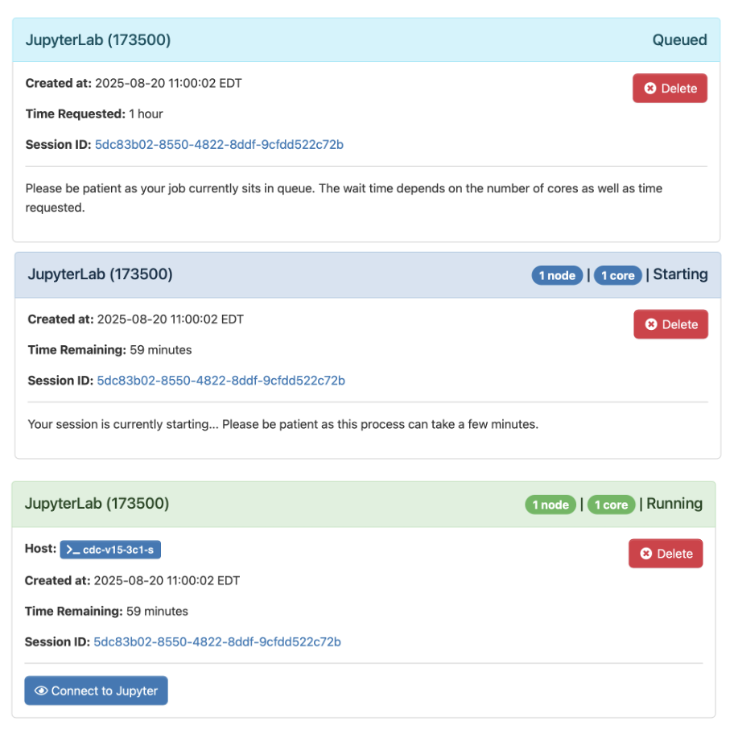
Queueing the Session
Once you’ve filled out the resource request form, click the Launch button at the bottom to queue your job.
While queued, the job will wait for the resources you’ve asked for to become available.
Requests with higher resource requests (more cores, more memory, more time) may wait longer.

Slide 24
Launching the Session
When the job has started, the status will change from Queued to Running. A button will appear to open a browser, launching the interactive session.

Slide 25
Interactive Desktop
The Interactive Desktop application launches a virtual desktop session.
The Desktop app is a great tool for managing files and launching applications with a graphical user interface.
A Firefox browser is available and can be used to browse the web. The browser must be launched from a terminal with the network proxy set. Use the following commands in a terminal:
export HTTPS_PROXY=http://figgis-s.hpc.virginia.edu:8080
export HTTP_PROXY=http://figgis-s.hpc.virginia.edu:8080
firefox

Slide 26
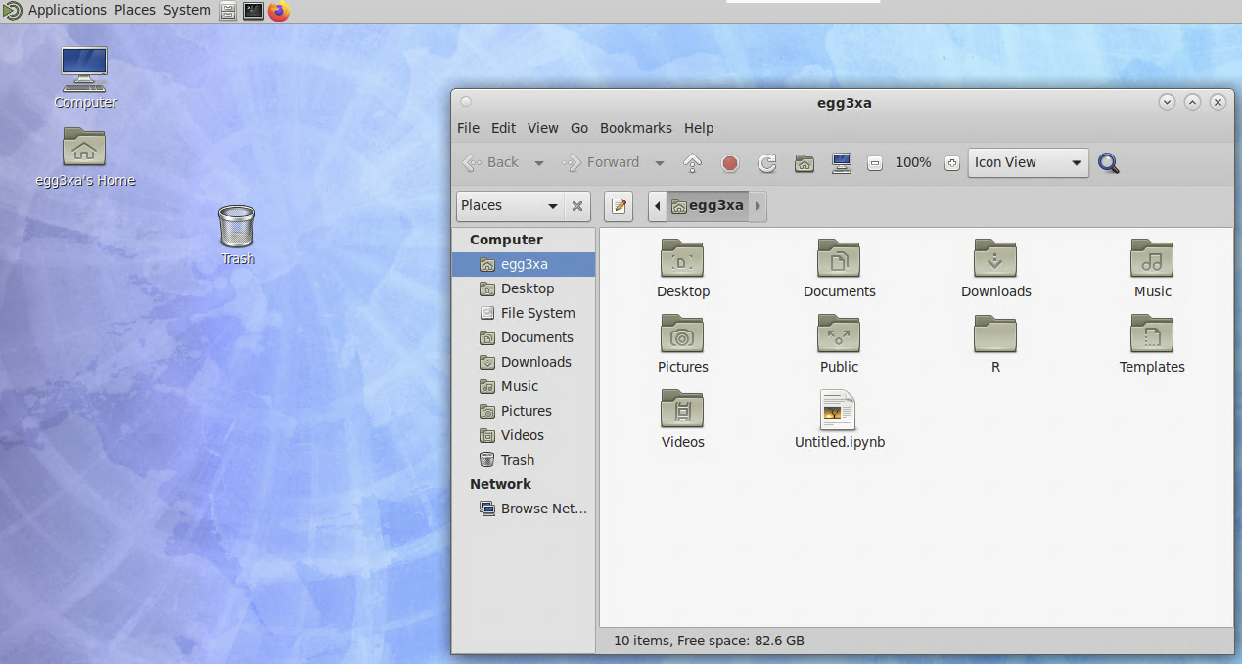
Working with Files Using the Desktop
The Desktop app has a graphical file manager that can be opened by clicking the folder icon on the desktop or the file cabinet icon on the applications bar.
Using it should feel familiar. You can click and drag to move files/folders. Right-click to cut, copy, and paste.
You can create and edit files by using the Pluma editor. Right-click in the empty space and select “Create Document” to create a text file. Right-click the new file and select “Open with Pluma” to edit it. You can edit existing files this way.
MATE Desktop with ​CAJA file browser open (white box on menu bar)​

Slide 27
How to edit a file in Linux VM
Editors you can use:
When in a Terminal Window, use vi/emacs/pluma.
vi/emacs uses all keyboard shortcuts and may take a while to learn.
pluma is a very basic editor. To launch, type: pluma myfile.txt
In Desktop, you can use Pluma Text Editor.

Slide 28
Preinstalled Software
Every VM comes with a base installation of software by default. New software can be installed upon request.
Software not already approved will need to undergo a security evaluation to determine if it is suitable for a High Security environment.
Python and R packages are available to users through the normal pip, conda, and CRAN library installation methods.
Access to installed software is done using the lmod Module System.

Slide 29
Modules
Any application software that you want to use will need to be loaded with the module load command.
For example:
module load apptainer/1.3.1
Modules are loaded only in your current shell. For repeated use, you must:
Load software every time you log out and back in
Load software every time you run a batch job on a compute node

Slide 30
Modules Basics
Some basic commands to use lmod:
module avail – lists every module avaiable to load
module key <keyword> - searches for modules in a category specified
Example: module key bio
module spider <module-name> - prints information about the software including different offered versions
module load <module-name> - load the desired software
Use module load <module-name/ver-number> to load a specific version
module unload <module-name> – unloads the desired software
module list – prints all currently loaded modules
module purge – unloads all modules

Slide 31
Python & R packages
Since /home is not mounted on compute nodes, locally installed Python and R packages must be staged on /standard instead.
Both languages, by default, install to a folder in /home. Configuration changes are necessary to use Python and R in your compute jobs on Rio.
Instructions for each are posted on our website:
Conda environments
R libraries
When using interactive JupyterLab or RStudio, extra setup is not necessary.

Slide 32
Slurm
Slurm manages the hardware resources on the cluster (e.g. compute nodes/cpu cores, compute memory, etc.).
Slurm allows you to request resources within the cluster to run your code.
It is used for submitting jobs to compute nodes from an access point (Ivy VM).
Frontends are intended for editing, compiling, and submitting jobs
Production jobs go to the compute nodes through the resources manager.
Slurm has documentation and we have condensed notes on our website:

Slide 33
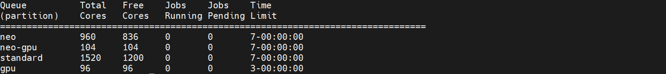
Partitions (Queues)
Rio has several partitions (or queues) for job submissions.
You will need to specify a partition when you submit a job.
To see the partitions that are available to you, type qlist at the command-line prompt.
The neo partitions are exclusive to a specific group and are not for general users of Rio.

Slide 34
Slurm Script Example
A Slurm script is a bash script with Slurm directives (#SBATCH) and command-line instructions for running your program.
#!/bin/bash
#SBATCH --nodes=1 #total number of nodes for the job
#SBATCH --cpus-per-task=1 #total number of cores for the job
#SBATCH --time=1-12:00:00 #amount of time for the whole job
#SBATCH --partition=standard #the queue/partition to run on
#SBATCH --account=ivy-hip-name #name of your Ivy group
module purge
module load goolf R #load modules that my job needs
Rscript myProg.R #command-line execution of my job

Slide 35
Submitting a Slurm Job
To submit the Slurm command file to the queue, use the sbatch command at the command line prompt.
/home only exists on VM. Compute nodes do not have access to /home.
Job submission needs to be done from /standard/storage/
Recommended to include the complete file paths in the script
For example, if the script on the previous slide is in a file named job_script.slurm, we can submit it as follows:
[jus2yw@ivy-tst-rc-1 ivy-tst-rc]$ sbatch job_script.slurm
Submitted batch job 18316

Slide 36
Submitting an Interactive Slurm Job
To submit an interactive SLURM job to the queue, use the ijob command at the command line prompt.
For example, if you want to run an interactive application on a compute node in the standard queue using one cpu, we can submit it as follows:
-bash-4.1$ ijob –c 1 –p standard –A ivy-hip-name -t 06:00:00
﻿salloc: Pending job allocation 21640112
salloc: job 21640112 queued and waiting for resources
salloc: job 21640112 has been allocated resources
salloc: Granted job allocation 21640112
srun: Step created for job 21640112
udc-aw34-21c0-teh1m$

Slide 37
Checking Queued Jobs
To display the status of only your active jobs, type: squeue –u <your_user_id>
The squeue command will show pending jobs and running jobs, but not failed, canceled or completed job.
A job's status is indicated by:
PD – pending, R – running, CG – exiting
-bash-4.2$ squeue –u mst3k
JOBID PARTITION NAME USER ST TIME NODES NODELIST(REASON)
standard job_sci mst3k R 1:45 1 udc-aw38-34-l

Slide 38
Canceling a Job
To delete a job from the queue, use the scancel command with the job ID number at the command line prompt:
To cancel all your jobs, run this command:
-bash-4.2$ scancel 18316
-bash-4.2$ scancel –u $USER

Slide 39
Checking Job Status
scontrol returns information for a running job
scontrol show job <jobid>
sacct will return accounting information about completed and queued jobs. See Slurm's docuementation for a full list of options.
Use the option –o <options,list> to customize the output
Use the option –S <yyyy-mm-dd> to inspect jobs finished after the given start date
Use the option –j <jobid> to inspect a particular job
seff will return information about the utilization (called the “efficiency”) of core and memory.
Seff <jobID>

Slide 40

Need help?
Research Computing Zoom Office Hours
Tuesdays: 3 pm – 5 pm
Thursdays: 10 am – noon
To connect to the Zoom sessions, go to https://www.rc.virginia.edu/support/#office-hours and click on the “Join us via Zoom” button
Or, contact us through the forms at:
https://www.rc.virginia.edu/support/

