Slide 1

https://qiime2.org
What is QIIME 2?
QIIME 2 is a powerful, extensible, and decentralized microbiome analysis package with a focus on data and analysis transparency. QIIME 2 enables researchers to start an analysis with raw DNA sequence data and finish with publication-quality figures and statistical results.
Key features:
Integrated and automatic tracking of data provenance
Semantic type system
Plugin system for extending microbiome analysis functionality
Support for multiple types of user interfaces (e.g. API, command line, graphical)
QIIME 2 is a complete redesign and rewrite of the QIIME 1 microbiome analysis pipeline. QIIME 2 will address many of the limitations of QIIME 1, while retaining the features that makes QIIME 1 a powerful and widely-used analysis pipeline
Notes:
OUT=Operational Taxonomic Unit

Slide 2
https://qiime2.org
High-level features (these attract users to system)
Latest and greatest microbiome bioinformatics methods and visualizations.
Accessibility through accurate, detailed, and interesting documentation and well-designed interfaces.
A community of microbiome scientists, developers, and bioinformaticians.

Slide 3
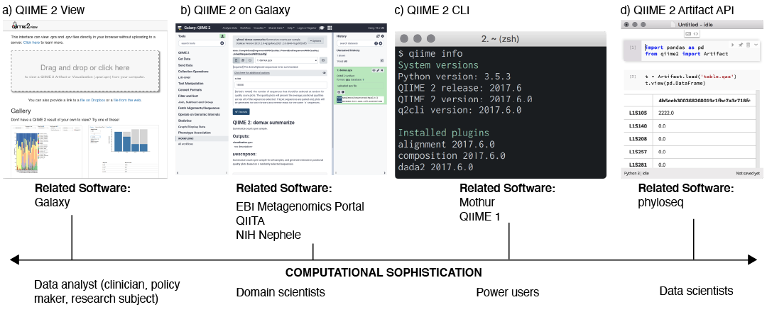
Choose the QIIME 2 interface that helps you work most efficiently.

Slide 4
QIIME 2 Core 2022.8 distribution The QIIME 2 Core 2022.8 distribution includes the QIIME 2 framework, q2cli (a QIIME 2 command-line interface) and the following plugins:
q2-alignment q2-composition q2-cutadapt q2-dada2 q2-deblur q2-demux q2-diversity q2-diversity-lib q2-emperor
q2-empress q2-feature-classifier q2-feature-table q2-fragment-insertion q2-gneiss q2-longitudinal q2-metadata q2-phylogeny
q2-picrust2 q2-quality-control q2-quality-filter q2-sample-classifier q2-taxa q2-types q2-vsearch
Note The QIIME 2 Core 2022.8 distribution includes plugins and interfaces that are developed, maintained, tested, and distributed by the QIIME 2 development team. The Core distribution is necessary to run the commands in the QIIME 2 tutorials. If there are additional QIIME 2 plugins or interfaces you would like to install, please consult the relevant package(s) documentation. Other types of distributions may be made available in the future in addition to Core.

Slide 5
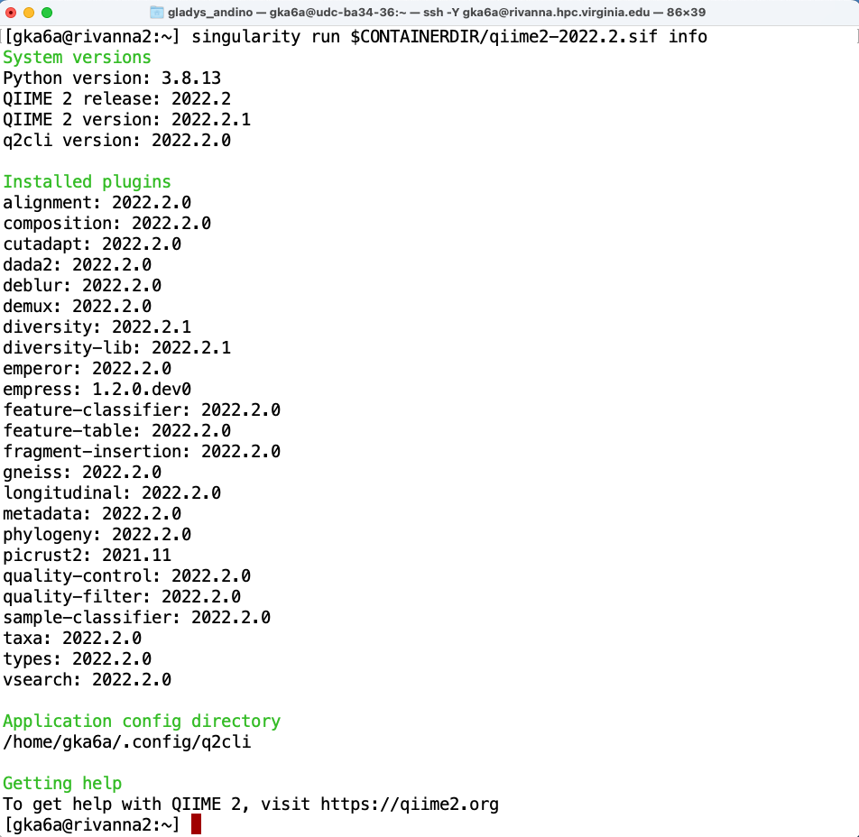
QIIME 2 Cli interface that helps you work on Rivanna.

Slide 6
Importing data
https://docs.qiime2.org/2022.8/tutorials/importing/ Data files: QIIME 2 artifacts
Data produced by QIIME 2 exist as QIIME 2 artifacts. A QIIME 2 artifact contains data and metadata. The metadata describes things about the data, such as its type, format, and how it was generated (provenance). A QIIME 2 artifact typically has the .qza file extension when stored in a file.
Since QIIME 2 works with artifacts instead of data files (e.g. FASTA files), you must create a QIIME 2 artifact by importing data. You can import data at any step in an analysis, though typically you will start by importing raw sequence data. QIIME 2 also has tools to export data from an artifact. See the importing guide for details.

Slide 7
QIIME 2 uses Artifacts and Visualizations
Where did my FASTA file go?
It’s inside a ZIP file
.qza and .qzv files are just zip files
We aren’t inventing new formats
A QIIME 2 result can be “used” on almost any computer
ZIP64 (OS X by default only knows ZIP32, but other OSes work well)
Use qiime tools extract if unzipping isn’t working.
Learn More: https://dev.qiime2.org/latest/storing-data/

Slide 8
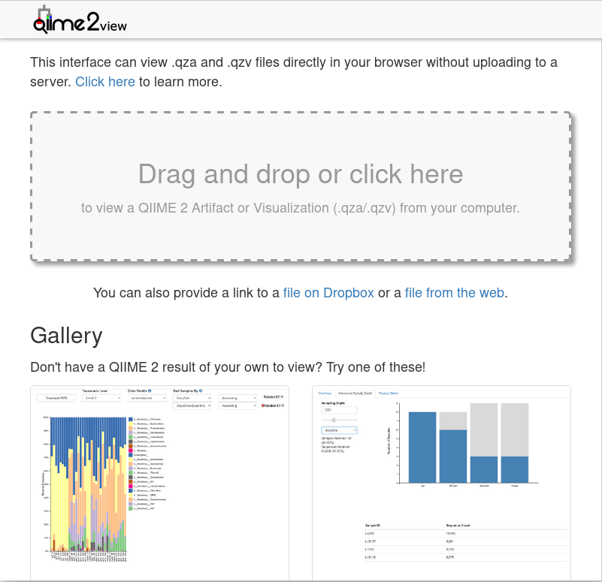
QIIME 2 View (https://view.qiime2.org):
a read-only web interface for viewing results without having QIIME 2 installed
Reads QIIME 2 outputs (QZAs and QZVs)
No installation required
Easily share links using Dropbox with collaborators
No uploading (your data stays on your computer)!

Slide 9
Hands-on
Copy the following files to your home directory
cp -rp /project/rivanna-training/singularity_qiime2 ./
Submit the job to run
sbatch q2-import.slurm

