Slide 1
Bioinformatics Data Visualization with Seurat
UVA Research Computing
Gladys Andino, Marcus Bobar, Caitlin Jagla

Slide 2
Agenda
Intro to scRNA-seq
Seurat capabilities
Data preprocessing
QC & selecting cells for further analysis
Linear dimensional reduction (PCA)
Clustering (UMAP)
Differential expression between clusters
Visualization

Slide 3
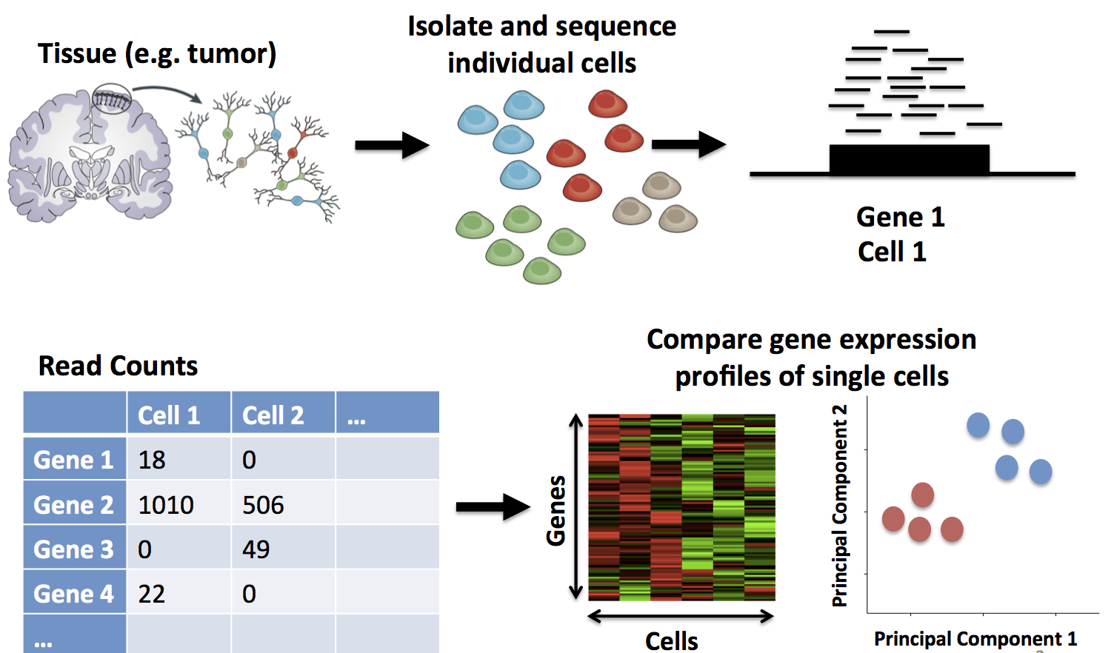
Single Cell RNA Sequencing (scRNA-seq)
https://learn.gencore.bio.nyu.edu/single-cell-rnaseq/

Slide 4
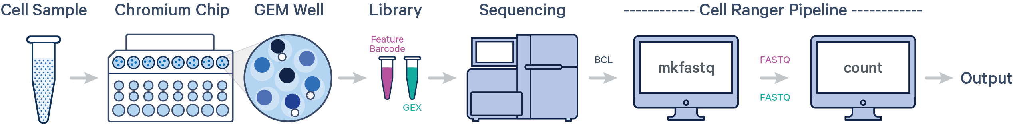
10X Genomics Cell Ranger Pipeline
10X Genomics is a company that pioneered scRNA-seq
Chromium platform for sequencing → Cell Ranger pipeline for data processing
Align reads → filter → count barcodes → count UMIs → generate matrices
https://support.10xgenomics.com/single-cell-gene-expression/software/pipelines/latest/what-is-cell-ranger
Notes:
We have Cell Ranger on Rivanna so you can use it to process your scRNAseq data but we aren't going into details about that today – focusing on visualization / downstream analysis

Slide 5
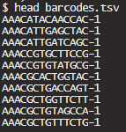
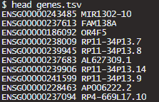
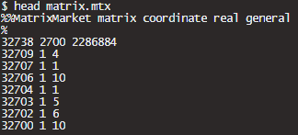
10X Genomics Cell Ranger Output
barcodes.tsv
1 barcode per cell
genes.tsv
Ensembl IDs & gene symbols
matrix.mtx
actual data
Notes:
We have Cell Ranger on Rivanna so you can use it to process your scRNAseq data but we aren't going into details about that today – focusing on visualization / downstream analysis

Slide 6
Intro to Seurat
An R package that takes the output from Cell Ranger and other pipelines for QC, analysis, and visualization of single cell data
Capabilities:
Basics: preprocessing, QC, dimensional reduction, clustering, differential expression
Multimodal analysis (e.g., paired scRNA-seq & scATAC-seq)
Spatial datasets (transcriptomic or multiplexed imaging-based)
Data integration (multiple sources of single cell data)
https://satijalab.org/seurat/

Slide 7
Intro to Seurat
A dataset of 2,700 Peripheral Blood Mononuclear Cells (PBMCs) made publicly available by 10X Genomics.
This tutorial implements the major components of a standard unsupervised clustering workflow including QC and data filtration, calculation of high-variance genes, dimensional reduction, graph-based clustering, and the identification of cluster markers.
Notes:
This tutorial implements the major components of a standard unsupervised clustering workflow including QC and data filtration, calculation of high-variance genes, dimensional reduction, graph-based clustering, and the identification of cluster markers.

Slide 8
UVA OpenOnDemand RSTUDIO SERVER
https://rivanna-portal.hpc.virginia.edu/

Slide 9
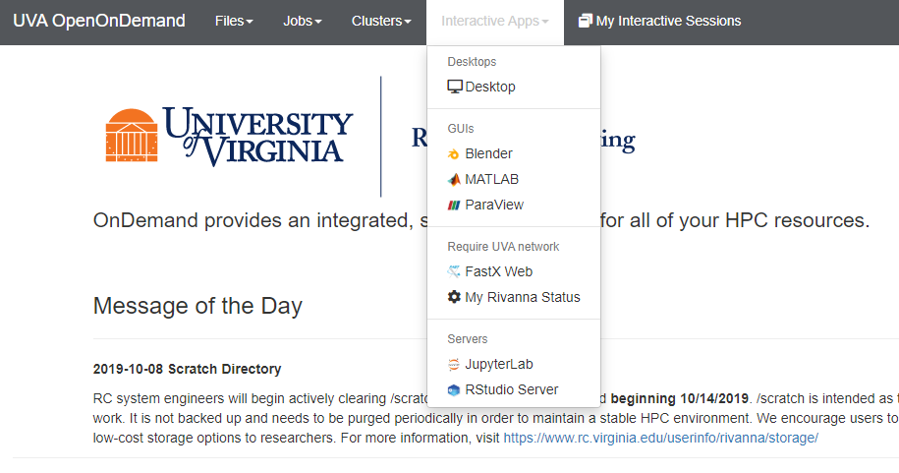
RStudio Server

Slide 10
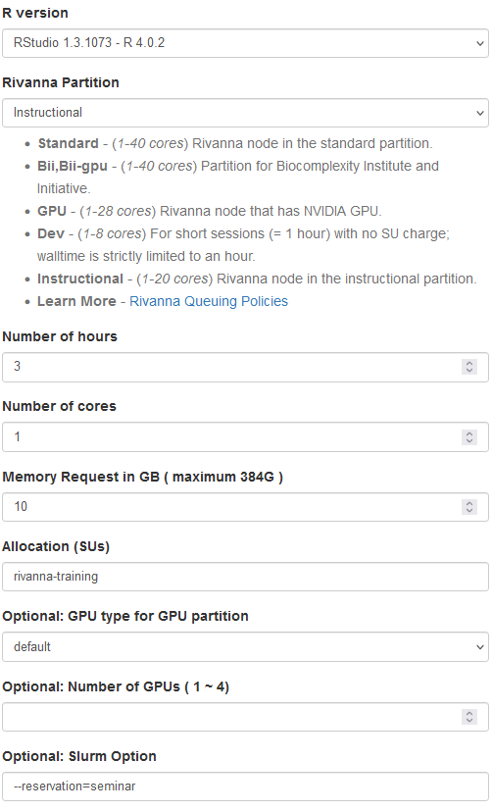
RStudio Web Form

Slide 11
RStudio Web Form
Let’s take a quick look at some of the fields.
Rversion: Rstudio 1.3.1073 – R 4.0.2
Rivanna Partition: Instructional
Number of hours: 3 hours
Number of cores: 1
Memory Request in GB ( maximum 384G ): 10G
Allocations (SUs): rivanna-training
Slurm option: --reservation=seminar
Launch

Slide 12
Interactive Workshop:
Setup/Loading Seurat
We already installed Seurat on Rivanna for your use at this workshop
# set working space
user <- Sys.getenv("USER")
setwd(paste0("/scratch/", user))
# copy data and libraries
system("cp -r /project/rivanna-training/bio-data-viz-seurat ./ ")
# Move to the data directory on your scratch space
setwd(paste0("/scratch/", user, "/bio-data-viz-seurat"))
dir()
# Set the libraries path
.libPaths("./R_libs")
.libPaths()
# load the libraries
library(Seurat)
library(dplyr)
library(patchwork)
Notes:
Gladys needs to update this one

Slide 13
Interactive Workshop:
Data Access & Loading
We already downloaded the data on Rivanna for your use at this workshop
# Load the PBMC dataset
pbmc.data <- Read10X(data.dir = "./data_seurat/filtered_gene_bc_matrices/hg19/")
nrow(pbmc.data)
print(pbmc.data[1,1:5])
# Initialize the Seurat object with the raw (non-normalized data).
pbmc <- CreateSeuratObject(counts = pbmc.data, project = "pbmc3k", min.cells = 3, min.features = 200)
pbmc

Slide 14
Interactive Workshop:
Preprocessing/QC
Main steps we will cover:
selection and filtration of cells based on QC metrics
data normalization and scaling
detection of highly variable features

Slide 15
Interactive Workshop:
Preprocessing/QC
A few QC metrics commonly used by the community include:
The number of unique genes detected in each cell
Low-quality cells or empty droplets will often have very few genes
Cell doublets or multiplets may exhibit an aberrantly high gene count
Similarly, the total number of molecules detected within a cell (correlates strongly with number of unique genes)
The percentage of reads that map to the mitochondrial genome
Low-quality / dying cells often exhibit extensive mitochondrial contamination

Slide 16
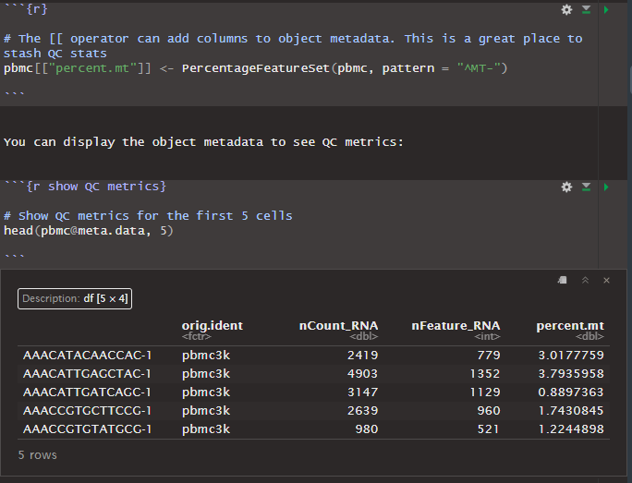
Interactive Workshop:
Preprocessing/QC
<-- Adding % mitochondrial column to metadata dataframe
<-- visualize metadata dataframe
Notes:
We're adding slots to the pbmc data object

Slide 17
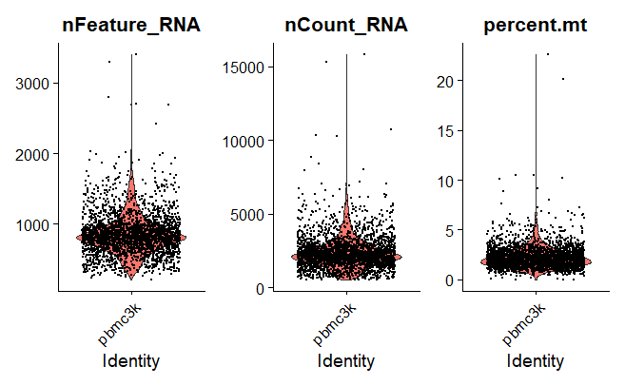
Interactive Workshop:
Preprocessing/QC
Violin plot: visualize distribution of numerical data & show summary statistics
VlnPlot(pbmc, features = c("nFeature_RNA", "nCount_RNA", "percent.mt"), ncol = 3)
Notes:
Features (genes) density
A violin plot is a hybrid of a box plot and a kernel density plot, which shows peaks in the data. It is used to visualize the distribution of numerical data. Unlike a box plot that can only show summary statistics, violin plots depict summary statistics and the density of each variable.

Slide 18
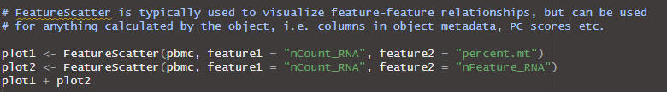
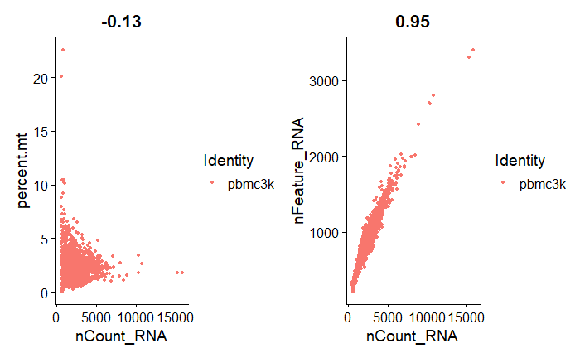
Interactive Workshop:
Preprocessing/QC
Notes:
nCount_RNA & nFeature_RNA are highly correlated (0.95) while percent mitochondrial & nCount are not correlated at all (-0.13)
What can we infer from this? How does it help QC?

Slide 19
Interactive Workshop:
Filter & Normalize
Visualized QC metrics --> use them to filter cells:
Remove cells with unique features (genes) over 2,500 or less than 200
Remove cells that have >5% mitochondrial counts
Note that subset() arguments define cells you want to keep (e.g., percent.mt < 5)
Normalize the data
Global-scaling normalization, “LogNormalize”:
normalize feature expression measurements for each cell by total expression → multiply by scale factor (10000) → log-transform
Stored in pbmc[[“RNA”]]@data
Notes:
QC metrics from previous slides are what we use to filter the cells
Why is it important to normalize?
Remove cells with unique features (genes) over 2,500 or less than 200

Slide 20
Interactive Workshop:
Identify Highly Variable Features
Identify subset of features that exhibit high cell-to-cell variation
i.e, they are highly expressed in some cells, and lowly expressed in others
focusing on these genes in downstream analysis helps to highlight biological signal in single-cell datasets
directly modeling the mean-variance relationship inherent in single-cell data
FindVariableFeatures() function
Default returns 2,000 features per dataset
Use in downstream analysis like PCA
Notes:
directly modeling the mean-variance relationship inherent in single-cell data --> genes with higher mean expression have higher variance across cells

Slide 21
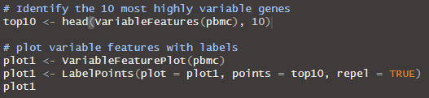
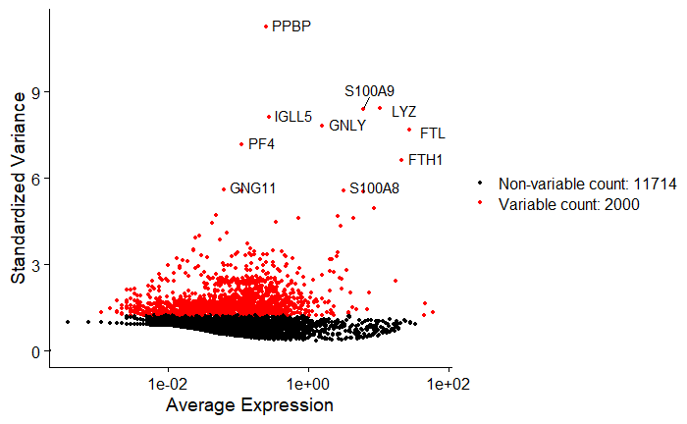
Interactive Workshop:
Identify Highly Variable Features
Notes:
Why are we measuring average expression vs standardized variance?
Normalized data = removed relationship between expression and variation
PPBP Gene - Pro-Platelet Basic Protein - only expressed in platelets

Slide 22

Interactive Workshop:
Scale the Data
linear transformation, standard pre-processing step prior to dimensional reduction (PCA, etc.)
ScaleData() function:
Shifts the expression of each gene, so that the mean expression across cells is 0
Scales the expression of each gene, so that the variance across cells is 1
This step gives equal weight in downstream analyses, so that highly-expressed genes do not dominate
The results of this are stored in pbmc[["RNA"]]@scale.data
Notes:
ScaleData now incorporates the functionality of the function formerly known as RegressOut (which regressed out given the effects of provided variables and then scaled the residuals). To make use of the regression functionality, simply pass the variables you want to remove to the vars.to.regress parameter.
Setting center to TRUE will center the expression for each feature by subtracting the average expression for that feature. Setting scale to TRUE will scale the expression level for each feature by dividing the centered feature expression levels by their standard deviations if center is TRUE and by their root mean square otherwise.

Slide 23
Interactive Workshop:
Linear Dimension Reduction (PCA)
PCA: Principal Components Analysis
Reduce number of variables in dataset while preserving as much info as possible
first principal component accounts for the largest possible variance in the data set
https://builtin.com/data-science/step-step-explanation-principal-component-analysis
Perform PCA on the scaled data
By default, only the previously determined variable features are used as input (top 2000)
can be defined using `features` argument if you wish to choose a different subset
Notes:
Reduce number of variables, where each gene is a variable
When you run a PCA you get the PCs and the loadings

Slide 24
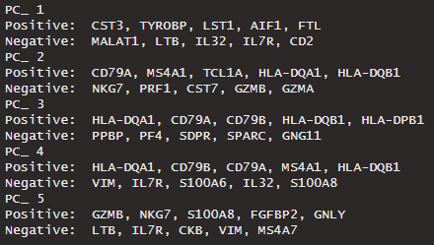
Interactive Workshop:
Visualize PCA Results
Notes:
Genes that contribute to each PC --> positive or negatively correlated
These values are called the loadings, and they describe how much each variable contributes to a particular principal component. Large loadings (positive or negative) indicate that a particular variable has a strong relationship to a particular principal component. The sign of a loading indicates whether a variable and a principal component are positively or negatively correlated.
http://strata.uga.edu/8370/lecturenotes/principalComponents.html

Slide 25
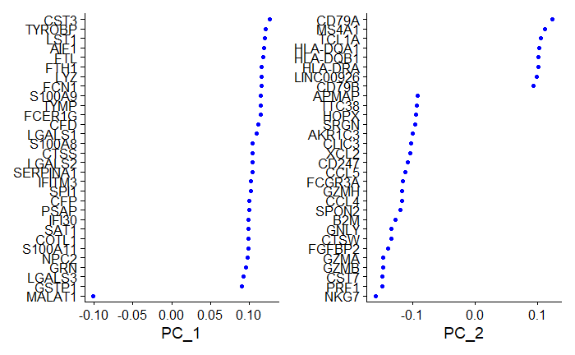
Interactive Workshop:
Visualize PCA Results
Notes:
These values are called the loadings, and they describe how much each variable contributes to a particular principal component. Large loadings (positive or negative) indicate that a particular variable has a strong relationship to a particular principal component. The sign of a loading indicates whether a variable and a principal component are positively or negatively correlated.
http://strata.uga.edu/8370/lecturenotes/principalComponents.html
Dims = 1:2 <- PC1 & PC2

Slide 26

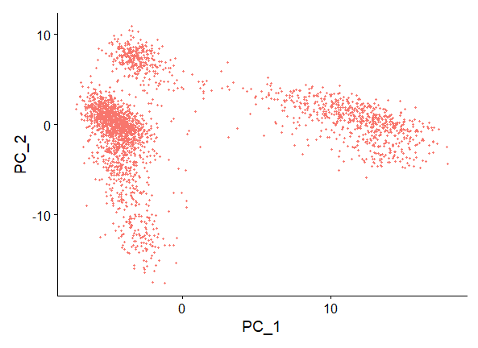
Interactive Workshop:
Visualize PCA Results
Notes:
Note that the cells form distinct clusters in PC1vPC2 dimensional space

Slide 27
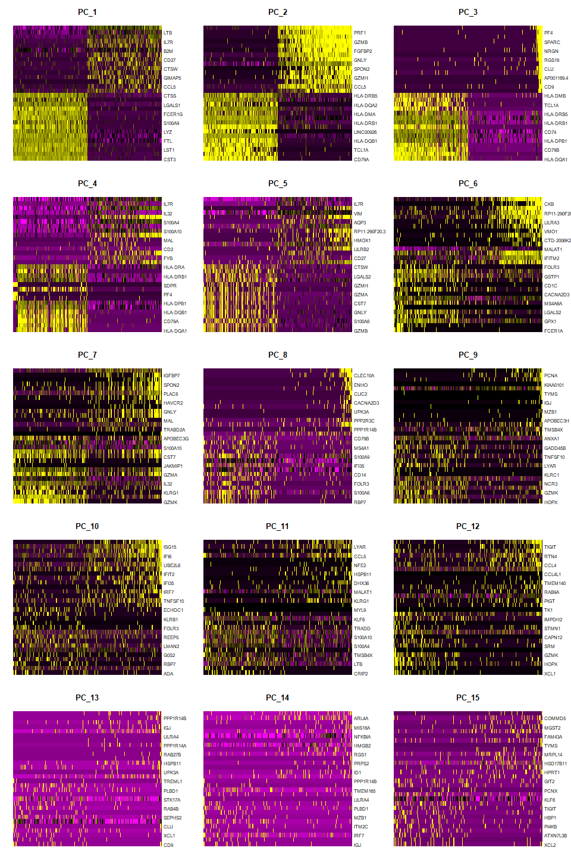
Interpretation: earlier PCs have greater variation (brighter yellow, darker purple) while later PCs are more homogenous, indicating that the later PCs do not explain much of the variance in the dataset
Interactive Workshop:
Visualize PCA Results
Notes:
Interpretation: earlier PCs have greater variation (brighter yellow, darker purple) while later PCs are more homogenous, shows that the later PCs do not explain much of the variance in the dataset
can see which genes are positive and negative loadings
Balanced = Plot an equal number of genes with both + and - scores.

Slide 28
Interactive Workshop:
Determine Dimensionality via PCA Results
How many components should we choose to include?
top principal components represent a robust compression of the dataset
JackStraw procedure-inspired resampling test
randomly permute a subset of the data (1% by default) and rerun PCA → construct ‘null distribution’ of feature scores → repeat this procedure
identify ‘significant’ PCs as those who have a strong enrichment of low p-value features
Computationally intense
Elbow plot
Ranking of PCs based on percentage of variance explained by each one
Much less computationally intense

Slide 29

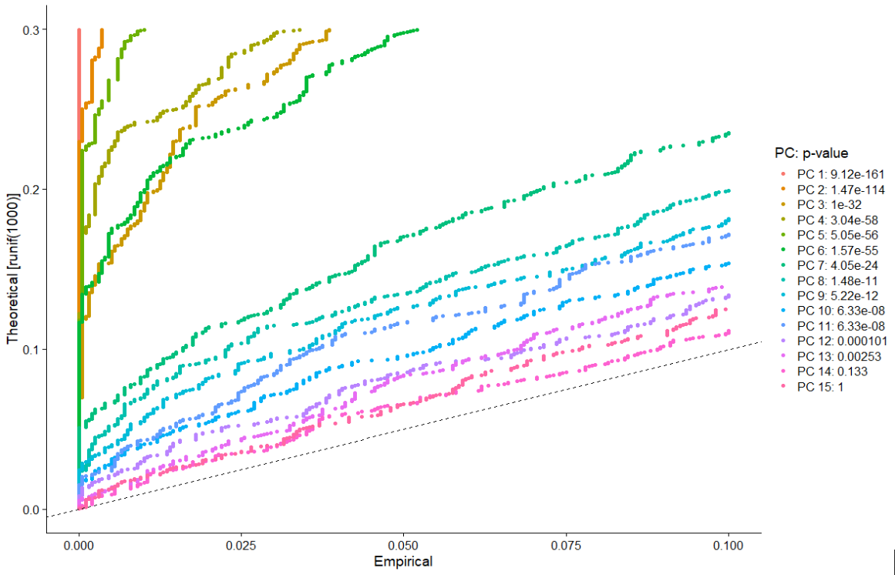
Interactive Workshop:
Determine Dimensionality via PCA Results
Compare distribution of p-values for each PC with a uniform distribution (dashed line)
‘Significant’ PCs show a strong enrichment of features with low p-values (curve above the dashed line)
drop-off in significance after the first 10-12 PCs
Notes:
JackStraw test: Randomly permutes a subset of data, and calculates projected PCA scores for these 'random' genes. Then compares the PCA scores for the 'random' genes with the observed PCA scores to determine statistical significance. End result is a p-value for each gene's association with each principal component.
Plot provides a visualization of the statistical test that calculates the significance of your principal components
Significant PCs should show a p-value distribution (black curve) that is strongly skewed to the left compared to the null distribution (dashed line) The p-value for each PC is based on a proportion test comparing the number of genes with a p-value below a particular threshold (score.thresh), compared with the proportion of genes expected under a uniform distribution of p-values
First 6 PC's are very highly significant ; next ones are less so but the blue/green lines are higher above the uniform distribution dashed line

Slide 30
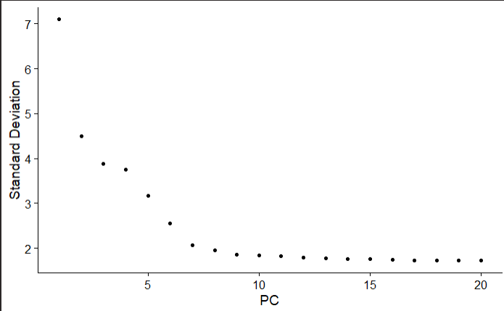
Interactive Workshop:
Determine Dimensionality via PCA Results
ranking of principle components based on the percentage of variance explained by each one
observe ‘elbow’ around PC9-10, suggesting that the majority of true signal is captured in the first 10 PCs
Notes:
'elbow' starts at ~PC 7, definitely flattens off by PC 10, so we will choose PC10 as our cutoff for significant PCs

Slide 31
Interactive Workshop:
Clustering
“distance” metric drives clustering analysis based on previously identified PCs
Embed cells in a graph structure (i.e., K-nearest neighbor (KNN)) → draw edges between cells with similar feature expression patterns → partition graph into highly interconnected ‘communities’ or ‘quasi-cliques’
FindNeighbors()
construct KNN graph based on Euclidean distance in PCA space
refine edge weights between any two cells based on shared overlap in local neighborhoods (Jaccard similarity)
input = previously defined dimensionality of dataset (first 10 PCs)
FindClusters()
Apply modularity optimization techniques (Louvain algorithm by default) to iteratively group cells together
‘resolution’ parameter = set granularity of downstream clustering (higher resolution = more clusters; 0.4-1.2 is optimal for datasets of ~3000 cells)
https://blog.bioturing.com/2022/02/15/the-essence-of-scrna-seq-clustering/
Notes:
clustering helps you to zoom in your scRNA-Seq data like a microscope and find interesting observations through noises
https://blog.bioturing.com/2022/02/15/the-essence-of-scrna-seq-clustering/

Slide 32

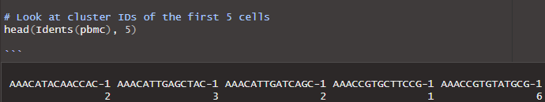
Interactive Workshop:
Clustering
Notes:
FindNeighbors() dims parameter = number of PCs you determined to be significant based on elbow plot and jackstraw plot

Slide 33
Interactive Workshop:
Non-Linear Dimensionality Reduction (UMAP)
Goal = learn the underlying manifold of the data in order to place similar cells together in low-dimensional space
tSNE and UMAP
https://blog.bioturing.com/2022/01/14/umap-vs-t-sne-single-cell-rna-seq-data-visualization/
Cells within the graph-based clusters determined previously should co-localize on these dimension reduction plots
Input the same PCs as used in the clustering analysis
Notes:
Seurat can do tSNE and UMAP but we will only show UMAP today
https://blog.bioturing.com/2022/01/14/umap-vs-t-sne-single-cell-rna-seq-data-visualization/

Slide 34
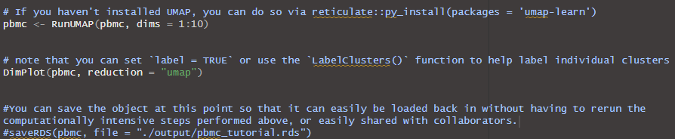
Interactive Workshop:
Non-Linear Dimensionality Reduction (UMAP)

Slide 35
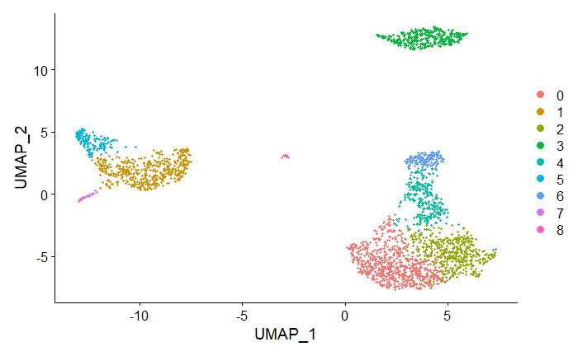
Interactive Workshop:
Non-Linear Dimensionality Reduction (UMAP)
Colored by clusters previously identified in KNN clustering, note colocalization of cells in each cluster
https://pair-code.github.io/understanding-umap/

Slide 36
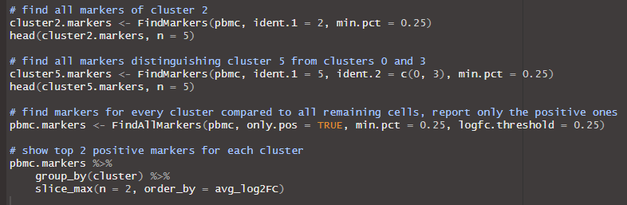
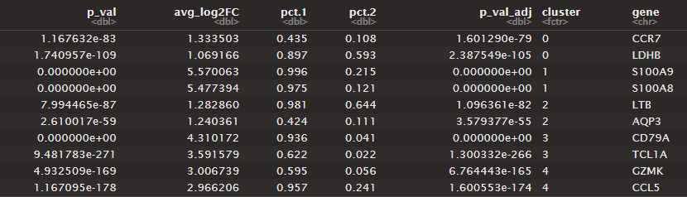
Interactive Workshop:
Differential Expression (Identify Biomarkers)
Notes:
Now that we have clustered the data, we want to identify biomarkers for each cluster
Table shows output from last 3 lines of code (find markers for every cluster compared to all remaining cells, report only the positive ones, show top 2 for each cluster)

Slide 37
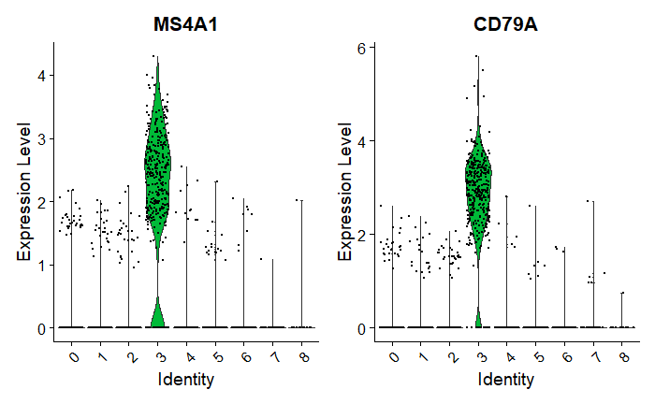
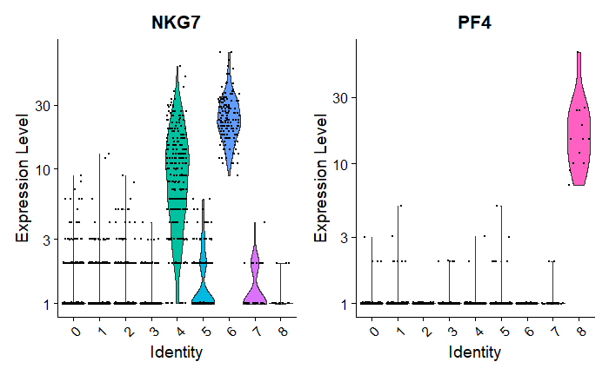
Interactive Workshop:
Visualize Expression Across Clusters
Notes:
Cluster 3 is heavily expressing MS4A1 & CD79A, cluster 8 heavily expressing PF4, NKG7 is expressed by clusters 4 & 6 mostly

Slide 38

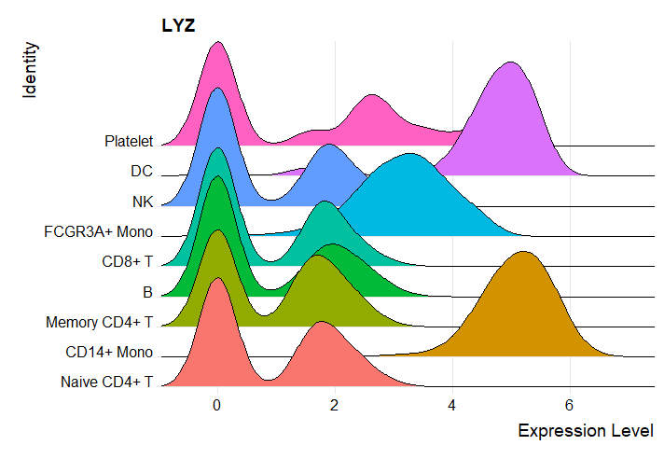
Interactive Workshop:
Visualize Expression Across Clusters
8
7
6
5
4
3
2
1
0

Slide 39
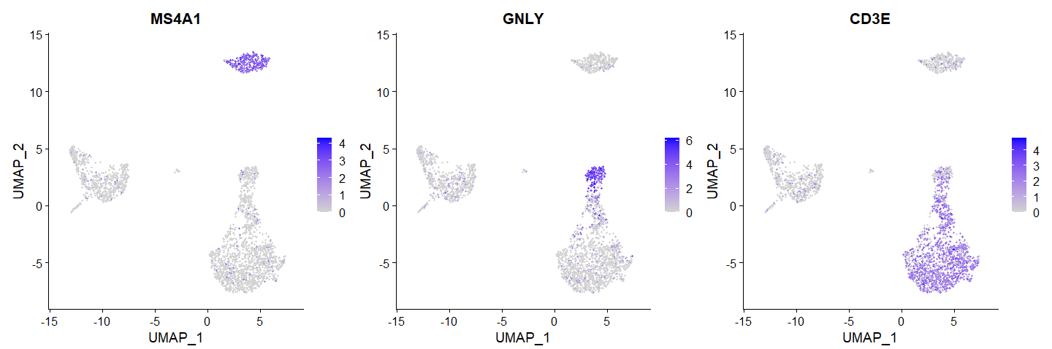
Interactive Workshop:
Visualize Expression Across Clusters
Notes:
Can overlay gene expression on the UMAP
Cropped image to only show first 3 plots so you can see them better

Slide 40
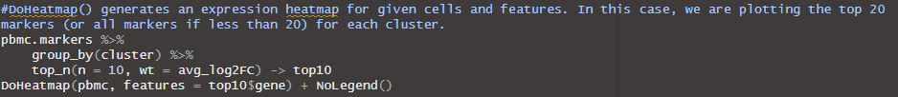
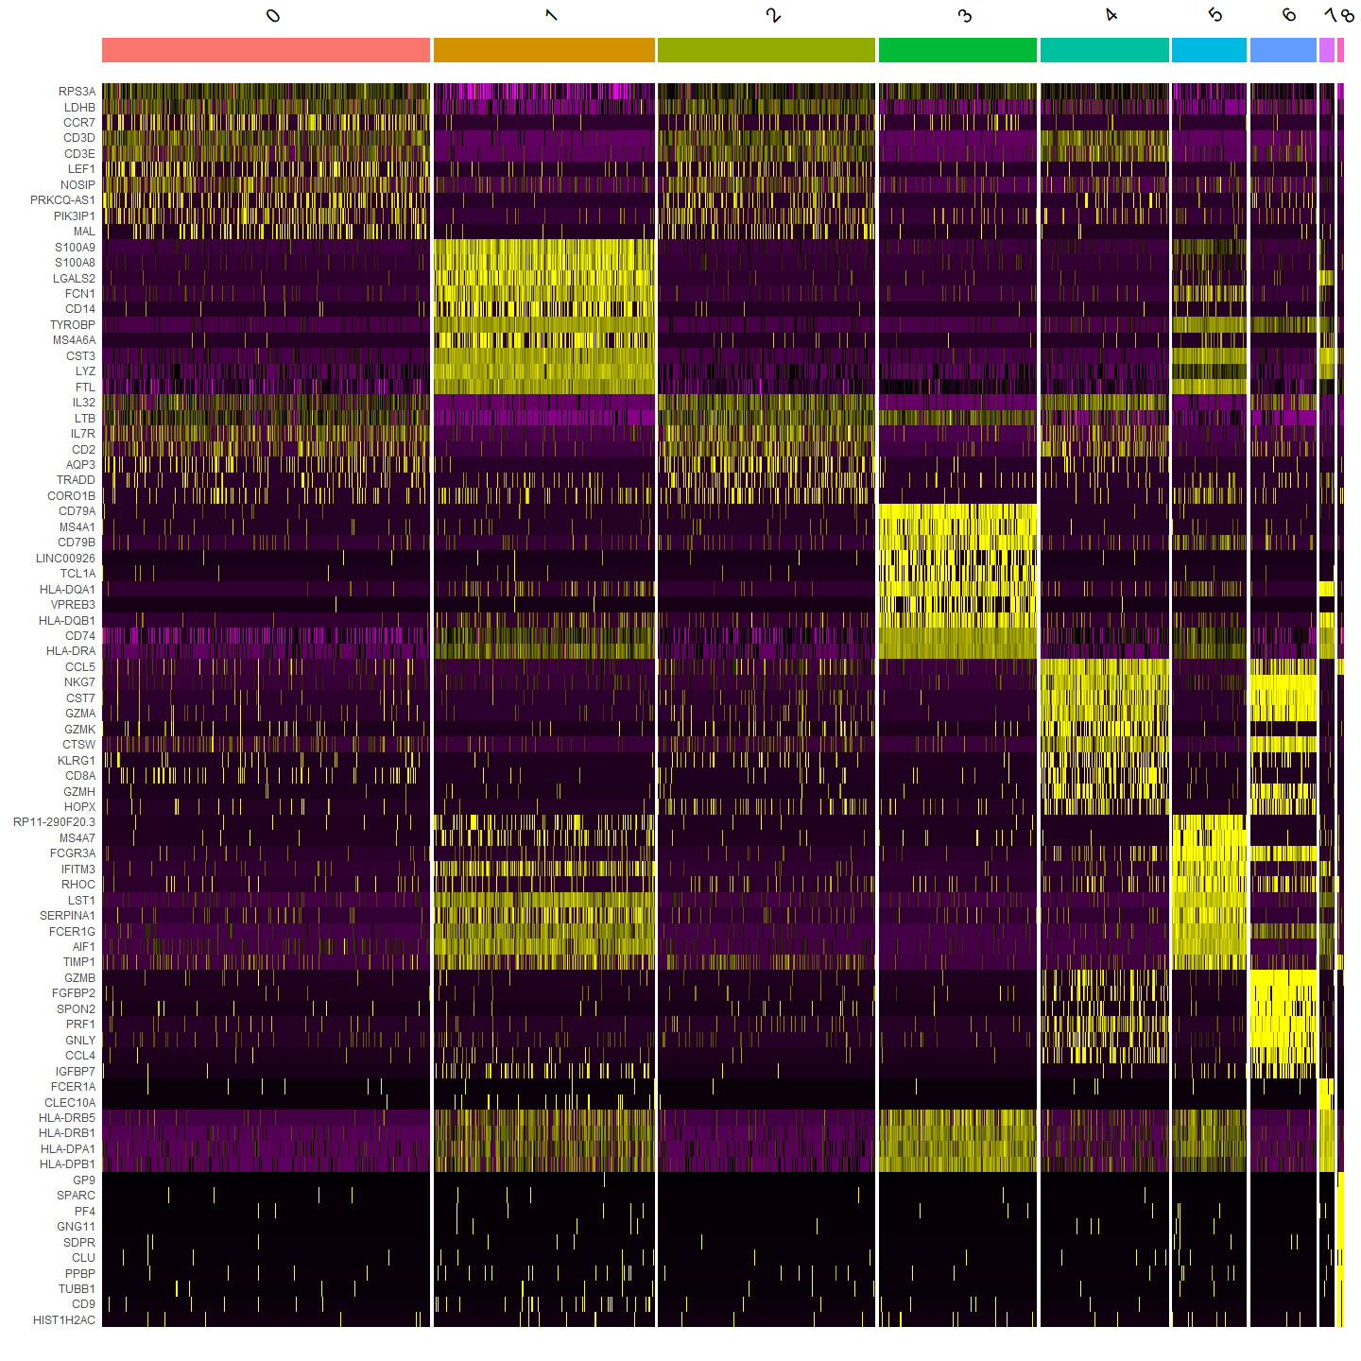
Interactive Workshop:
Visualize Expression Across Clusters
Notes:
Heatmap showing expression levels of the top 20 markers for each cluster

Slide 41
Interactive Workshop:
Known Biomarkers
Our dataset has known canonical biomarkers (PBMC = peripheral blood mononuclear cells)
Cluster ID | Markers | Cell Type
0 | IL7R, CCR7 | Naive CD4+ T
1 | CD14, LYZ | CD14+ Mono
2 | IL7R, S100A4 | Memory CD4+
3 | MS4A1 | B
4 | CD8A | CD8+ T
5 | FCGR3A, MS4A7 | FCGR3A+ Mono
6 | GNLY, NKG7 | NK
7 | FCER1A, CST3 | DC
8 | PPBP | Platelet
Notes:
We can use these canonical biomarkers to name our clusters based on cell type

Slide 42
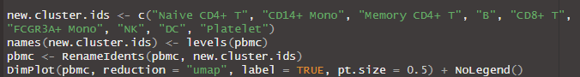
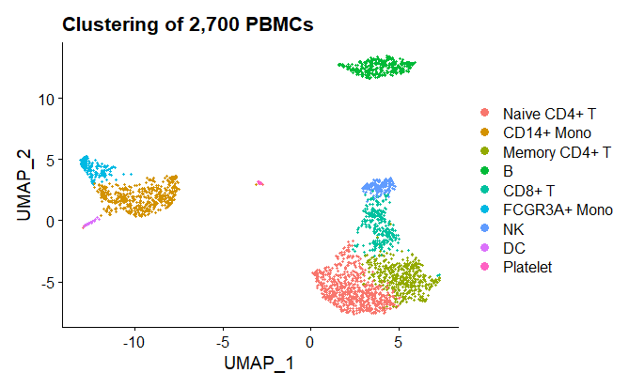
Interactive Workshop:
Modifying Plots
All Seurat plots are ggplot2-compatible, so you can add titles (as shown here), change themes, etc.

Slide 43
Recap
Data preprocessing
QC & selecting cells for further analysis
Linear dimensional reduction (PCA)
Clustering
Non-linear dimensional reduction (UMAP)
Differential expression between clusters
Visualization

Slide 44

Loading Seurat on your own
To install into your own home directory through Open On Demand RStudio Server (do this later to work on your own):
install.packages("Seurat")
install.packages("Matrix")
BiocManager::install("limma")
reticulate::py_install(packages = 'umap-learn’)
https://satijalab.org/seurat/articles/install.html
R version 4.0 or greater is required
Notes:
Gladys needs to update this one

