Slide 1


Bank Sales Analysis Case Study

Slide 2



Introduction
This case study analyses daily sales data for a single product at a large retail store. The goal is to derive insights into pricing, profitability, and promotional impacts using Databricks, SQL, and Excel.

Slide 3

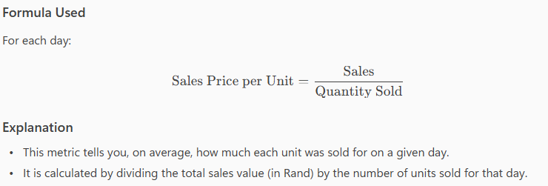
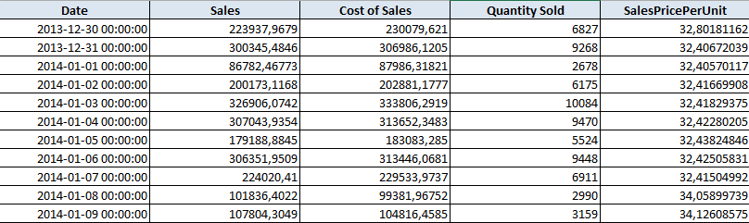
Question 1: Daily Sales Price Per Unit
*A sample from the cleaned data in the Excel document

Slide 4
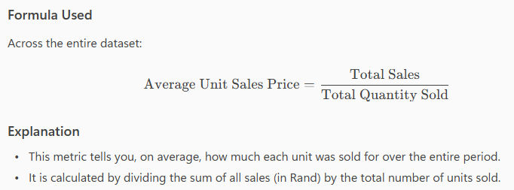
Q2: Average Unit Sales Price
•The average unit sales price over the period is R37.07.

Slide 5
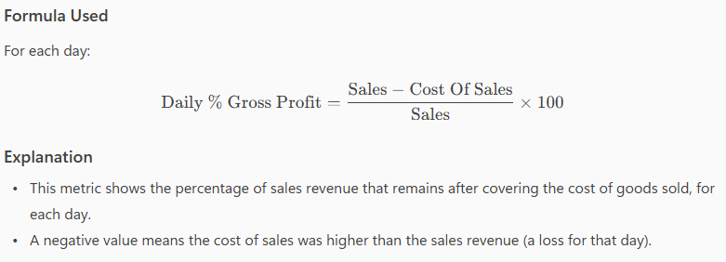
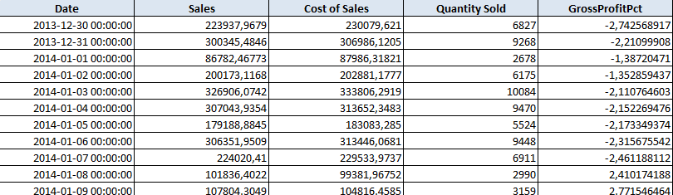
Q3: Daily % Gross Profit
*A sample from the cleaned data in the Excel document

Slide 6
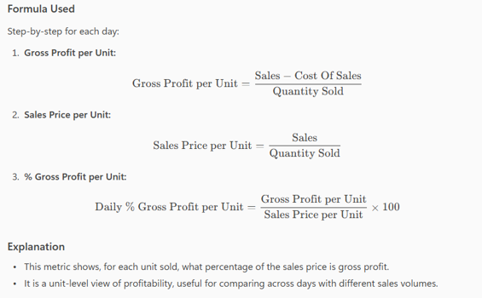
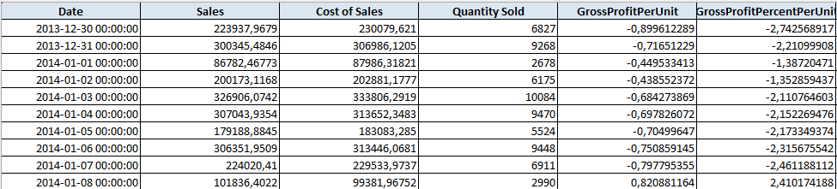
Q4: Daily % Gross Profit per Unit
*A sample from the cleaned data in the Excel document

Slide 7
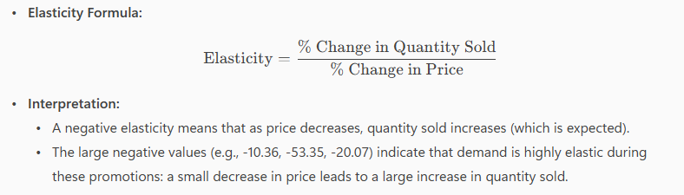

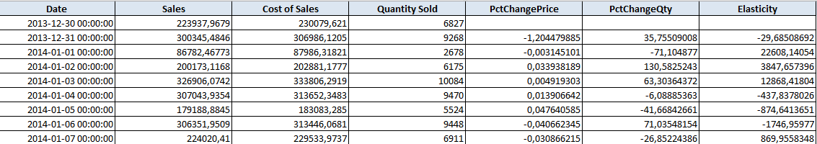
Q5: Promotion Periods & Elasticity
*A sample from the cleaned data in the Excel document

Slide 8
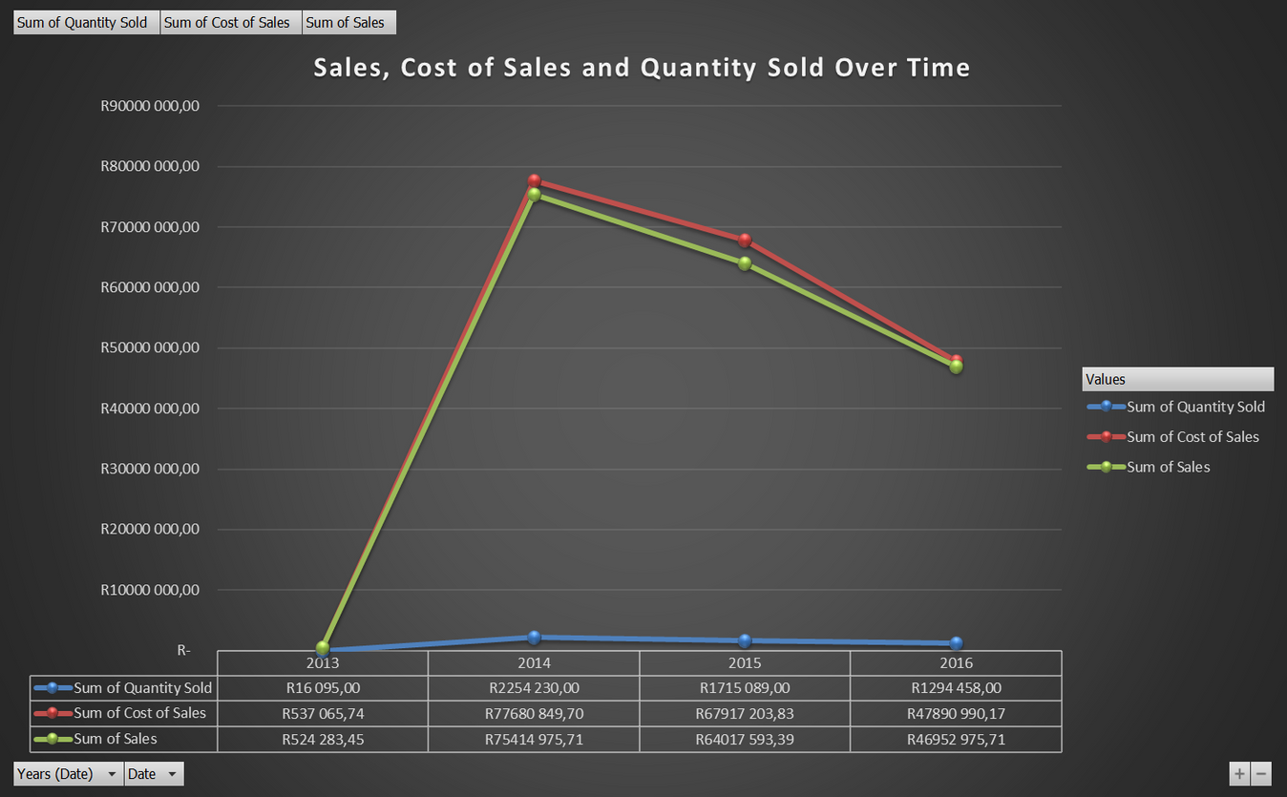
Q6: Key Insights
Sales Trends: Sales show clear peaks and troughs, indicating possible seasonality.
Profitability: Gross profit percentage fluctuates, with some periods of negative gross profit (losses), often aligning with promotions or price drops.
Promotions: During promotions, even small price reductions resulted in significant increases in quantity sold, confirming high price sensitivity.
Variability: Both sales and profitability are highly variable, suggesting the influence of external factors such as seasonality, promotions, or market conditions.
Actionable Finding: Monitoring and optimizing promotional pricing can significantly boost sales volume, but may impact profitability if not managed carefully.

