Slide 1
Why are passwords meant to disappear ?
And how can we replace them?
Assis Hugo
Notes:
Title screen

Slide 2
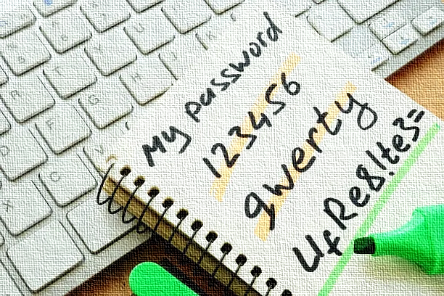
What is a password ?
Notes:
Display of what a password can be

Slide 3
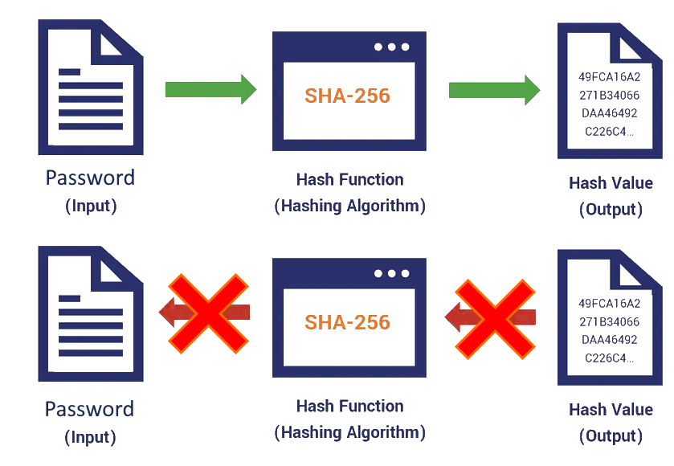
How hashing work?
It’s difficult, not impossible, to find the input based on the output but it’s very difficult, and if you already know the association then hashing does nothing.
Notes:
Explanation about how a hashing function works

Slide 4
Example of hashing:
Notes:
Example of hashing

Slide 5
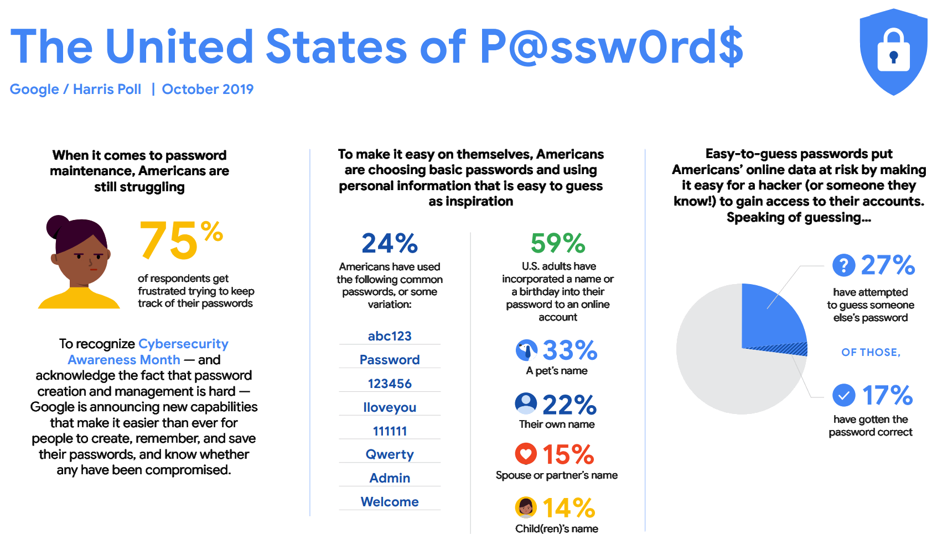
Notes:
Stats about passwords

Slide 6
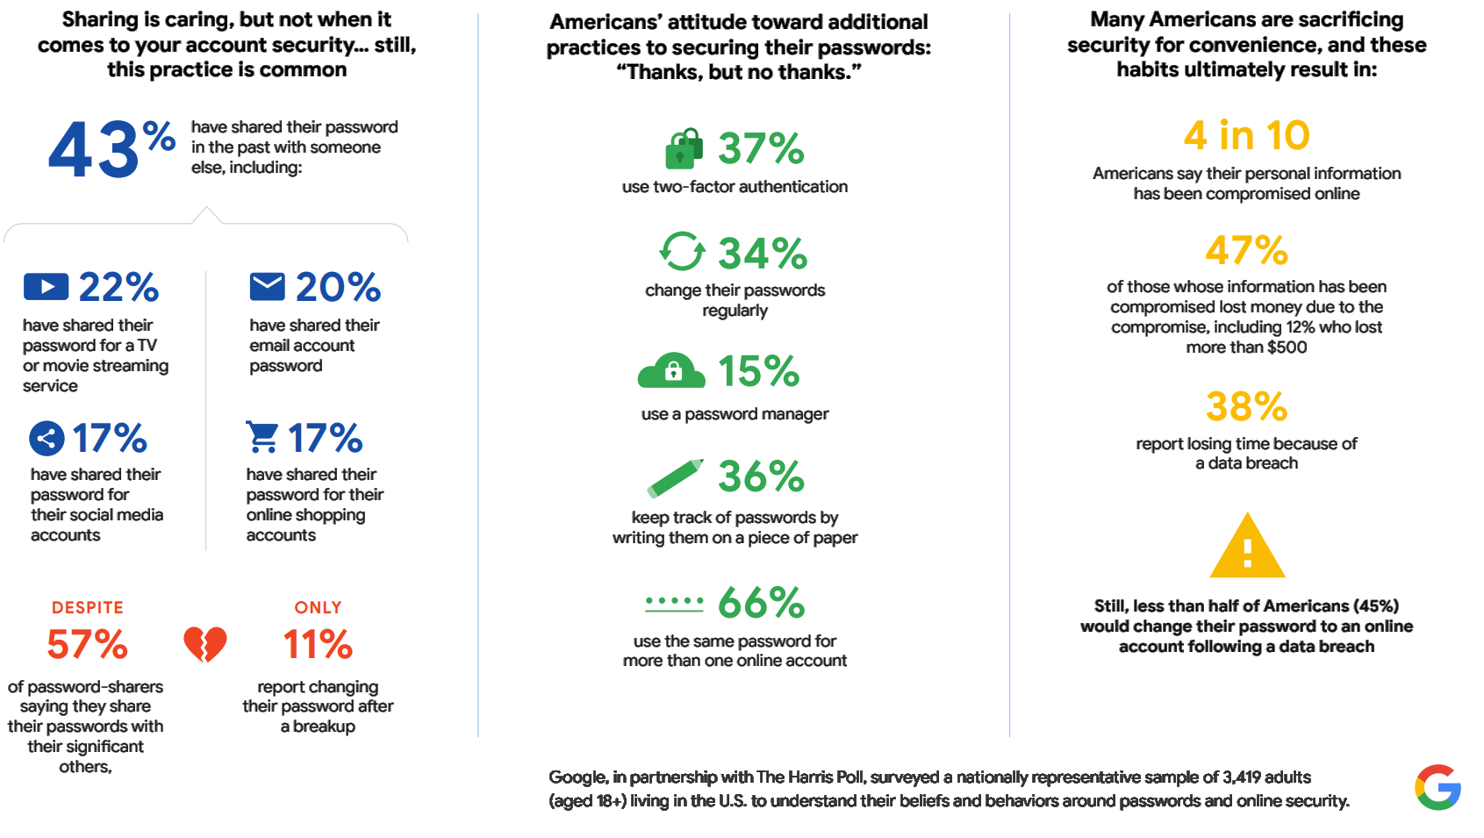
Notes:
More stats about passwords

Slide 7
Conclusion: (/!\ This is a representation and is not accurate)
Notes:
Relationship between security and convenience

Slide 8
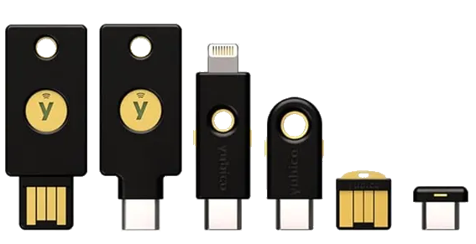



What are the solutions?
Notes:
Possible alternatives to passwords

Slide 9
Links
Website with stats about passwords
https://www.comparitech.com/blog/information-security/password-statistics/
2019 Google study
https://storage.googleapis.com/gweb-uniblog-publish-prod/documents/PasswordCheckup-HarrisPoll-InfographicFINAL.pdf
Hash function
https://emn178.github.io/online-tools/sha256.html
Notes:
Links

Slide 10




Tips and Services
1 - Use a password manager such as these:
2 - Do not share or make a copy of your passwords
3 - Use Passkeys or Two Factor Authentification whenever possible
4 - Make strong passwords and do not re-use them
Notes:
Tips and services

