Slide 1
Why are passwords meant to disappear ?
And how can we replace them?
Notes:
Title screen

Slide 2
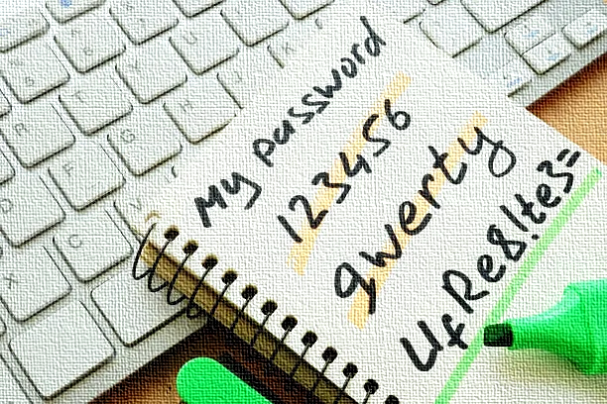
What is a password ?

Slide 3
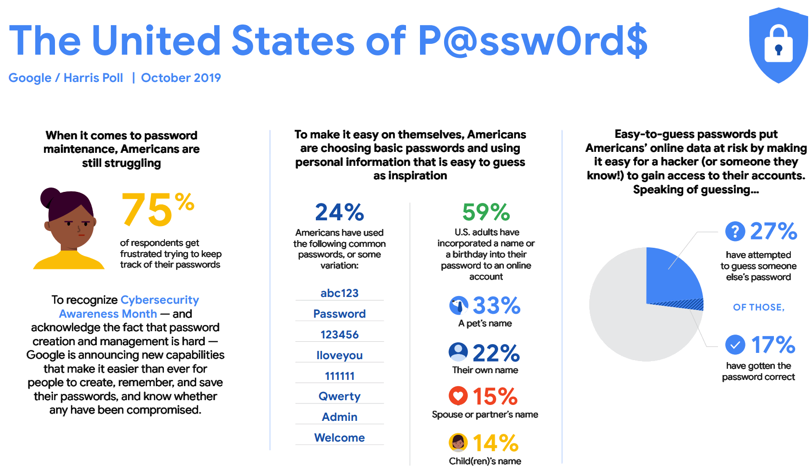
Notes:
Stats about passwords

Slide 4
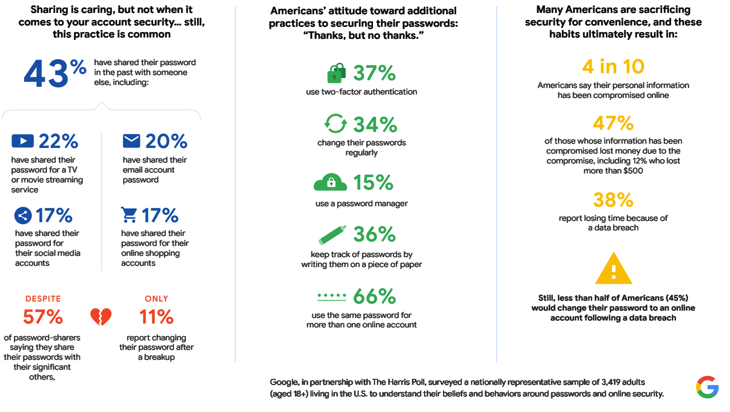
Notes:
More stats about passwords

Slide 5
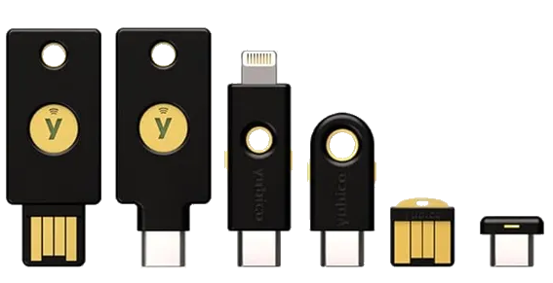



What are the solutions?

Slide 6
Links
Website with stats about passwords
https://www.comparitech.com/blog/information-security/password-statistics/
2019 Google study
https://storage.googleapis.com/gweb-uniblog-publish-prod/documents/PasswordCheckup-HarrisPoll-InfographicFINAL.pdf

Slide 7



Tips and Services
1 - Use a password manager such as these:
2 - Do not share or make a copy of your passwords
3 - Use Passkeys or Two Factor Authentification whenever possible
4 - Make strong passwords and do not re-use them

