Slide 2
Cloud Computing
and
Internet of Things
C3 - JavaScript Overview
Ioan Bistran
15 March 2017

Slide 3
Way JavaScript?
JavaScript is used in millions of Web pages to improve the design, validate forms, detect browsers, create cookies, and much more.
JavaScript is the most popular scripting language on the internet, and works in all major browsers, such as Internet Explorer, Mozilla, Firefox, Netscape, Opera, ...
Everyone can use JavaScript without purchasing a license

Slide 4
What is JavaScript?
JavaScript is a scripting language
(a scripting language is a lightweight programming language)
A JavaScript consists of lines of executable computer code
A JavaScript is usually embedded directly into HTML pages
JavaScript is an interpreted language
(scripts execute without preliminary compilation)
JavaScript was designed to add interactivity to HTML pages
JavaScript runs in client software

Slide 5
JavaScript short History
JavaScript created by Brendan Eich (Netscape)
- was called Mocha (April – Sept. 1995)
- renamed LiveScript (September 1995)
- JavaScript
https://en.wikipedia.org/wiki/Brendan_Eich
JScript created by Microsoft
IE and Netscape renderings are slightly different
Standardized by European Computer Manufacturers Association (ECMA) in 1997
ECMA-262 is the official name of the standard
ECMAScript is the official name of the language
http://www.ecma-international.org/publications/standards/Ecma-262.htm

Slide 6
JavaScript is not Java
Java and JavaScript are two completely different languages in both concept and design!
Java (developed by Sun Microsystems) is a powerful and much more complex programming language - in the same category as C and C++.

Slide 7
Learning JavaScript
Special syntax to learn
Learn the basics and then use other people's work (lots of free sites)
Write it in a text editor, view results in browser
You need to revise your HTML
You need patience and good eyesight!

Slide 8
Useful Resources and Interesting Examples
JavaScript Tutorials
http://www.w3schools.com/
Some examples from W3Schools
JavaScript Examples
JavaScript Object Examples
JavaScript HTML DOM Examples
JavaScript DHTML GUI Components
http://www.java2s.com/Code/JavaScript/GUI-Components/CatalogGUI-Components.htm
EditGrid
http://www.editgrid.com/

Slide 9
Content
JavaScript Syntax
JavaScript – Data types
JavaScript – Array
JavaScript – Objects
JavaScript – Functions
JavaScript – Scope
JavaScript – Debugging
JavaScript – Best Practices
JavaScript – Style Guide

Slide 10
1. JavaScript Syntax - Statements
JavaScript statements are composed of
Values,
Operators,
Expressions,
Keywords,
Comments.

Slide 11
1. JavaScript Syntax - Values
JavaScript Values:
fixed values - called literals
variable values - called variables
JavaScript Literals:
Numbers - written with or without decimals: 5.3 ; -120
Strings are text - written within double or single quotes: ‘testJS’ ; “testJS”
JavaScript Variables:
JavaScript uses the var keyword to declare variables.
An equal sign is used to assign values to variables.
var x; x = 6;

Slide 12
1. JavaScript Syntax - Operators
JavaScript arithmetic operators
The + operator can also be used to add (concatenate) strings.
Adding two numbers, will return the sum, but adding a number and a string will return a string:
x = 5 + 5; returns 10 y = "5" + 5; 55 z = "Hello" + 5; Hello5
+ | Addition
- | Subtraction
* | Multiplication
/ | Division
% | Modulus
++ | Increment
-- | Decrement

Slide 13
1. JavaScript Syntax - Operators
JavaScript assignment operators
Operator | Example | Same As
= | x = y | x = y
+= | x += y | x = x + y
-= | x -= y | x = x – y
*= | x *= y | x = x * y
/= | x /= y | x = x / y
%= | x %= y | x = x % y

Slide 14
1. JavaScript Syntax - Operators
JavaScript comparison operators
Operator | Description
== | Equal to
=== | Equal value and equal type
!= | Not equal
!== | Not equal value or not equal type
> | Greater than
< | Less than
>= | Greater than or equal to
<= | Less than or equal to
? | Ternary operator
Syntax | Example
variableName = (condition) ? value1:value2 | voteAble = (age < 18) ? "Too young":"Old enough";

Slide 15
1. JavaScript Syntax - Operators
JavaScript logical operators
Operator | Description | Example, given x = 6 and y = 3
&& | Logical AND | (x < 10 && y > 1) is true
|| | Logical OR | (x === 5 || y === 5) is false
! | Logical NOT | !(x === y) is true

Slide 16
1. JavaScript Syntax - Operators
JavaScript typeof & instanceof operators
Operator | Description
typeof | Returns the type of variable (string, number, boolean, null, undefined)
instanceof | Returns true if an object is an instance of an object type
typeof "John" // Returns string typeof 3.14 // Returns number typeof NaN // Returns number typeof false // Returns boolean typeof [1, 2, 3, 4] // Returns object typeof {name:'John', age:34} // Returns object typeof new Date() // Returns object typeof function () {} // Returns function typeof myCar // Returns undefined (if myCar is not declared) typeof null // Returns object
var c = new Customer();
c instanceof Customer; //Returns true as c is just a customer
c instanceof String; //Returns false as c is not a string

Slide 17
1. JavaScript Syntax - Operators
JavaScript delete operator
The delete operator deletes a property from an object
Example
var person = {firstName:"John", lastName:"Doe", age:50, eyeColor:"blue"}; delete person.age; // or delete person["age"];
The delete operator deletes both the value of the property and the property itself.
After deletion, the property cannot be used before it is added back again.
The delete operator is designed to be used on object properties.
It has no effect on variables or functions.

Slide 18
1. JavaScript Syntax - Operators
JavaScript in operator
The in operator returns true if the specified property is in the specified object, otherwise false
// Arrays var cars = ["Saab", "Volvo", "BMW"]; "Saab" in cars // Returns false (specify the index number instead of value) 0 in cars // Returns true 1 in cars // Returns true 4 in cars // Returns false (does not exist) "length" in cars // Returns true (length is an Array property) // Objects var person = {firstName:"John", lastName:"Doe", age:50}; "firstName" in person // Returns true "age" in person // Returns true // Predefined objects "PI" in Math // Returns true "NaN" in Number // Returns true "length" in String // Returns true

Slide 19
1. JavaScript Syntax - Operators
JavaScript void operator
The void operator evaluates an expression and returns undefined.
This operator is often used to obtain the undefined primitive value, using "void(0)" (useful when evaluating an expression without using the return value).
Example
<a href="javascript:void(0);"> Useless link </a> <a href="javascript:void(document.body.style.backgroundColor='red');"> Click me to change the background color of body to red </a>

Slide 20
1. JavaScript Syntax - Expressions
An expression is a combination of values, variables, and operators, which computes to a value.
The computation is called an evaluation.
5 * 10 evaluates to 50:
Expressions can also contain variable values:
x * 10
The values can be of various types, such as numbers and strings.
For example, "John" + " " + "Doe", evaluates to "John Doe":
Operators and Operands
The numbers (in an arithmetic operation) are called operands.
The operation (to be performed between the two operands) is defined by an operator.
operand | operator | operand
100 | + | 50

Slide 21
1. JavaScript Syntax - Keywords, Statements
Statement | Description
break | Exits a switch or a loop
continue | Breaks one iteration (in the loop) if a specified condition occurs, and continues with the next iteration in the loop
debugger | Stops the execution of JavaScript, and calls (if available) the debugging function
do ... while | Executes a block of statements and repeats the block while a condition is true
for | Marks a block of statements to be executed as long as a condition is true
for ... in | Marks a block of statements to be executed for each element of an object (or array)
function | Declares a function
if ... else ... else if | Marks a block of statements to be executed depending on a condition
return | Stops the execution of a function and returns a value from that function
switch | Marks a block of statements to be executed depending on different cases
throw | Throws (generates) an error
try ... catch ... finally | Marks the block of statements to be executed when an error occurs in a try block, and implements error handling
var | Declares a variable
while | Marks a block of statements to be executed while a condition is true

Slide 22
1. JavaScript Syntax - Comments
Code after double slashes // or between /* and */ is treated as a comment.
Comments are ignored, and will not be executed.
Single line comments start with //.
var x = 5; // will be executed // var x = 6; will NOT be executed
Multi-line comments start with /* and end with */.
/* document.getElementById("myH").innerHTML = "My First Page"; document.getElementById("myP").innerHTML = "My first paragraph."; */

Slide 23
1. JavaScript Syntax - Identifiers
Identifiers are names.
In JavaScript, identifiers are used to name variables (and keywords, and functions, and labels).
In JavaScript, the first character must be a letter, an underscore (_), or a dollar sign ($).
Subsequent characters may be letters, digits, underscores, or dollar signs.
All JavaScript identifiers are case sensitive.
The variables lastName and lastname, are two different variables.
var lastname, lastName; lastName = “Popescu"; lastname = “Georgescu";
JavaScript does not interpret VAR or Var as the keyword var.

Slide 24
1. JavaScript Syntax - Camel Case
Hyphens:
first-name, last-name, master-card, inter-city.
Hyphens are not allowed in JavaScript. It is reserved for subtractions.
Underscore:
first_name, last_name, master_card, inter_city.
Upper Camel Case (Pascal Case):
FirstName, LastName, MasterCard, InterCity.
Lower Camel Case:
firstName, lastName, masterCard, interCity.

Slide 25
2. JavaScript - Data types
Numbers
var length = 16;
Strings
var lastName = "Johnson";
Booleans
true, false
Array
var colors = [“red", “blue", “green", “purple"]
Array indexes are zero-based, which means the first item is [0], second is [1], and so on.
Objects
var person = {firstName:"John", lastName:"Doe", age:50, eyeColor:"blue"};
the object person has 4 properties: firstName, lastName, age, and eyeColor.
JavaScript has dynamic types, the same variable can be used to hold different data types:
var x; // Now x is undefined var x = 5; // Now x is a Number var x = "John"; // Now x is a String

Slide 26
2. JavaScript - Data types
Undefined
In JavaScript, a variable without a value, has the value undefined.
The typeof is also undefined.
Example
var person; // Value is undefined, type is undefined
Any variable can be emptied, by setting the value to undefined.
The type will also be undefined.
Null
In JavaScript null is "nothing". It is supposed to be something that doesn't exist.
In JavaScript, the data type of null is an object.
You can empty an object by setting it to null:
Example
var person = null; // Value is null, but type is still an object
You can also empty an object by setting it to undefined:
var person = undefined; // Value is undefined, type is undefined
Empty Values
An empty value has nothing to do with undefined.
An empty string variable has both a value and a type.
Example
var car = ""; // The value is "", the typeof is "string"
Difference Between Undefined and Null
typeof undefined // undefined typeof null // object null === undefined // false null == undefined // true

Slide 27
3. JavaScript - Array
Array Properties
Property | Description
constructor | Returns the function that created the Array object's prototype
length | Sets or returns the number of elements in an array
prototype | Allows you to add properties and methods to an Array object
Array Methods
Method | Description
concat() | Joins two or more arrays, and returns a copy of the joined arrays
copyWithin() | Copies array elements within the array, to and from specified positions
every() | Checks if every element in an array pass a test
fill() | Fill the elements in an array with a static value
filter() | Creates a new array with every element in an array that pass a test
find() | Returns the value of the first element in an array that pass a test
findIndex() | Returns the index of the first element in an array that pass a test
forEach() | Calls a function for each array element

Slide 28
3. JavaScript - Array
Array Methods
Method | Description
indexOf() | Search the array for an element and returns its position
isArray() | Checks whether an object is an array
join() | Joins all elements of an array into a string
lastIndexOf() | Search the array for an element, starting at the end, and returns its position
map() | Creates a new array with the result of calling a function for each array element
pop() | Removes the last element of an array, and returns that element
push() | Adds new elements to the end of an array, and returns the new length
reduce() | Reduce the values of an array to a single value (going left-to-right)
reduceRight() | Reduce the values of an array to a single value (going right-to-left)
reverse() | Reverses the order of the elements in an array
shift() | Removes the first element of an array, and returns that element
slice() | Selects a part of an array, and returns the new array
some() | Checks if any of the elements in an array pass a test
sort() | Sorts the elements of an array
splice() | Adds/Removes elements from an array
toString() | Converts an array to a string, and returns the result
unshift() | Adds new elements to the beginning of an array, and returns the new length
valueOf() | Returns the primitive value of an array

Slide 29
3. JavaScript - Array
Array map() method
The map() method creates a new array with the results of calling a provided function on every element in this array.
var numbers = [1, 4, 9, 16, 25]
for(var i = 0 in numbers){ // for(var i = 0; i < numbers.length; i++)
var rad = Math.sqrt(numbers[i]);
document.write(rad + ', ');
}
var x = numbers.map(Math.sqrt);
document.write(x);
map calls a provided callback function once for each element in an array, in order, and constructs a new array from the results. callback is invoked only for indexes of the array which have assigned values, including undefined.

Slide 30
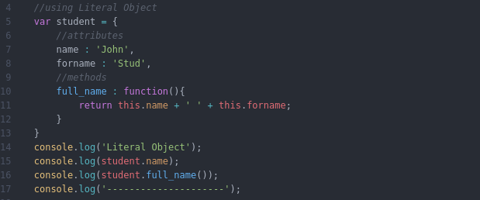
4. JavaScript - Objects
There are three methods to define an object in JavaScript:
Object Literal,
JavaScript Key Word new,
using a JavaScript constructor
Object Literal definition

Slide 31
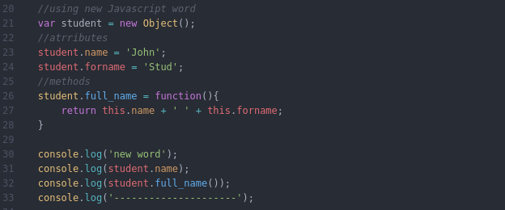
4. JavaScript - Objects
JavaScript Key Word new

Slide 32
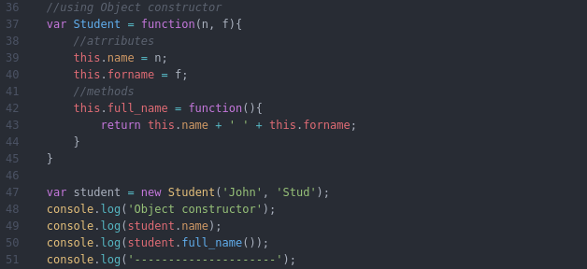
4. JavaScript - Objects
JavaScript constructor

Slide 33
4. JavaScript - Objects
Accessing Object Properties
You can access object properties in two ways:
objectName.propertyName
or
objectName["propertyName"]
Example
student.name;
or
student[“name"];
Accessing Object Methods
You access an object method with the following syntax:
objectName.methodName()
Example
studentName = student.full_name();
If you access the full_name method, without (), it will return the function definition.

Slide 34
5. JavaScript - Functions
Why Functions?
You can reuse code: define the code once, and use it many times.
You can use the same code many times with different arguments, to produce different results.
Example:
(https://www.w3schools.com/js/js_functions.asp)
Convert Fahrenheit to Celsius:
function toCelsius(fahrenheit) { return (5/9) * (fahrenheit-32); } document.getElementById("demo").innerHTML = toCelsius(77);

Slide 35
5. JavaScript - Functions
A JavaScript function is a block of code designed to perform a particular task.
Function Invocation
The code inside the function will execute when "something" invokes (calls) the function:
When an event occurs (when a user clicks a button)
When it is invoked (called) from JavaScript code
Automatically (self invoked)
Function Return
When JavaScript reaches a return statement, the function will stop executing.
If the function was invoked from a statement, JavaScript will "return" to execute the code after the invoking statement.
Functions often compute a return value. The return value is "returned" back to the "caller“.
var x = myFunction(4, 3);
function myFunction(a, b) {
return a * b;
}

Slide 36
5. JavaScript - Functions
Functions can be used in the same way as you use variables, in all types of formulas, assignments, and calculations.
Example
(https://www.w3schools.com/js/js_functions.asp)
Instead of using a variable to store the return value of a function:
var x = toCelsius(77); var text = "The temperature is " + x + " Celsius";
You can use the function directly, as a variable value:
var text = "The temperature is " + toCelsius(77) + " Celsius";

Slide 37
6. JavaScript - Scope
In JavaScript, objects and functions are also variables.
In JavaScript, scope is the set of variables, objects, and functions you have access to.
JavaScript has function scope: the scope changes inside functions.

Slide 38
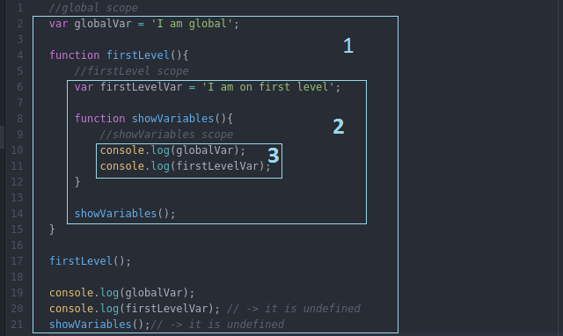
6. JavaScript - Scope
1. The global scope of the application
2. The internal scope of the function firstLevel. All variables and function from global are available inside
3. The internal scope of the function showVariables. Because this function is declared inside firstLevelVar all variables and functions will be available in this scope including the ones defined in an upper scope.

Slide 39
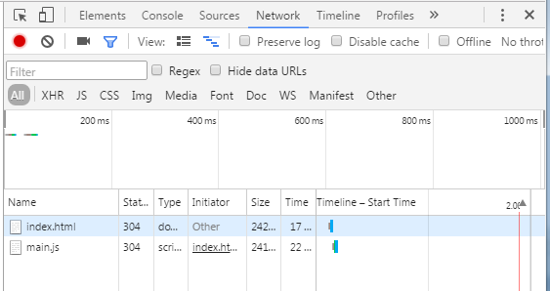
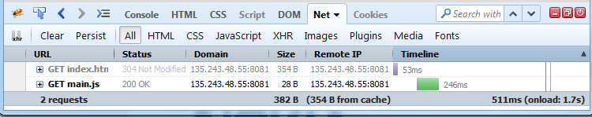
7. JavaScript - Debugging
Chrome developer tools
Firebug for Firefox http://getfirebug.com/

Slide 40
8. JavaScript - Best Practices
Avoid Global Variables
Always Declare Local Variables
Declarations on Top
Initialize Variables
Never Declare Number, String, or Boolean Objects
Don't Use new Object()
Beware of Automatic Type Conversions
End Your Switches with Defaults
…….
(https://www.w3schools.com/js)

Slide 41
9. JavaScript - Style Guide and Coding Conventions
Variable names
use camelCase for identifier names (variables and functions).
all names start with a letter.
firstName = "John";
Spaces around operators
always put spaces around operators ( = + - * / ), and after commas
var x = y + z; var values = ["Volvo", "Saab", "Fiat"];
Code indentation
always use 4 spaces for indentation of code blocks
function toCelsius(fahrenheit) { return (5 / 9) * (fahrenheit - 32); }
(https://www.w3schools.com/js)

Slide 42
9. JavaScript - Style Guide and Coding Conventions
Statement rules
always end a simple statement with a semicolon
var values = ["Volvo", "Saab", "Fiat"];
for complex (compound) statements:
put the opening bracket at the end of the first line.
use one space before the opening bracket.
put the closing bracket on a new line, without leading spaces.
do not end a complex statement with a semicolon.
for (i = 0; i < 5; i++) { x += i; }
--------------------
if (time < 20) { greeting = "Good day"; } else { greeting = "Good evening"; }
(https://www.w3schools.com/js)

Slide 43
9. JavaScript - Style Guide and Coding Conventions
Object rules
place the opening bracket on the same line as the object name.
use colon plus one space between each property and its value.
use quotes around string values, not around numeric values.
do not add a comma after the last property-value pair.
place the closing bracket on a new line, without leading spaces.
always end an object definition with a semicolon.
var person = { firstName: "John", lastName: "Doe", age: 50, eyeColor: "blue" };
(https://www.w3schools.com/js)

Slide 44

Thank you for your attention!

