Slide 1

UVT 2017 lab 2

Slide 2
Lab 2 Scope
Status program actual
See C++11 features: Override, final
Overload cin (operator<<), cout (operator<<)
Generate few shapes and save all shapes in a vector
Display using an iterator vector content
Search for a specific shape in vector
Delete vector content and resize vector

Slide 3
Overload operators
In C++ there are a few types of operators:
Arithmetic: +, -, *, / and %
Logic: &&, ||, !
Bitwise: >>, <<, &, |, ^, ~
Relational and comparison: ==, !=, >, >=, <, <=
Stream extraction and insertion: >>, <<

Slide 4
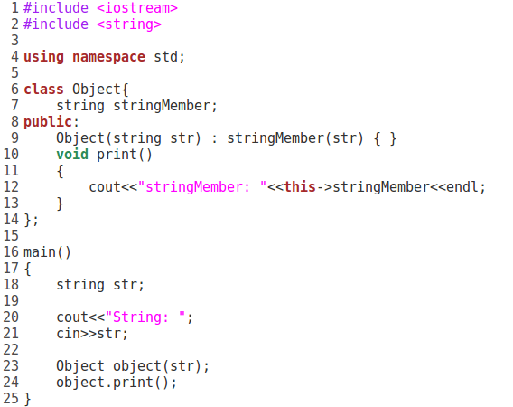
Standard way of doing it

Slide 5
Operator overload
The syntax is: type operator sign (parameters) { /*... body ...*/ }
C++ is able to input and output the built-in data types using the stream extraction
operator >> and the stream insertion operator <<. The stream insertion and stream extraction operators also can be overloaded to perform input and output for user-defined types like an object.

Slide 6
Operator overload
The syntax is: type operator sign (parameters) { /*... body ...*/ }
C++ is able to input and output the built-in data types using the stream extraction
operator >> and the stream insertion operator <<. The stream insertion and stream extraction operators also can be overloaded to perform input and output for user-defined types like an object.
are three different ways to overload operators:
the member function way
the friend function way(the most intuitive- direct access to the internal members of the classes you’re operating on)
and the normal function way(needs to use dedicated public methods to access private members)

Slide 7
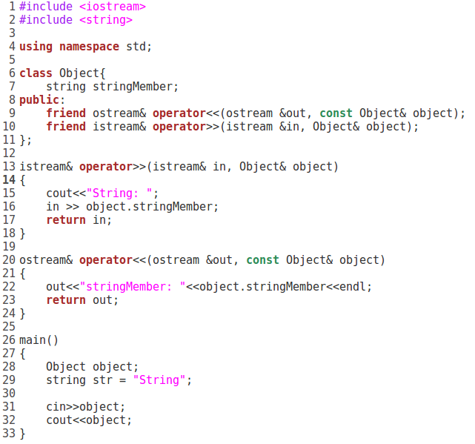
Overload operator<< and operator>>

Slide 8


