Slide 1

Cloud Computing and Internet of Things C++ 11
Nokia Romania
Cristian Cosariu / Bogdan Jurcul

Slide 2
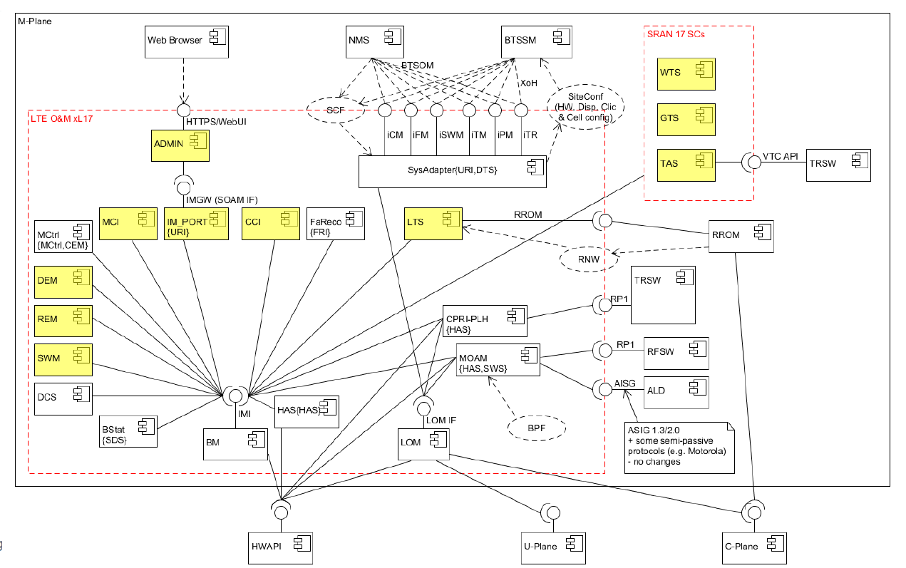
Cloud Computing – LTE Architecture
JS/Node
C++ 11
JS/Node
C++ 11
C++ 11
C++ 11
C++ 11
C++ 11
C++ 11
C++ 11
C++ 11
C++ 11
C++ 11
C++ 11
C++ 11
C++ 11

Slide 3
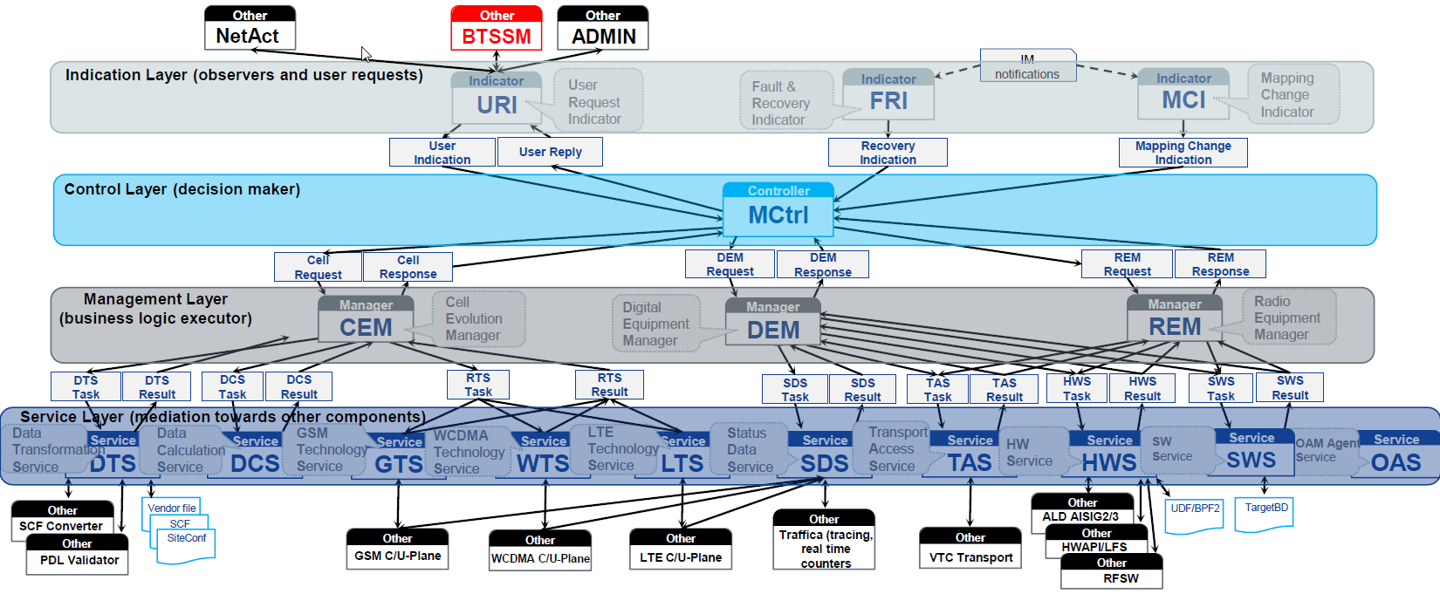
Nokia Timisoara – Moving SW components to cloud
Cloud Computing

Slide 4
Nokia Timisoara – Communication
Operations are modelled as objects, operation result is modelled as child object of particular operation object instance.
Indication Layer
EXAMPLE_NOTIF-1
RESULT-1
EXAMPLE_IND-1
EXAMPLE_IND-1
RESULT-1
Control Layer
EXAMPLE_REQ-1
EXAMPLE_REQ-1
RESULT-1
Management Layer
EXAMPLE_TASK-1
EXAMPLE_TASK-1
RESULT-1
Service Layer
EXAMPLE_NOTIF-1

Slide 5
Cloud Computing – LTE Architecture
Write a program that implements a class hierarchy that can be used to model geometric shapes using C++ 11 features, based on the following program structure.
Notes:
Realizati o aplicatie care sa implementeze o ierarhie de clase cu ajutorul careia sa puteti modela figuri geometrice folosind feature-uri specifice C++11, pornind de la urmatorul schelet.

Slide 6


