Slide 1
Quantifying Uncertainty in Calculated Quantities
ChemE 436
Chad Curtis
Autumn 2019
Notes:
Introduction to course: purpose.
Introduction to Slack
Poll Everywhere survey
Go through syllabus

Slide 2
Lecture objectives
Perform statistical analysis to quantify uncertainty in calculated quantities.
Calculate uncertainty using both error propagation and bootstrapping methods.
Present data in both tabular and graphical form.
Notes:
Translate customer needs into a testable hypothesis and experiment.

Slide 3
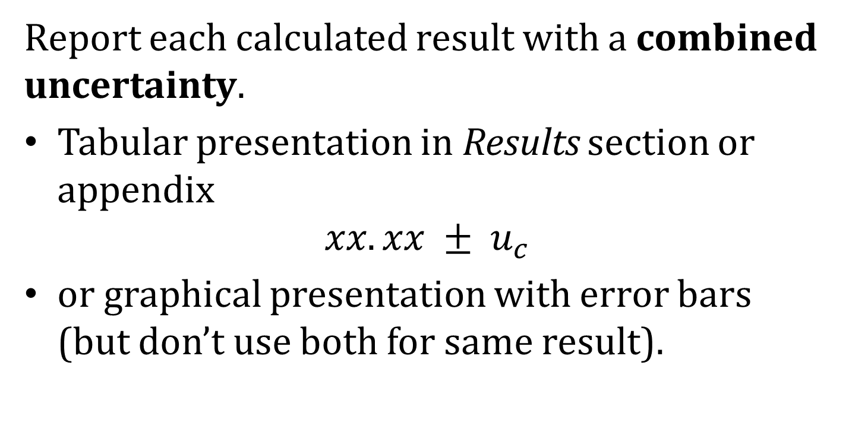
Reporting Calculated Results

Slide 4
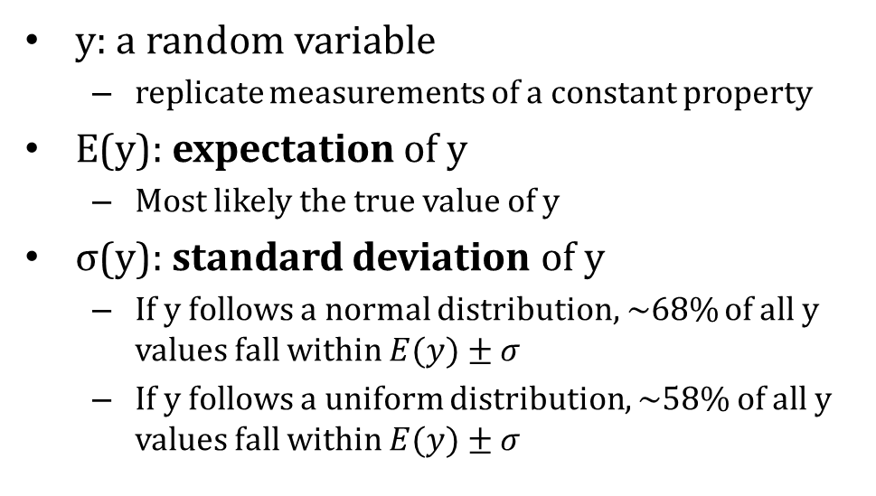
Concept Review
Normal Distribution
-
E(y)
68%
σ
y
y

Slide 5
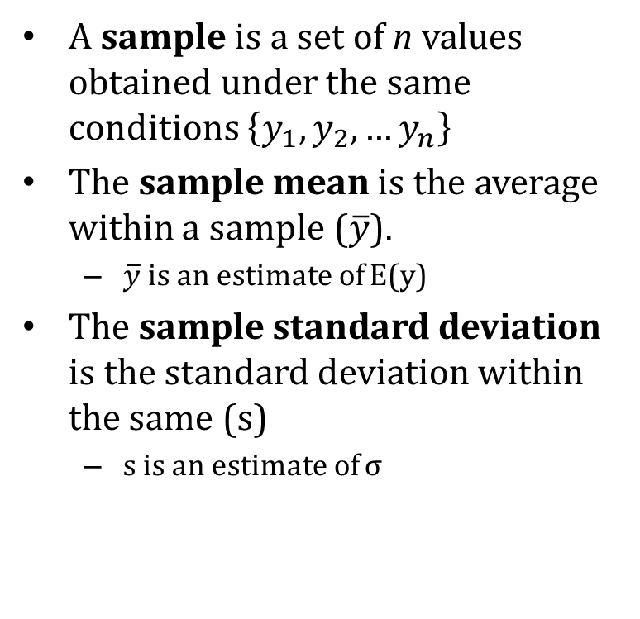
Concept Review
Normal Distribution
-
E(y)
68%
σ
y
y

Slide 6
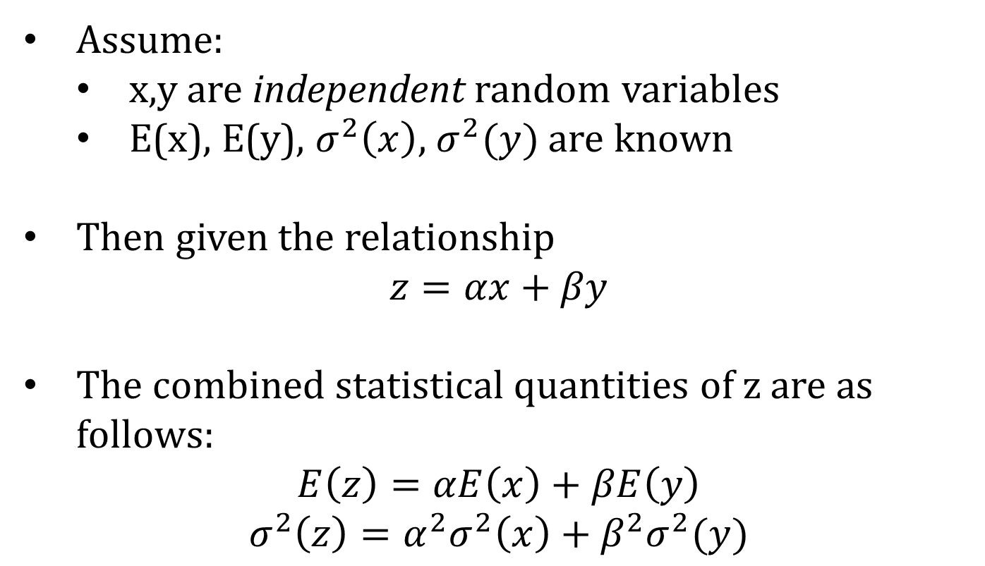
Combined Uncertainty: Linear Function
Assume:
x,y are independent random variables
E(x), E(y), $σ^{2}\left(x\right)$, $σ^{2}(y)$ are known
Then given the relationship
$$z=αx+βy$$
The combined statistical quantities of z are as follows:
$$E\left(z\right)=αE\left(x\right)+βE\left(y\right)$$
$$σ^{2}\left(z\right)=α^{2}σ^{2}\left(x\right)+β^{2}σ^{2}(y)$$

Slide 7
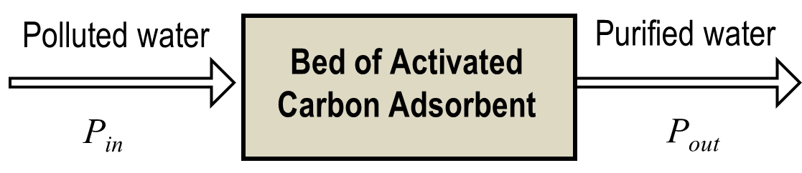
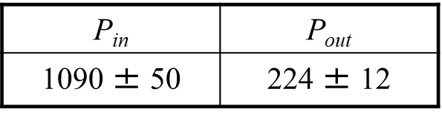

Approach 1: Error Propagation
Calculate standard uncertainties for the individual measurements (see Lecture 2):
Determine combined error using the given formulae.
k | P_{in} | P_{out}
1 | 1030 | 211
2 | 1220 | 252
3 | 985 | 197
4 | 1120 | 237

Slide 8
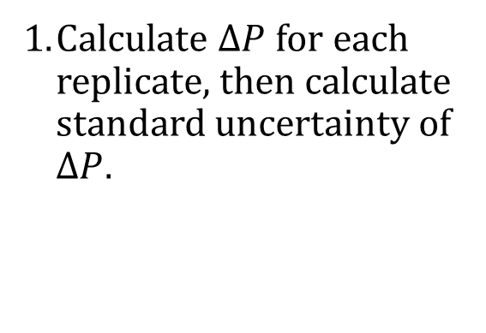
Approach 2: Repeat Calculations
dddddddd
k | P_{in} | P_{out} | _{ΔP}
1 | 1030 | 211 | 819
2 | 1220 | 252 | 968
3 | 985 | 197 | 788
4 | 1120 | 237 | 883

Slide 9
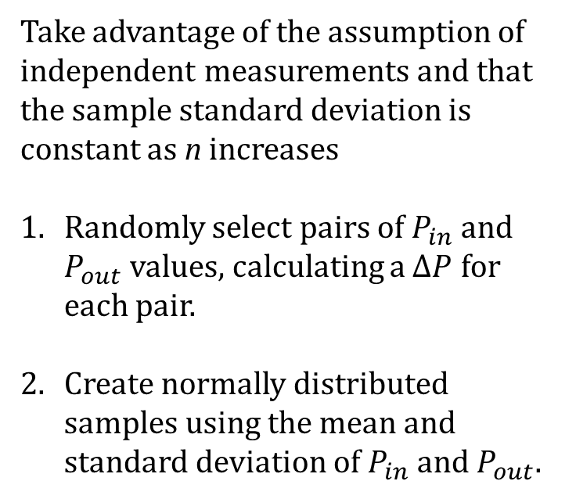
Approaches 3/4: Bootstrapping
k | P_{in} | P_{out} | _{ΔP}
1 | 1120 | 237 | 883
2 | 1220 | 237 | 983
3 | 985 | 237 | 748
4 | 1030 | 252 | 778
5 | 1120 | 252 | 868
6 | 1220 | 252 | 968
7 | 1030 | 197 | 833
Take advantage of the assumption of independent measurements and that the sample standard deviation is constant as n increases
Randomly select pairs of $P_{in}$ and $P_{out}$ values, calculating a $∆P$ for each pair.
Create normally distributed samples using the mean and standard deviation of $P_{in}$ and${ P}_{out}$.

Slide 10
Comparison of Approaches
Approaches are equivalent, and will converge as n gets large, but
Approach 1 is useful to show impact of each measurement uncertainty, but can be difficult for non-linear relationships. Good for planning phase.
Approaches 2 and 3 are entirely generalizable to non-linear relationships.
Approach 2 underestimates uncertainty significantly.
Approach 3 simulates a large dataset and provides best approximation of uncertainty.

Slide 11
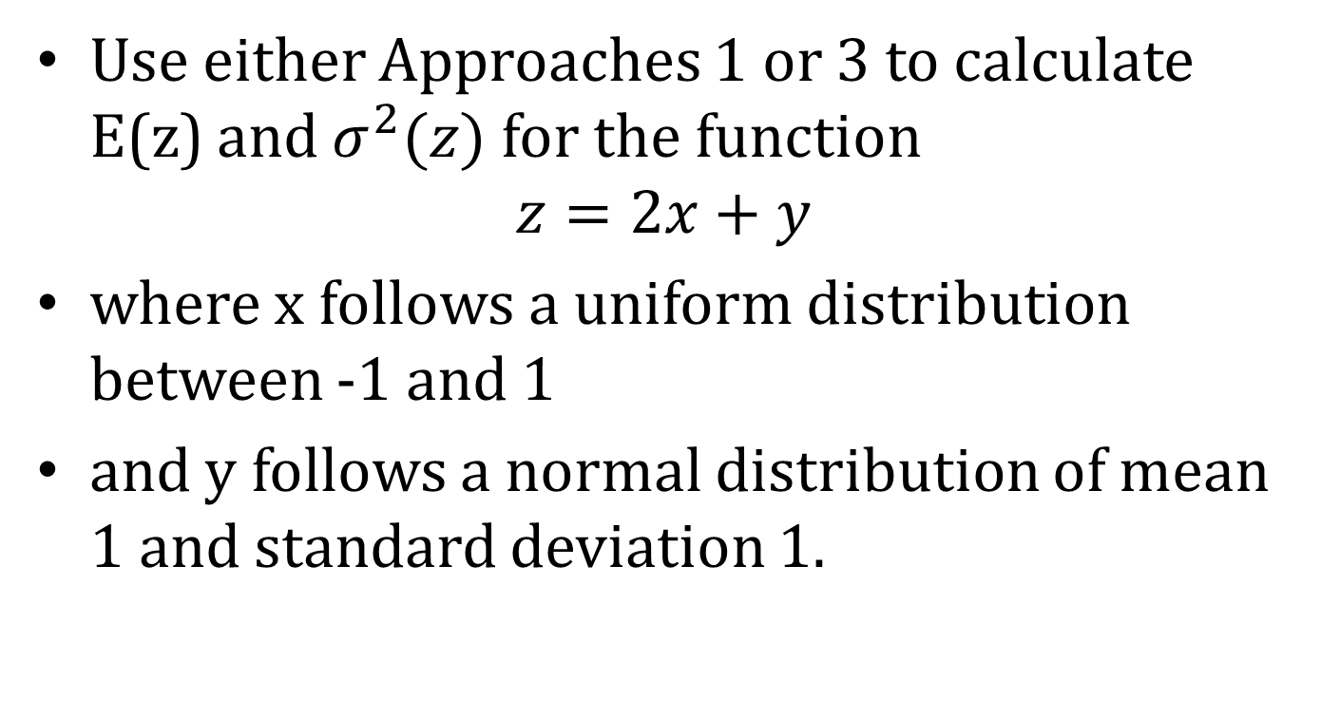
Exercise

Slide 12
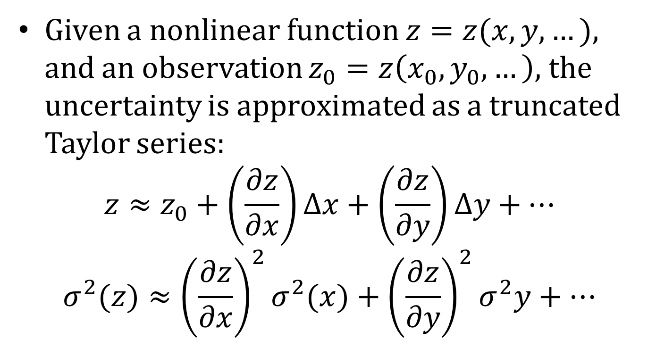
Combined Uncertainty: Nonlinear Equations

Slide 13
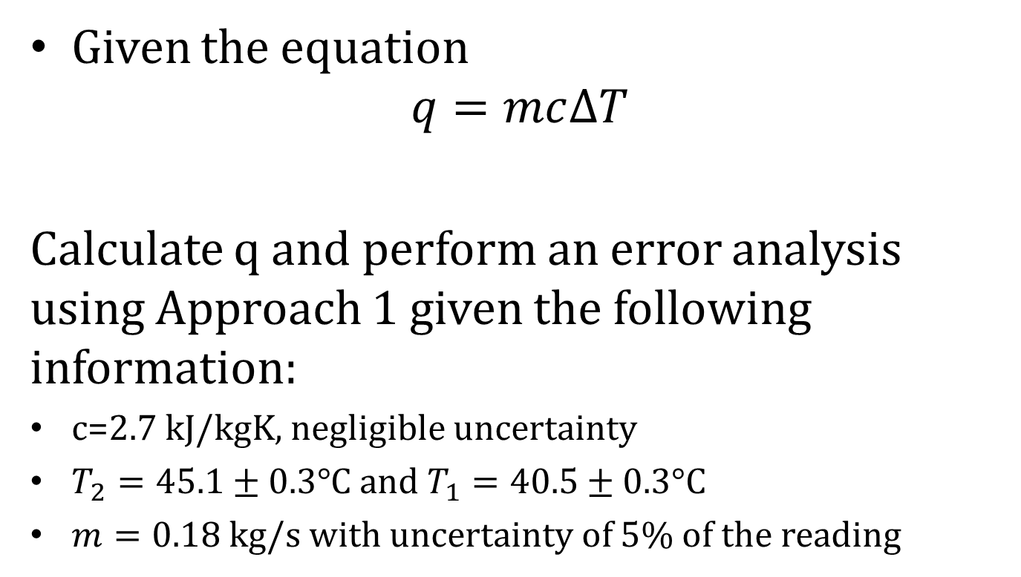
Example: Heat Transfer (Planning)
Given the equation
$$q=mc∆T$$
Calculate q and perform an error analysis using Approach 1 given the following information:
c=2.7 kJ/kgK, negligible uncertainty
$T_{2}=45.1±0.3°$C and $T_{1}=40.5±0.3°\text{C}$
$m=0.18$ kg/s with uncertainty of 5% of the reading

Slide 14
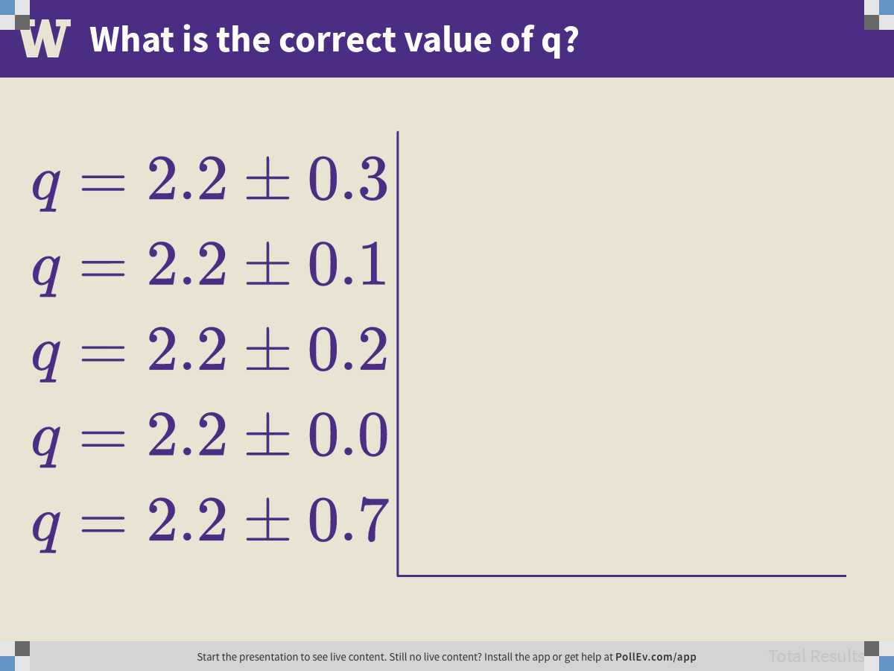
Notes:
Poll Title: What is the correct value of q? https://www.polleverywhere.com/multiple_choice_polls/C50fHqC2c1BZowdJ1jKCZ

Slide 15
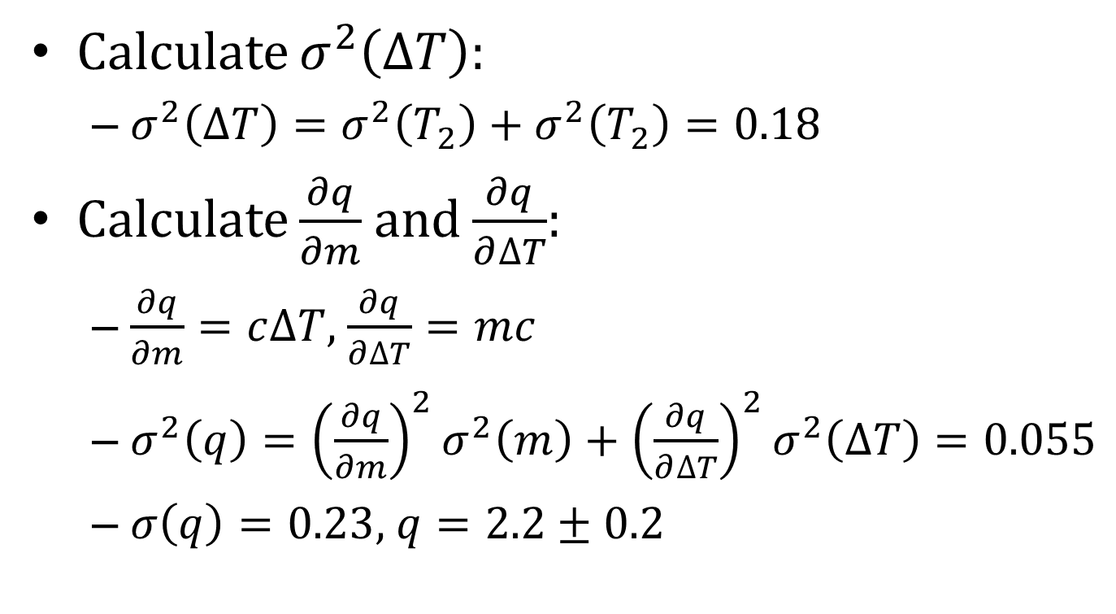
Heat Transfer Solution
Calculate $σ^{2}\left(∆T\right):$
$σ^{2}\left(∆T\right)=σ^{2}\left(T_{2}\right)+σ^{2}\left(T_{2}\right)=0.18$
Calculate $\frac{∂q}{∂m}$ and $\frac{∂q}{∂∆T}$:
$\frac{∂q}{∂m}=c∆T$, $\frac{∂q}{∂∆T}=mc$
$σ^{2}\left(q\right)={\left(\frac{∂q}{∂m}\right)}^{2}σ^{2}\left(m\right)+{\left(\frac{∂q}{∂∆T}\right)}^{2}σ^{2}\left(∆T\right)=0.055$
$σ\left(q\right)=0.23$, $q=2.2±0.2$

Slide 16
Example: Heat Transfer (Final)
You have collected the following data from an experiment:
Calculate q and perform error analysis using any one of the approaches used thus far.

Slide 17
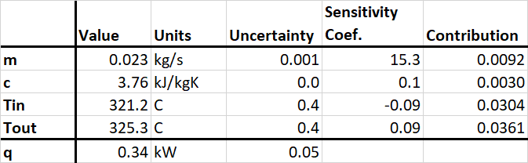
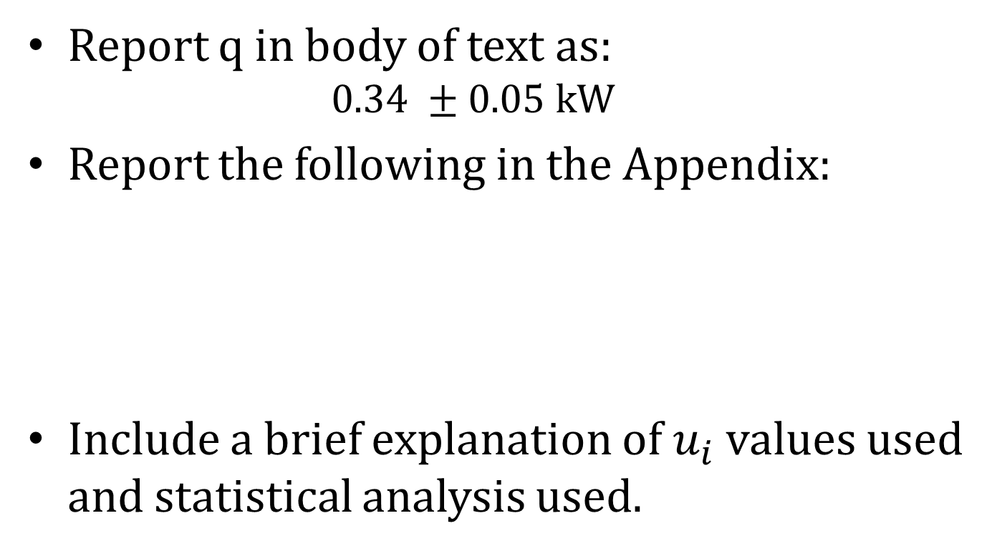
Example: Heat Transfer (Final)
Report q in body of text as:
$$0.34 ±0.05 kW$$
Report the following in the Appendix:
Include a brief explanation of $u_{i}$ values used and statistical analysis used.

Slide 18
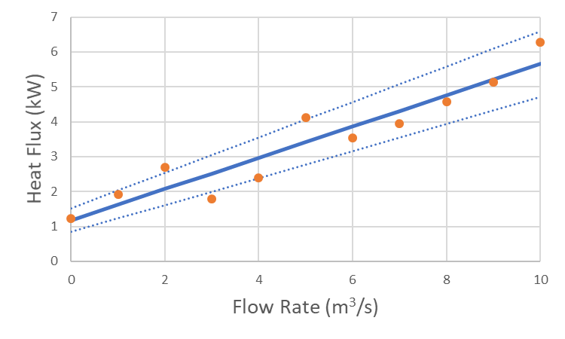
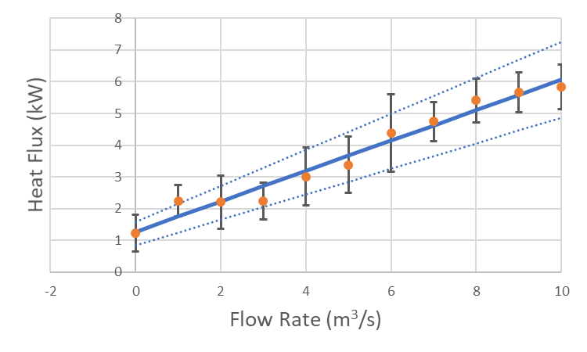
Combined Uncertainty: Graphical Presentation
Consider using when you want to
Show whether data follow a trend
Compare data to an assumed model
Show uncertainty using error bars
No replicate values
Error bars of linear fit displayed
Negligible uncertainty in x values
Model error calculated taking into account error of individual points

Slide 19
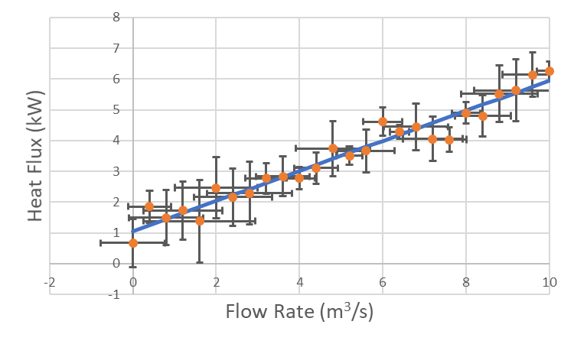
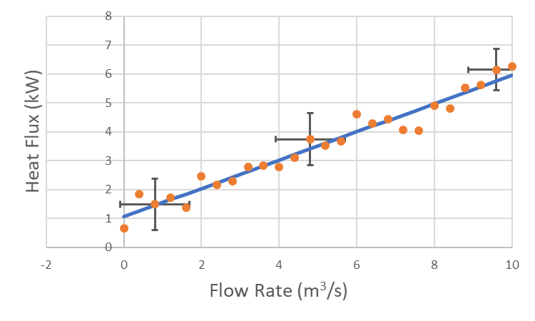
Combined Uncertainty: Graphical Presentation
Consider using when you want to
Show whether data follow a trend
Compare data to an assumed model
Show uncertainty using error bars
Uncertainty in both x and y
Error bars make graph illegible
Display only a few error bars to reduce “junk”

