Slide 1
Factorial Design
ChemE 436
Chad Curtis
Autumn 2019
Notes:
Introduction to course: purpose.
Introduction to Slack
Poll Everywhere survey
Go through syllabus

Slide 2
Lecture objectives
Perform statistical analysis to quantify uncertainty in calculated quantities.
Calculate uncertainty using both error propagation and bootstrapping methods.
Present data in both tabular and graphical form.
Notes:
Translate customer needs into a testable hypothesis and experiment.

Slide 3
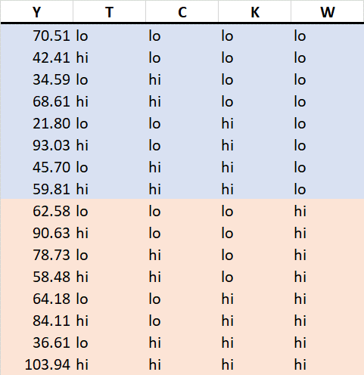
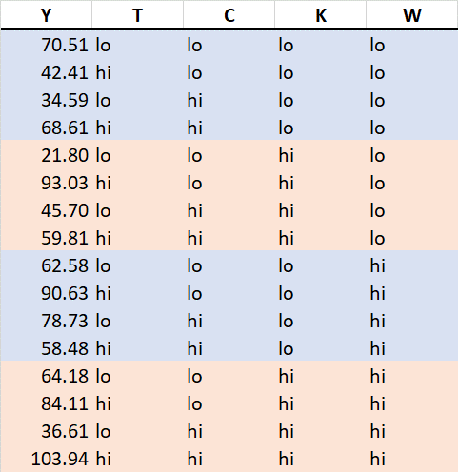
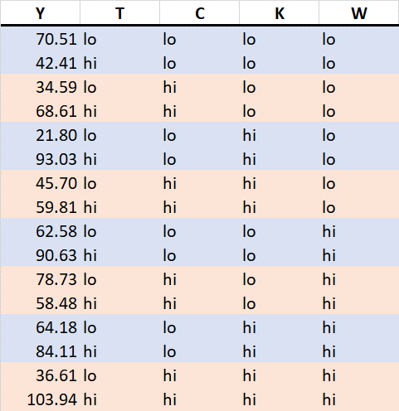
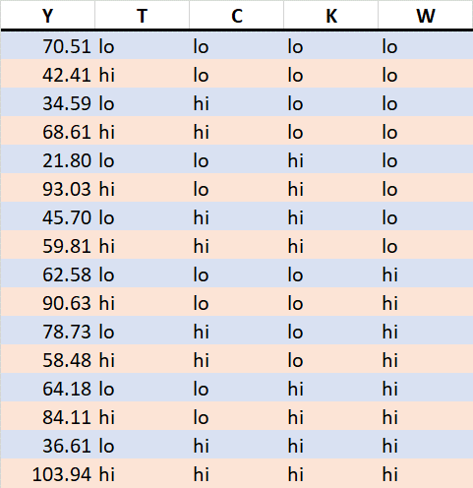
Example 1
Goal: determine how 4 factors (temperature, concentration, catalyst, other) affect reaction yield and which are important.
Full 2⁴ factorial with each point replicated. Total 16 runs.

Slide 4
Factorial Experimental Design
Well suited for exploration: What is important?
Provide maximum information for effort expended.
Vocabulary:
Factor: An independent variable (e.g. temperature, pressure, concentration). Must be at least 2.
Response: The dependent variable (e.g., yield)
Level: A factor’s value (e.g. 100°C). Can be qualitative (e.g., on/off)
Main Effect: The response to a particular factor with other factors held constant.
Interaction: The response to a simultaneous change in 2 or more factors.

Slide 5

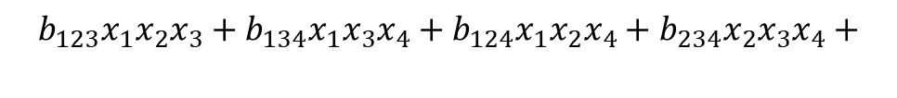
Factorial model
Assume a model of form:
Model is non-linear.
$$y= b_{0}+b_{1}x_{1}+b_{2}x_{2}+b_{3}x_{3}+b_{4}x_{4}+$$
Main effects
$$b_{12}x_{1}x_{2}+b_{13}x_{1}x_{3}+b_{14}x_{1}x_{4}+b_{23}x_{2}x_{3}+b_{24}x_{2}x_{4}+b_{34}x_{3}x_{4}+$$
2-way interaction
$$b_{123}x_{1}x_{2}x_{3}+b_{134}x_{1}x_{3}x_{4}+b_{124}x_{1}x_{2}x_{4}+b_{234}x_{2}x_{3}x_{4}+$$
3-way interaction
$$b_{1234}x_{1}x_{2}x_{3}x_{4}$$
4-way interaction

Slide 6
Choosing factor levels
Focus on quantitative factors for now.
Choose range for each factor
Large enough to cause measurable response (if one exists)
Consider normal “move size”
Not so large that response “saturates”
May require some try and error
Choose p_{i}, number of levels for i^{th} factor
Require p_{i} > 1
Define levels by dividing range into p_{i} - 1 equal increments
If p_{i} = 2, levels are lower and upper ends of range

Slide 7
Coding factor levels
Conventional to code (scale) the levels for each factor.
Let z_{i} be the coded version of factor x_{i} .
Suppose x_{i,min} and x_{i,max} are the minimum and maximum level for this factor.
Then, by convention, define
(p_{i} values)
Remark:
z_{i} varies between -1 and +1 as x_{i} varies between x_{i,min} and x_{i,max}.
z_{i} = -1 or +1 for two levels

Slide 8
Visualization factorial experiments
z₃
P = 2, n = 2 ( 2² = 4)
P = 2, n = 3 (2³ = 8)
z₂
z₂
z₁
(−1,−1,+1)
(−1,+1,+1)
(−1,+1)
(+1,+1)
(+1,+1,+1)
(+1,−1,+1)
z₁
(−1,−1,−1)
(−1,+1,−1)
(−1,−1)
(+1,−1)
(+1,+1,−1)
(+1,−1,−1)
Coded experiments (levels to be tested) are vertices of a square (p =2, n = 2), or a cube (p = 2, n = 3) centered on the origin.
For p = 2, n > 3, it’s a hypercube (hard to visualize ...)
Go to example →

Slide 9
Orthogonal vectors
Two vectors are orthogonal when they are mutually perpendicular.
The projection of one vector onto the other has zero length.
A
No projections --
Vectors A and B are orthogonal.
B
Inner product
If the inner (“dot” or “scalar”) product of two vectors is zero, the vectors are orthogonal.
To compute the inner product, multiply corresponding elements and sum.
A | B
1 | 1
-1 | 2
Inner product of these two vectors is:
So they are not orthogonal
B (1, 2)
A (1, -1)

Slide 10
What’s under the hood
Suppose X and y contain the data:
- X is a matrix with N rows and n columns, where
N = number of experiments
n = number of independent variables
- y is a column vector with N rows.
b is a column vector of constants to be estimated, n rows.
X₁₁ … X_{1n} y₁₁ b₁₁
. . .
. . . b_{n1}
. . .
X_{N1} … X_{Nn} y_{N1}

Slide 11
Matrix form
Added column to X matrix to account for the b₀ term
n
N
=
*
y = X * b

Slide 12
Least-squares Regression
The least-squares estimate of b involves the following matrix operations:
Multiply both sides by X transpose
X ^{T}X is n by n. IF it is invertible,
X^{T}y is inner product of y with each column of X
(or each row of X^{T}).
y
X^{T}
X^{T}y
n
*
=
N

Slide 13
LSR: Test Case
X^{T}X
X
X^{T}
*
X^{T} X
=
= 16 I
where I is the identity matrix, n by n.
Go to example →

Slide 14
Uncertainty analysis
If y includes random effect, N(0, σ_{y}), its propagation to b is:
For the full factorial design with orthogonal X, this reduces to
Thus:
All b elements have the same uncertainty
There is no cross-correlation between elements of b
The standard deviation for each b element is 2.83/4 = 0.707
cov(b): covariance
cov(b) = σ(b, b) = σ_{b}²

Slide 15
What is a full factorial is too much work?
Using first 8 runs of Expt. 1 only.
8 parameters, so model fits data exactly.
“Overparameterized” model – bad practice.

Slide 16
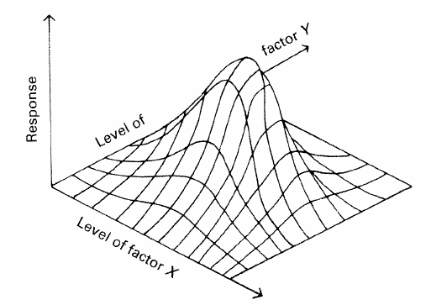
Motivation for partial factorials
As n increases, full factorial requires many experiments.
Also might want to use p > 2 (to test for “curvature”).
Example: p_{i} = 3, z_{i} = -1, 0, +1 for all n = 3 variables
Full factorial requires 3³ = 27 experiments + replicates.
Interactions often small, especially 3-way and greater.
Omitting them from model allows fewer experiments
Alternative: Partial factorial design.
Fewer levels may miss the conditions
for the optimal responses
A response surface for two factors

Slide 17
Partial factorial design
If we assume that there are no interactions, simpler model requires fewer experiments.
Example: n = 3 requires 4 parameters:
Requires at least 4 experiments.
Use the best 4 experiments.
(−1,−1,+1)
(−1,+1,+1)
Best: “unconnected” vertices
(+1,+1,+1)
(+1,−1,+1)
Either the orange or black
combinations would be good.
(−1,−1,−1)
(−1,+1,−1)
(+1,−1,−1)
(+1,+1,−1)

Slide 18
Partial factorial design
A poor choice
A terrible choice
(−1,−1,+1)
(−1,−1,+1)
(−1,+1,+1)
(−1,+1,+1)
(+1,+1,+1)
(+1,+1,+1)
(+1,−1,+1)
(+1,−1,+1)
(−1,−1,−1)
(−1,−1,−1)
(−1,+1,−1)
(−1,+1,−1)
(+1,−1,−1)
(+1,+1,−1)
(+1,+1,−1)
(+1,−1,−1)
Poor coverage.
Three of the four points have
z₁ = -1 and z₃ = +1.
If points are on one face, an independent variable is being held constant. Can’t invert X^{T}X.
Go to example →

Slide 19
Handling qualitative variables
Example 1 included a qualitative variable (catalyst type).
We coded one type as +1, and the other as -1.
What if there had been 3 (or more) catalysts?
Coding the three as one variable with levels +1, 0, -1 would lead to incorrect conclusions.
Implies catalysts are “ordered,” but they are discrete and independent.

Slide 20
Handling qualitative variables
Replace each qualitative variable having p > 2 levels with p-1 new variables, each having two levels (0 and +1).
Example 1: catalysts A, B, and C
p = 3, so define 2 variables:
x₁ = +1 if type A, otherwise 0.
x₂ = +1 if type B, otherwise 0.
Thus, only 3 combinations of x₁ and x₂ are possible.
If catalyst = A, x₁ = +1, x₂ = 0
If catalyst = B, x₁ = 0, x₂ = +1
If catalyst = C, x₁ = 0, x₂ = 0

Slide 21
Handling qualitative variables
Example 2: catalysts A, B, C, D
Replace with 3 variables:
If catalyst = A, x₁ = +1, x₂ = 0, x₃ = 0
If catalyst = B, x₁ = 0, x₂ = +1, x₃ = 0
If catalyst = C, x₁ = 0, x₂ = 0, x₃ = +1
If catalyst = D, x₁ = 0, x₂ = 0, x₃ = 0
Pattern: one (and only one) of the new variables is “on” (level = +1) or all are “off”.

