Slide 1
Hypothesis Testing
ChemE 436
Chad Curtis
Autumn 2019
Notes:
Introduction to course: purpose.
Introduction to Slack
Poll Everywhere survey
Go through syllabus

Slide 2
Lecture objectives
Formulate hypotheses that can be tested statistically.
Define relevant test statistics
Perform a t-test to compare two groups.
Perform an ANOVA to compare multiple groups.
Notes:
Translate customer needs into a testable hypothesis and experiment.

Slide 3
Example 1
Your company has modified a manufacturing process.
Operating Cost:
Before: $0.57±0.013/kg (avg. for last year)
After: $0.55±0.013/kg (avg. for 2-day trial run)
Assume the given error is the true standard deviation– rarely true.
Has the modification reduced operating costs?

Slide 4
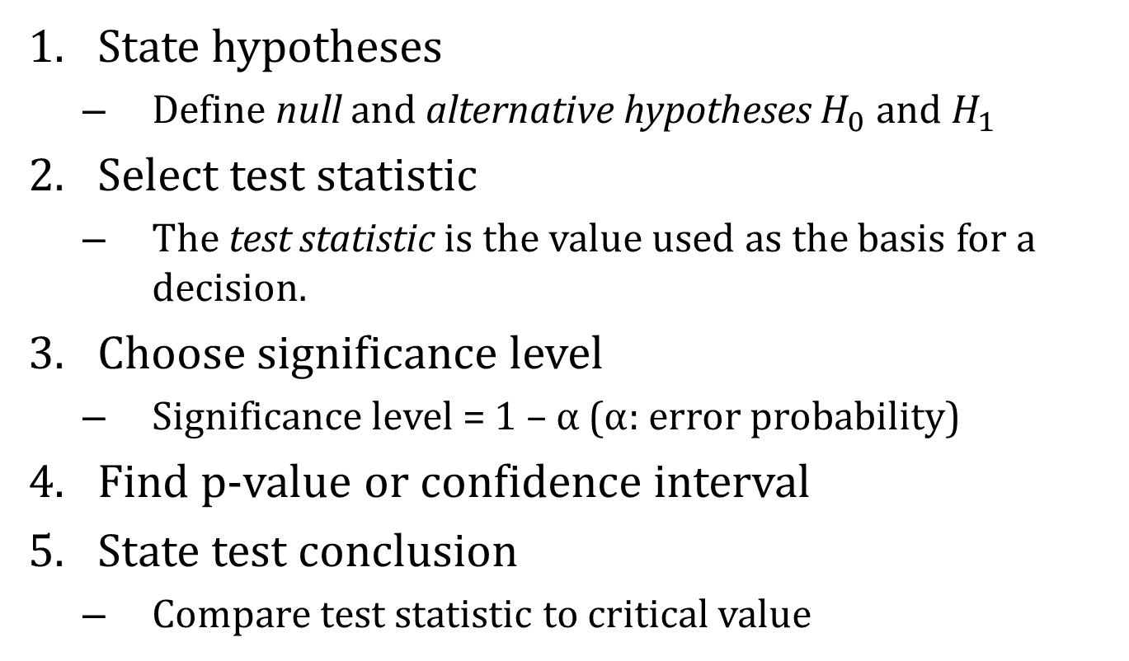
Hypothesis Testing Summary
State hypotheses
Define null and alternative hypotheses $H_{0}$ and $H_{1}$
Select test statistic
The test statistic is the value used as the basis for a decision.
Choose significance level
Significance level = 1 – α (α: error probability)
Find p-value or confidence interval
State test conclusion
Compare test statistic to critical value

Slide 5
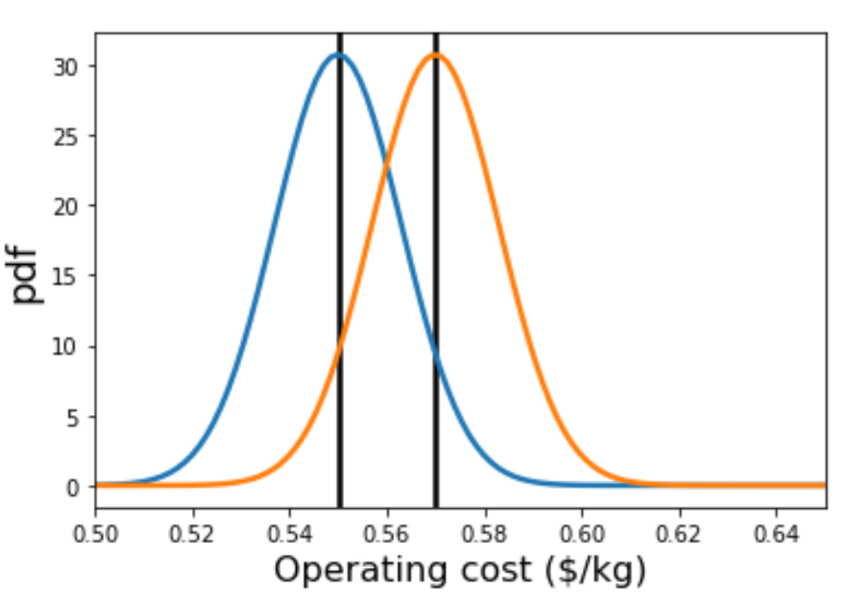
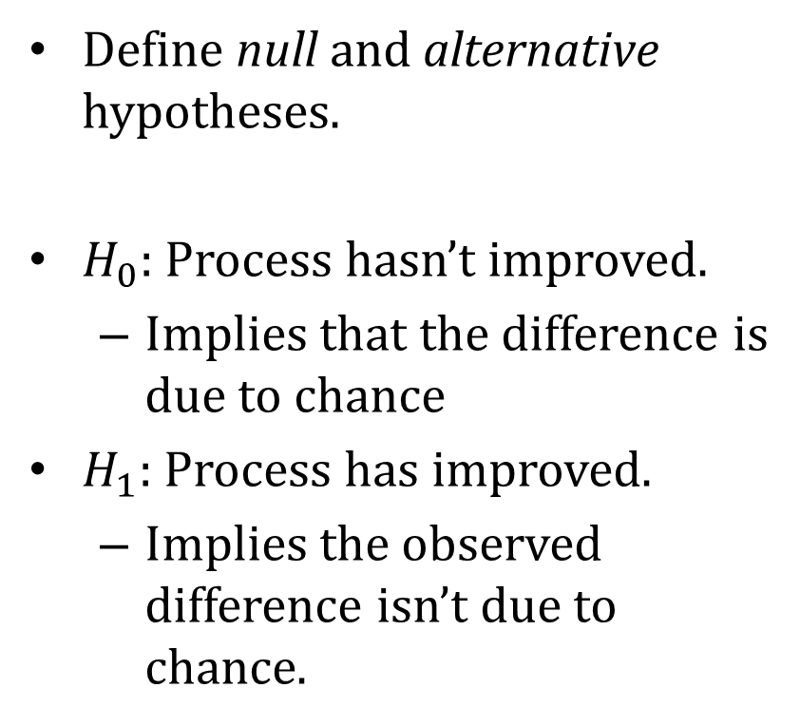
Step 1: State hypotheses
Define null and alternative hypotheses.
$H_{0}$: Process hasn’t improved.
Implies that the difference is due to chance
$H_{1}$: Process has improved.
Implies the observed difference isn’t due to chance.

Slide 6
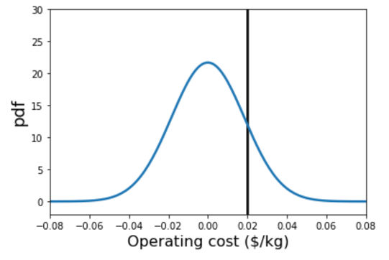
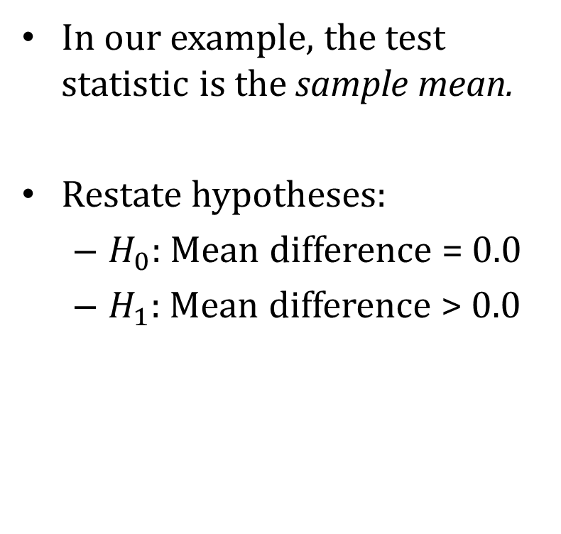
Step 2: Define test statistic
In our example, the test statistic is the sample mean.
Restate hypotheses:
$H_{0}$: Mean difference = 0.0
$H_{1}$: Mean difference > 0.0
Reframed as difference of two means:

Slide 7
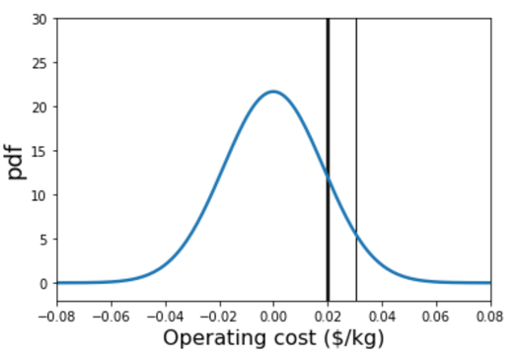
Step 3: Choose Significance Level
Significance level:
1 – α (1-sided t-test)
1 – α/2 (2-sided t-test)
α=0.05 is typical

Slide 8
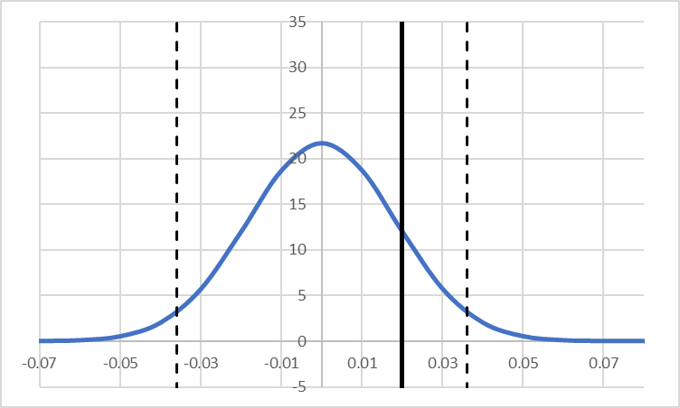


Step 4: Calculate a p-value
Method 1: calculate confidence interval and determine whether our test statistic is in the confidence interval
Method 2: calculate p-value and compare with the significance level.
$$p=0.138$$
$$95\% CI=−0.04−0.04$$

Slide 9

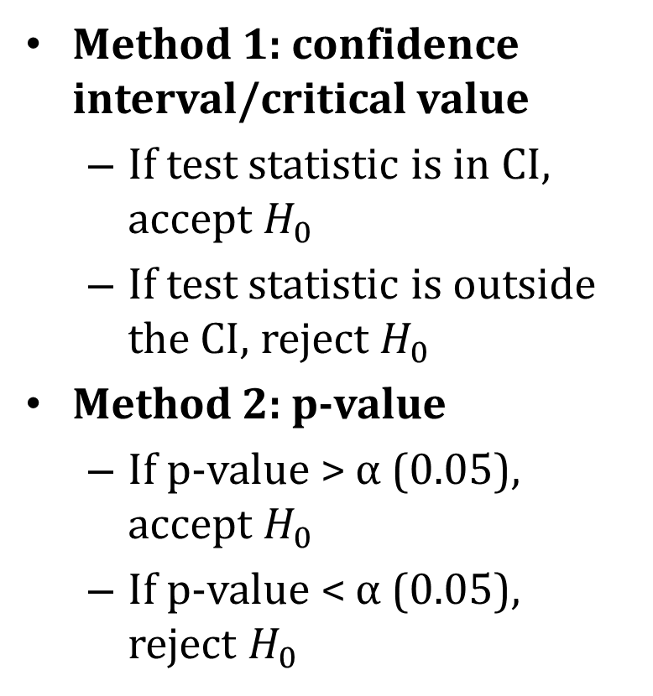
Step 5: State test conclusion
Method 1: confidence interval/critical value
If test statistic is in CI, accept $H_{0}$
If test statistic is outside the CI, reject $H_{0}$
Method 2: p-value
If p-value > α (0.05), accept $H_{0}$
If p-value < α (0.05), reject $H_{0}$
$$p=0.138$$
$$95\% CI=−0.04−0.04$$

Slide 10
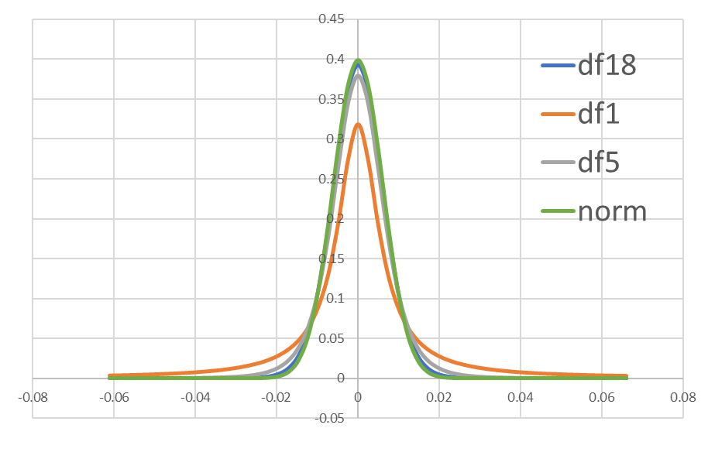
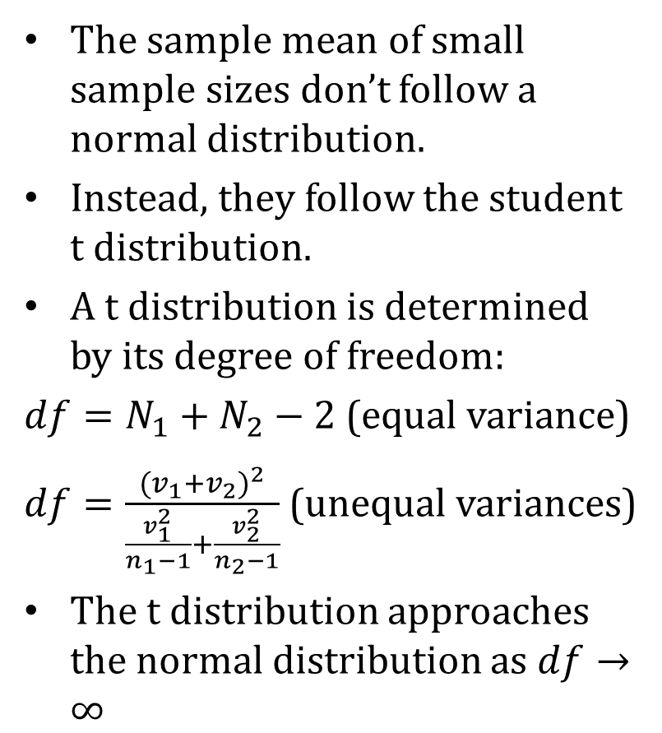
Introduction to t-test
The sample mean of small sample sizes don’t follow a normal distribution.
Instead, they follow the student t distribution.
A t distribution is determined by its degree of freedom:
$df=N_{1}+N_{2}−2$ (equal variance)
$df=\frac{{(v_{1}+v_{2})}^{2}}{\frac{v_{1}^{2}}{n_{1}−1}+\frac{v_{2}^{2}}{n_{2}−1}}$ (unequal variances)
The t distribution approaches the normal distribution as $df→∞$

Slide 11
Example 2
Your company has modified a manufacturing process.
You have been given the following data regarding operating costs.
Has the modification reduced operating costs?

Slide 12
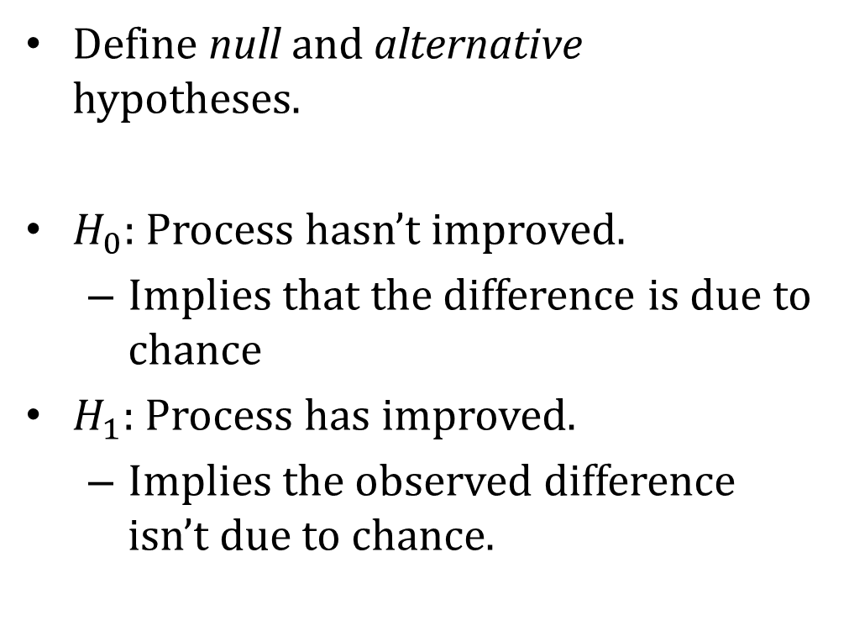
Step 1: State hypotheses
Define null and alternative hypotheses.
$H_{0}$: Process hasn’t improved.
Implies that the difference is due to chance
$H_{1}$: Process has improved.
Implies the observed difference isn’t due to chance.

Slide 13
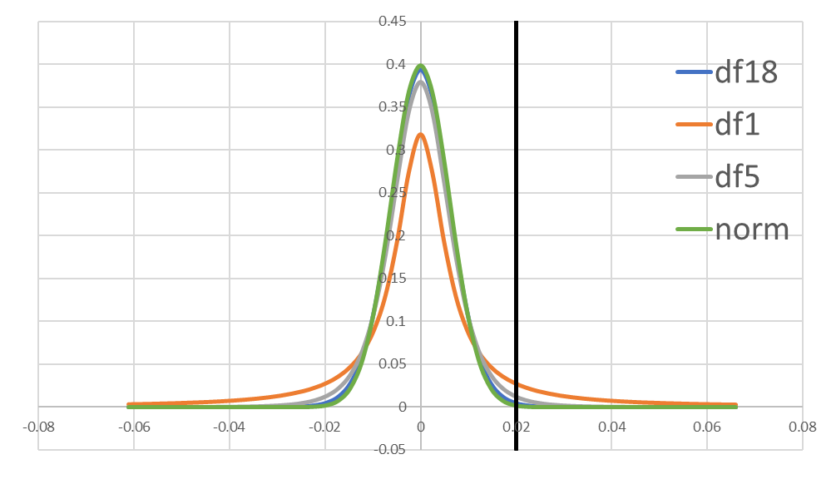
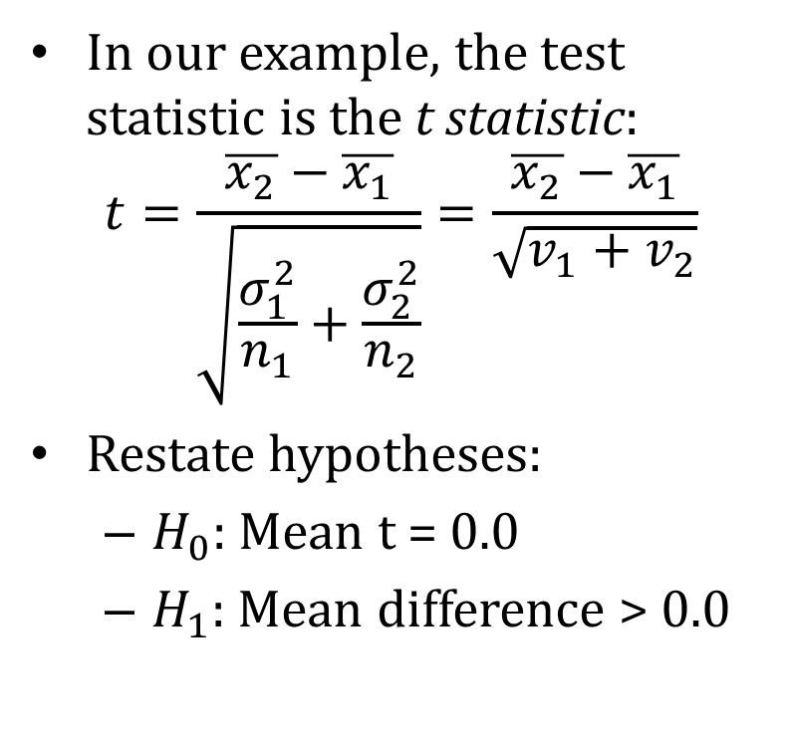
Step 2: Define test statistic
In our example, the test statistic is the t statistic:
$$t=\frac{\overline{x_{2}}−\overline{x_{1}}}{\sqrt{\frac{σ_{1}^{2}}{n_{1}}+\frac{σ_{2}^{2}}{n_{2}}}}=\frac{\overline{x_{2}}−\overline{x_{1}}}{\sqrt{v_{1}+v_{2}}}$$
Restate hypotheses:
$H_{0}$: Mean t = 0.0
$H_{1}$: Mean difference > 0.0
Reframed as difference of two means:

Slide 14
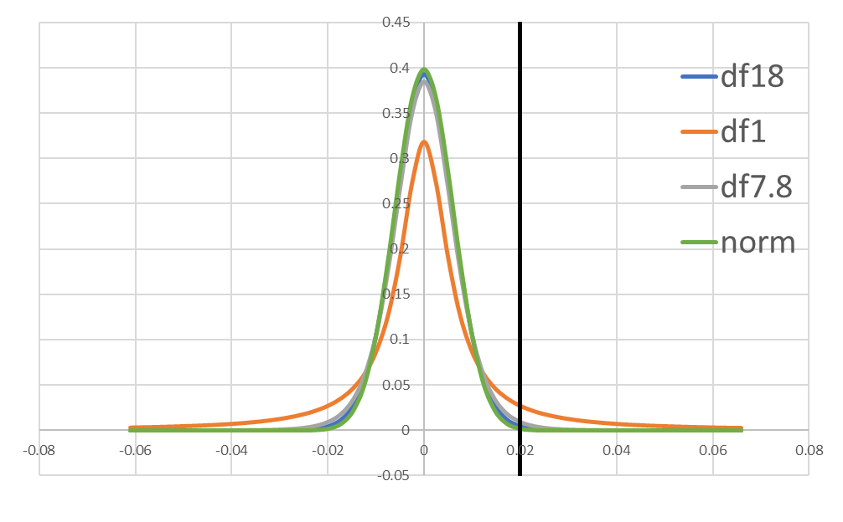
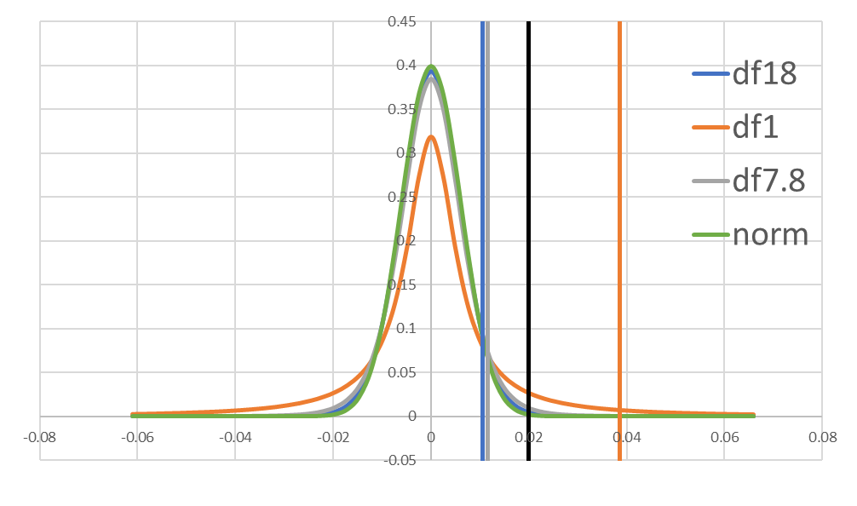
Step 3: Choose Significance Level
Significance level:
1 – α (1-sided t-test)
1 – α/2 (2-sided t-test)
α=0.05 is typical

Slide 15

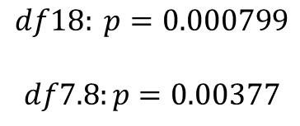
Step 4: Calculate a p-value
Method 1: calculate confidence interval and determine whether our test statistic is in the confidence interval
Method 2: calculate p-value and compare with the significance level.
$$df18: p=0.000799$$
$$df7.8:p=0.00377$$
$$df18: 90\% CI=−0.0106−0.0106$$
$df7.8:90\% CI=−0.0116−0.0116$

Slide 16


Step 5: State test conclusion
Method 1: confidence interval/critical value
If test statistic is in CI, accept $H_{0}$
If test statistic is outside the CI, reject $H_{0}$
Method 2: p-value
If p-value > α (0.05), accept $H_{0}$
If p-value < α (0.05), reject $H_{0}$
$$p=0.138$$
$$90\% CI=−0.03−0.03$$

Slide 17
ANOVA: Multiple Conditions
What if instead of comparing two mean values we have three or more?
Example: comparing friction factor of three different orifices
In this case, we need a multi-variate version of the t-test called Analysis of Variance (ANOVA)

Slide 18
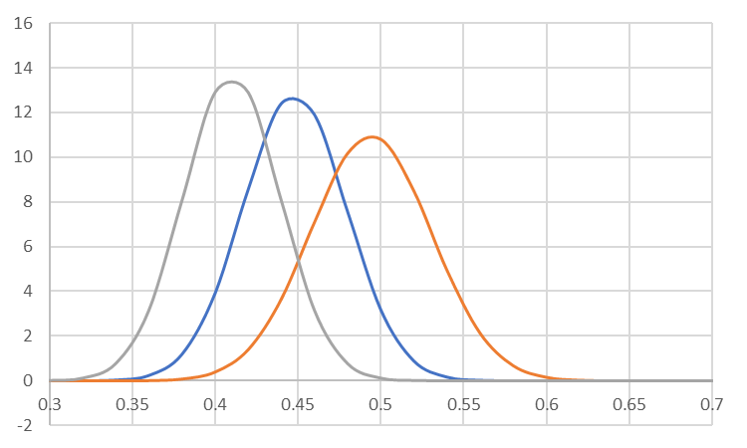
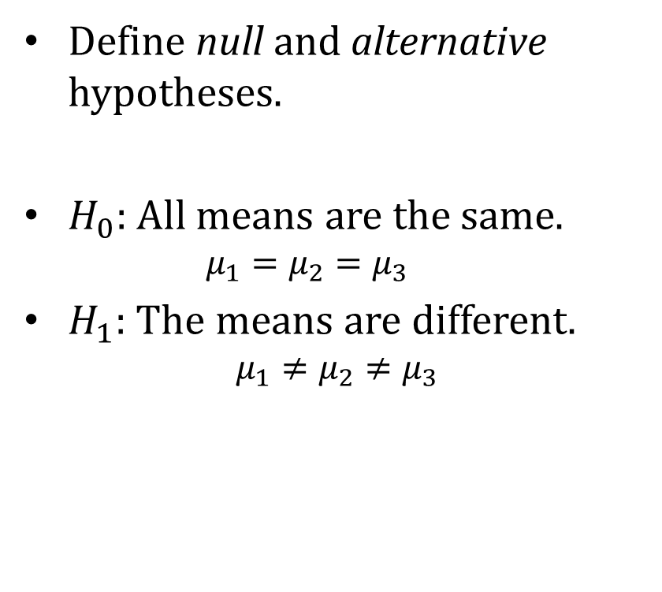
Step 1: State hypotheses
Define null and alternative hypotheses.
$H_{0}$: All means are the same.
$$μ_{1}=μ_{2}=μ_{3}$$
$H_{1}$: The means are different.
$$μ_{1}≠μ_{2}≠μ_{3}$$

Slide 19
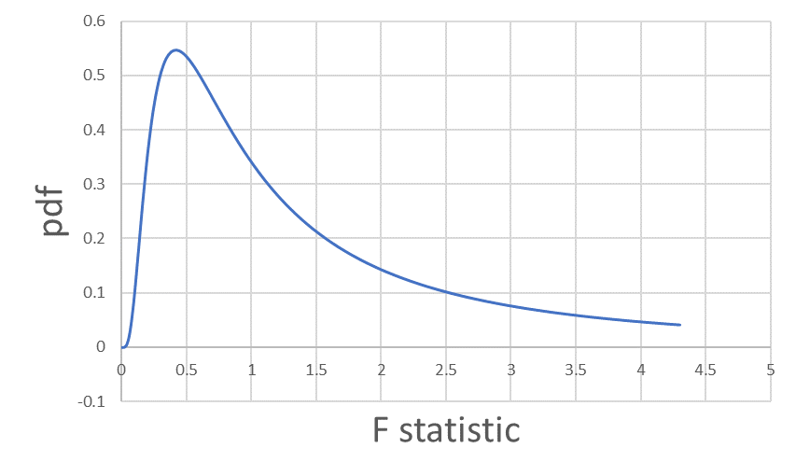
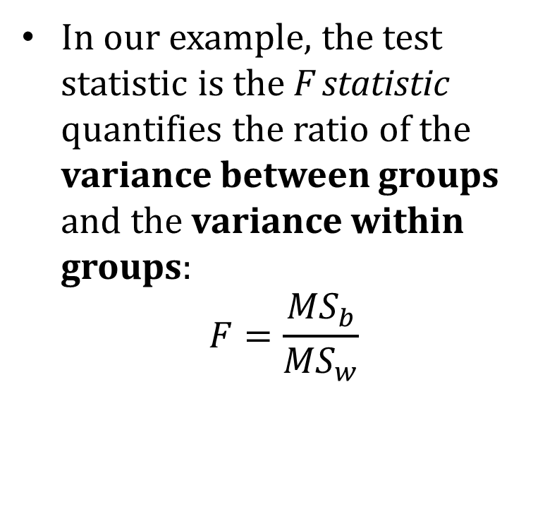
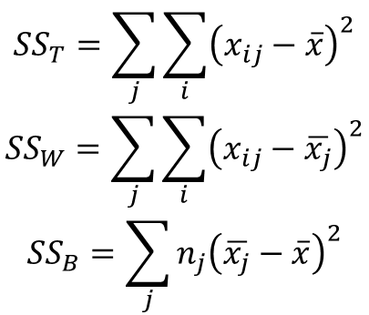
Step 2: Define test statistic
$${SS}_{T}=\sum_{j}{\sum_{i}{{\left(x_{ij}−\overline{x}\right)}^{2}}}$$
$${SS}_{W}=\sum_{j}{\sum_{i}{{\left(x_{ij}−\overline{x_{j}}\right)}^{2}}}$$
$${SS}_{B}=\sum_{j}{n_{j}{\left(\overline{x_{j}}−\overline{x}\right)}^{2}}$$
In our example, the test statistic is the F statistic quantifies the ratio of the variance between groups and the variance within groups:
$$F=\frac{{MS}_{b}}{{MS}_{w}}$$

