Slide 1
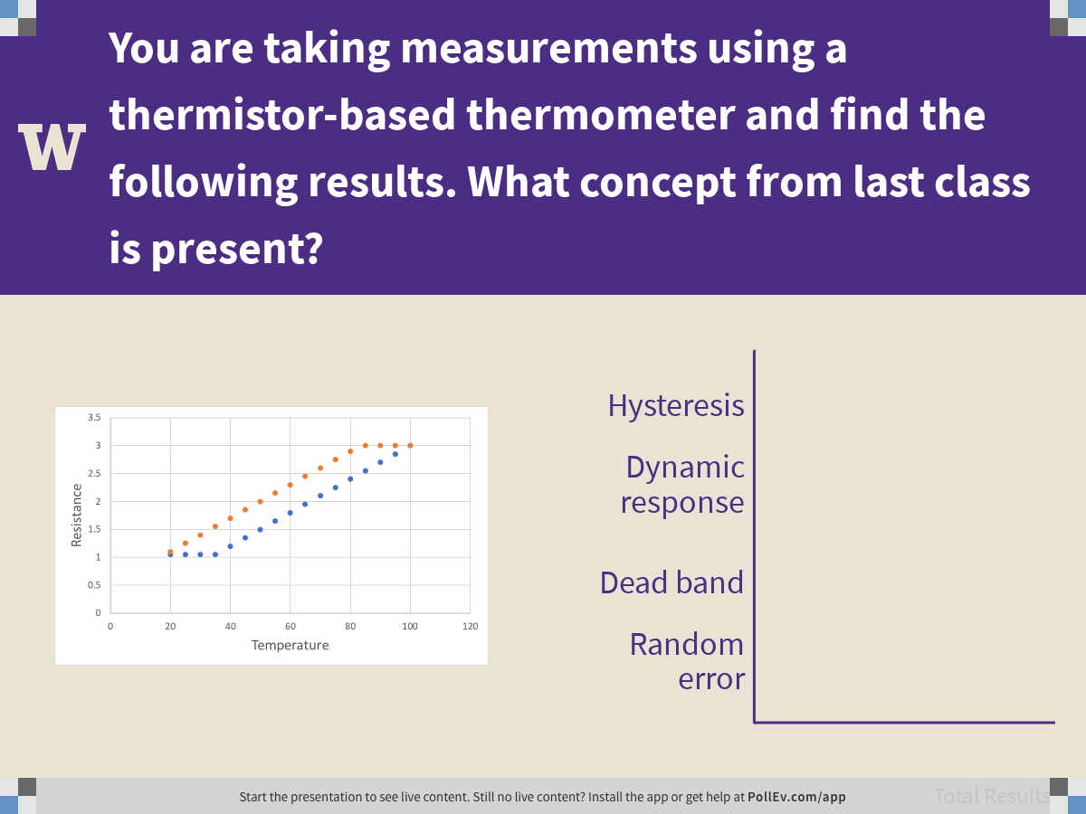
Notes:
Poll Title: You are taking measurements using a thermistor-based thermometer and find the following results. What concept from last class is present?
https://www.polleverywhere.com/multiple_choice_polls/i8r0LJCQi4RXFIAYISvPt

Slide 2
Quantifying Measurement Uncertainty
ChemE 436
Chad Curtis
Autumn 2019
Notes:
Introduction to course: purpose.
Introduction to Slack
Poll Everywhere survey
Go through syllabus

Slide 3
Lecture objectives
Perform statistical analysis to quantify uncertainty in experimental measurements.
Differentiate between standard deviation and standard error of the mean.
Estimate uncertainty when statistical analysis cannot be performed.
Use uniform and normal distributions to estimate uncertainty.
Notes:
Translate customer needs into a testable hypothesis and experiment.

Slide 4
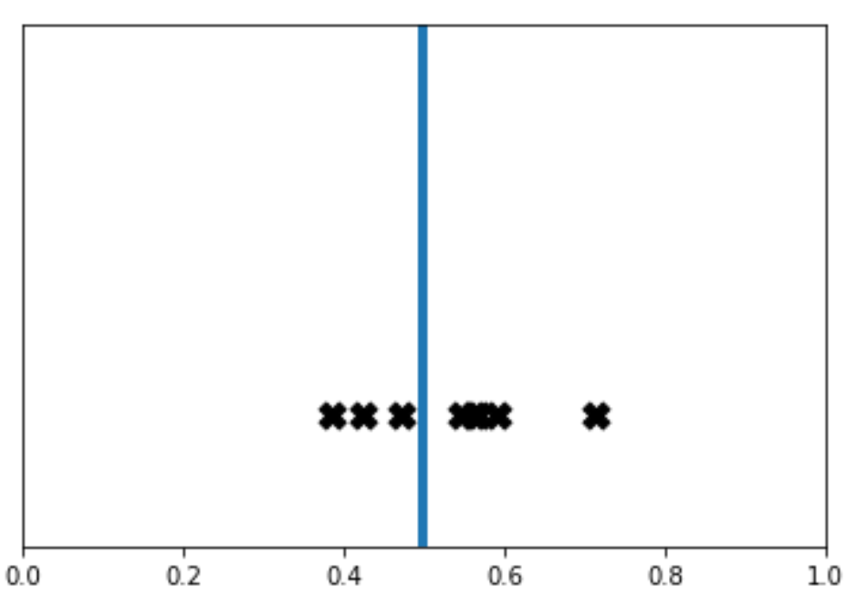
Premise
Measured value = Repeatable component + Random component
Random component :
  Includes influence of all factors affecting measurement precision
  Causes uncertainty in measured value
  Leads to uncertainty in calculated property based on the measured value

Slide 5
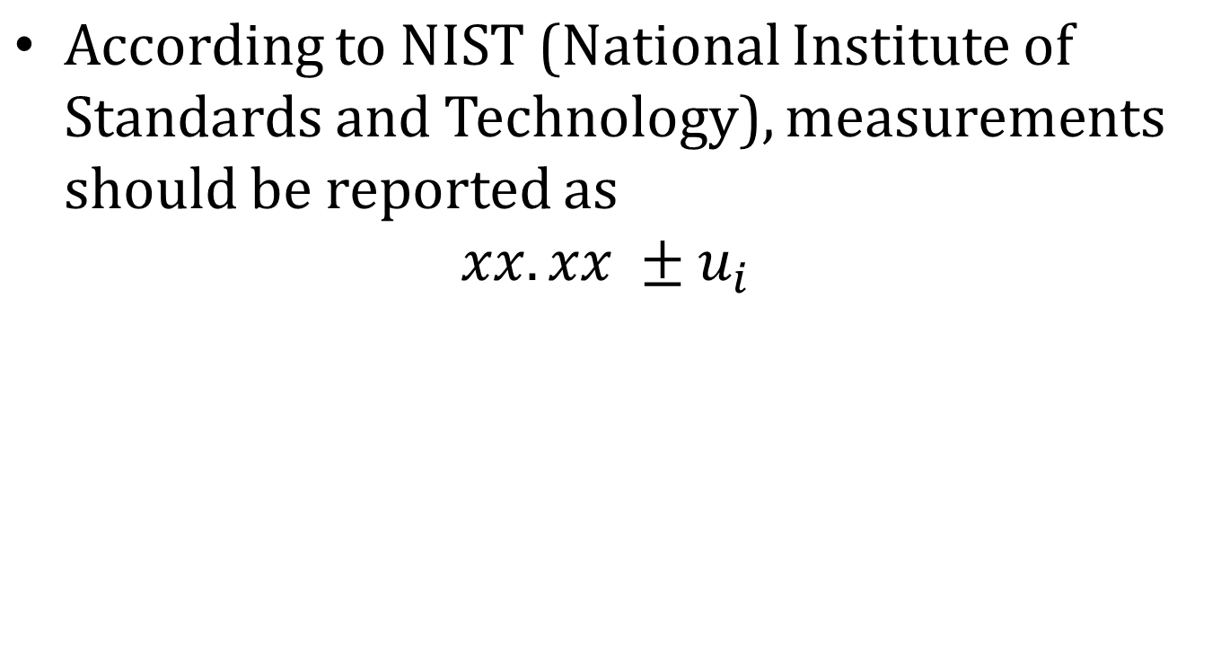
NIST Conventions
Best estimate of true value
(appropriate number of significant figures!)
standard uncertainty of measured value i
(same significant figures)

Slide 6
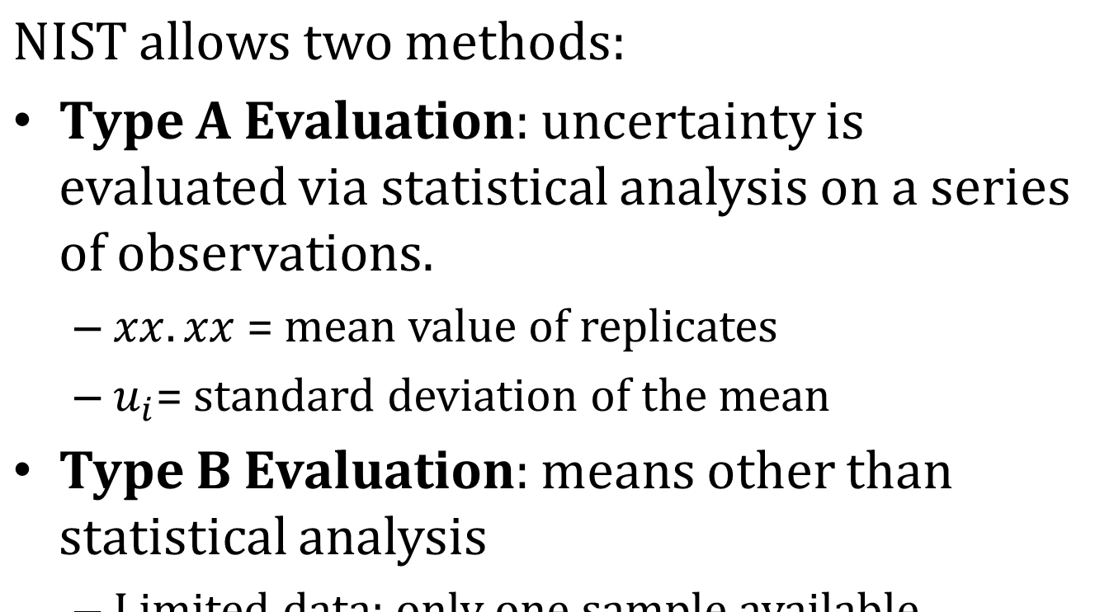
NIST Conventions

Slide 7
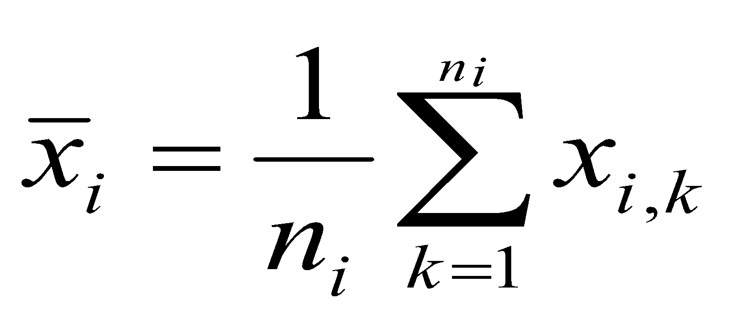
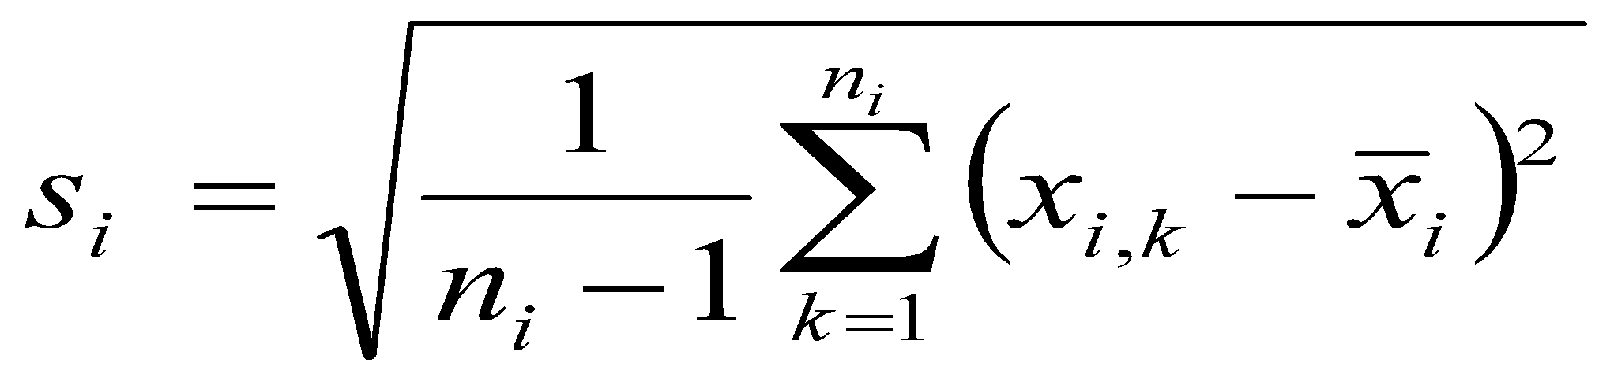
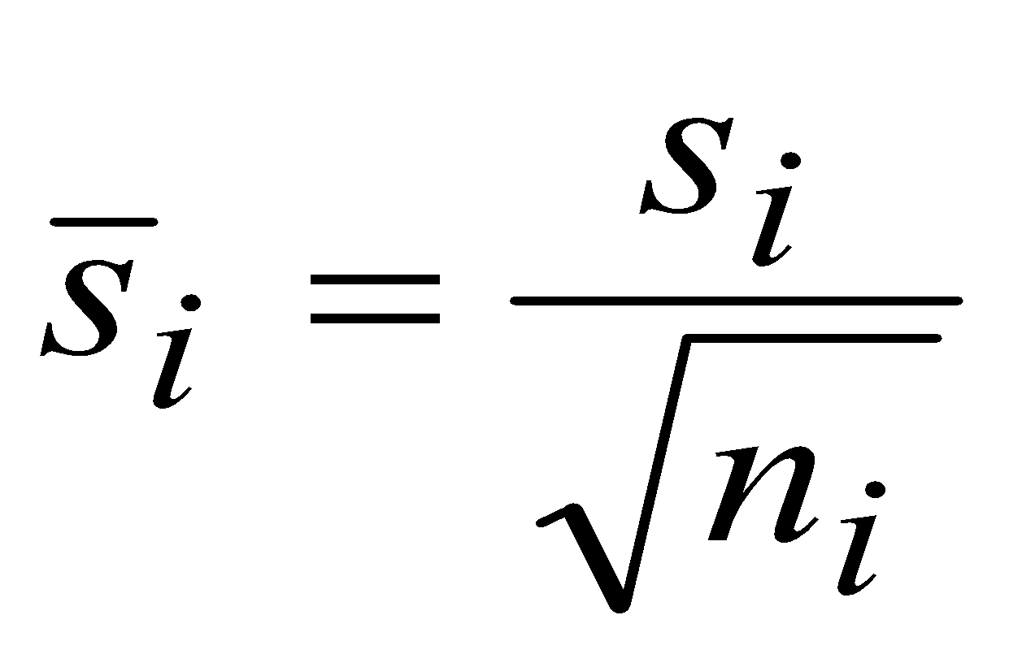
Statistical Definitions
Sample Mean
Sample Standard Deviation
Standard Deviation of the Mean

Slide 8
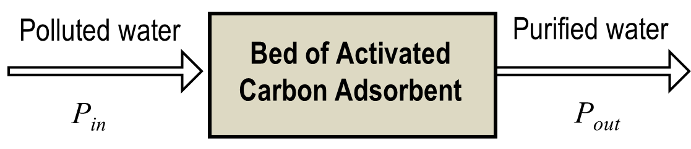
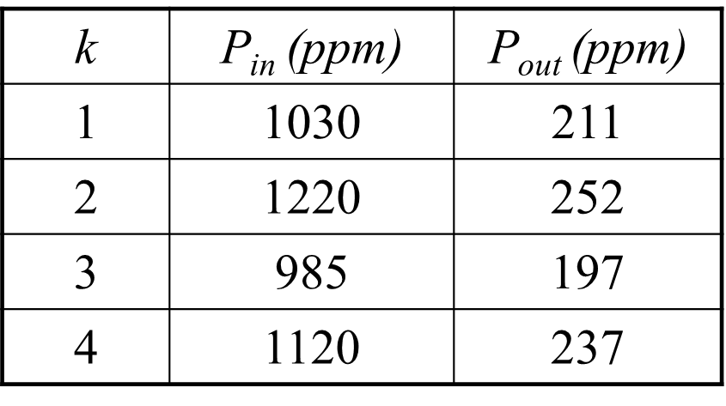
Example

Slide 9
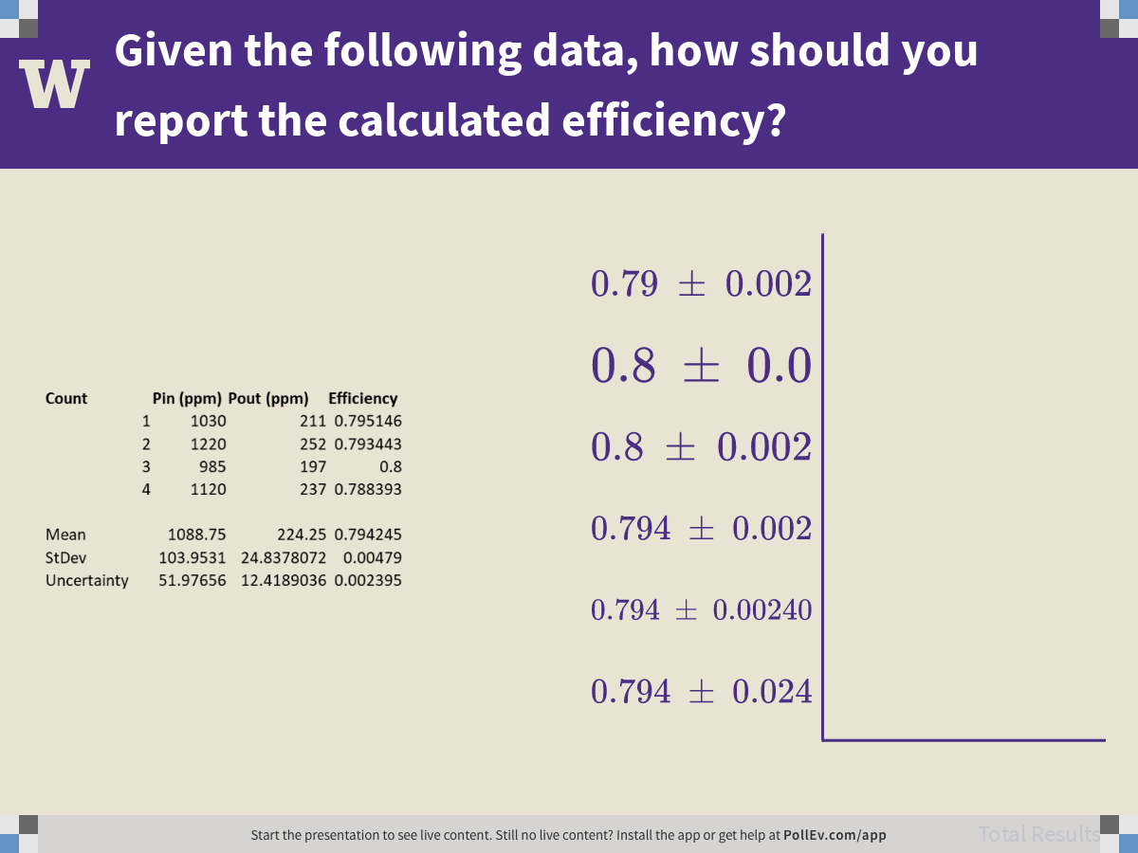
Notes:
Poll Title: Given the following data, how should you report the calculated efficiency?
https://www.polleverywhere.com/multiple_choice_polls/Y4DvugNwRjkr6kWRrg3k2

Slide 10
Type B Evaluation
Judgment based on:
Data obtained from a similar experiment
“Typical” instrument performance
Manufacturer’s specifications
Calibration report
Uncertainties assigned to handbook reference data
Etc.

Slide 11
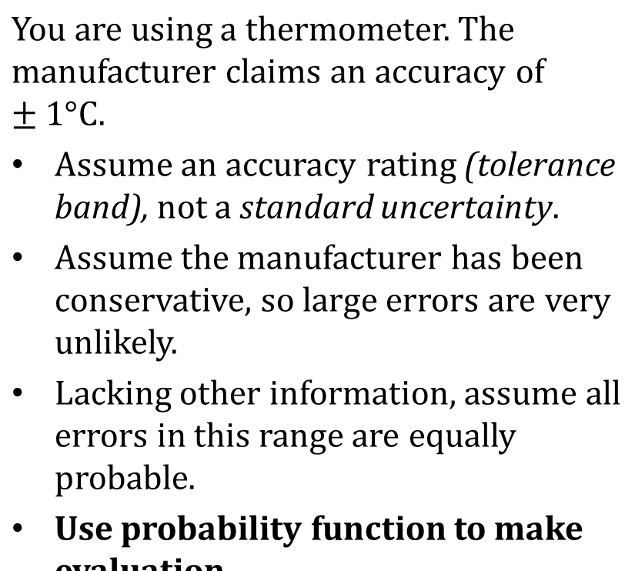
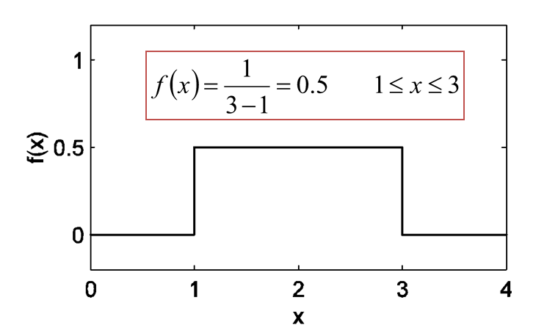
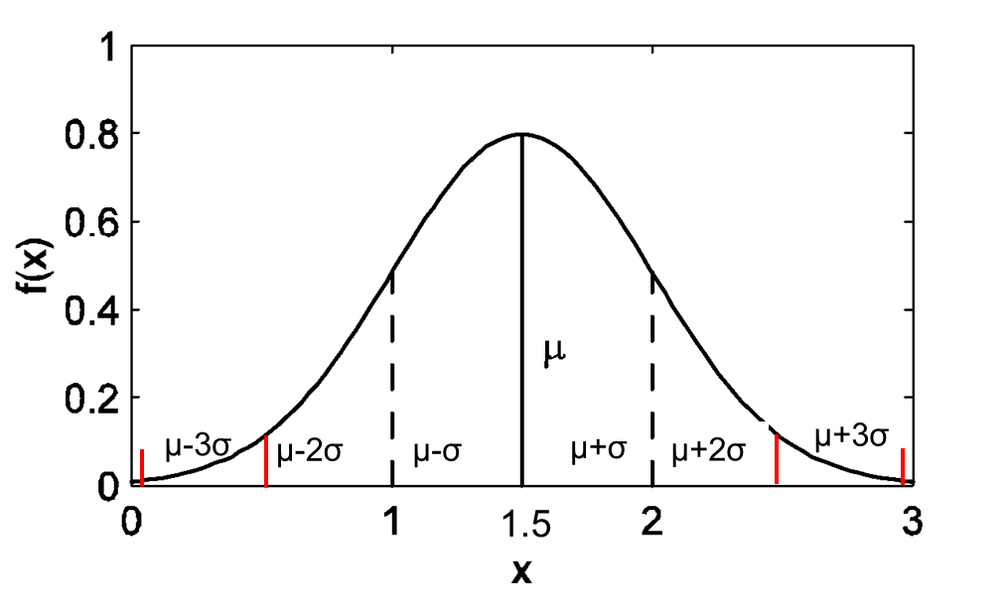
Example
Uniform Distribution
Normal Distribution

Slide 12
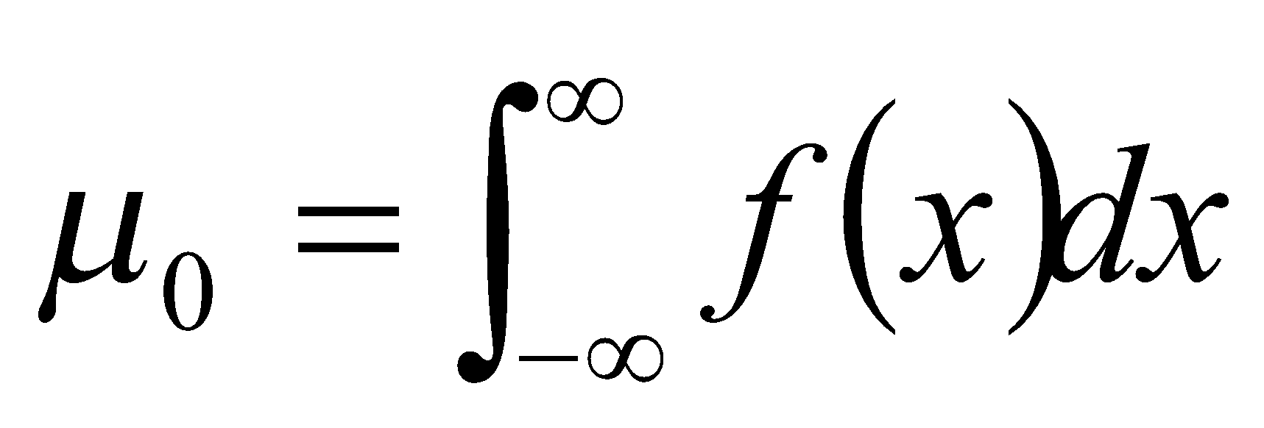
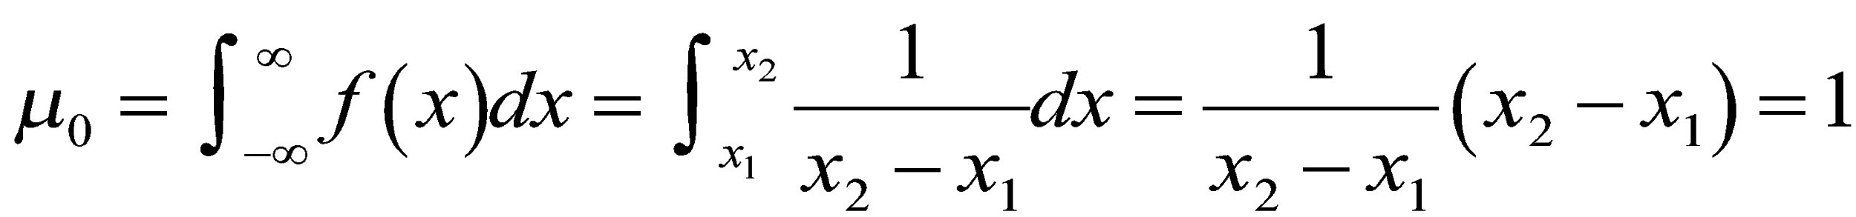
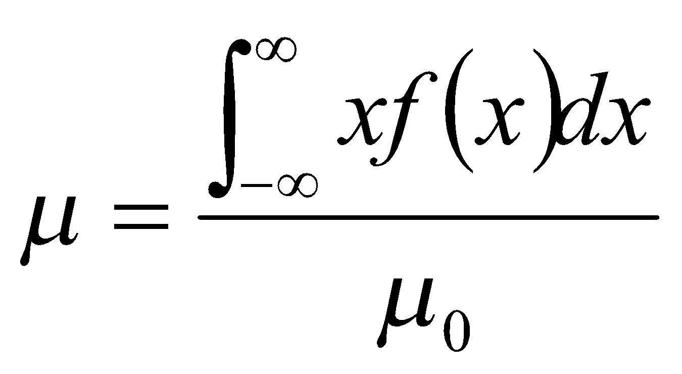
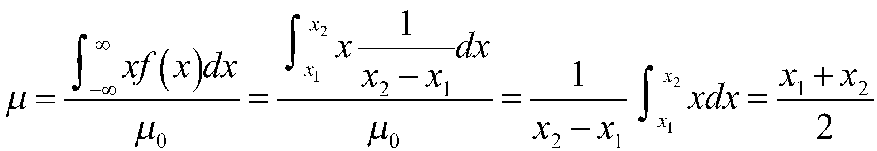
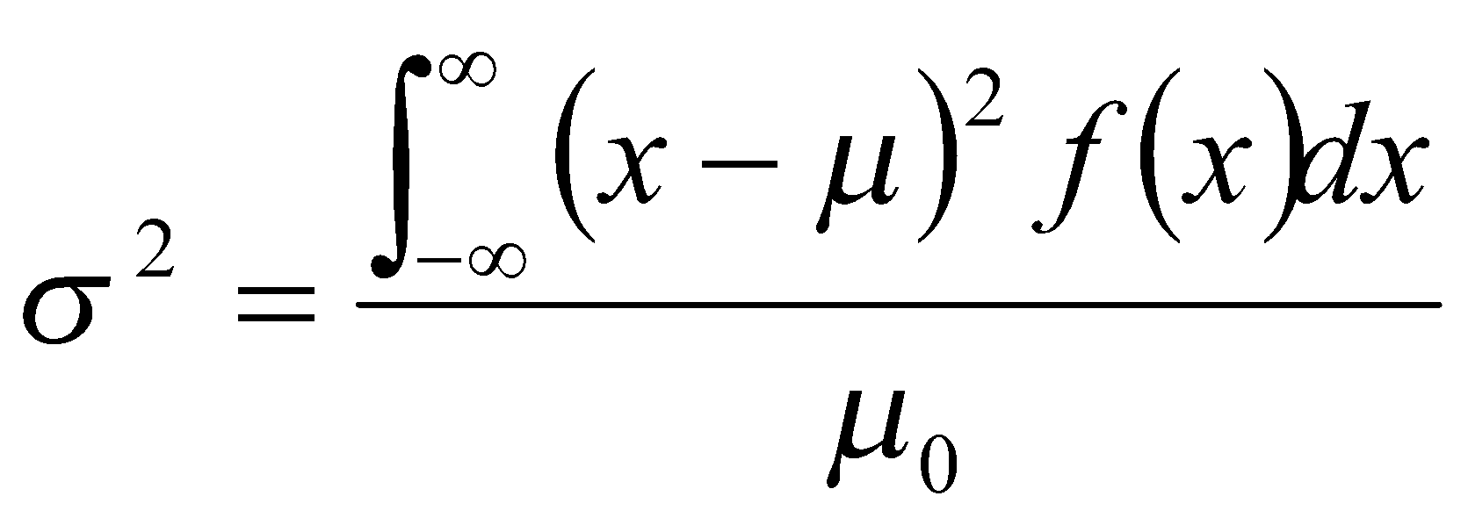
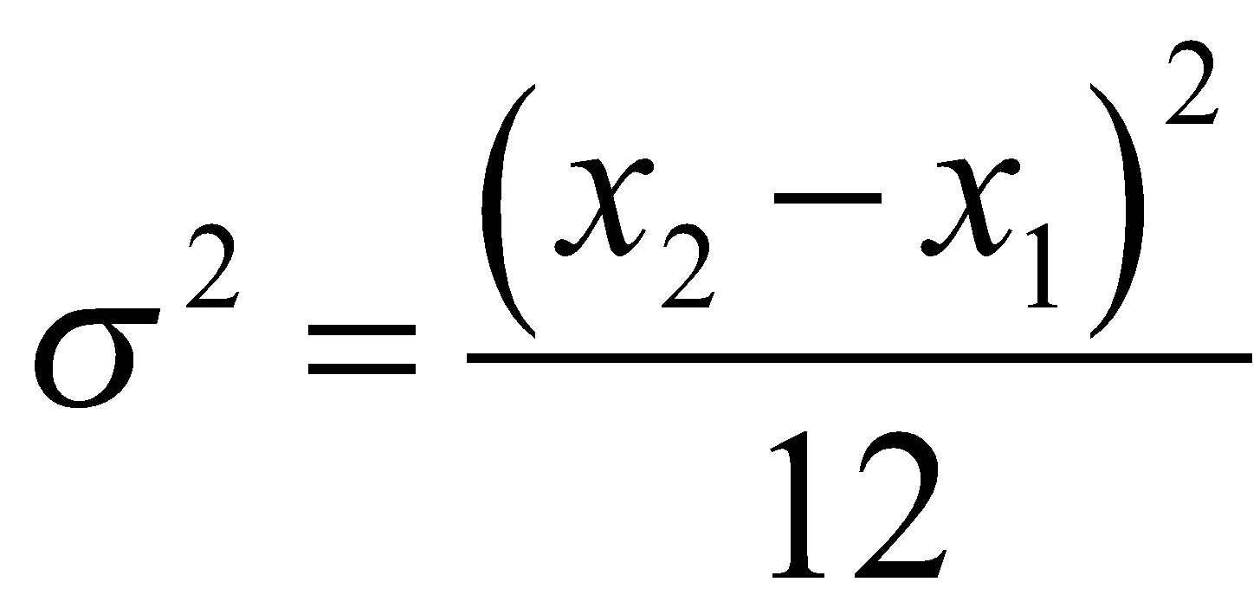
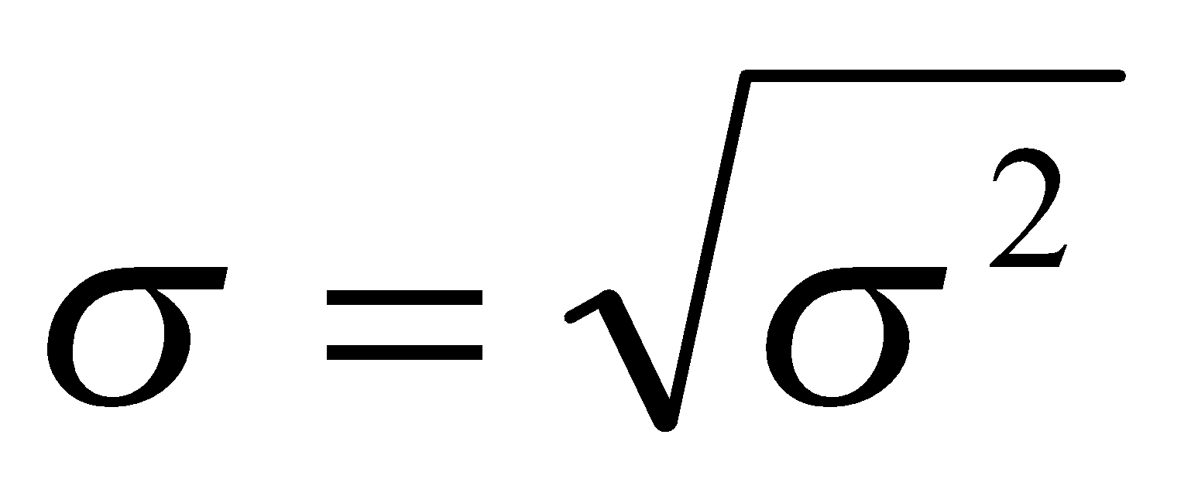
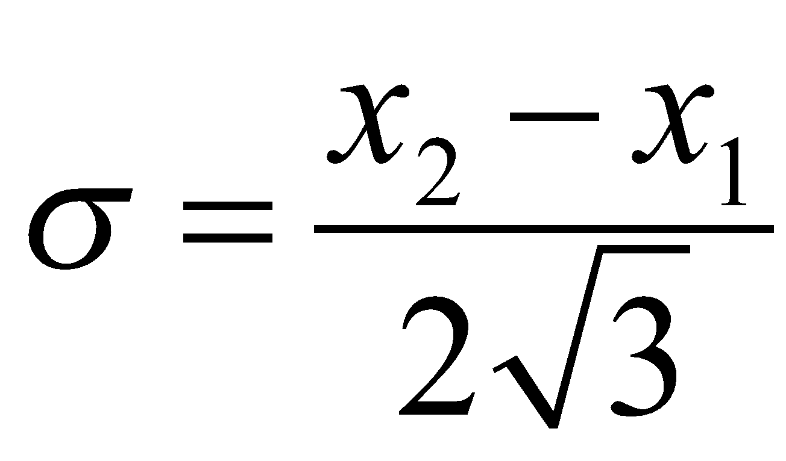
Uniform Distribution
Zeroth moment - area under f(x)
For a rectangular probability distribution
First moment – population mean
Second moment - variance
population standard deviation
(mean standard deviation)

Slide 13
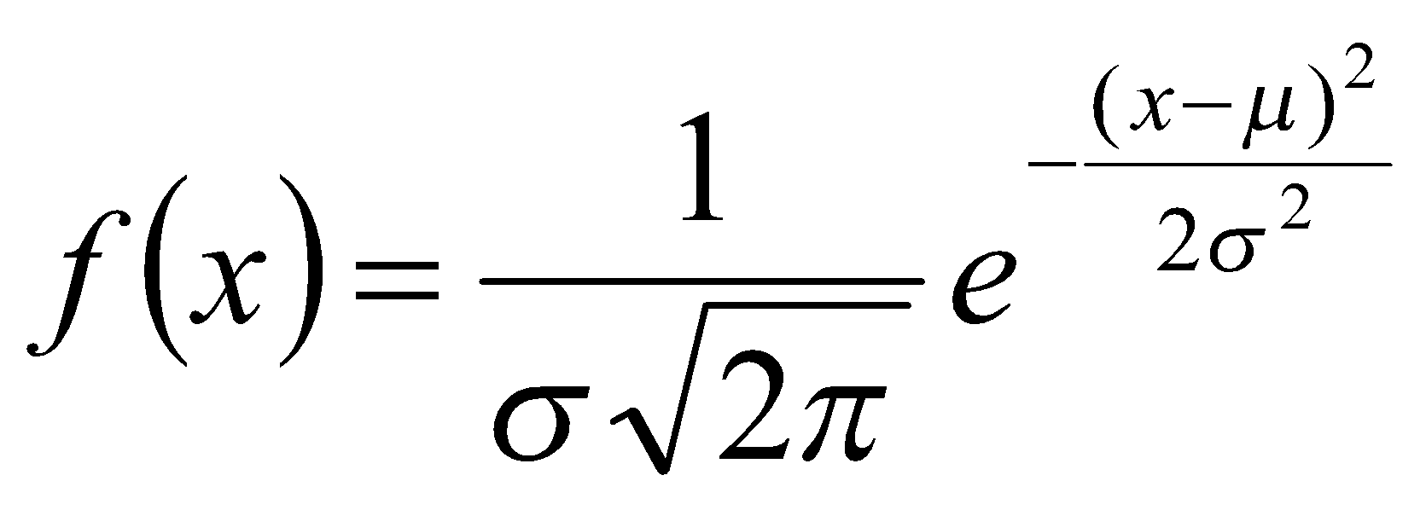

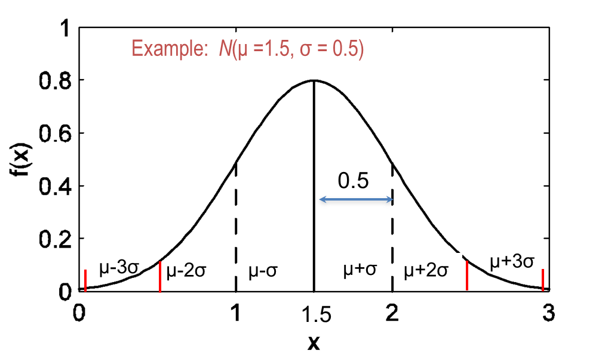
Normal Distribution
Note: x > μ + 3σ
x < μ - 3σ
very unlikely!
Thus, assume x₂ − x₁ = 6σ

