Slide 1
Elements of Design
Lecture 2
ChemE 486
Process Design II
April 1, 2020

Slide 2
ELEMENTS OF DESIGN (I)
Nature of uncertainty
Design problems, by definition, are underspecified
Additional information required from designer (that’s what makes it design)
Creativity
The ability to propose new, major, and perhaps offbeat solutions
A creative event relates two ideas previously thought to be unrelated … in a manner that is obvious
Innovation
The ability to propose next logical steps or solutions to minor problems

Slide 3
ELEMENTS OF DESIGN (II)
Solution development (brainstorming)
Understand fundamentals of system function
Analyze problem as a group or team
Collect all proposed solutions without regard to feasibility
Pruning
Reduce list of assumptions with some regard to feasibility
Choose those solutions easiest/least costly to implement
Retain one or more risky, but potentially high reward, solutions
Any uncertainties will become design alternatives

Slide 4
ELEMENTS OF DESIGN (III)
High risk / high reward development (aka Skunk Works)
Continue R&D of the risky ideas
Allow work to shift to other areas, if necessary
If another solution is found, whether more expensive or difficult to implement, patent it; it could become important years later
From Wikipedia: Skunk Works is an official pseudonym for Lockheed Martin’s Advanced Development Programs (ADP), formerly called Lockheed Advanced Development Projects. It is responsible for a number of aircraft designs, including the U-2, the SR-71 Blackbird, the F-117 Nighthawk, F-22 Raptor, and the F-35 Lightning II, which are used in the air forces of several countries. Its name was taken from the moonshine factory in the comic strip Li’l Abner. The designation “skunk works” or “skunkworks” is widely used in business, engineering, and technical fields to describe a group within an organization given a high degree of autonomy and unhampered by bureaucracy, with the task of working on advanced or secret projects.

Slide 5
CHEMICAL PLANT DEVELOPMENT (I)
Each chemical plant is result of over 500 designs
Average time from initial idea to finished product: ~6.2 years!
Type of Estimate | No. of Projects | Time | Error
Order of magnitude | ~ 500 | Days | 40%
Study estimate | ~ 100 | Weeks | 25%
Authorization | ~ 10 | Months | 12%
Project control estimate | 1 | Years | 6%

Slide 6
CHEMICAL PLANT DEVELOPMENT (II)
Strategy: Weed out unprofitable processes as early as possible
Method:
Start with simplest description of process
Successively refine it
Keep economics in mind all the way

Slide 7
GENERAL PROCESS FLOWSHEETS
Considerations
Valuable by-products, fuel
Pollution control
Recycle to feed prep. or reactor?
Purifying feed equivalent to adding sep. system

Slide 8
PROCESS FLOW DIAGRAM (PFD)
Major units shown
Stream table shows flow rates and conditions for each stream
Sufficient detail for mass and energy balances
Adheres to symbol convention (there is no fixed convention, however)

Slide 9
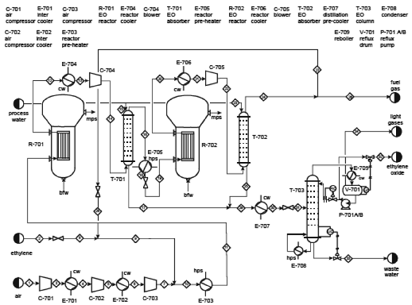
EtO PFD

Slide 10
PFD DETAILS
Streams numbered with diamonds
Process units given number and function, listed above and approximately above the unit
Stream table lists …
Flow rates of each stream and component (mass and/or molar quantities)
Physical conditions: temp., pres., vapor fraction, etc.
Major design aspects in the EtO PFD
Large compressor train for air
Two reactors in series
Keep conversion low to minimize combustion

Slide 11
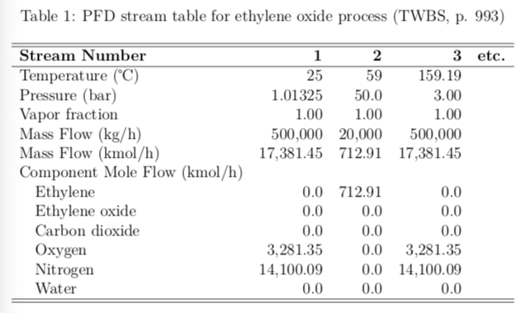
EtO STREAM TABLE

