Slide 1
ChemE 486: Design II
Lecture ?
Environmental Regulation for Chemical Engineers
Prof. Chad Curtis
May 27, 2020

Slide 2


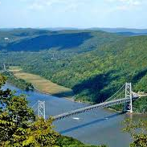
Objectives
Understand why chemical engineers should understand environmental law
Understand the role of government actors who determine environmental law
Understand how the environmental laws at different levels of government interact with each other
Understand the relevant statutory provisions that apply to the chemical industry

Slide 3
Why Environmental Law?
Environmental law requires chemical engineers to perform affirmative duties, which, if not discharged, can hold chemical engineers and their employers civilly/criminally liable.
Engineers are held to a professional code of ethics to “hold paramount the safety, health and welfare of the public and protect the environment.”
Chemical engineers who understand environmental law will be able to lobby for more effective law and regulations in the future.
Chemical engineers must communicate with environmental law professionals.

Slide 4

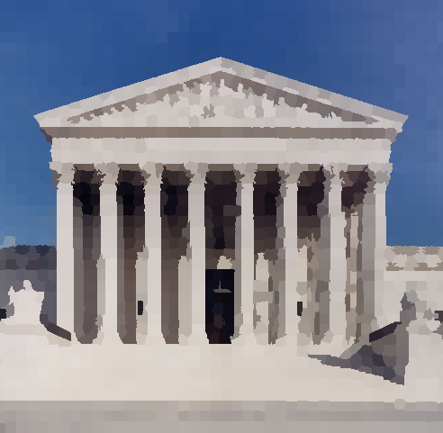
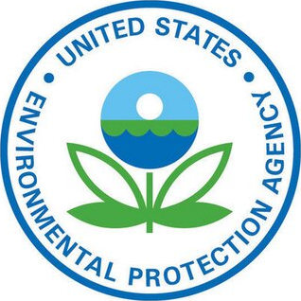
Governmenment Actors
Legislatures
Courts
Agencies

Slide 5
Legislatures
Enacts laws at the federal, state, and local levels.
Often do not have time or expertise to determine how statutes should be implemented – also allows them to avoid political heat. Defers these responsibilities to agencies.
Legislatures

Slide 6
Administrative Agencies
Agencies can be created by any branch of government, but administrative agencies are usually created by statute. Their powers are derived from the enabling legislation.
Agencies make rules and submit them to the Federal Register where they have the force of law.
Agencies also have authority to decide disputes arising from the exercise of their administrative powers.
Agencies

Slide 7
Courts
Courts resolve disputes over environmental regulation e.g.
A regulated entity may argue that it isn’t subject to a specific statutory program.
A regulated entity may argue that the environmental statue is unconstitutional.
A regulated entity may argue the agency didn’t have the power to develop and promulgate the regulation (ultra vires challenge)
A regulated entity may argue on procedural grounds that violations were made in how the regulation was implemented or promulgated.
Courts
Shell Oil Co. vs. Environmental Protection Agency (1991):
“Because the EPA failed to provide adequate notice and opportunity for comment with regard to the mixture and derived-from rules… we vacate these rules and remand them to the Agency.”
Notes:
The “mixture” rule required listed hazardous wastes to be regulated as hazardous wastes even when they were mixed with large quantities of non-hazardous wastes.

Slide 8
Courts
Before a party can seek judicial redress, they must establish standing, usually meaning they suffered some definable harm rather than harm suffered by the public at large.
Parties must also exhaust their administrative remedies, meaning they must go through administrative courts first.
Courts are very careful in terms of judicial review because
Agencies are considered experts on administrative matters
Judicial decisions could potentially threaten the separation of powers.
Courts
City of Klamath Falls vs. Environmental Quality Commission (1994)
“Initial interpretation of a regulation is for the administrative agency entrusted with that task by the legislature; it is not for appellate courts on judicial review. We are not able to hold, as the City argues we should, that EQC misinterpreted its own regulation as a matter of law.”
Notes:
EQC (1994):
The Oregon Supreme Court upheld a state environmental commission’s refusal to certify a hydroelectric facility because the facility would violate a state water temperature standard designed to protect trout. The City argued that the water temperature wouldn’t harm trout, and so didn’t violate the law.

Slide 9
Courts
Courts also are responsible for common law cases, cases determined by judicial precedent rather than legislative statute.
There are four causes of action that predominantly affect environmental law:
Nuisance: the defendant unreasonably interfered with the quiet enjoyment of his or her land.
Trespass: the defendant physically invaded his or her property.
Strict liability: the defendant operated an abnormally dangerous activity.
Negligence: the defendant breached the duty to act reasonably when acting in ways that could harm others.
Courts
Boomer et al v. Atlantic Cement Company (1970)
“The permanment impairment of private property for private purposes is not authorized in the absence of clearly demonstrated public benefit use… I would enjoin the defendant cement company from continuing the discharge of dust particles upon its neighbors’ property.”
Notes:
EQC (1994):
The Oregon Supreme Court upheld a state environmental commission’s refusal to certify a hydroelectric facility because the facility would violate a state water temperature standard designed to protect trout. The City argued that the water temperature wouldn’t harm trout, and so didn’t violate the law.

Slide 10
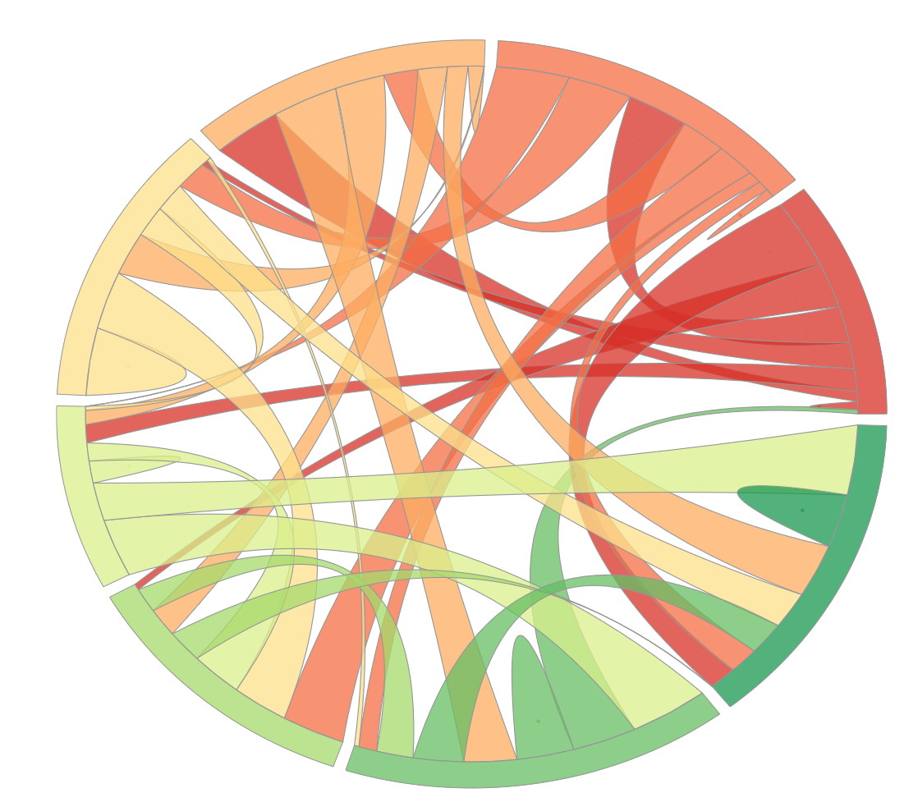
A tangled web of regulation
U.S. Congress
State Legislatures
U.S. Supreme Court, federal courts of appeals and district courts
Local governing bodies
State courts
EPA and other federal agencies
Local agencies
State agencies

Slide 11
Forms of interaction
Laws can interact in one of four ways:
No interaction
Complement each other
Require the same thing
Conflict with each other
The Clean Water Act allows states to implement the national pollutant discharge elimination system, instead of direct regulation from the EPA, complementing each other:
33 U.S.C.A. §1342(b)
“The Governor of each State desiring to administer its own permit program for discharges into navigable waters within its jurisdiction may submit to the Administrator a full and complete description of the program it proposes to establish…”

Slide 12
Doctrine of preemption
Supremacy Clause: in any area where the federal government has been accorded national powers, its regulatory authority can be exercised:
“This Constitution, and the Laws of the United States which shall be made in Pursuance thereof; and all Treaties made, or which shall be made, under the Authority of the United States, shall be the supreme Law of the Land; and the Judges in every State shall be bound thereby, any Thing in the Constitution or Laws of any State to the Contrary notwithstanding.”
Tenth Amendment: in areas that haven’t been delegated to the federal government, the states have unfettered authority to regulate:
“The powers not delegated to the United States by the Constitution, nor prohibited by it to the States, are reserved for the States respectively, or to the people.”

Slide 13
The Commerce Clause
Congress’s environmental regulatory powers are derived from the Commerce Clause:
Congress shall have power “to regulate Commerce with foreign Nations, and among the several States, and with the Indian Tribes.”
United States V. Lopez (1995)
Held that Congress exceeded its constitutional commerce authority when it enacted a statute to regulate the possession of guns near schools.
“To uphold the government’s contention here, we… would bid fair to convert congressional authority under the Commerce Clause to a general police power of the sort retained by the States.”

Slide 14
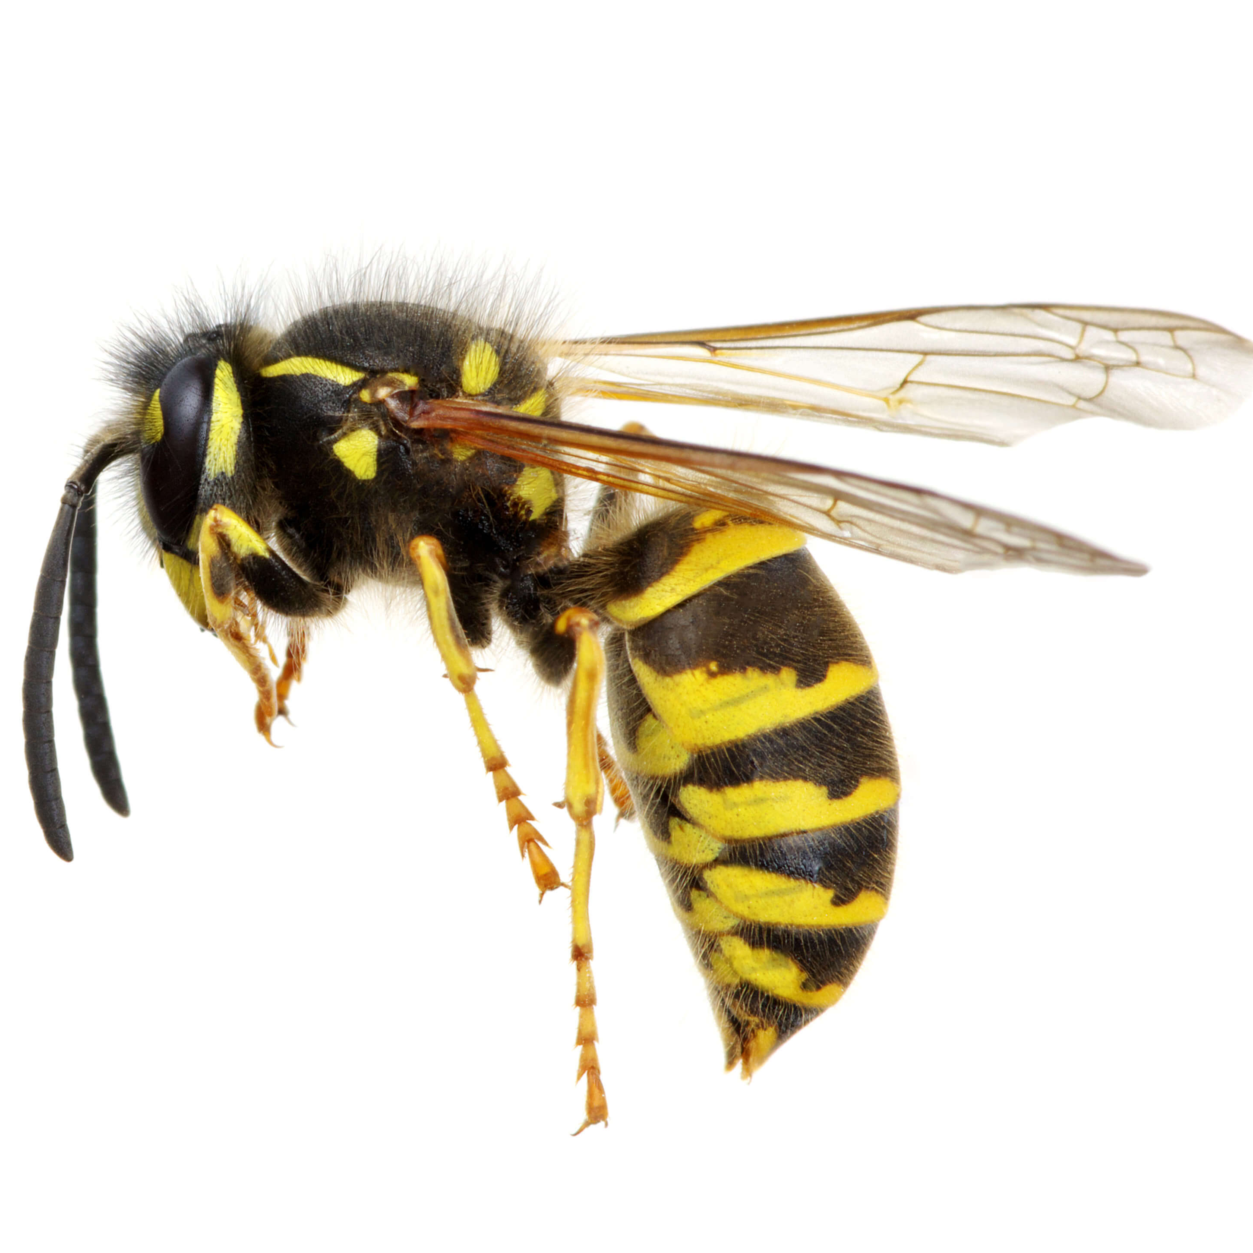
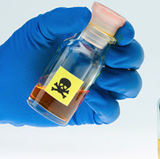

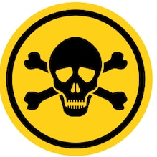

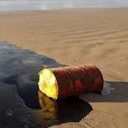
Nine Federal Environmental Regulations
Federal Insecticide, Fungicide, and Rodenticide Act
Toxic Substance Control Act
Clear Air Act
Pollution Prevention Act
Clean Water Act
Occupational Safety and Health Act
Resource Conservation and Recovery Act
Comprehensive Environmental Response, Compensation, and Liability Act
Emergency Planning and Community Right-to-Know Act

Slide 15
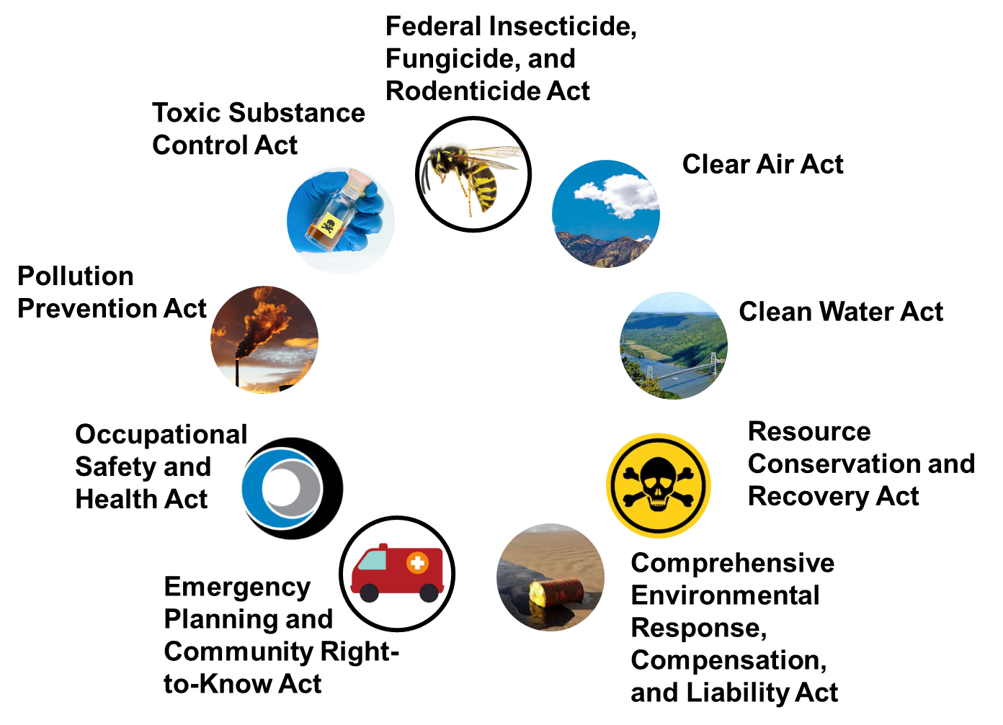
Exercise: Environmental Settlements
Select one of the 9 federal environmental regulations below.
Using the EPA’s Civil Cases and Settlement’s search tool to find a case involving a chemical or manufacturing company.
Identify what rules were violated, and what the settlement or penalty involved.
https://cfpub.epa.gov/enforcement/cases/index.cfm?templatePage=12&ID=9

Slide 16

Toxic Substances Control Act (1976)
Sparked by the contamination of the Hudson River with polychlorinated biphenyls and the contamination of milk cows by polybrominated biphenyls in Michigan.
Requires the EPA to screen new chemicals and certain existing chemicals to assess their risks.
When a chemical is found to pose an “unreasonable risk” to human health or the environment, the EPA is authorized to take action.
“Dover violated section 5(a) of Toxic Substances Control Act 15. U.S.C. § 2604(a)(l) by manufacturing short-chained, medium-chained, and long-chained chlorinated paraffins without first submitting a pre-manufacture notice to the Administrator of EPA at least 90 days before manufacturing such substance.”
Fine: $1.4 million
Notes:
https://cfpub.epa.gov/enforcement/cases/index.cfm?templatePage=12&ID=9

Slide 17


Federal Insecticide, Fungicide, and Rodenticide Act
Originally enacted in 1947, but amended in 1972 to strengthen enforcement provisions, shifting emphasis from labelling to protecting health and environment and more regulatory powers.
Pesticides must be registered with the EPA before they are distributed or sold.
Scotts distributed or sold millions of units of unregistered, improperly labeled, and formulated pesticides in violation of FIFRA since 2003… More than 100 Scotts’ products were in violation of FIFRA
Fine: $6 million civil penalty, and $2 million in environmental projects

Slide 18



Clean Air Act
Requires new and existing sources of air pollution to comply with source-specific emission limits designed to meet air quality standards.
1990 amendments
Established market-based emissions allowances for SO2
Established a clean-fuel vehicle program
Created a market for alternative fuels and required tailpipe emission standards.
Instituted a state-run permit program for point sources.
U.S. v. NGL Crude Logistics (2018)
NGL failed to retire RINs when it designated the biodiesel it sold to Western Dubuque as a “feedstock.”
NGL illegally transferred invalid RINs that Western Dubuque generated from NGL’s methyl ester “feedstock”
NGL caused Western Dubuque to commit prohibited acts.
Fine: purchase and retire 36 million valid RINS, and a civil penalty of $25 million
Notes:
RINs are renewable fuel credits

Slide 19


Occupational Safety and Health Act
Requires OSHA to set workplace standards that are designed to provide all workers with a safe and healthy work environment e.g. exposure limits, labeling reqs, PPE, monitoring reqs.
Establishes uniform hazard communication requirements (e.g. MSDSs)
Requires employers to maintain records of employees’ work-related deaths, injuries, and illnesses.
Republic Steel (2013)
“OSHA received a formal complaint from the United Steelworkers Union alleging inadequate fall protection and other unsafe practices exposing workers to various hazards in the plant’s melt shop. During the inspection, OSHA discovered that two workers had been seriously injured in falls at the site.”
Fine: $1.1 million
Notes:
RINs are renewable fuel credits

Slide 20

Clean Water Act
Requires OSHA to set workplace standards that are designed to provide all workers with a safe and healthy work environment e.g. exposure limits, labeling reqs, PPE, monitoring reqs.
Establishes uniform hazard communication requirements (e.g. MSDSs)
Requires employers to maintain records of employees’ work-related deaths, injuries, and illnesses.
Republic Steel (2013)
“OSHA received a formal complaint from the United Steelworkers Union alleging inadequate fall protection and other unsafe practices exposing workers to various hazards in the plant’s melt shop. During the inspection, OSHA discovered that two workers had been seriously injured in falls at the site.”
Fine: $1.1 million
Notes:
RINs are renewable fuel credits

