Slide 1
Start using CSS Grid today

Slide 2
Agenda
We’re not going to get into the weeds
Several examples
Lessons learned
Compare current code to CSS Grid
Real life examples

Slide 3
CSS Grid lessons learned
Grid doesn’t have to be complicated or hard to learn
You can get really complicated with it or you can keep it super simple
You can use it in small parts of a page – you don’t have to try to figure out how to use it for your whole page or site layout

Slide 4
CSS Grid lessons learned, continued
If you’re learning or even if you just want to understand your code later, keep it simple & maybe don’t use the grid shorthand
.container {
grid: 100px 300px / 3fr 1fr;
}
Use tools that minify and compress to your advantage.

Slide 5
About that example…
This:
.container {
grid: 100px 300px / 3fr 1fr;
}
Is the same as:
.container {
grid-template-rows: 100px 300px;
grid-template-columns: 3fr 1fr;
}
Source: CSS Tricks

Slide 6

Example from uw.edu

Slide 7
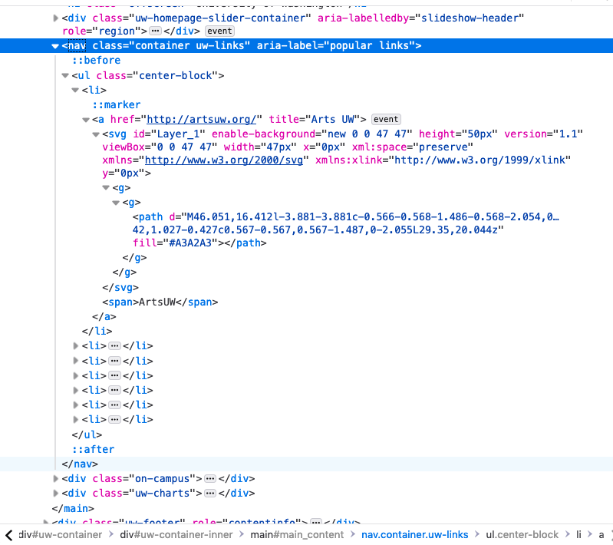
Current HTML for block nav

Slide 8
.uw-links {
position: relative;
margin-top: -20px;
background-color: white;
.box-shadow(0px 0px 4px rgba(164, 164, 164, 0.5));
ul {
padding: 0;
list-style: none;
li {
a {
font-family: @font-family-headline;
color: @purple;
font-weight:800;
text-align: center;
display: block;
width: 14%;
float: left;
padding: 10px 0 0;
margin: 35px 0 40px;
-moz-box-sizing: border-box;
-webkit-box-sizing: border-box;
box-sizing: border-box;
text-transform: uppercase;
border-right: 1px solid #EBEBEB;
transition: all .1s ease-in-out;
line-height: 1.3;
&:hover svg, &:focus svg {
transform: scale(1.15);
transition: all 0.1s ease;
transform-origin: center center;
path {
fill: @purple;
}
}
span {
display: block;
margin-top: 10px;
}
&:focus { text-decoration: none; }
}
&:last-child a { border: none; }
}
}
}

Slide 9
.home #uw-container div#uw-container-inner {
background-color: #F0EDE3;
}
// Mobile
@media only screen and (max-width : 767px) {
.uw-links {
padding: 3% 0;
ul li {
padding: 0 5%;
a {
width: 23%;
padding: 10px 0;
margin: 10px 5%;
font-size: 13px;
line-height: 14px;
border-right: none;
span { padding-top: 6px; }
}
}
}
}

Slide 10
New code – HTML, using Bootstrap 4
Original:
<nav aria-label="popular links" class="container
uw-links">
<ul class="center-block">
Changed to:
<nav aria-label="popular links" class="secondary-nav-basic popular-links">
<ul class="nav">
The HTML could be identical.
The main difference in the HTML is we are using the Bootstrap nav class on the <ul>. On other menus we’re using the full Bootstrap nav but not here.

Slide 11
Reminder of this visually

Slide 12
New code – CSS (Sass)
nav.popular-links {
@include shadow-2;
border: 1px solid rgba(0, 0, 0, 0.14);
border-radius: 2px;
ul.nav {
display: grid;
grid-template-columns: repeat(auto-fit, minmax(140px, 1fr));
justify-content: center;
margin: 0;
padding: 0;
list-style: none;
li {
border-left: 1px solid rgba(0, 0, 0, 0.14);
line-height: 20px;
margin: 40px 0;
&:first-child { border-left: 0 none; }
a {
display: flex;
flex-direction: column;
align-items: center;
text-decoration: none;
span, h4 {
display: block;
text-align: center;
}
span {
color: $purple;
font-family: $headings, sans-serif;
font-weight: bold;
font-size: 20px;
margin-top: 10px;
}
}
}
}
}

Slide 13
Grid Template Columns
ul.nav {
display: grid;
grid-template-columns: repeat(auto-fit, minmax(140px, 1fr));
justify-content: center;
}
What the heck is going on here?
Set up grid columns to repeat – as long as they fit in the parent element (auto-fit)
minmax: the minimum width of each column is 140px, the maximum is 1fr.
fr: Fractional unit. Represents a fraction of the free space on the container grid, so these boxes fill the open space.

Slide 14
Flexbox inside Grid??
li {
a {
display: flex;
flex-direction: column;
align-items: center;
}
}
What the heck is going on here?
We’re setting each link to display flexbox, as a column, and align items in the center.
This gives us the stacked, centered layout of each link box.
You can use flexbox inside grid, grid inside flexbox, and even grid inside grid (but that gets tricky and isn’t fully supported yet).

Slide 15
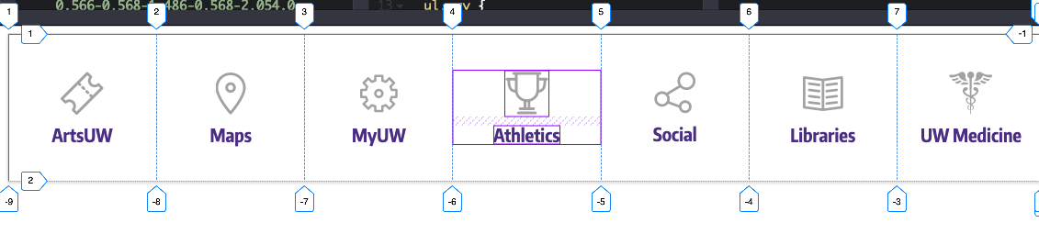
Example with Firefox Developer Tools grid & flex overlays enabled

Slide 16
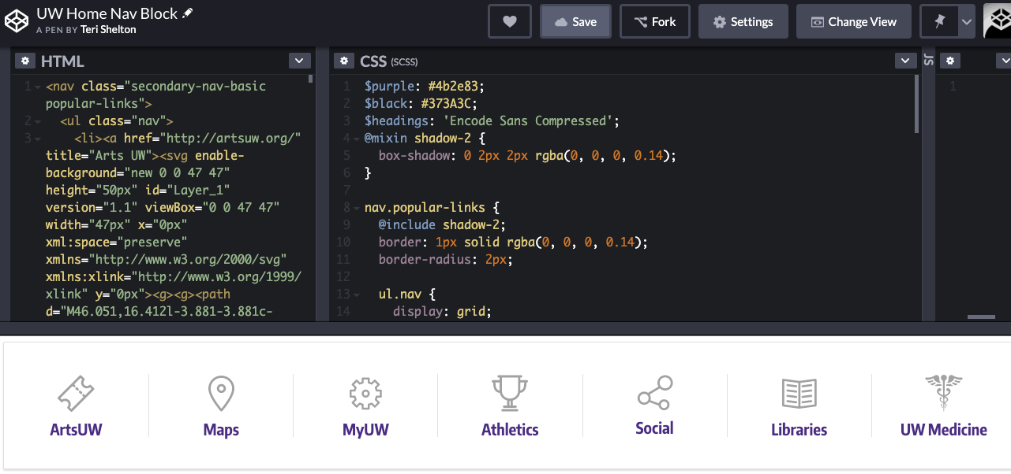
See this example live

Slide 17
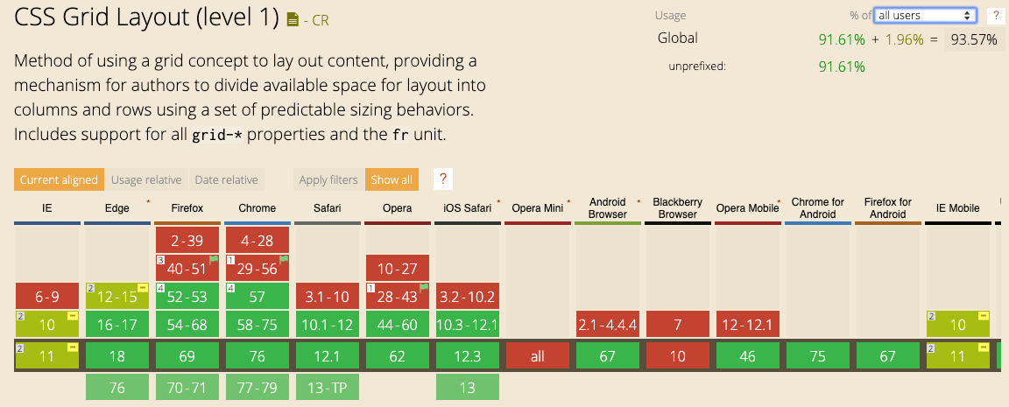
But what about browser support?

Slide 18

Browser usage
94% of browsers being used in the world can use CSS Grid!
92% can use it without prefixing
Know your users

Slide 19
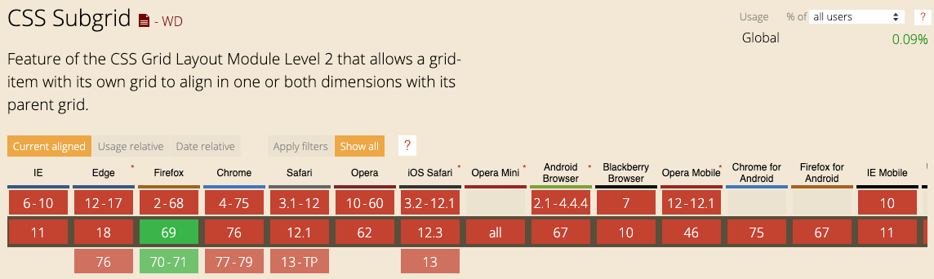
Subgrid support is another story
Only .09% usage

Slide 20
We’re using grid now
Impactful Stories: https://www.washington.edu/boundless/stories/
Sea lessons, Policy in Action, Caring for Every Child
Perfect LinkedIn Profile page: https://www.washington.edu/social/perfect-linkedin-profile/

Slide 21
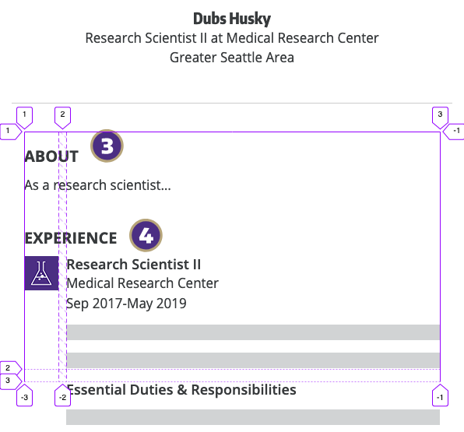
Perfect LinkedIn Profile page

Slide 22
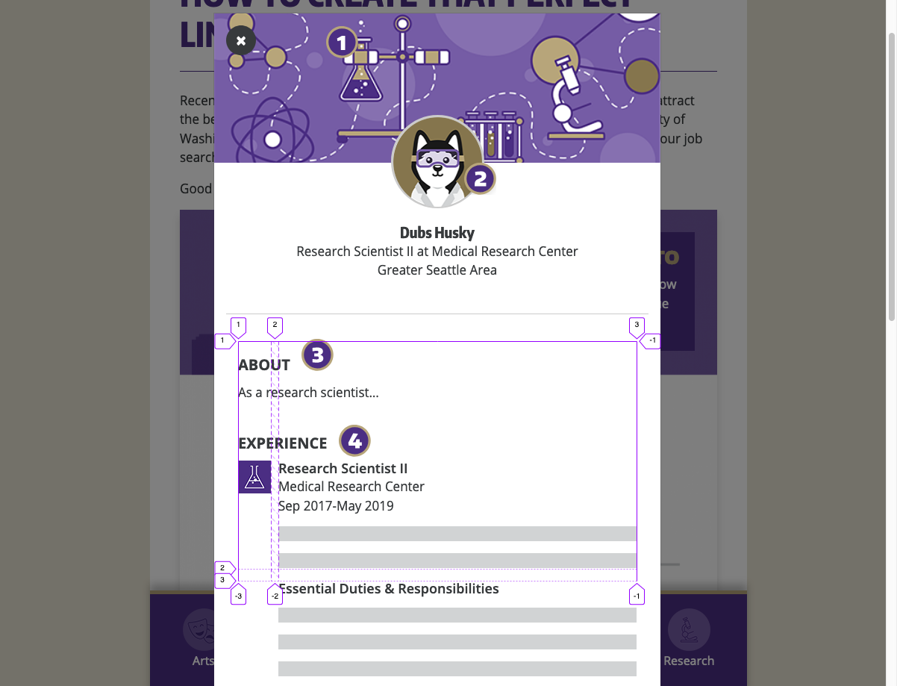

Slide 23
Perfect LinkedIn Profile – simplified HTML
<div class="experience-layout">
<img src="https://s3-us-west-2.amazonaws.com/uw-s3-cdn/wp- content/uploads/sites/67/2019/07/31141504/research-medical-research-center.png" alt="Research Group icon" width="44" height="44" class="alignnone size-full wp-image-75” />
<div class="experience-description">
<h3>Research Scientist II</h3>
<p>Medical Research Center<br>
Sep 2017-May 2019</p>
...
<h3>Essential Duties &amp; Responsibilities</h3>
...
</div>
</div>

Slide 24
Perfect LinkedIn Profile – CSS (Sass)
.experience-layout {
display: grid;
grid-template-columns: 44px 1fr;
grid-column-gap: 10px;
img {
grid-column-start: 1;
grid-row-start: 1;
}
.experience-description {
grid-column-start: 2;
grid-row-start: 1;
}
}

Slide 25
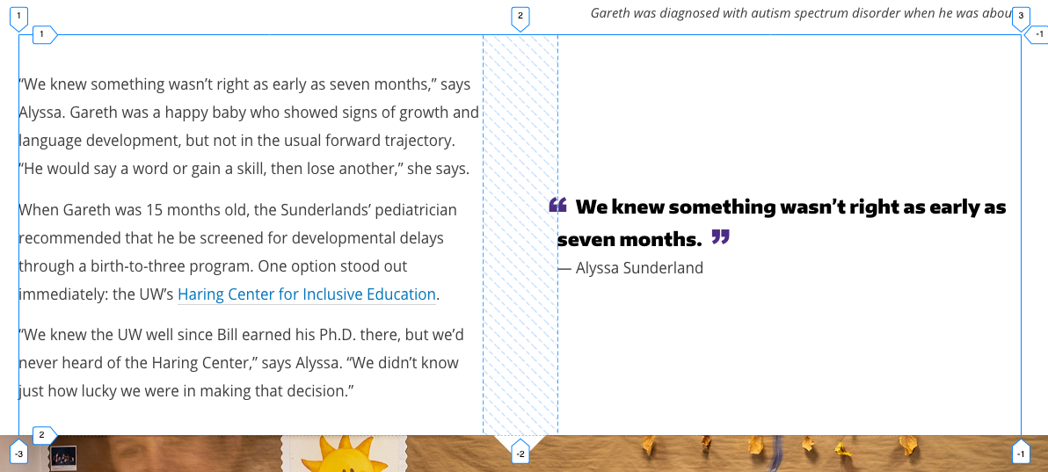
Caring for every child story

Slide 26
Caring for every child - HTML
<div class="col-lg-12 grid">
<div class="copy">
<p>&ldquo;We knew something wasn&rsquo;t right as early as seven months,&rdquo; says Alyssa. Gareth was a happy baby who showed signs of growth and language development, but not in the usual forward trajectory. &ldquo;He would say a word or gain a skill, then lose another,&rdquo; she says.</p>
<p>When Gareth was 15 months old, the Sunderlands&rsquo; pediatrician recommended that he be screened for developmental delays through a birth-to-three program. One option stood out immediately: the UW&rsquo;s <a href="https://haringcenter.org/">Haring Center for Inclusive Education</a>.</p>
<p>&ldquo;We knew the UW well since Bill earned his Ph.D. there, but we&rsquo;d never heard of the Haring Center,&rdquo; says Alyssa. &ldquo;We didn&rsquo;t know just how lucky we were in making that decision.&rdquo;</p>
</div>
<div class="quote-cite center-mobile top-quote">
<blockquote>We knew something wasn&rsquo;t right as early as seven months.</blockquote>
<cite>&mdash; Alyssa Sunderland</cite>
</div>
</div><!-- .col-lg-12 .copy .grid -->

Slide 27
Caring for every child – CSS (Sass)
.text-block .row .grid {
display: grid;
grid-template-columns: 1fr 1fr;
.copy {
grid-column: 1;
grid-row: 1;
margin-right: 2.5em;
}
.quote-cite {
grid-column: 2;
grid-row: 1;
align-self: center;
margin-left: 2.5em
}
@supports (grid-column-gap: 1rem) {
grid-column-gap: 5em;
.copy { margin-right: 0; }
.quote-cite { margin-left: 0; }
}
}

Slide 28
Resources
CSS Tricks: Complete Guide to Grid
Rachel Andrew’s Grid by Example
Can I Use?
Firefox Developer Tools
MDN & MDN Newsletter
PostCSS with Autoprefixer and Preset Env (previously CSSNext)
Use with Gulp and BrowserSync to automate workflow!

Slide 29
Questions?
Teri Shelton
Front-End Developer, Web Strategy, UMAC
tjshelt@uw.edu

