Slide 1
CSS in Emails
Front End Developers Community of Practice
Sept. 17, 2019

Slide 2
CSS in Emails
Overview:
Coding like it’s 1999!
Anatomy of a generic HTML email
A look at what’s specific to Marketo templates
Developing for dozens of browsers/devices/clients

Slide 3
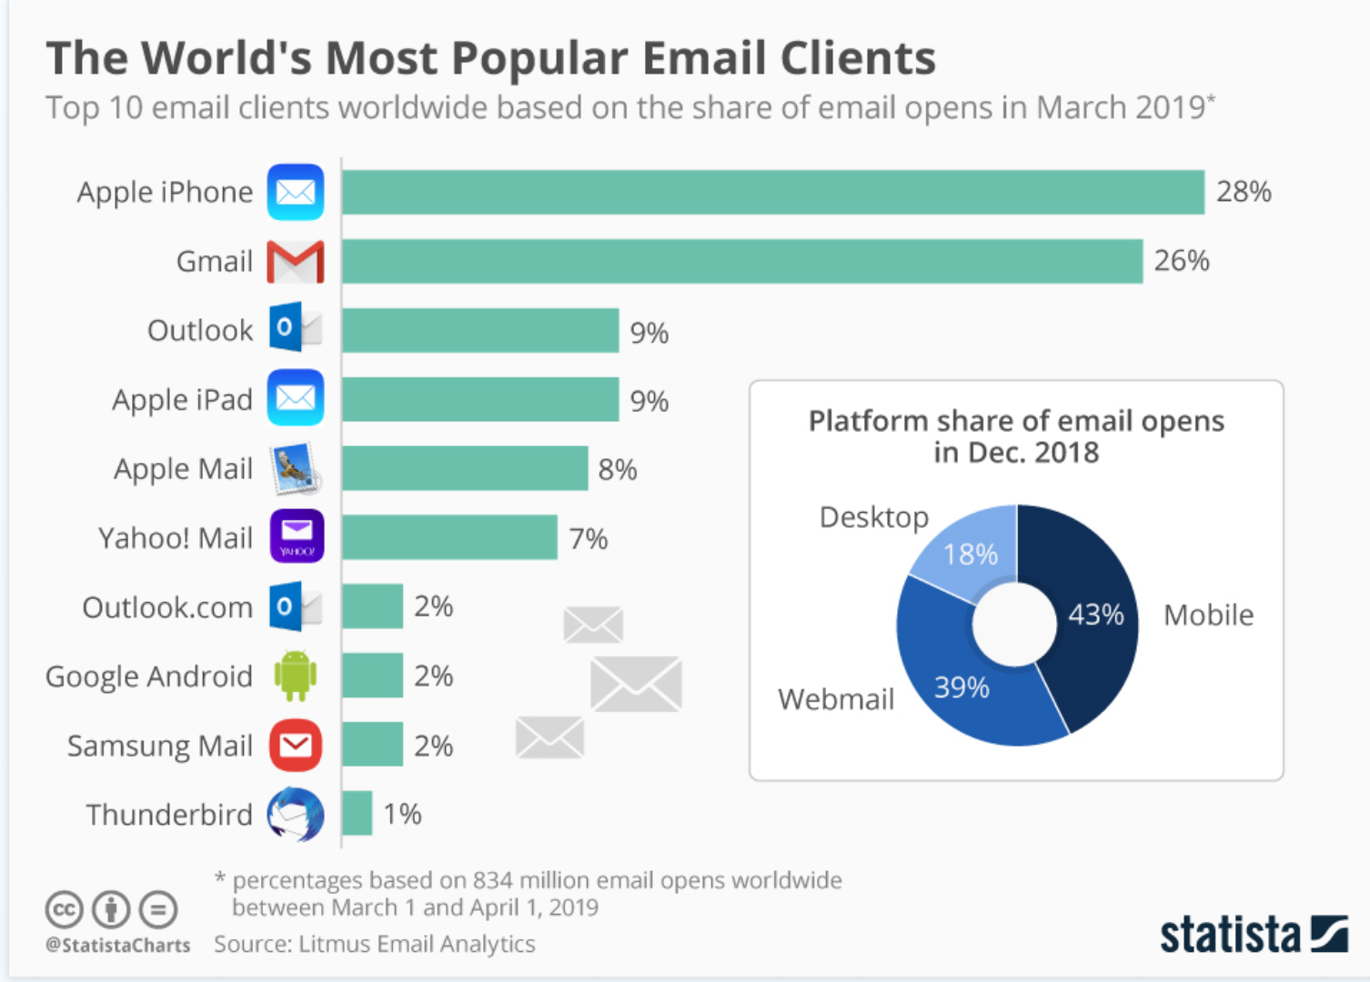
Here are just a few
Source: https://www.statista.com

Slide 4
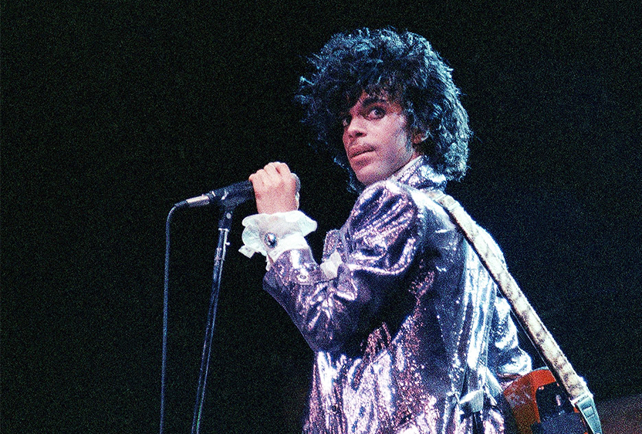
Coding like it’s 1999!
HTML Email = table-based designs
Why tables?
Different email applications/devices use different rendering engines.
They don't all display emails the same way
Tables help maintain consistency across environments

Slide 5
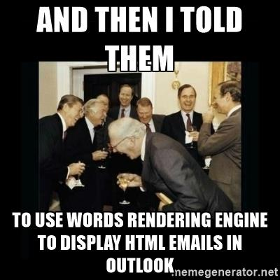
Outlook 2003/2007/2013/2016
Outlook uses MS Word to display HTML emails, making it a special case in developing templates
As a result, Outlook on Windows is most difficult client to develop for
Previous versions of Outlook use IE to render

Slide 6
Anatomy of an HTML email
A quick look at the basic structure
<!DOCTYPE html PUBLIC "-//W3C//DTD XHTML 1.0 Transitional//EN" "http://www.w3.org/TR/xhtml1/DTD/xhtml1-transitional.dtd">
<html xmlns="http://www.w3.org/1999/xhtml">
<head>
<meta http-equiv="Content-Type" content="text/html; charset=UTF-8" />
<title>Email template</title>
<meta name="viewport" content="width=device-width, initial-scale=1.0"/>
</head>
<body style="margin: 0; padding: 0;">
<table border="0" cellpadding="0" cellspacing="0" width="100%">
<tr>
<td>
<table align="center" border=“0" cellpadding="0" cellspacing="0" width="600" style="border-collapse: collapse;">
<tr>
<td bgcolor="#4b2e83"> Header row </td>
</tr>
<tr>
<td bgcolor="#ffffff"> Main content </td>
</tr>
<tr>
<td bgcolor="#e8e3d3"> Footer row </td>
</tr>
</table>
</td>
</tr>
</table>
</body>
</html>

Slide 7
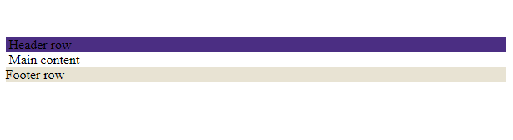
Anatomy of an HTML email

Slide 8
Anatomy of an HTML email
<table role="presentation" width=“100%" align="center" cellpadding="0" cellspacing="0" border="0">
<tr>
<td width="100%">
// Email content //
</td>
</tr>
</table>
Use HTML attributes for width, border, etc.
role="presentation": defines the <table> as being presentational, rather than tabular data, preventing it from creating issues for readers using assistive technologies.

Slide 9
Anatomy of an HTML email
CSS inline and in style block – no external stylesheets
<table role="presentation" width=“100%" align="center" cellpadding="0" cellspacing="0" border="0">
<tr>
<td width="100%" "style="font-family: Arial, sans-serif; font-size:16px; line-height:1.5em; color:#ffffff; padding:2em; background-color:# 4b2e83;">
// Email content //
</td>
</tr>
</table>
No external stylesheets
Put styles on the <td>
Styles should be avoided on the content within the <td>
Exceptions for <a> or <span> tags
Notes:
<style> block in head not supported by: Gmail Android IMAP, Gmail mobile webmail, Yahoo Android app, AOL mail. MUST USE INLINE FOR THESE

Slide 10
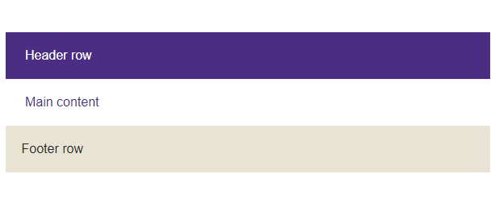
Anatomy of an HTML email

Slide 11
Things to consider
Instead of: | Use:
<div> | <table>, <tr>, <td>
<p> | <td> OR use <p> but add margin: 0
<h1>, <h2>, <h3>, etc. | <td> or <span> OR use <h> but add margin: 0
margin ( in Outlook on Windows ) | <td style=”padding:10px;”>
float ( in Outlook on Windows ) | multiple table cells and align
position | multiple table cells and align
Abbreviated hex codes (ex: #fff) | Full 6-digit hex codes (#FFFFFF)
Animations (@keyframes, transition) | Gifs. Limited support (in Outlook on Windows)
Javascript | nothing

Slide 12
Specifics to Marketo templates
Required attributes
<table align="center" cellpadding="0" cellspacing="0" width="100%" class="border" style="max-width:600px !important; font-size: 0px !important; line-height: 0px !important;">
<tr>
<td align="center" valign="top">
<table align="center" border="0" cellspacing="0" width="100%">
<tr>
<td class="mktoContainer" id="marketoContainer">
<!--UNIT NAME-->
<table border="0" cellspacing="0" cellpadding="0" width="100%" class="mktoModule" id="unitName" mktoName="Unit Name" role="presentation">
<tr>
<td valign="top" class="text unit-name" style="background-color: #ffffff; color: #4b2e83; font-family: 'Open Sans', arial, sans-serif; font-size: 14px; font-weight: 600; line-height: 1.2; text-transform: uppercase; text-align: right; padding: 12px 15px; vertical-align: middle;">
<div class="mktoText" id="unitNameText" mktoName="Unit Name Text">
Your Unit Name
</div>
</td>
</tr>
</table>
A div? This required for editable areas in Marketo. Class, ID and mktoname are also required.

Slide 13
Let's look at the CSS again
<style> <!- – in head - - >
.purple-background td {
background-color: #4b2e83;
}
.apple-link-white {
color: #ffffff !important;
}
@media screen and (max-width:480px){
.body-copy{
font-size: 14px !important;
line-height: 160% !important;
}
}
</style>
<table border="0" cellspacing="0" cellpadding="0" width="100%" class="purple-background mktoModule" id="bodyCopyPurple" mktoName="Body Paragraph - Purple" role="presentation">
<tr>
<td align="left" valign="top" class="text body-copy" style="background-color: #4b2e83; color: #FFFFFF; font-family: 'Open Sans', arial, sans-serif; font-size: 13px; font-weight: 400; line-height: 22px; padding: 10px 15px 10px 15px; vertical-align: top;">
<div class="mktoText" id="bodyCopyParagraphPurple" mktoName="Body Paragraph">
Mus es eipcipit atisquis aliassimo maximpe venis ea eosae occulpari odit.
<a class="text apple-link-white" href="#ADDLINK" style="color: #FFFFFF;">I am a link!</a>
</div>
</td>
</tr>
</table>
Notes:
Media queries supported by most major email environments except Outlook 2007 -2016, Outlook.com, Gmail Android IMAP, Gmail mobile webmail, AOL

Slide 14
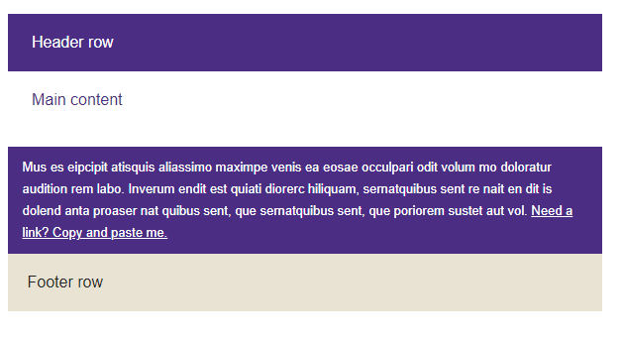
Result:

Slide 15
Our friend Outlook on Windows
Where is .text in styles?
MS Outlook on Windows doesn't use web fonts. But our template uses 'Open Sans'. If a backup font isn't declared specifically for Outlook, it will default to Times New Roman.
So we add conditional styles in an "if mso" comment:
<a class="text apple-link-white" href="#ADDLINK" style="color: #FFFFFF;">
I am a link!
</a>
<!--[if mso]>
<style type="text/css">
.text {
font-family: Arial, sans-serif !important;
}
</style>
<![endif]-->
Notes:
Outlook 2007 – 2011?? for desktop uses MS Word as its rendering engine

Slide 16
What about images?
Add style="display:block;” to prevent some email clients adding gaps underneath your images
Use alt text and add styles for it. If images are not displayed in browser, the text is styled according to the CSS
Limit text on images to decorative only. Use background images + text
Don't use an image for your entire message
Notes:
Outlook for desktop defaults to "Right click to download images...."

Slide 17
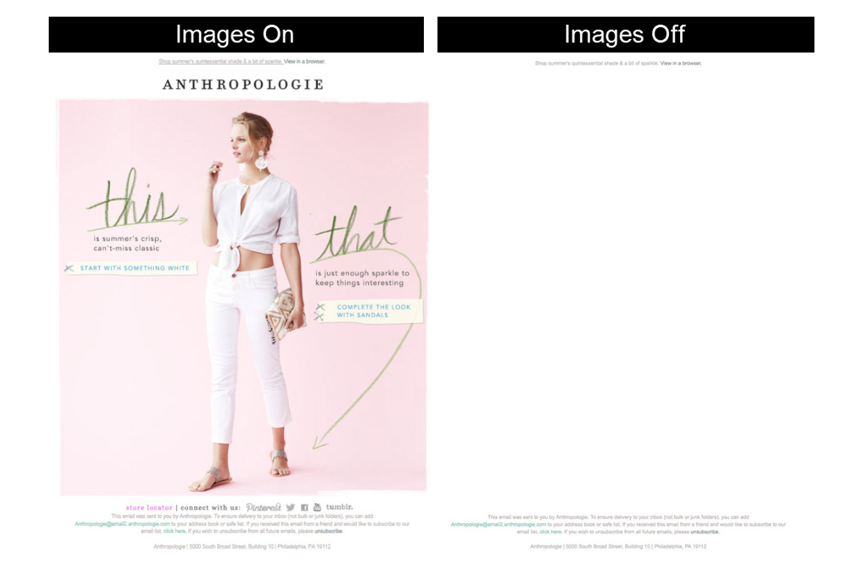
Don't do this
Source: litmus.com
Notes:
Outlook for desktop defaults to "Right click to download images...."

Slide 18
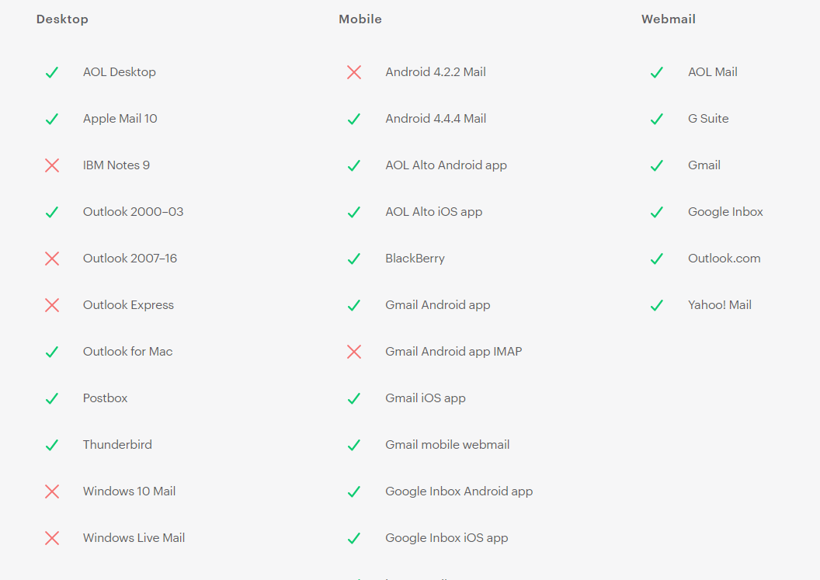
Support for background images
Source: campaignmonitor.com
Notes:
Outlook for desktop defaults to "Right click to download images...."

Slide 19
Outlook workaround
Must use VML markup
<table cellpadding="0" cellspacing="0" border="0" width="100%">
<tr>
<td background="https://i.imgur.com/YJOX1PC.png" bgcolor="#4b2e83" valign="top">
<!--[if gte mso 9]>
<v:rect xmlns:v="urn:schemas-microsoft-com:vml" fill="true" stroke="false" style="mso-width-percent:1000;">
<v:fill type="tile" src="https://i.imgur.com/YJOX1PC.png" color="#4b2e83" />
<v:textbox style="mso-fit-shape-to-text:true" inset="0,0,0,0">
<![endif]-->
<div>
<!-- content on top of image -->
</div>
<!--[if gte mso 9]>
</v:textbox>
</v:rect>
<![endif]-->
</td>
</tr>
</table>
Generate VML code at Bulletproof Background Images (https://backgrounds.cm/)
Notes:
Outlook for desktop defaults to "Right click to download images...."

Slide 20
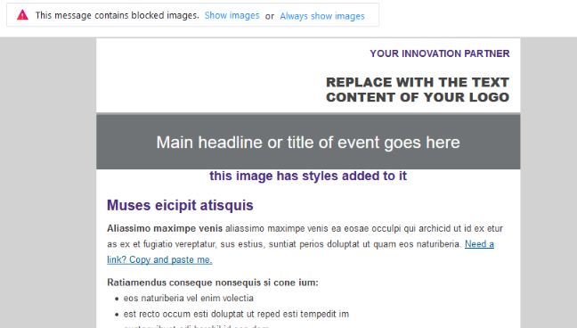
Styled alt-text
<img alt="this image has styles added to it" src="http://explore.uw.edu/rs/131-AQO-225/images/img.jpg" width="600" class="mktoImg" id="img"
style="color: #444444; display: block; font-family: 'Open Sans', arial, sans-serif; font-size: 14px; height: auto; line-height:18px; width: 100% !important; text-align: center !important; vertical-align: middle;“
/>
Surprise! This doesn’t work for Outlook
Notes:
Outlook for desktop defaults to "Right click to download images...."

Slide 21
Animations
Animated GIFs are the best bet
Good support across clients, but keep file size under 1MB. Can use lots of data on mobile
Outlook on Windows will only show the first frame of the animated GIF
CSS animations, transition = Limited support. Do not use
How about video? Very limited support. Use still image, link to YouTube or other hosted video

Slide 22
Other considerations
Negative values on margins aren’t well supported
Position not well supported
CSS Grid and Variables not well supported
Dark mode – double check your message in dark mode (Outlook on Mac, others?)
Notes:
Outlook 2007 – 2011?? for desktop uses MS Word as its rendering engine

Slide 23
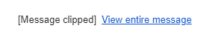
Other considerations – Gmail
Gmail clips messages over 102 kb
Gmail doesn’t support attribute selectors and most pseudo-classes – div[class="content"]{ color: red }
Gmail automatically converts phone numbers and URLs to links.
Notes:
Outlook 2007 – 2011?? for desktop uses MS Word as its rendering engine

Slide 24
Other considerations – iOS
Generally good support for CSS, but:
Needs min-width:100% on body and tables
Needs webkit-text-size-adjust – prevents iPhone from automatically increasing font-size
body {-webkit-text-size-adjust: none}
Address/phone number style gets overridden.
Override the override with this: <meta name=“format-detection” content=“telephone=no”>
Or add a class to a surrounding span to control color, text-decoration + !important. <a href="#" style="color:#ffffff; text-decoration:none;"><span style="color:#ffffff; text-decoration:none;">CONTACT US</span></a>
Notes:
Outlook 2007 – 2011?? for desktop uses MS Word as its rendering engine

Slide 25
Resources
https://www.campaignmonitor.com/css/
https://validator.w3.org/ – great to check for missing tags, other errors
https://www.caniemail.com/ – NEW!!
BEST BET – email mktohelp@uw.edu

Slide 26
Questions?
Tiffany Sevareid
Front End Developer
UMAC
tlb3@uw.edu

