Slide 1
Scripts
Folders
Manual
Step1
01inputVideos
01getFramesFromVideo.py
01pngFilesUnreviewed
Step 2
Review pngs
Step 3a
02pngFilesReviewed
createModelWithoutMarkersAgisoft1.py
Step 3b
03AgisoftModels
Review models, if bad, add markers.
Step 3c
Step 4
createModelAfterMarkersAgisoft2.py (if added markers)
Use CloudCompare to segment out clipplots. Uses centeredsquare.shp. Move square, then segment.
04CloudCompareTxt
Step 5
sfmNormalize_RGB.R
05Normalized
Step 6
sfmShiftXYvalues.R
Step 7
<site>
/photogram/cr_sfm/norm
Copy files

Slide 2
Workflow to get from video to preliminary point cloud
GoPro video for SfM
parseFramesFromVideo.py
I did a quick review here to discard the first and last images from the set, because they were usually of the technician’s shoes or hands. Also check for any weird images of the sky.
Images for Agisoft
A G I S O F T
A G I S O F T
A G I S O F T
createModelsStep1.py
Sparse point cloud
Manual reference marking and scaling
createModelsStep2.py
A G I S O F T
See slide 4 for marking protocol - this tells Agisoft 1) what plot corners are what and 2) how big the plots are. I manually referenced and scaled the 1st, 50th, 100th, 150th, etc images from the full set
Point cloud for voxel plot (.laz or .las)
This preliminary point cloud must then be clipped and georeferenced to TLS data (I did this in CloudCompare - see slide 2 for details)

Slide 3
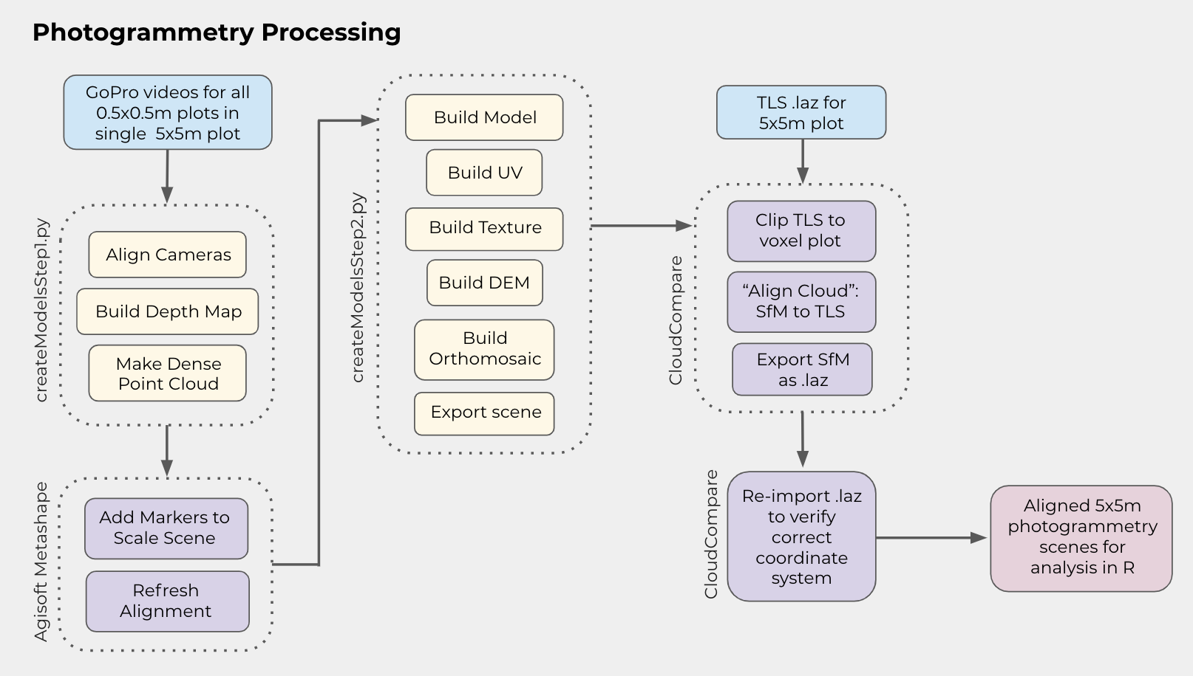

Slide 4
Workflow to get from clipped and georeferenced point cloud to dataframe
Point cloud for voxel plot (.laz or .las)
Normalizeand
Autorotate.r
Adjusted point cloud
PointCloud
Processing.r
Whole-plot structural metrics
Field Structural Metrics
FullData
FramePrep.r
All Sites - Field Occupied Voxels
Biomass by Stratum Dataset
Biomass
DataPrep.r
Field Biomass Data
Analysis-ready dataframe

Slide 5
Reference marker schema in Agisoft
CTR 1-4
NE 5-8
NW 9-12
SE 13-16
SW 17-20
9
10
5
6
NW
NE
12
11
8
7
In Agisoft, manual placement of reference markers is necessary, otherwise the software may think two different frames are the same and will try to stitch them together in the point cloud (imagine CTR getting merged with NE - weird things happen). For each 5x5, I kept the order of the markers consistent based on this schema. Once markers were placed, I also used the scale option to tell Agisoft that the distance between 1 and 2 was 0.5 m, the distance between 1 and 4 was 0.5 m, and so on.
1
2
CTR
4
3
17
18
13
14
SW
SE
20
19
16
15

