Slide 1

If You Can’t Reproduce It,
Is It Still Science?
And how long will it take?
Paul Wilson
Inspired by Greg Wilson
Software Carpentry

Slide 2
Reality of Research Computing
Many scientists spend most of their time developing, maintaining, or running software
  Most don’t consider themselves software engineers
  Few have ever been taught how
    Learned on-the-job
    Knowledge passed down

Slide 3
So What…
Most results take longer to produce than they need to
  Not because of a lack of computers
Difficult to assess quality
  Often measured by reproducibility
  “System” doesn’t care

Slide 4
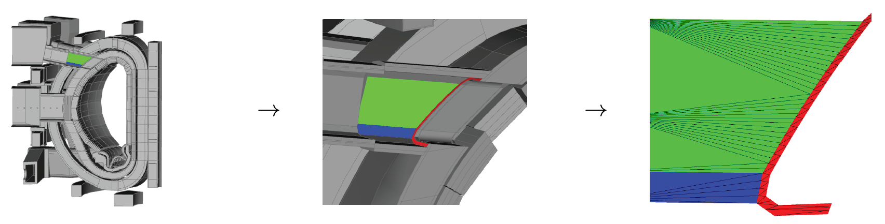
A Recent Story:
Sealing a Faceted Geometry

Slide 5
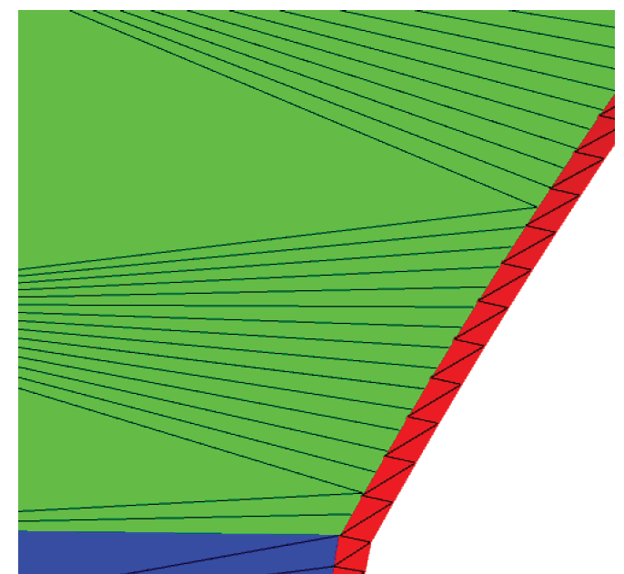
A Recent Story:
Sealing a Faceted Geometry

Slide 6
A Recent Story:
Sealing a Faceted Geometry
Lost particles
through “leaks”
Reduce confidence in
solution

Slide 7
A Recent Story:
Sealing a Faceted Geometry
Model | Particles Simulated [millions] | Lost Particles
 |  | Original | Robust
UW Nuclear Reactor | 41 | 5649 ± 178 | 0
Advanced Test Reactor | 74 | 141 ± 32 | 0
40° ITER Benchmark | 225 | 67 ± 39 | 0
ITER TBM | 205 | 665 ± 184 | 0
ITER Module 4 | 59 | 59 ± 19 | 0
ITER Module 13 | 79 | 450 ± 60 | 0
FNG Benchmark | 1310 | 31273 ± 989 | 0
ARIES First Wall | 4070 | 25 ± 18 | 0
HAPL IFE | 286 | 65 ± 19 | 0
Z-Pinch Fusion | 409 | 2454 ± 317 | 0

Slide 8
Software Carpentry to the Rescue
Best practices used by the best software engineers whose business is development of quality software
  They don’t always have formal training
  They don’t always follow all the practices
  Growing evidence supported by empirical studies

Slide 9
Write Programs for People,
Not Computers
Most researchers will spend more time reading code than writing code
  It’s the primary way to learn what it does and how
Recognize realities of human cognition
  Working memory is limited
  Pattern matching abilities are finely tuned
  Attention span is short

Slide 10
Automate Repetitive Tasks
This is why we invented computers!!
  It’s not why we invented graduate students
Saves time & avoids errors
Can track dependencies
Unambiguous record of workflow
Motivates command-line interfaces

Slide 11
Use the Computer
to Record History
Careful record keeping is fundamental to science
  A manual log book works for experiments occurring at a “traditional” pace
  What happens when you can perform 100 experiments/day? 1000? 10,000?

Slide 12
Use the Computer
to Record History
Use software tools to track computational work
  Unique identifiers/versions for data
  Unique identifiers/versions for software
  All input parameters
Embed this information in output

Slide 13
Make Incremental Changes
Long development cycles have many disadvantages
  Human attention span
  Delayed identification
  of bugs
  Adapt to changes
  in requirements
“Agile” development
cost
time

Slide 14
Use Version Control
Two big challenges
  Tracking all the changes to code over time
  Synchronizing changes during collaboration
Bleeds back to provenance
  How do you know exactly which version you used?

Slide 15
Use Version Control
Ad-hoc solutions:
  Make separate copies for different versions
  Dropbox, email for sharing
All subject to human error
Why not “Use the Computer to Record [this] History”, too?

Slide 16
Use Version Control
A great big “undo” button
Focus on changes

Slide 17
Don’t Repeat Yourself
(or Others)
Anything repeated in 2 or more places is difficult to maintain
  Increases chance of errors and inconsistencies
Modularize the code you write
Don’t reinvent the wheel

Slide 18
Plan for Mistakes
Bugs are guaranteed!
Finding bugs is hard!
No single practice will catch all defects – use in combination
  Defensive programming
  Testing
  Debuggers

Slide 19
Optimize Software Only
After it Works Correctly
Correct is more important than fast
Complexity of modern hardware & software make it difficult to predict bottlenecks
Profile and test performance after it works to identify need for improvement

Slide 20
Optimize Software Only
After it Works Correctly
Corollary: Use high level languages!
Fixed: number of lines of code per day, independent of the language
Get more done with high-level languages, even if slower
Profile, measure and improve

Slide 21
Document the Design and Purpose of Code Rather than its Mechanics
Most research software will be handed off at least once
  Large cost for “forensic” analysis
Documentation is critical
  … but only if it’s good documentation

Slide 22
Document the Design and Purpose of Code Rather than its Mechanics
Document interfaces
  How to use something
  What behavior to expect & why
Do not document implementation
  Well-written implementation should be self explanatory
  If not, refactor it until it is
  May need to document reasons for specific implementation decision

Slide 23
Conduct Code Reviews
Peer review is a cornerstone of modern research
  Reduces errors
  Improves communication/
  understandability
Why review publications based on software and not the software itself?

Slide 24
A Recent Story:
Sealing a Faceted Geometry
Why did this disruption happen?
  Inadequate testing
  Inadequate reporting of version numbers
  Lack of automation

Slide 25
Combining Best Practices
Continuous Integration
  Automatically rebuild and retest every time a test is made
    Automation of repetitive task
    Supports agile development
    Relies on testing

Slide 26
Two Days ≠ Ten Practices
Automation (requires Shell)
Writing Code for People
Don’t Repeat Yourself (or Others)
Version Control
Testing
Collaboration

Slide 27
Make Incremental Changes Redux
This applies to HOW you work
Choose one practice
  Implement it in your work
  Share it with your lab group
  Allow it to sink in
Repeat

Slide 28
How to Choose Where to Start?
It will depend on the nature of your work
Consider the purpose:
  Improve productivity
  Improve quality

Slide 29
Thoughts on Productivity and Automation
Cumulative Effort
Time

Slide 30
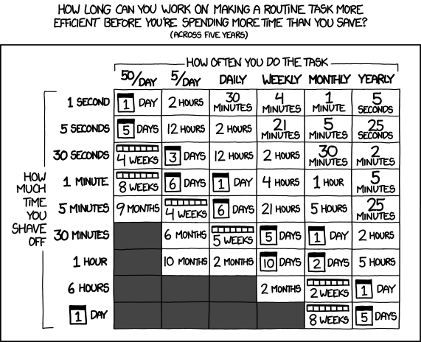
Thoughts on Productivity and Automation

