Slide 1
11. SSL and Security
CITS3002 Networks and Security
Dr David Glance

Slide 2
SSL/TLS
The Secure Sockets Layer (SSL) implements 3 cryptographic assurances
authentication
confidentiality
message integrity.
Netscape developed SSL protocol in its browsers in 1994, and then v2.0 in 1995.
Microsoft developed Private Communicating Technology (PCT) in 1995,
Transport Layer Security (TLS) 1999 IETF v 1. TLS 1.2 RFC 5246
SSL uses TLS in https

Slide 3
TLS
Secure session layer on top of TCP
Provides stream abstraction (like TCP)
Adds:
Confidentiality
Integrity
Authenticity
A TLS session negotiates four ciphers:
Authentication of server and optionally client
Key exchange (RSA, DHE)
Symmetric confidentiality (RC4, AES, DES)
Integrity (HMAC-MD5, HMAC-SHA)
Negotiated in 5-step session initiation protocol

Slide 4
TLS Cipher Negotiation
Client
Server
Supported ciphers, client random
not confidential
chosen ciphers, server random, certificate
not confidential
encrypted pre-master secret
encrypted with server public key
MAC of handshake messages
encrypted with session key
MAC of handshake messages
encrypted with session key

Slide 5
TLS Message Format
TLS breaks stream of data from application into records
1-2¹⁴ bytes in length
Records are compressed (Default compression algorithm is null)
Records sent over TCP stream (broken into segments, etc)
HTTP
Application Data
TLS
record
record
record
record
TCP
segment
segment
segment
segment
segment
segment

Slide 6
Establishing Session Keys
Both client and server add randomness with chosen numbers
Client sends “pre-master secret” encrypted with server’s public key
Use master secret and random numbers to generate session keys
Client to server write (encryption)
Client to server MAC
Server to client write (encryption)
Server to client MAC
Client initialization vector
Server initialization vector
Support for resuming sessions with master secret (but new key)

Slide 7
SSL and Man-in-the-Middle Attacks
SSL can be subverted by a hacker getting a client to connect to its site first
The hacker then creates a separate SSL connection to the real site and relays messages
For the client, it will only know that is has connected to a different host name
Another method is to get the client to use http to communicate to the mitm using a technique called ssl stripping (https://www.youtube.com/watch?v=MFol6IMbZ7Y)
To prvent SSL stripping servers can use HSTS

Slide 8
History of hacking
Even before computers, people have subverted communications mediated by technology
1903 Nevil Maskelyne disrupted John Ambrose Fleming’s and Marconi’s demonstration of wireless telegraphy (the original Lulz?)
"There was a young fellow of Italy, who diddled the public quite prettily”
1957 Joe Engressia whistles to control the telephone in the first example of “phreaking”
1963 First use of hackers
1979 Keven Mitnick breaks into the Ark – a computer system of DEC
1988 The Morris Worm – spreads to 6,000 computers Robert Morris is arrested
1988 Computer Emergency Response Team (CERT) is created by DARPA to address network security
1989 First ransomware with the AIDS Trojan Horse
1996 Hackers start defacing web sites

Slide 9
History of Hacking continued
Malware, viruses, trojans and worms proliferate during the 1990’s
2001 Microsoft subjected to a denial-of-service attack on their DNS
2003 Anonymous formed
Cyberwarfare started 2004, North Korea attacks South Korea
2007 Estonia suffers massive DoS attack
2011 Lulz sec formed – along with anyomous, they become responsible for surge in“hacktivism” and doing things for the “Lulz”.
2016 DDoS from Mirai Botnet – Internet of Things
2016 DDoS of Dyn DNS provider using the Mirai Botnet

Slide 10
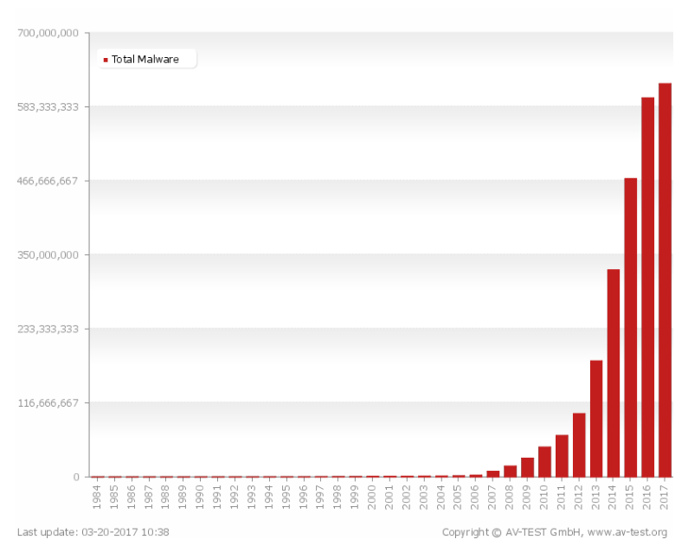
Growth of Malware

Slide 11
Growth of DDoS

Slide 12
Network Attacks
Listening in: Sniff and record network data or metadata (Australian ISPs now doing this)
Passively tap an electrical or optical cable
Listen to WiFi (using a packet sniffer like Wireshark)
Compromise a router to duplicate and forward data
Modify, delete, insert – actively tamper with data by:
Changing contents of packets
Redirect packets to another server
Take over control of an end-host
Prevent communication: (Denial of Service, DoS)

Slide 13
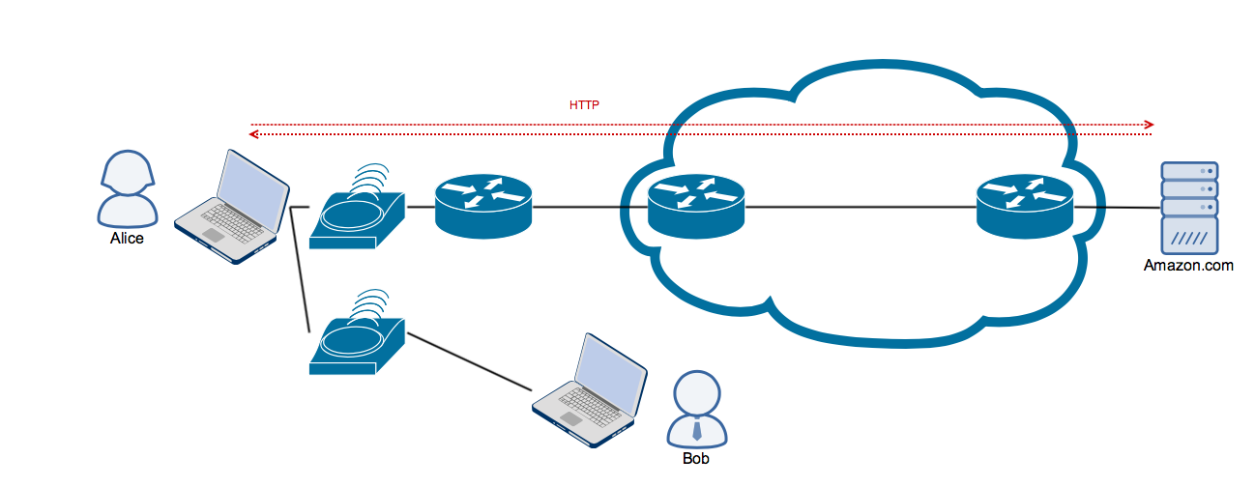
Network Attacks: Listening

Slide 14
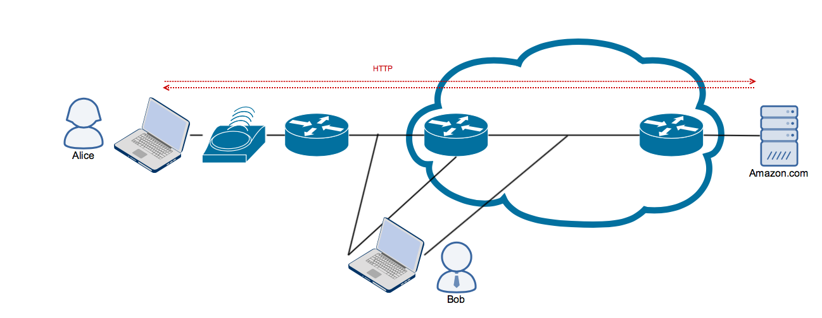
Network Attacks: Listening

Slide 15
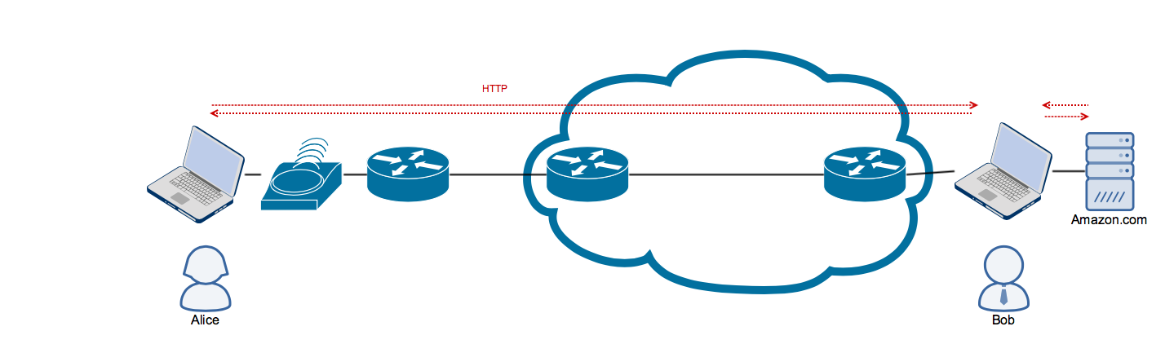
Network Attacks: MitM

Slide 16
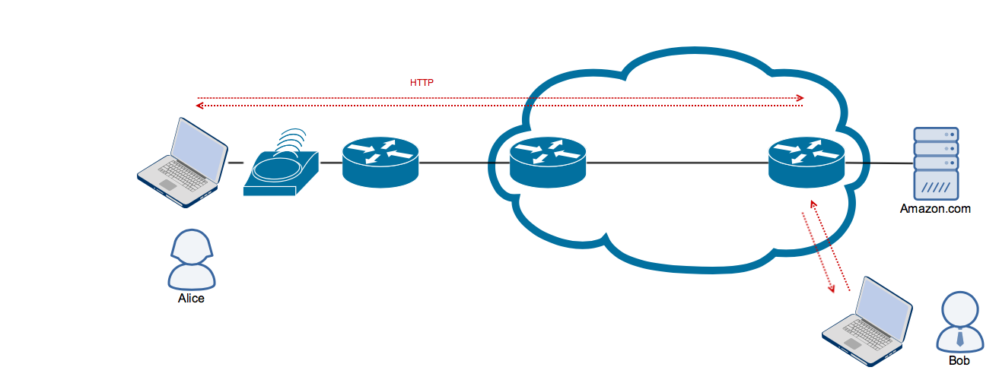
Network Attacks: Masquerade

Slide 17
Desirability
Secrecy/confidentiality (Encryption)
Integrity (MACs)
Authentication (Certificates)
Uninterrupted communication

Slide 18
Layer 2 Attacks
Listening in with an interface in promiscuous mode especially wireless
Doesn’t work with switches because packets are private to the links
Force packets to be broadcast then use [1]
Prevent Ethernet switch from learning forwarding destinations forcing it to broadcast its packets
Masquerade as DHCP or ARP server – redirect packets to an end host

Slide 19
Layer 2 Attacks in Practice
MAC Overflow Attack
Attacker sends packets with new Ethernet addresses to flood the forwarding tables in switches
These operate on a “least recently used” basis and so old addresses get dropped
Rogue DHCP Server responds faster than the real DHCP server
advertises new router address to send packets to attacker
give a rogue DNS server with malicious addresses
Rogue ARP server
again sets destination to a pwned server

Slide 20
Layer 3 Attacks
ICMP to tell source end-host to redirect traffic
ICMP redirect messages are sent preemptively to redirect traffic
Can be used as DoS or MitM attack
IP (BGP) hijacking
ISP advertises prefxes belonging to someone else to capture traffic
ISP advertises invalid ISP path creating a “black hole” for traffic
This is sometimes used for dealing with DDoS attacks
These attacks require masquerading as ISP or taking over BGP TCP session
More specific prefix

Slide 21
Denial of Service
Feb 2000 Yahoo router crashing because of being flooded by ICMP echo packets
Basic Denial of Service
Overload a server or network with too many packets
Maximise cost of each packet to server in CPU and memory
DDoS particularly effective
Penetrate many machines in semi-automatic fashion
Make hosts into “Zombies” that will attack on command
Later start simultaneous attacks on a victim

Slide 22
Denial of Service
Class attacks that just target availability
Motivation
Extortion
Revenge
Hacktivism (Anonymous and Visa, PayPal)
Bragging rights
Lulz

Slide 23
Simple DoS attacks
Wireless jamming at physical layer
Simple, cordless phone, microwave?
Exploit NAV structure at 802.11 link layer
Net Allocation Vector – used to suggest when network may be free (e.g. after RTS/CTS exchange)
Use to reserve net repeatedly for max number of seconds
Flooding attack e.g. flood ping
Amplification attacks
e.g. EDNS (Extensions for DNS) – request is 60 bytes bur response is 3,000 bytes
flood DNS (especially open DNS resolvers)
spoof SRC IP address to be victims
Attackers’ identity is hidden

Slide 24
SMURF Attack
ICMP echo supports pinging IP address
Big amplification for flooding attack
spoof broadcast address from victim’s IP
Attack was used against Yahoo in 2000

Slide 25
SYN-bomb Attack
TCP handshake
C → S: SYN, S → C: SYN-ACK, C → S: ACK
How to implement
Server inserts connection state in a table
Waits for 3rd packet (times out after a minute)
Compares each new ack packet to existing connections
OS can’t handle arbitrary or partial connections
Attack: Send SYN packets from bogus addresses
SYN-ACKS disappear into the ether
Server’s tables fill up, stops accepting connections
A few hundred packets/second disables most servers

Slide 26
SYN-bomb Attacks in the Wild
MS Blaster worm
Flooded port 80 of windowsupdate.com with SYN packets
50 SYN packets/sec (40 bytes each)
Randomised last two bytes of source IP address
Clients couldn’t update to fix problem
Microsoft’s solution:
Change the URL to windowsupdate.microsoft.com
Update old clients through Akamai

