Slide 1
9. Internet Transport Layer Protocols
CITS3002 Networks and Security
Dr David Glance

Slide 2
Internet Transport Layer Protocols
Packaging of successive layers to get data to the network

Slide 3
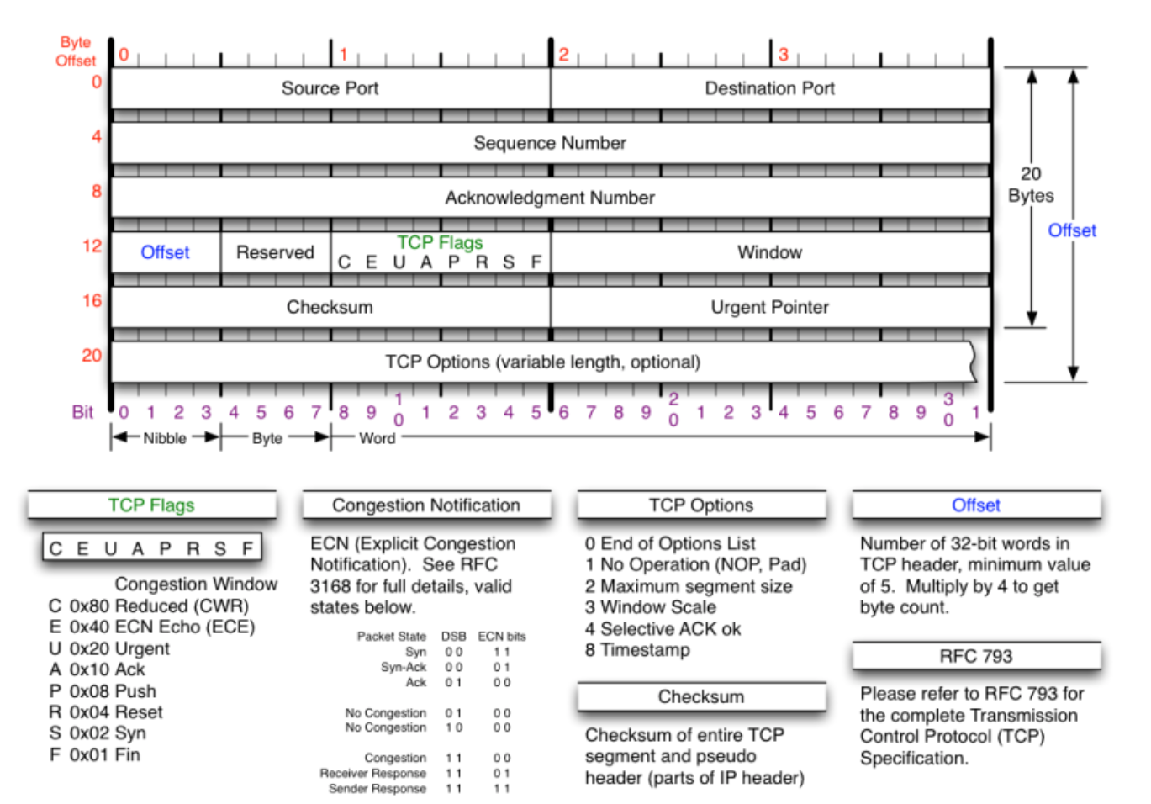
Transmission Control Protocol TCP

Slide 4
IPv6
IPv4 addresses have been exhausted
IPv6 caters for the massive explosion of connected things in the Internet of Things (IoT)
Addresses are 128 bits

Slide 5
IPv6
Traffic class replaces Type of Service
Flow Label support for real-time delivery
Next Header: extension headers and IPv4 protocol
Hop Limit: TTL

Slide 6
IPv6
Global Routing Prefix: 1st 3 bits are 001 to indicate unicast
Subnet identifier: subnet within site
Interface ID: unique identifier on a subnet
Special addresses:
::1 equivalent of 127.0.0.1 (loopback)

Slide 7
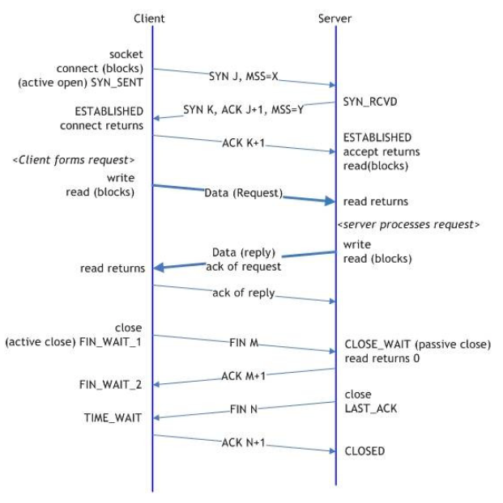
TCP/IP 3-way connection establishment and teardown
A→B : SYN, ISN_{a}
B → A: SYN, ISN_{b}, ACK(ISN_{a})
A → B: ACK(ISN_{b})
SSN: Synchronize sequence number

Slide 8
TCP/IP Retransmissions
TCP/IP covers a range of distances – cms to kms.
TCP/IP uses a sliding window protocol
timeouts are employed to force re-transmissions.
TCP maintains a dynamic estimate of the current round trip time (RTT) for each connection.
TCP averages RTTs into a smoothed round trip time (SRTT)
SRTT = (α x SRTT) + ((1-α) x RTT)
α = smoothing factor that determines weight of new values
When α=1, the new value of RTT is ignored,
when α=0 all previous values are ignored.
Typically α is between 0.8 and 0.9.
The SRTT estimates the average round trip time.
To also allow for queuing and transmission delays, TCP also calculates the mean deviation (MDEV) of the RTT from the measured value.
This is also smoothed:
SMDEV = (α x SMDEV) + ((1-α) x MDEV)
RTO = SRTT + 2 x SMDEV

Slide 9
TCP/IP Congestion Control
Most important and most “tinkered with” feature of TCP
Metric of congestion is overall packet loss.
TCP receiver puts remaining buffer available to sender in Window field of an acknowledgment header
When a message is lost, the TCP sender could naively retransmit enough data to fill the receiver's buffers. Instead, TCP commences by sending a single packet. If an acknowledgment for this single packet returns, the sender next transmits two packets; if all of their acknowledgments return, up to four, and so on.
In effect, the protocol doublesthe sender's sliding window until packets are lost; it then restarts at 1.
TCP/IP responds to congestion by backing-off quickly, and then slowly increasing offered traffic. RFC 2001.

Slide 10
Network APIs
Network APIs are largely the same on all platforms
Common framework to access both files and devices.
Calls to Unix open() return a file descriptor which is then used in calls to read() and write().
Model of network I/O use similar semantics to file, or stream, I/O, but:
The typical client-server relationship is not symmetrical
Network connections may be connection-oriented or connectionless.
With a connectionless protocol there is nothing akin to open() since every network I/O operation could be with a different process on a different host.
Names are more important to networking than for file operations.
Networking applications need to verify peer processes when accepting new connections.
There are more associations to be made for network I/O than for file I/O:
{ protocol, local-address, local-process remote-address, remote-process }
Many file I/O models presume all data is in a continuous data stream; this precludes networking applications working with variable length datagrams.

Slide 11
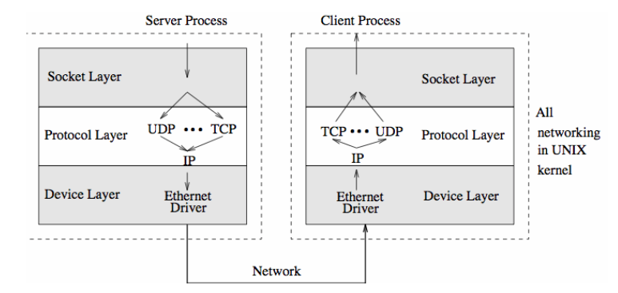
An Example Network API - Berkeley Sockets
Sockets are a generalization of the Unix file system I/O model
For File I/O an fd is bound to a file. Sockets allow different destinations with each access

Slide 12
Berkeley Sockets continued
The current (kernel) socket implementation consists of three parts:
1. The socket layer provides the interface between user programs and the networking (via Unix system calls).
2. The protocol layer supports different protocols in use, such as TCP/IP, X.25, etc.
3. The device driver supports the physical devices such as Ethernet controllers.
Essential reading: A Guide to Network Programming using Internet sockets, by Brian "Beej" Hall.

Slide 13
Domain Addressing
Sockets that share common communication properties, such as naming conventions and protocol address formats, are grouped into address families.
The Linux file /usr/include/bits/socket.h lists all supported address families.
The Linux file /usr/include/bits/socket.h lists all supported address families
#define AF_UNSPEC 0 // unspecified
#define AF_UNIX 1 // local to host (pipes, portals)
#define AF_INET 2 // internetwork: UDP, TCP, etc.
#define AF_IMPLINK 3 // arpanet imp addresses
#define AF_CCITT 10 // CCITT protocols, X.25 etc
#define AF_SNA 11 // IBM SNA
#define AF_DECnet 12 // DECnet
#define AF_APPLETALK 16 16 // Apple Talk
#define AF_NIT 17 // Network Interface Tap
#define AF_802 18 // IEEE 802.2, also ISO 8802
#define AF_OSI 19 // umbrella for all families used by OSI
#define AF_X25 20 // CCITT X.25 in particular
#define AF_GOSIP 22 // U.S. Government OSI

Slide 14
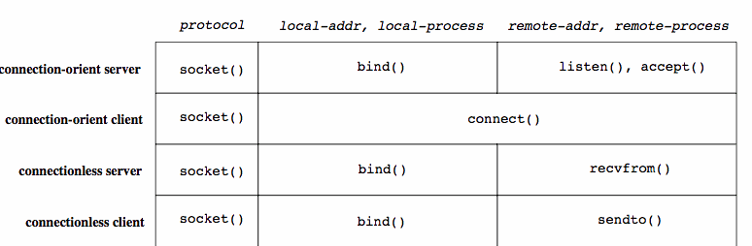
Establishing sockets with OS system calls
#include <sys/socket.h>
int family, type, protocol;
int sd, socket(int, int, int);
...
sd = socket(addr_family, type, protocol);
Different uses of socket

Slide 15
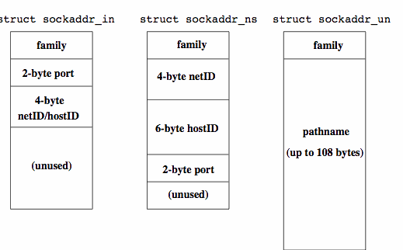
Naming Sockets
Socket is created initially unbound
Bind() provides an address (a name) for the local end of the socket

Slide 16
Naming Sockets II
Bind() provides an address (a name) for the local end of the socket
// Socket address, UNIX style.
struct sockaddr { u_short sa_family; // address family
char sa_data[108]; // up to 108 bytes of addr
};
// Socket address, internet style.
struct sockaddr_in { short sin_family; // AF_INET u_short sin_port; // 16-bit port number
struct in_addr sin_addr; // 32-bit netid/hostid
char sin_zero[8]; // unused
};
....
bind(sd, socket_addr, sizeof(socket_addr));
....

Slide 17
Naming Sockets II
bind() provides an address (a name) for the local end of the socket
connect() connects to remote address
servers use listen() and accept() to prepare for calls from clients
// Socket address, UNIX style.
struct sockaddr { u_short sa_family; // address family
char sa_data[108]; // up to 108 bytes of addr
};
// Socket address, internet style.
struct sockaddr_in { short sin_family; // AF_INET u_short sin_port; // 16-bit port number
struct in_addr sin_addr; // 32-bit netid/hostid
char sin_zero[8]; // unused
};
....
bind(sd, socket_addr, sizeof(socket_addr));
....

Slide 18
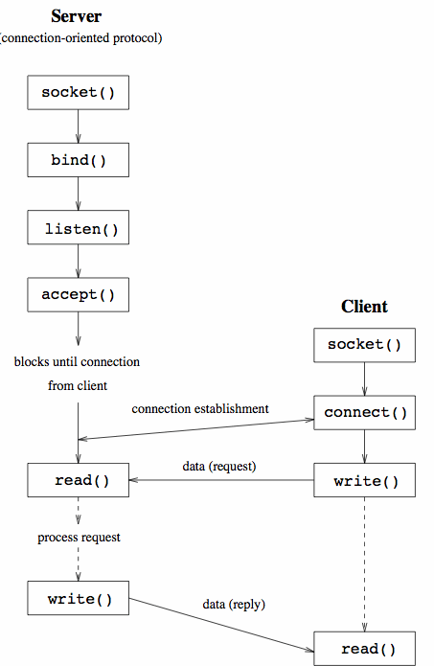
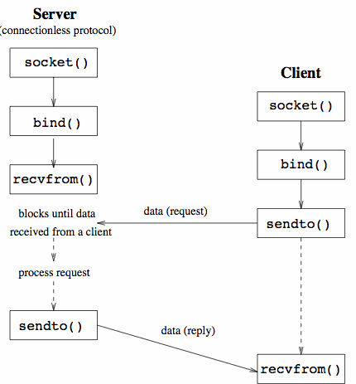
Socket Summary

Slide 19
Client app in C
#include <many-header-files.h>
int write_file_to_server(int sd, const char filenm[]) {
// ENSURE THAT WE CAN OPEN PROVIDED FILE
int fd = open(filenm, O_RDWR, 0);
if(fd >= 0) {
char buffer[1024];
int nbytes;
// COPY BYTES FROM FILE-DESCRIPTOR TO SOCKET-DESCRIPTOR
while( (nbytes = read(fd, buffer, sizeof(buffer) ) ) {
if(write(sd, buffer, nbytes) != nbytes) {
close(fd);
return 1;
}
}
close(fd);
return 0;
}
return 1;
}
int main(int argc, char *argv[]) {
// ASK OUR OS KERNEL TO ALLOCATE RESOURCES FOR A SOCKET
int sd = socket(AF_UNIX, SOCK_STREAM, 0);
if(sd < 0) {
perror(argv[0]); // issue a standard error message
exit(EXIT_FAILURE);
}
// FIND AND CONNECT TO THE SERVICE ADVERTISED WITH "THREEDsocket"
if(connect(sd,"THREEDsocket",strlen("THREEDsocket")) == -1) {
perror(argv[0]); // issue a standard error message
exit(EXIT_FAILURE);
}
write_file_to_server(sd, FILE_OF_COMMANDS);
shutdown(sd, SHUT_RDWR); close(sd);
exit(EXIT_SUCCESS);
}

Slide 20
Server app in C
#include <many-header-files.h>
int main(int argc, char *argv[]) {
// ASK OUR OS KERNEL TO ALLOCATE RESOURCES FOR A SOCKET
int sd = socket(AF_UNIX, SOCK_STREAM, 0);
if(sd < 0) {
perror(argv[0]); // issue a standard error message
exit(EXIT_FAILURE);
}
// ADVERTISE THE STRING "THREEDsocket" TO THE NEW SOCKET
if(bind(sd, "THREEDsocket", strlen("THREEDsocket")) != 0) {
perror(argv[0]); // issue a standard error message
exit(EXIT_FAILURE);
}
// ENQUEUE 5 NEW CLIENTS BEFORE REFUSING NEW CONNECTIONS
listen(sd, 5);
while(true) {
struct sockaddr sockaddr;
socklen_t fromlen = sizeof(sockaddr);
// USE THE 'ADVERTISING' DESCRIPTOR TO ACCEPT NEW CONNECTIONS
int newsd = accept(sd, &sockaddr, &fromlen);
if(newsd >= 0) {
read_file_for_printing(newsd);
shutdown(newsd, SHUT_RDWR);
close(newsd);
}
}
exit(EXIT_SUCCESS);
return 0;
}

Slide 21
A Remote Login Client
#include <many-header-files.h>
int main(int argc, char *argv[]) {
// LOCATE INFORMATION ABOUT THE REQUIRED SERVICE (PROTOCOL AND PORT)
struct servent *sp = getservbyname("login", "tcp");
if(sp == NULL) {
fprintf(stderr,"rlogin: tcp/login: unknown service\n");
exit(1);
}
// LOCATE INFORMATION ABOUT THE REQUIRED HOST (ITS IP ADDRESS)
struct hostent *hp = gethostbyname(argv[1]);
if(hp == NULL) {
fprintf(stderr,"rlogin: %s: unknown host\n",argv[1]);
exit(2);
}
// ASK OUR OS KERNEL TO ALLOCATE RESOURCES FOR A SOCKET
int s = socket(AF_INET, SOCK_STREAM, 0);
if(s < 0) {
perror("rlogin: socket");
exit(3);
}
// INITIALIZE FILEDS OF A STRUCTURE USED TO CONTACT SERVER
struct sockaddr_in server;
memset(&server, 0, sizeof(server));
memcpy(&server.sin_addr, hp->h_addr, hp->h_length);
server.sin_family = hp->h_addrtype; server.sin_port = sp->s_port;
// CONNECT TO SERVER
if(connect(s, &server, sizeof(server)) < 0) {
perror("rlogin: connect");
exit(4);
}
communicate_with_rlogin_server(sd);
shutdown(sd, SHUT_RDWR);
close(sd, SHUT_RDWR);
exit(EXIT_SUCCESS);
}

Slide 22
Why you would never write an app like these
Doesn’t handle:
Authentication
Secure transport TLS
IPv6
Messages
Exceptions and errors between clients and server
Failures
To do this, this functionality is essentially written from scratch with values “hard coded”
It is written in C ;)

Slide 23
Node.js WebSockets version: Server
var server = require('websocket').server, http = require('http');
var socket = new server({
httpServer:
http.createServer().listen(1337)});
socket.on('request', function(request) {
var connection = request.accept(null, request.origin);
connection.on('message', function(message) {
console.log(message.utf8Data);
connection.sendUTF('hello');
setTimeout(function() {
connection.sendUTF('this is a websocket example');
}, 1000);
});
connection.on('close', function(connection) {
console.log('connection closed');
});
});

Slide 24
Node.js WebSockets version: Client
<div id="content"></div>
<script type="text/javascript">
var content = document.getElementById('content');
var socket = new WebSocket('ws://localhost:1337');
socket.onopen = function () {
socket.send('hello from the client');
};
socket.onmessage = function (message) {
content.innerHTML += message.data +'<br />'; };
socket.onerror = function (error) {
console.log('WebSocket error: ' + error);
};
</script>

Slide 25
Node.js WebSockets version: Using SSL
'use strict'; var fs = require('fs'); // you'll probably load configuration from config var cfg = { ssl: true, port: 8080, ssl_key: './key.pem', ssl_cert: './cert.pem' }; var httpServ = require('https'); var app = null; // dummy request processing var processRequest = function (req, res) { res.writeHead(200); res.end('All glory to WebSockets!\n'); }; app = httpServ.createServer({ // providing server with SSL key/cert key: fs.readFileSync(cfg.ssl_key), cert: fs.readFileSync(cfg.ssl_cert) }, processRequest).listen(cfg.port); // passing or reference to web server so WS would knew port and SSL capabilities var WebSocketServer = require('ws').Server; var wss = new WebSocketServer({ server: app }); wss.on('connection', function (wsConnect) { wsConnect.on('message', function (message) { console.log(message); }); });

