Slide 1
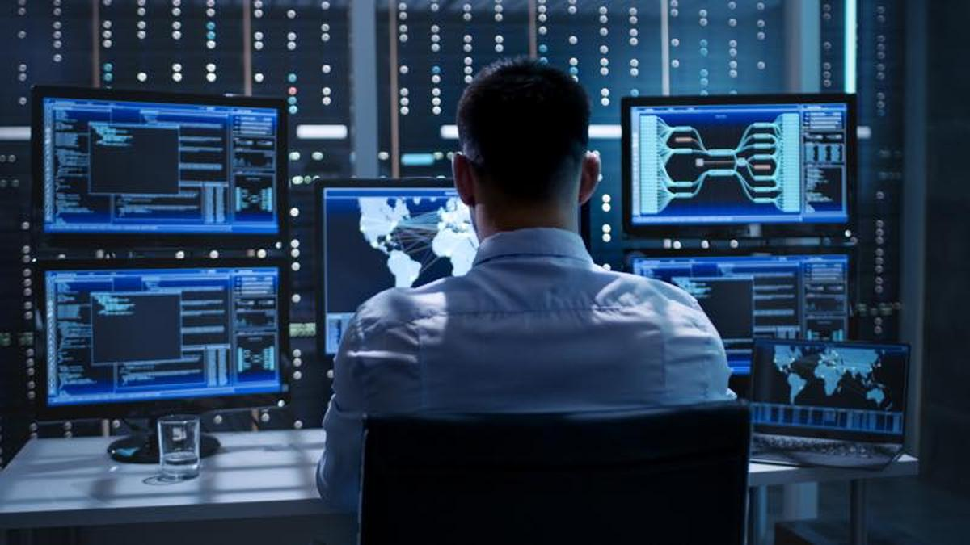

1a. Introduction
Expectations Reality
Garrison Gao
garrison.gao@uwa.edu.au

Slide 2
1a. Introduction: outline
KineticIT Prize
University Computer Club
Team
Location
Schedule
Assessments
Remember

Slide 3
KineticIT Prize
1,000$ prize for Defensive Cybersecurity Unit
Rules
One student with highest grade in CITS1003
If there are more than one students have the highest grade, then the one with the highest WAM

Slide 4
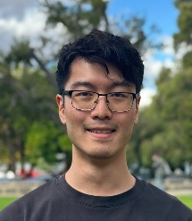
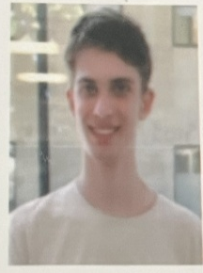
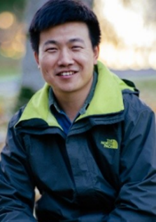

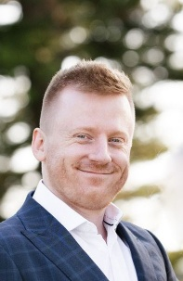
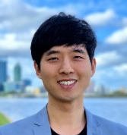
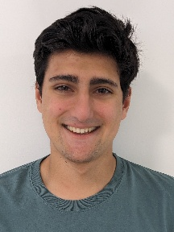
Team
Larry Huynh
Senior Lab Facilitator
Ari Carter
Lab facilitator
Elliott Naidoo
Lab facilitator
James Caporn
Lab facilitator
Robin Candy
Lab facilitator
Garrison Gao
Unit coordinator
Room CS G.08
garrison.gao@uwa.edu.au
Jin Hong
Lecturer
Room CS1.10
jin.hong@uwa.edu.au

Slide 5
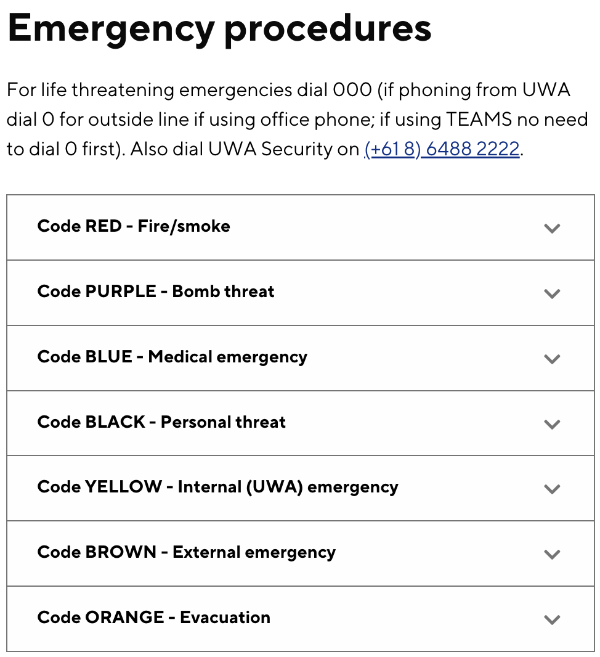



Emergency
General emergency: call campus security at 6488 2222 (or 1800 655 222)
In super emergency: call emergency at 000
In all buildings, we have an emergency procedure booklet that outlines how to react when such event happens.
Please take a time and read it.
For more details, please have a read through our emergency procedure for various potential incidents
https://www.uwa.edu.au/about/campus-services/safety/hazards-incidents-and-emergencies/emergency-procedures

Slide 6
Location
Lecture
Venue: Austin Lecture Theatre (ARTS 159)
Time: Mondays 12pm – 2pm
Labs
Lab 1: CSSE G09 @ Mondays 2pm – 4pm (A replacement in week 9)
Lab 2: CSSE G09 @ Tuesdays 11am – 1pm
Lab 3: CSSE G09 @ Tuesdays 4pm – 6pm
Lab 4: CSSE G09 @ Thursdays 10am – 12pm
Consultation
Office at Computer Science building – email to book a time with Garrison or Jin
Changes will be announced (if any)

Slide 7
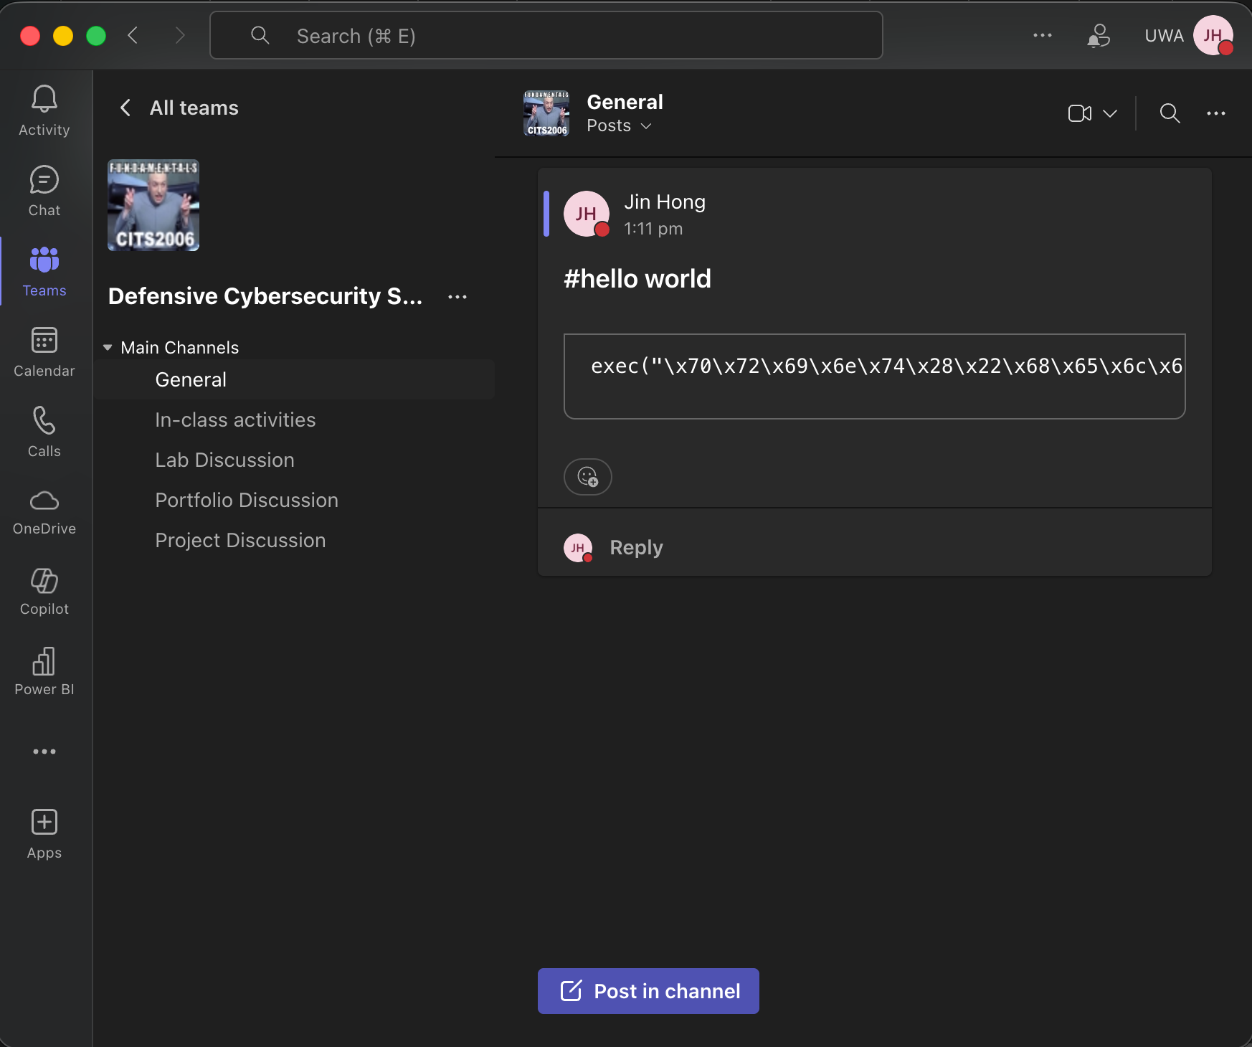
Location

Slide 8
Schedule overview: Term 1
Labs start first week!
Week | Lecture | Lab | Assessments
1 | Intro + Defence overview | Lab 0: Linux and Networking | Portfolio out Project out
2 | Cryptography* | Lab 1: Hashing and Blockchain
3 | Privacy | Lab 2: Privacy
4 | Access Control | Lab 3: Access Control
5 | Security Management | Lab Quiz 1 demo | Lab Quiz 1
6 | Security Tools | Lab 4: Vulnerability Analysis | Portfolio part 1 due
*Cryptography lecture will be available online due to Labour Day public holiday on Monday

Slide 9
Schedule overview: Term 2
Week | Lecture | Lab | Assessments
Break
7 | IDS | Project T1 demo | Project T1 due
8 | Security Modelling and Analysis | Lab 5: IDS
9 | Proactive Cybersecurity | Lab 6: Risk Analysis
10 | Threat Intelligence | Lab Quiz 2
11 | AI and Security | Lab Quiz 2 Demo | Project T2 due
12 | Special Topic | Project demo | Portfolio part 2 due

Slide 10
Assessments
Assessment Item | When | Covers | Worth (total)
Lab Quizzes | Weeks 5, 10 | Topics up to the week | 40% (20% each)
Project | Weeks 7 (Task 1) Week 11 (Task 2) | Various | 40%
Portfolio | Week 6 (Part 1) Week 12 (Part 2) | Various | 20%
Please note, all dates are tentative and subject to change!

Slide 11
How does the lab quiz work?
During your scheduled lab time, you will be supervised by a lab facilitator to complete a timed lab quiz (~60 mins but can vary).
You cannot receive mark if your attendance is not confirmed by the lab facilitator.
i.e., you must be supervised/invigilated by the lab facilitator to receive marks.
Attendance is required for all F2F students (unless a reasonable excuse is provided).

Slide 12
How does the lab quiz work?
We will be using a peer-marking system, where you will be formed into a group of 4.
Marking keys will be provided.
For Demo, you will be given 10~15 min slots to complete the demo.
Marking keys will be provided for peer markers to use and submit the report.
The peer markers will also provide feedback to the demonstrator including the mark range.
Facilitators will be available for any moderations and review of the peer marking process.
All submitted peer marks will be reviewed and moderated by the teaching staff, and finalised marks will be released to students.

Slide 13
Project
You will form a group
Part 1 (20%) : Security issues in the community (research)
Part 2 (30%) : Enhancing security in the community (implementation)
Part 3 (20%) : Demonstration and highlight video (communication)
Part 4 (30%) : Individual contributions
You will submit a final report as well as doing Demo as required. All members are expected to be present at the demo and participate.
TBC, details may be adjusted.

Slide 14
Portfolio
You are given a list of tasks to complete over the semester.
Keep track of your activities and completed tasks to create a portfolio.
Submit the portfolio in week 6 and in week 12.
There will be a set of tasks (easier ones) to be completed by the week 6 submission.
The remaining tasks (harder ones) are to be submitted by the week 12 submission.
You can start early on all tasks regardless of the deadline.

Slide 15
Prerequisites and recommendations
Prerequisites: CITS1003 and CITS1401 (or their equivalents)
You will need to be familiar with Linux
You will also need to study a bit about basic computer networking
Lab 0 will cover Linux and basic networking so don't panic.
You may also use other programming languages other than Python as necessary.
But we'll keep this to minimal.
You should also be familiar with basic discrete mathematics and number theory.

Slide 16
Please note
Lectures provide theoretical and conceptual understandings of the topics presented
But we will also do some practicals in the lectures as applicable
So, you should bring your laptop if you want to try them in class as well
Labs, portfolio tasks and the project provide practical skills of the topics presented
The contents in Lectures, labs, portfolio tasks and the project will be related, but they are all INDEPENDENT learning materials
i.e., you will be learning new things in each lecture, lab, portfolio task and the project.

Slide 17
Copyright notice
Commonwealth of Australia
Copyright Regulations 1969
WARNING
Materials in this unit (CITS3006 – Penetration Testing) have been reproduced and communicated to you by or on behalf of The University of Western Australia pursuant to Part VB of the Copyright Act1968 (the Act).
The material in this communication may be subject to copyright under the Act. Any further reproduction or communication of this material by you may be the subject of copyright protection under the Act.

