Slide 1
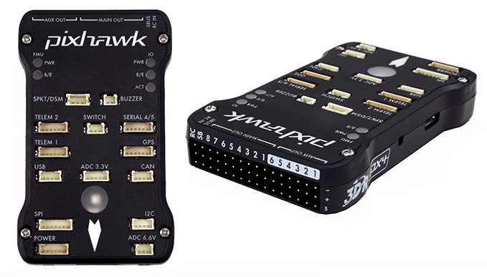

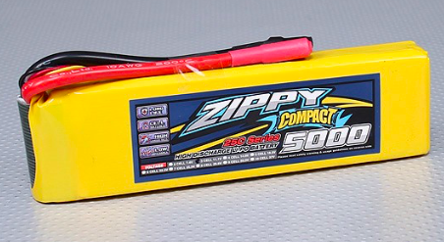
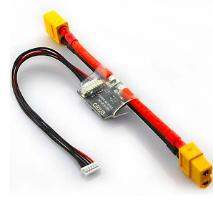
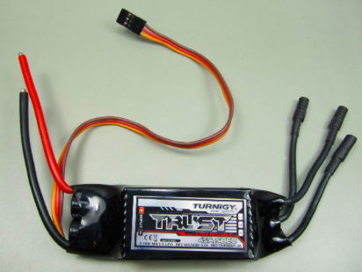
All-In-One USB-buzzer-servo arming-I2C Unit
Has 4 bundles of wires coming out
I2C; 4-pin; Orange, yellow, green, black
Airspeed Sensor
SWITCH; 3-pin; Yellow, white, red
DF-13 (shiny wires with white connectors)
BUZZER; 2-pin; Red, black
I2C
GPS/Compass
USB; 4-pin; Red, yellow, white, black
Airspeed
Servo wire
Mag
Mag;
4-pin,
2-wire
GPS; 6-pin
GROUND WIRE DOWN (Away from LED side)
12 gauge wire
I2C
Receiver
Empty
I2C Splitter
Note that one of the wires from the ESC goes straight to the motor, without routing through the switch. It does not matter which one.
GROUND WIRES UP
Motor
Telemetry Radio
Ch 1 – Ailerons
Ch 2 – Elevator
Ch 3 – Throttle
Ch 4 – Rudder
Ch 5 – Flaps
Bullet connectors
Main Power Switch
Motor Safety Switch
XT60
XT60
XT60
Battery
Power Module
ESC
12-GAUGE WIRE on all bold purple connections

