Slide 1
Mission Planner Advanced Features and Hardware-in-the-Loop Simulation
Melanie Clark
2/9/15

Slide 2
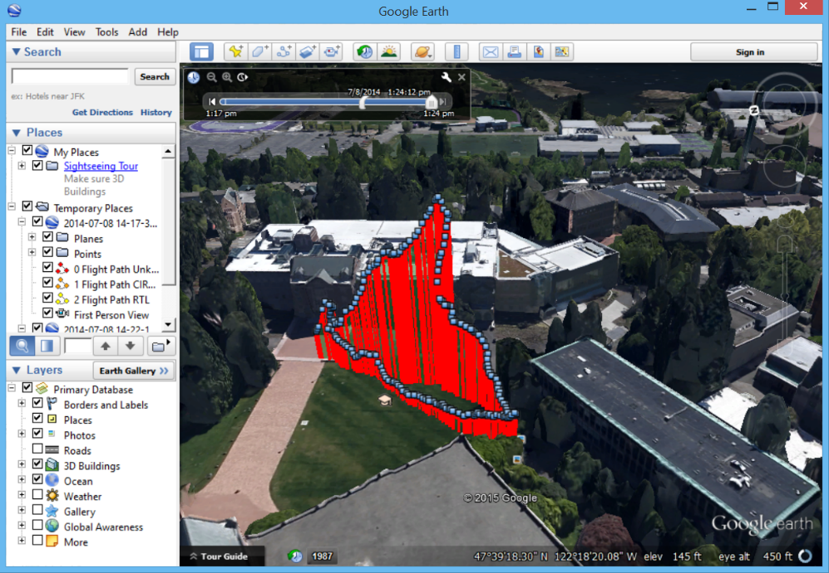
Mission Planner Advanced Features
Google Earth Logging
Each flight automatically logged, saved as .tlog in “logs” subfolder of Mission Planner
Telem. uplink rates adjustable in MP ->Config/Tuning>Planner

Slide 3
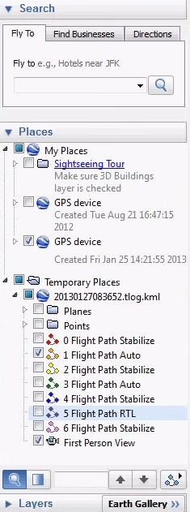
Mission Planner Advanced Features
Google Earth Logging
Flight modes viewed individually
Lat/Long, Altitude/Pitch/Roll/Yaw data available for each point.
First-person view replay available

Slide 4
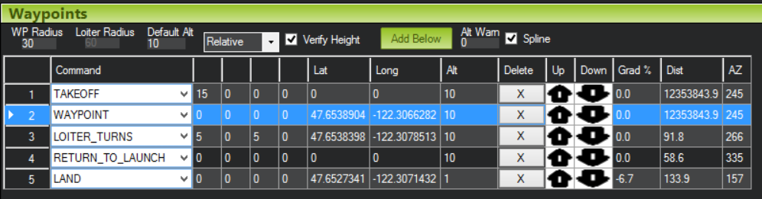
Mission Planner Advanced Features
Mission Planning
Point-and-click flight paths
Takeoff, WP, loiter, RTL, land & more
Loiter options: forever, # circles, specific time
New mission can be programmed and uploaded via telemetry during active mission

Slide 5
Mission Planner Advanced Features
Other Mission Planning Features of Interest (from drop-down menus)
Condition_Delay
Delays execution of next command
Do_Set_ROI
Points nose of vehicle and camera gimbal to the programmed “region of interest”
Do_Jump
Jumps to specific WP specific # of times. (Useable only 3 times per mission)
Do_Change_Speed
Do_Set_Cam_Trigg_Dist
Triggers the camera shutter at regular distance intervals

Slide 6
Mission Planner Advanced Features
RTL: Return to Launch
Returns plane to launch point (where GPS lock first established)
Plane will rise to RTL_ALT as it returns home
Important to acquire GPS lock before arming for any GPS dependent mode to work properly.
Flight Modes
Flight modes assigned to transmitter switches in MP ->Initial Setup -> Flight Modes
When switched to Auto (Programmed Mission), plane continues from previous mission item
While in Auto, pilot has partial control of plane via “stick mixing,” similar to FBWA mode

Slide 7
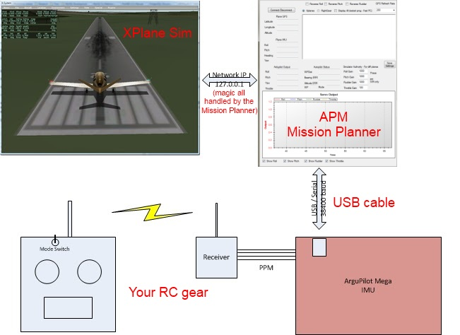
Mission Planner Advanced Features
Hardware-in-the-Loop Simulation With X-Plane

Slide 8

Mission Planner Advanced Features
Hardware-in-the-Loop Simulation With X-Plane
APM connected to computer by USB but not “Connected” to Mission Planner
In Mission Planner Initial Setup -> HIL Simulator -> Plane
MP serves as bridge to X-Plane and sends output from APM to flight simulator
X-Plane and MP can run on separate computers, as they communicate over network (important for improved framerate)

Slide 9
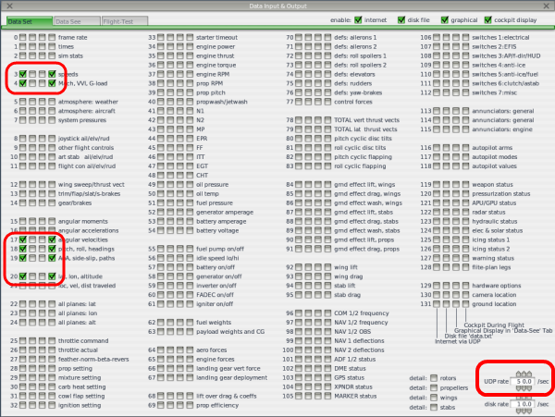
Mission Planner Advanced Features
Hardware-in-the-Loop Simulation With X-Plane
In X-Plane: Settings -> Data Input & Output

Slide 10
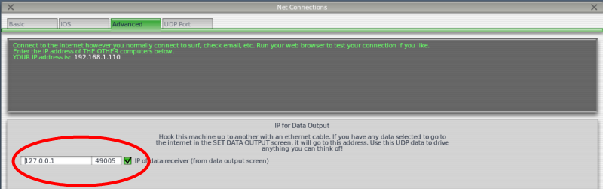
Mission Planner Advanced Features
Hardware-in-the-Loop Simulation With X-Plane
In X-Plane: Settings -> Net Connection
Enter IP of computer running MP
IP in image is loopback

Slide 11
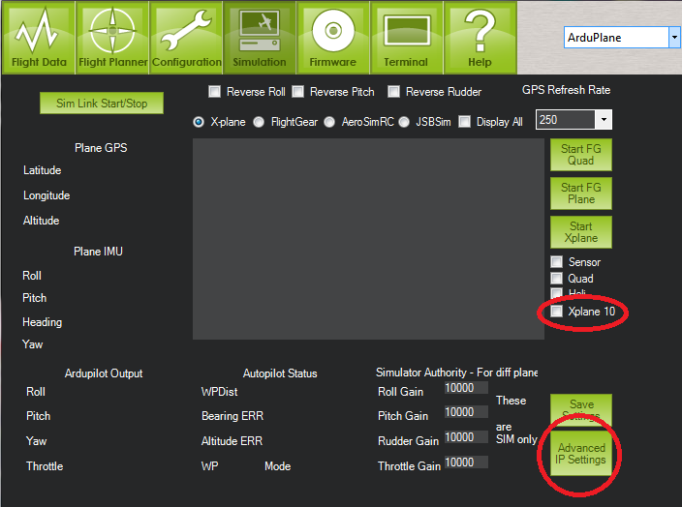
Mission Planner Advanced Features
Hardware-in-the-Loop Simulation With X-Plane
Check X-Plane box
Enter IP of computer running X-Plane (port 49000)
Select Sim Link Start/Stop
To test: set three RC toggle switch modes to Manual, Stabalize and RTL via MAVLink (ctrl-G)

Slide 12
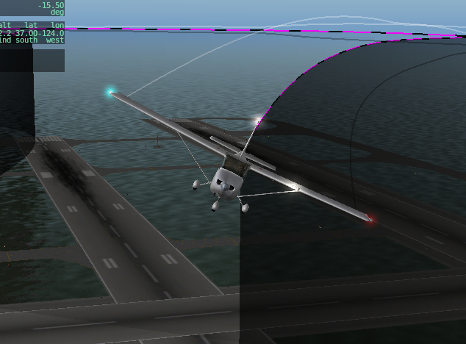
Mission Planner Advanced Features
Hardware-in-the-Loop Simulation With X-Plane
Once flying in sim, hit ‘C’ to view plane
Verify transmitter sticks move control surfaces in correct direction
Reversal is done as normal RC control
Enjoy your flight!

