Slide 1
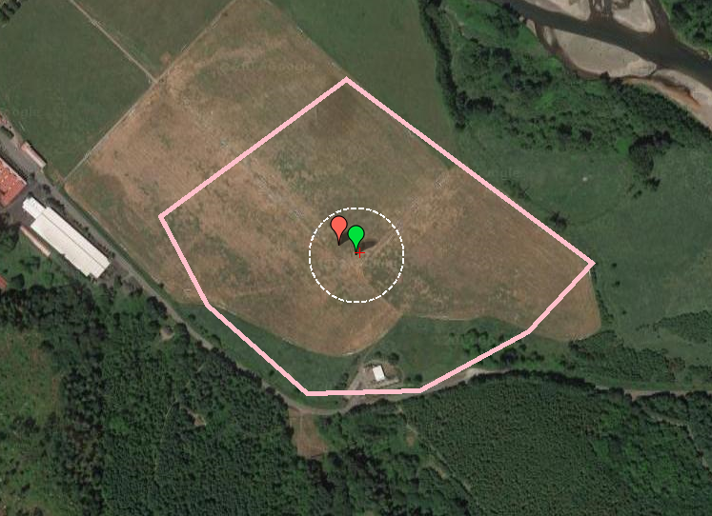
Mission Planner Geo-Fence

Slide 2
What is a Geo-Fence?
The Geo-Fencing support in Plane allows you to set a virtual ‘fence’ around the area you want to fly in, specified as an enclosed polygon of GPS positions plus a minimum and maximum altitude.
When fencing is enabled, if your plane goes outside the fenced area then it will switch to GUIDED mode, and will fly back to a pre-defined return point, and loiter there ready for you to take over again.
For complete notes, see: http://ardupilot.org/plane/docs/geofencing.html

Slide 3
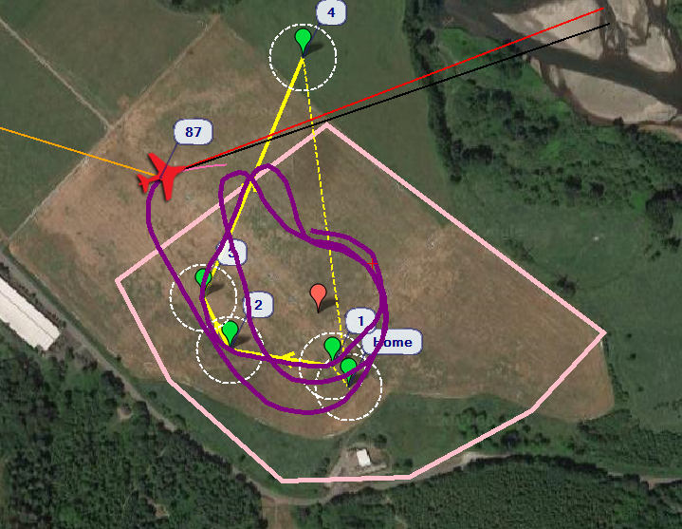
Example
Notes:
This is an actual test of the Geofence, conducted 4/21/18.

Slide 4
Setting Up Geo-Fencing
Things to configure:
the boundary of the fence, as a set of GPS points
the action to take on fence breach
the location of the return point; note that optionally you may use the FENCE_RET_RALLY parameter to have the plane return to the closest Rally Point instead of the fence return point.
the minimum and maximum altitude of the fenced area
what RC channel on your transmitter you will use to enable geo-fencing (if any)
an optional setting (FENCE_AUTOENABLE) when you want to configure the fence to automatically enable after an autonomous takeoff and automatically disable after an autonomous landing
how you want to take back control after a fence breach

Slide 5
Things to Consider
When the plane hits the fence, it will have some momentum and will pass through it, so leave a safety margin inside the true boundary of where you want to fly.
You can set it to either take control of the aircraft, or simply display a message in the case of a breach.
Parameters are FENCE_...

Slide 6
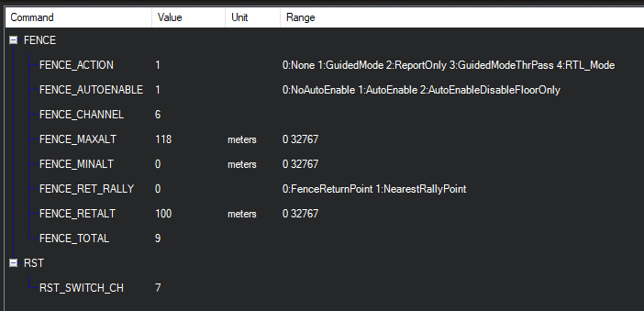
Parameters

