Slide 1
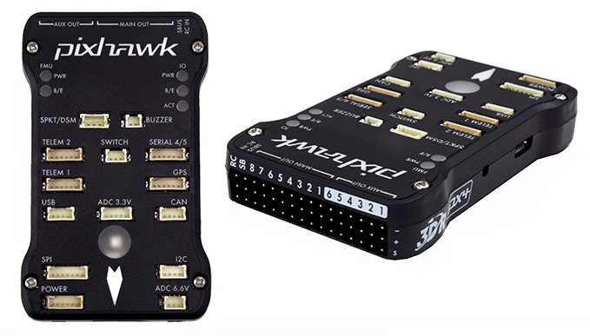

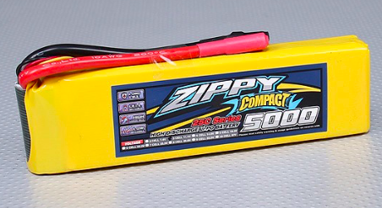
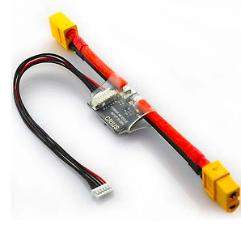
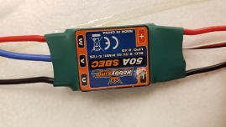
SWITCH
3-pin
Yellow
Black
Red
DF-13 (shiny wires with white connectors)
BUZZER
2-pin
Black
Black
Empty
GPS/Compass
Servo wire
Empty
Mag;
4-pin,
2-wire
GPS; 6-pin
12 gauge wire
Empty
GROUND WIRE DOWN (Away from LED side)
USB
4-pin
Red
Yellow
White
Black
Mag
Receiver
I2C
I2C Splitter
Note that one of the wires from the ESC goes straight to the motor, without routing through the switch. It does not matter which one.
GROUND WIRES UP
Motor
Telemetry Radio
Ch 1 – Ailerons
Ch 2 – Elevator
Ch 3 – Throttle
Ch 4 – Rudder
Ch 5 – Flaps
Bullet connectors
Main Power Switch
Motor Safety Switch
XT60
XT60
XT60
Battery
ESC
Power Module
12-GAUGE WIRE on all bold purple connections

