Slide 1

Commercial and Civilian Applications of Unmanned Aerial Systems
Christopher Lum lum@uw.edu
Jon Smith jsmith@uw.edu
Tim Brown tbrown@uw.edu
http://www.aa.washington.edu/research/afsl
April 30, 2016
<Insert Title of Event (Conference Name, Masters Thesis Presentation, etc.)>
<Insert Location of Presentation (Seattle, WA)>

Slide 2
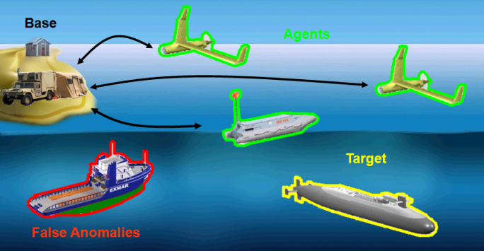
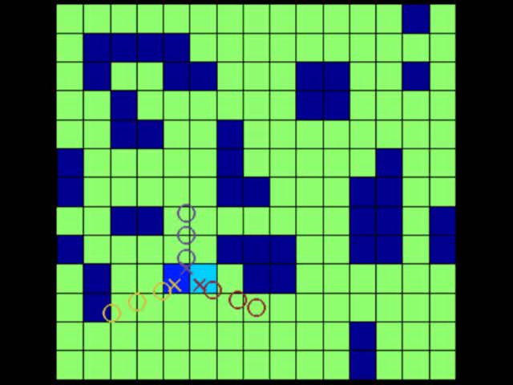
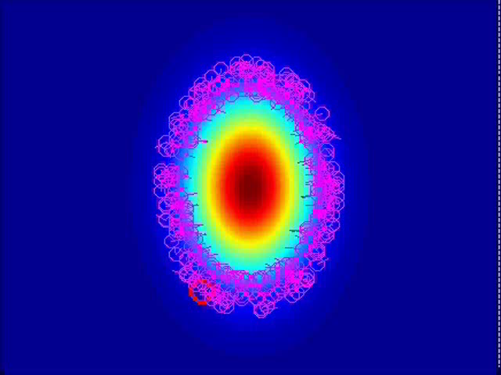
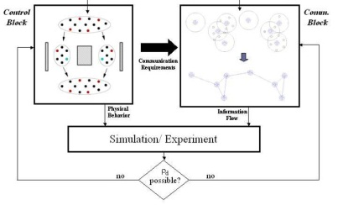
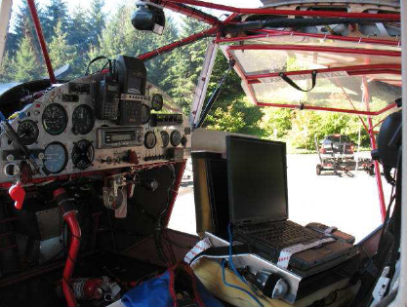
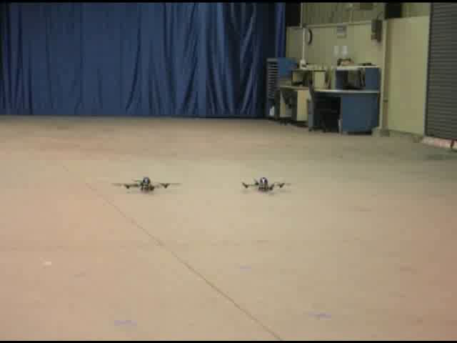
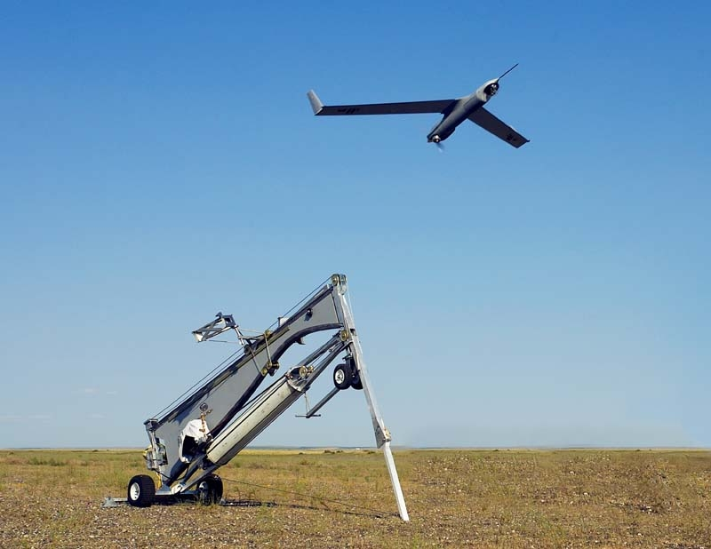
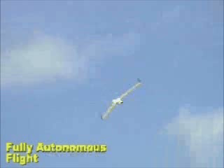
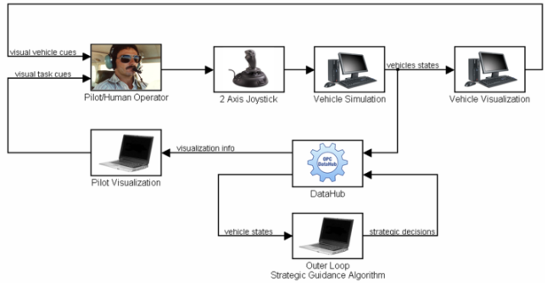
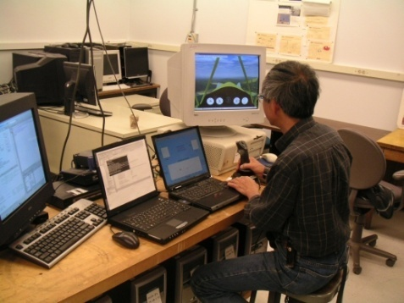
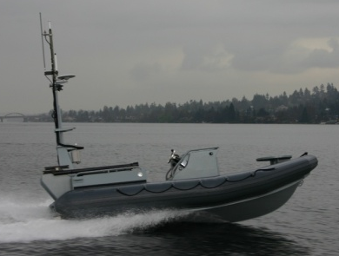
Autonomous Flight Systems Laboratory
Dynamic Mission Management
The mission of the AFSL is to conduct research that advances technologies relevant to unmanned systems
Algorithm Development
Flight Testing and Integration
General UAS GN&C Work
Human in the Loop Architectures

Slide 3
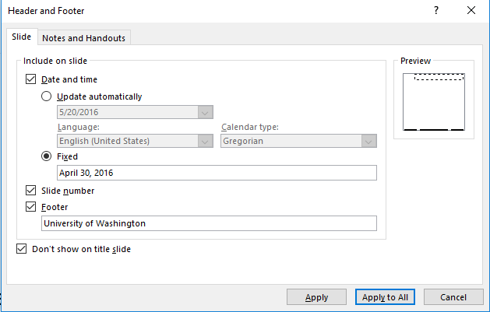
TITLE OF SLIDE HERE
Top level bullet here (Font: Arial, Size: 20)
Second level bullet here (Font: Arial, Size: 16)
Be sure to update the Footer with the date of the presentation
Insert > Header & Footer > Changed the fixed date to the date of presentation
Use this style to cite papers
C.W. Lum, R.T. Rysdyk, and J. Vagners, “A Search Algorithm for Teams of Heterogeneous Agents with Coverage Guarantees” AIAA Journal of Aerospace Computing, Information, and Communication, Vol. 7, pg. 1-31.
C.W. Lum, J. Vagners, J.S. Jang, and J. Vian “Partitioned Searching and Deconfliction: Analysis and Flight Tests” Proceedings of the 2010 American Control Conference, July 2010.

Slide 4
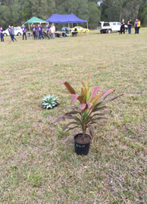
Pictures
For pictures, do not insert high resolution, large files.
Most projectors can show resolutions of 1920 x 1080 pixels at the most, so any more resolution in your picture is wasted an only serves to increase the size of the .pptx file.
PowerPoint will embed a copy of the picture into the .pptx file so a large file will increase the size of the .pptx file.
Downsize a high resolution picture before inserting it into a presentation.
Try to use captions on pictures if possible
Font: Arial, Size: 11 (see example)
For example, this picture’s original file size was 8 MB but it was downsized to a more reasonable resolution and therefore only increases the size of the .pptx file by 134 KB
Plants used to simulate invasive species

Slide 5
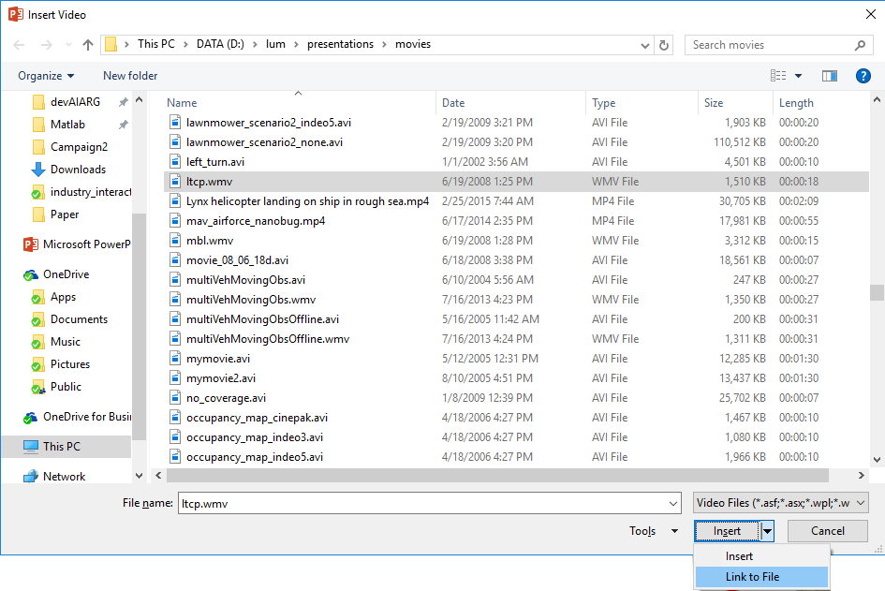
Movies
Use "C:\dev\AFSL\TechnicalDataPackage\Presentations\robocopy\copy_movies_to_C_drive.cmd“ to copy movies from K drive to your local machine.
Insert links to movies rather than directly embedding in the .pptx file.
By default, PowerPoint will embed a copy of movies directly into the .pptx file. While this makes it more likely to play when you transfer the movie, it makes the .pptx file very large in size. Instead, you should do the following.
Insert > Video > Video on My PC
On the resulting dialog box, navigate to the desired video , click on the name, then click on the down arrow next to ‘Insert’ and instead select ‘Link to file’
YouTube tutorial here.

