Slide 1
Kickoff Meeting for the UW Unmanned Aerial System (UAS) Project
June 26, 2014

Slide 2
UW Capabilities and Deficiencies
UW controls researchers focus on many topics related to unmanned systems
Search and rescue algorithms
Collision awareness algorithms
Strategic path and task planning algorithms
Verification and validation of flight control laws
Inner loop control design
UW lacks a flight vehicle to test these algorithms and thus is forced to use external resources to perform flight testing.
Students at UW have created sophisticated remote controlled systems.
We can leverage this experience to create a UW UAS.

Slide 3
Project 1: Identify Airframe
We need to identify what airframe will fulfil our needs.
Step 1: Create a use case document
Enumerate and identify as many different use cases as possible (search and rescue, inner loop control validation, forest fire monitoring, etc.)
Step 2: Create engineering requirements document
Translate use cases into engineering requirements (endurance, payload, speed, etc.)
Step 3: Identify system to meet requirements.
Research potential airframes to meet as many requirements as possible.

Slide 4
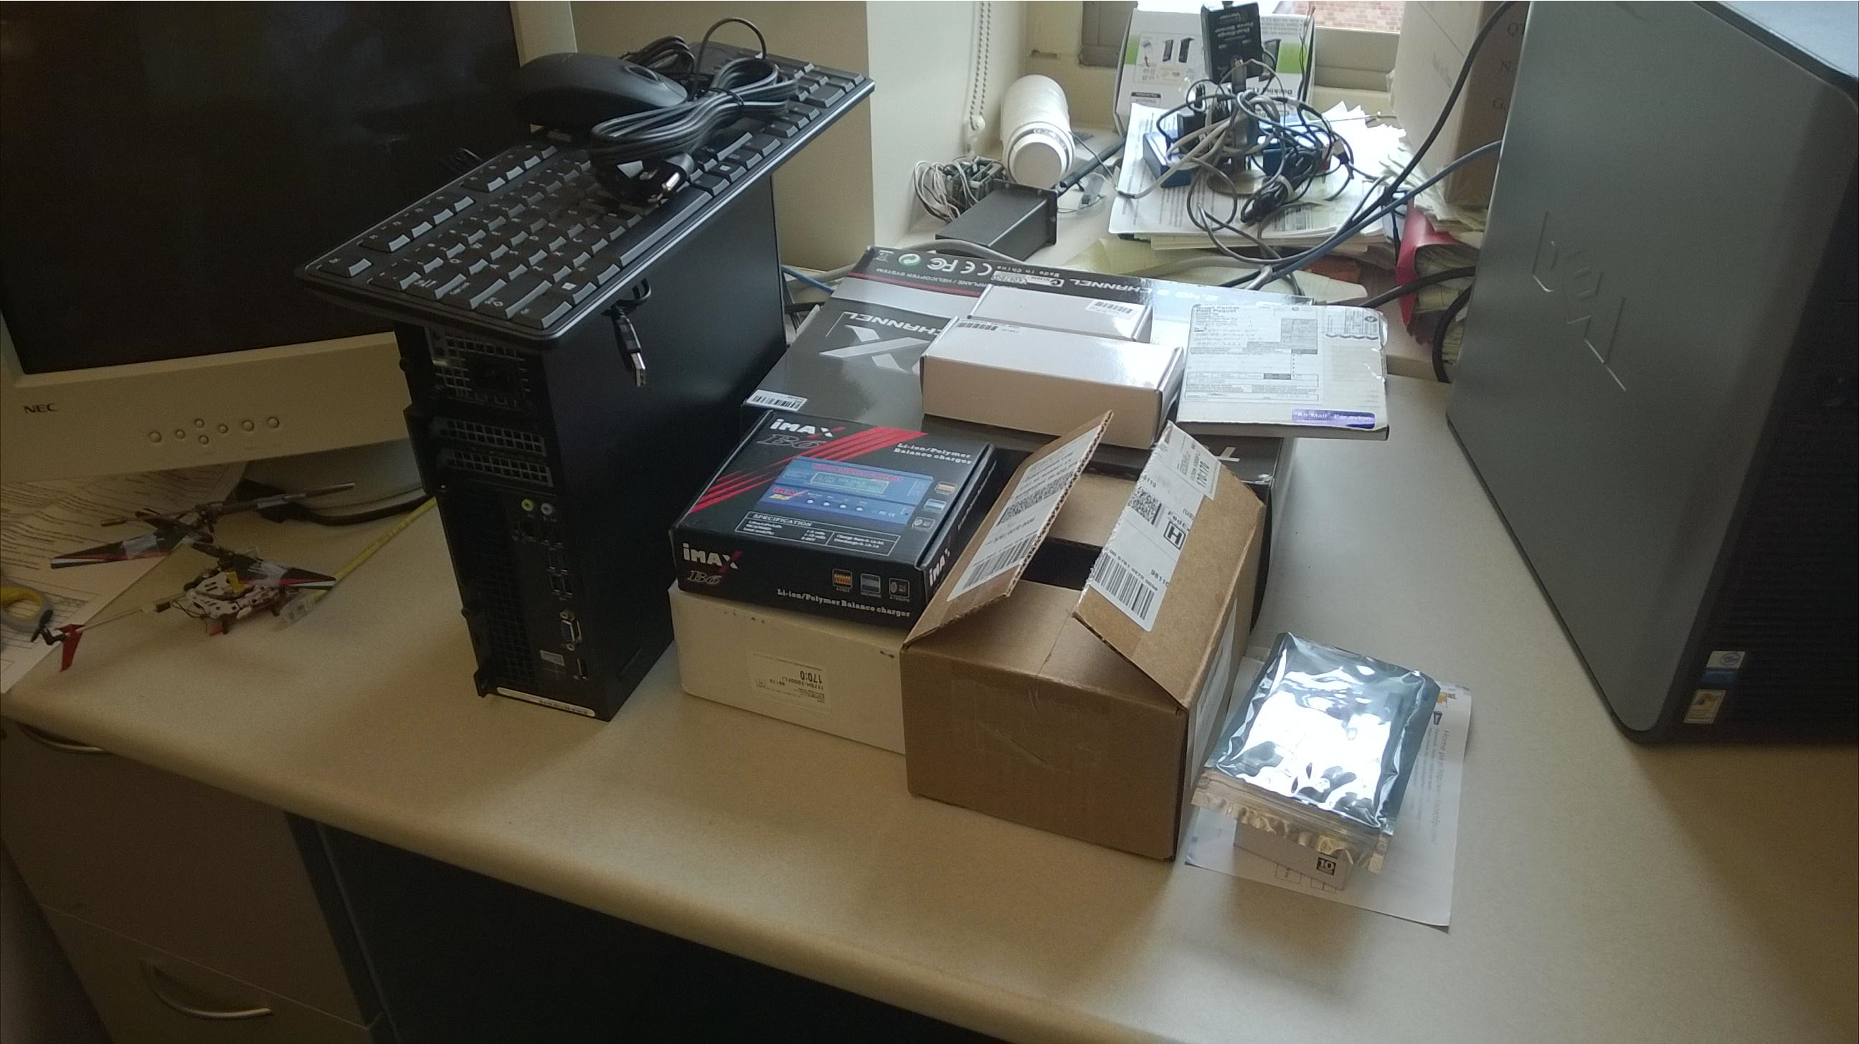
Project 2: Component Familiarization
We have a significant amount of RC hardware
Task 1: Log and document all components/systems.
Task 2: Familiarize with RC components and hardware
Task 3: Setup APM system in AFSL lab

Slide 5
Future Projects
Airframe construction
Preliminary flight testing (RC)
Autopilot integration
Software simulation
FAA COA application
Limited autonomous flight testing
Algorithm integration and advanced projects

