Slide 1
UW UAS Safety Guide
Aleksandr Tereshchenkov
October 30, 2014

Slide 2
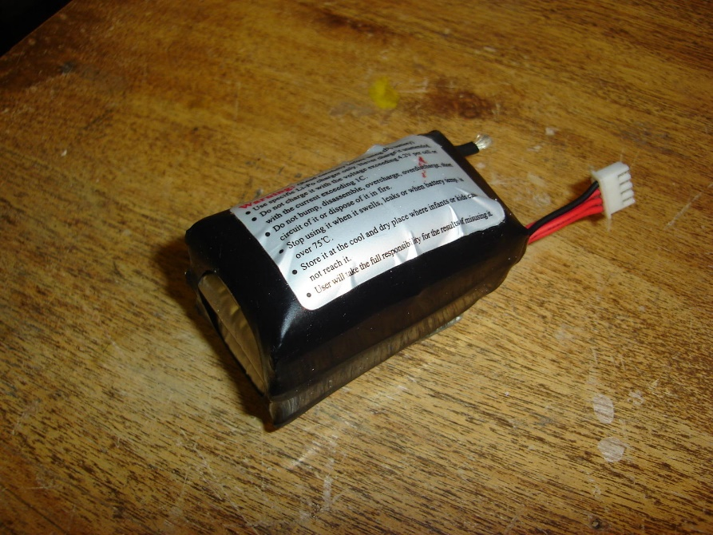
LiPo Battery Safety
Inspect battery for “ballooning” before use
Puncturing battery can cause a fire
Make sure not to short the battery when soldering
Do not discharge the battery under 3.0V/Cell

Slide 3
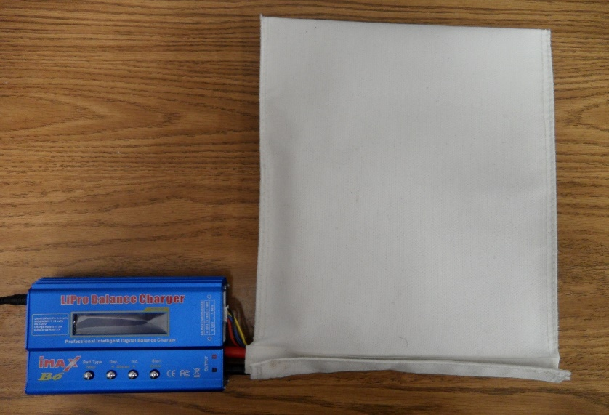
Rules For Charging LiPo Batteries
Wrong settings on the charger can lead to destruction of the battery
Batteries should be charged in LiPo Safe Bag
Never Charge batteries unattended
Charging instructions located on PV4

Slide 4
Spinning Propeller Hazards
Any necessary modifications to the motor and propeller should be done before connecting the battery
Malfunction in hardware can cause the motor to rotate at any time when battery is engaged
When the battery is plugged in, treat the motor as a loaded gun

Slide 5
Construction Tools Hazards
Be extra careful when using power tools
Some substances can produce fumes (e.g. epoxy, paint, soldering), make sure to have good ventilation
Do not use spray paint inside buildings
If you do not know how to use a particular tool, ask for assistance

Slide 6
Field Experiment Rules
Fly below 400 ft
Stay in visual range
Do not fly within 5 miles of airports
Do not fly over people, cars, buildings, etc.
Fly in designated areas
Links to AMA rules located in the UW UAS Safety Guide on PV4

