Slide 1
Data Analysis Flight Test January 21, 2017
Hannah Rotta hrotta@uw.edu
Selina Lui luisel@uw.edu
January 31, 2017

Slide 2
Data Analysis with MATLAB
The MATLAB script for each mission can be found in \FlightOperations\Operations\Missions\17_01_21_meadowbrook\DataAnalysis
This data is from data flash logs and telemetry logs pulled off the Pixhawk and GCS, respectively.

Slide 3
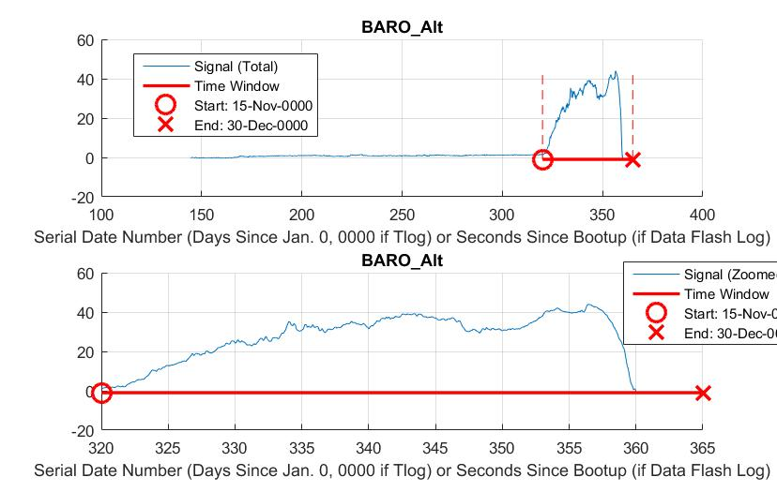
Anakin - Barometer Altitudes

Slide 4
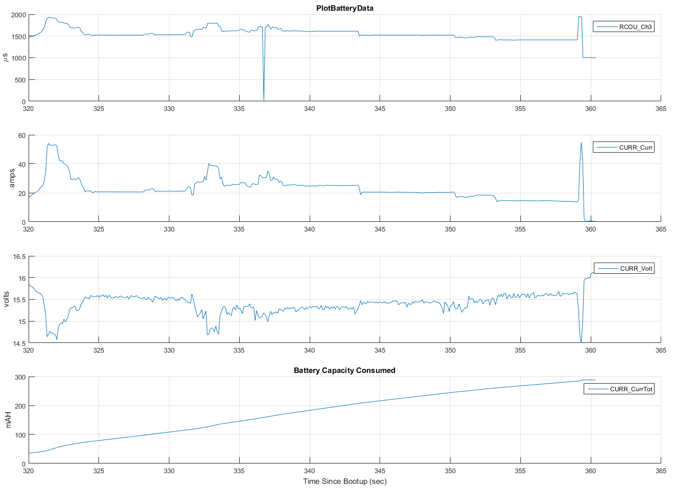
Anakin - Battery Plots

Slide 5
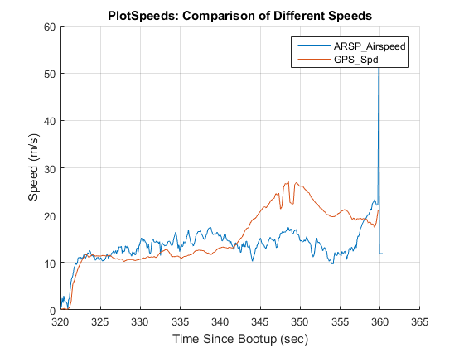
Anakin - Air and Ground Speed

Slide 6
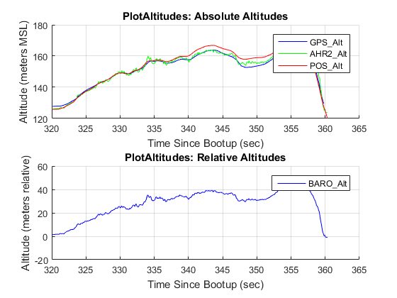
Anakin - Altitude Plots

Slide 7
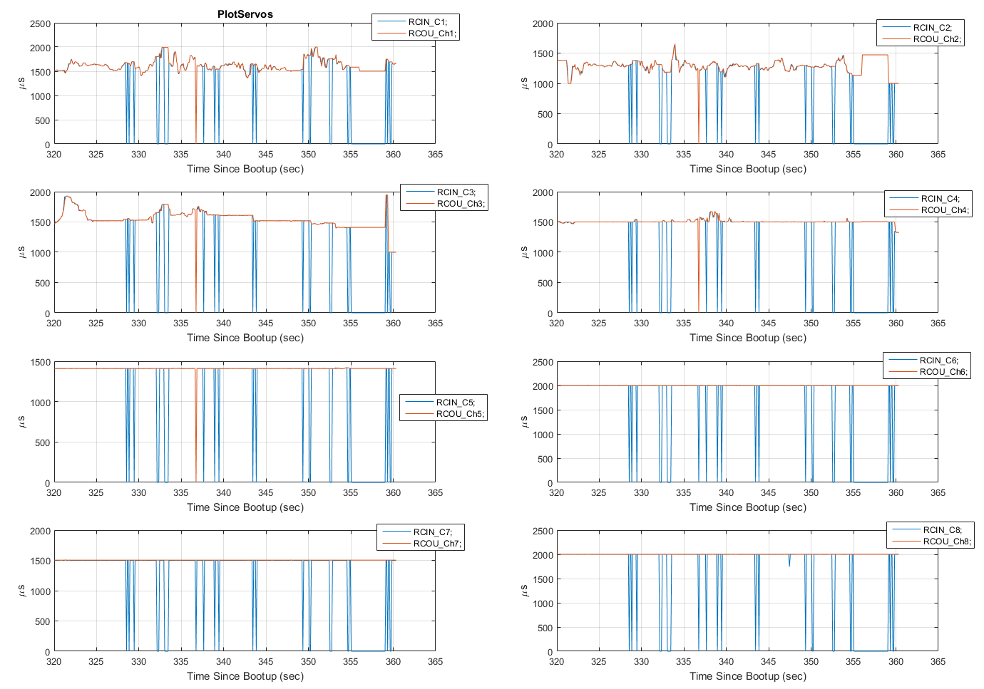
Anakin - Servo Input and Outputs

Slide 8
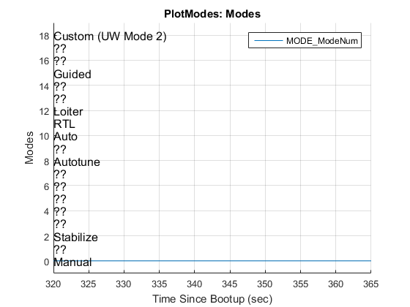
Anakin - Flight Modes

Slide 9
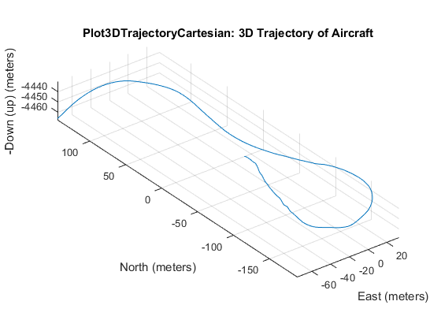
Anakin - Aircraft Trajectory

Slide 10
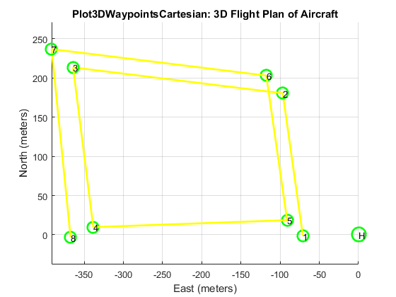
Anakin

Slide 11
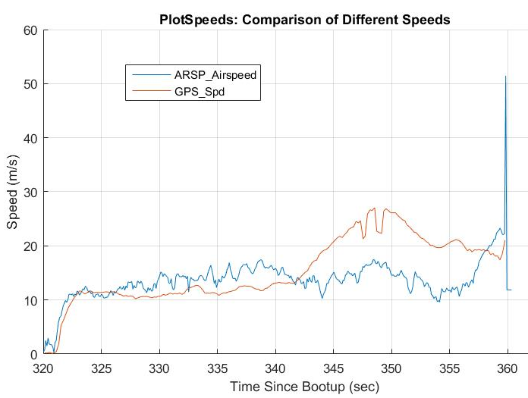
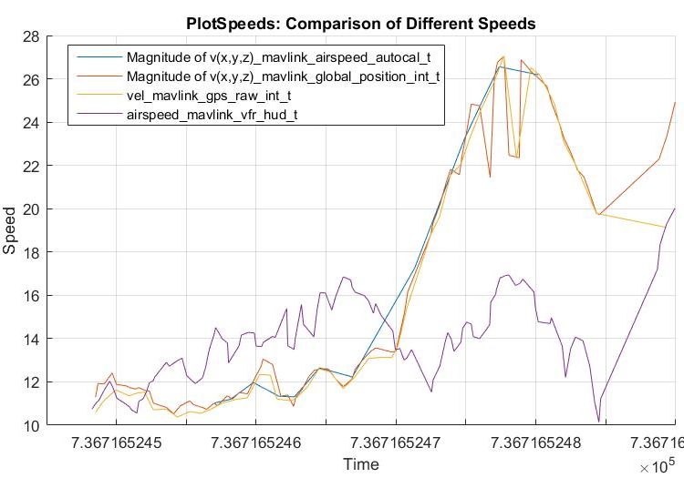
Data Flash and Telemetry Logs
Pulled from Data Flash
Pulled from Telemetry

Slide 12
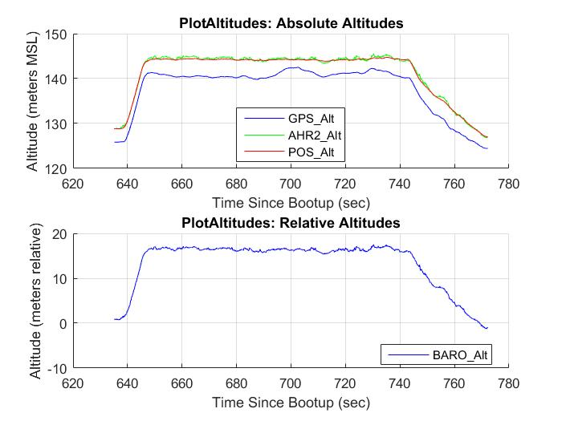
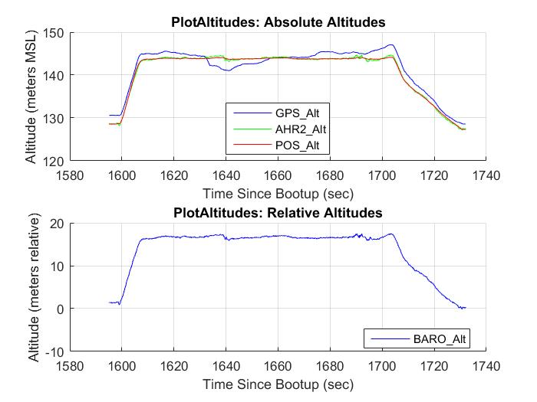
MARV and Argo
MARV
Argo

Slide 13
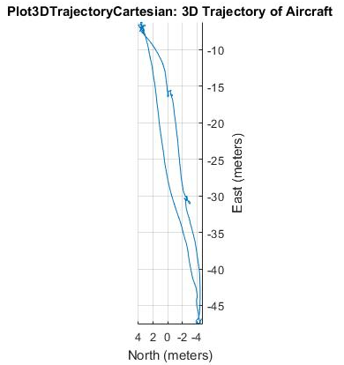
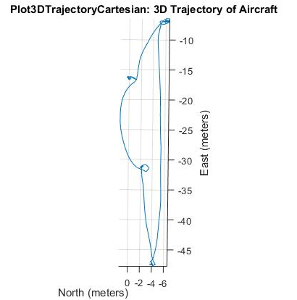
MARV and Argo
MARV
Argo

