Slide 1
Unmanned Aerial System Swarm technology
Zach Caratao zcaratao@uw.edu
Feb 7, 2017

Slide 2
Precautions
Requires Part 107 Waiver of 14 CFR § 107.35 Operation of multiple small unmanned aircraft
“A person may not operate or act as a remote pilot in command or visual observer in the operation of more than one unmanned aircraft at the same time.”
Recommended at least 90 days in advance (FAA)
Will need to mandate new flight procedures with swarm control
Requires some SITL and HITL testing
Network Traffic & emergency procedures
May use one transmitter per vehicle for safety

Slide 3
General Set Up
One 3DR radio per vehicle
Different MAVlink IDs
PX4 Pro Parameter: MAV_SYS_ID
ArduPilot Firmwares: SYSID_THISMAV
Values range from 0-255
Combine MAVlink streams
For Ground Station Connection, specify COM PORT

Slide 4
Mission Planner
Beta implementation
Rigid control (manually change formation in-flight)
Way Swarm control works
Multiple serial port MAVLink connections simultaneously OR Antenna Tracker
Pass GPS position from one leader (in any mode) to other followers (in Guided mode) with a user-defined X,Y,Z offset.

Slide 5
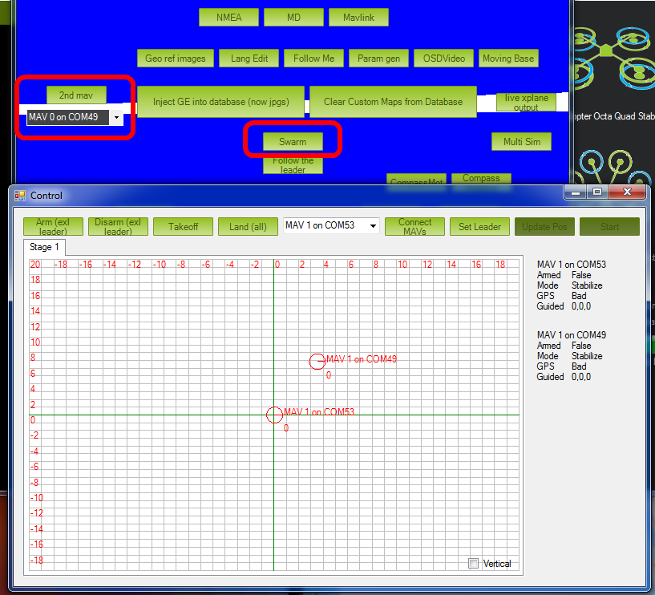
Mission Planner Setup Procedure
Plug one 3DR radio per vehicle
Connect to the leader in Mission Planner
Some preflight procedures for followers also come here
Open Swarm UI in Mission Planner(control+F)
Activate swarm control via pressing “Swarm Button”
Click “Set Leader”
Click “Connect MAVs” and Connect each MAV
Drag circles around grid to set offsets
Fly leader
Click “Start” to send “Guided Mode” waypoints to all followers and set followers to launch
Control+X to switch to different vehicles to set to different modes
Mission Planner Swarm UI

Slide 6
Mission Planner Multi-Vehicle Flying
Without using Beta Swarm
User-Specified commands by GCS for each vehicle
After pre-flight procedures, Switch Each vehicle to guided mode
Control-X to select vehicles via COMPorts
Guided Mode: GCS user can select locations on the map for the vehicle to travel to and specify Takeoff height
Switch to specified vehicles to set Takeoff height & control
Switch specified vehicles to Auto-mode for flying their flight paths
To retake control
[Multiple Transmitter] Person manipulating TX controls switches to Loiter/Stabilize
[One Transmitter] GCS switches to specified vehicle and activates loiter,
Person Manipulating TX controls will have control
Note: Other vehicles will ignore the roll, pitch, and throttle inputs, but NOT YAW input

Slide 7
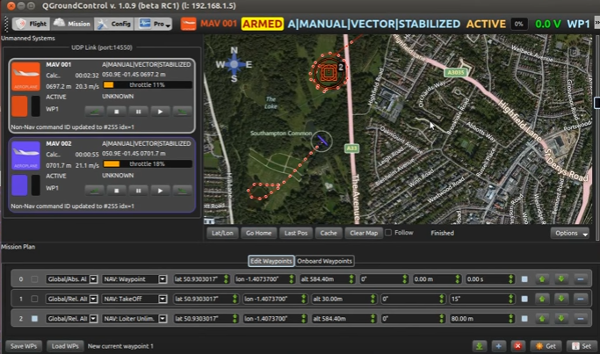
QGroundControl & APM Planner 2.0
Dynamically configure each vehicle
Better UI
QGroundControl UI (MultiVehicle)

Slide 8
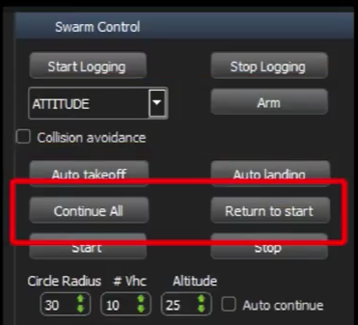
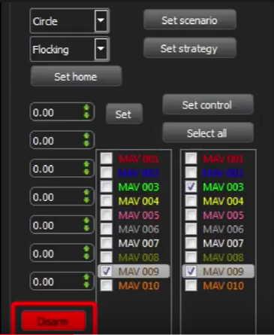
“Extension of a Ground Control Interface for Swarms of Small Drones” (Extension of QGroundControl)
Ground Control Interface Window

Slide 9
Dorr, L., & Duquette, A. (2016, June 21). Fact Sheet – Small Unmanned Aircraft Regulations (Part 107). Retrieved from https://www.faa.gov/news/fact_sheets/news_story.cfm?newsId=20516
Federal Aviation Administration. (2016, August 29). Applying for a Waiver under the New Drone Rules. Retrieved from https://www.faa.gov/news/updates/?newsId=86286
ArduPilot Dev Team. (2016). Swarming. Swarming/Formation-Flying Interface (Beta). Retrieved from http://ardupilot.org/planner/docs/swarming.html
ArduPilot Dev Team. (2016). Use-Cases and Applications. Multi-Vehicle Flying. Retrieved from http://ardupilot.org/copter/docs/common-multi-vehicle-flying.html
Mackay, Randy. (2015, May 3). Multi-Vehicle test with APM:Copter, Tracker, Mission Planner. Retrieved from https://www.youtube.com/watch?v=M4LxtYa94nk
Dousse, Nicolas. (2016, March 5). Extension of a Ground Control Interface for Swarms of Small Drones. Retrieved from https://www.youtube.com/watch?v=AE0KQHYT2MI

