Slide 1
A Collision Warning System for the Insitu Common Open-mission Management Command and Control (ICOMC2) System
External Demo
Sprint 1309
August 30, 2013

Slide 2
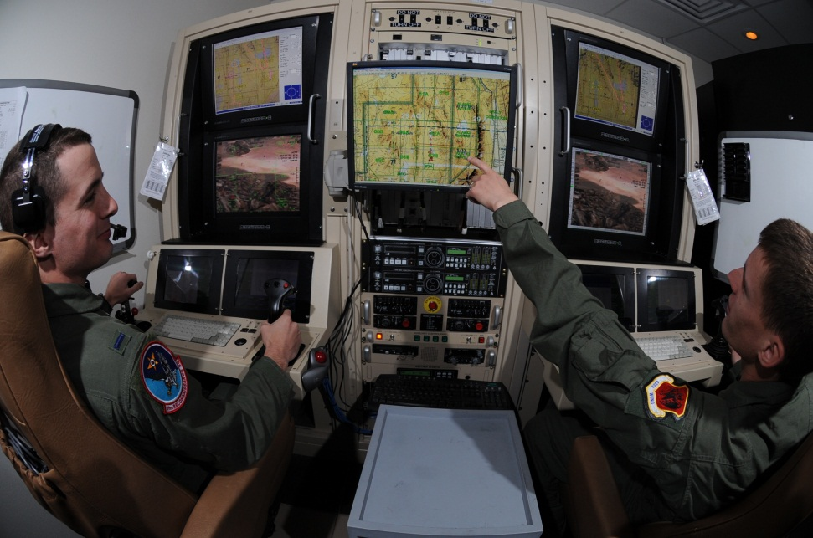

Project Goal
Create a collision warning system for the ICOMC2 system so operators are aware of potential conflicts and can direct the system to deconflict flight paths.
August 30, 2013
August 8, 2013
University of Washington
University of Washington

Slide 3
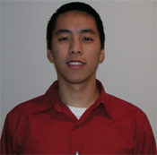
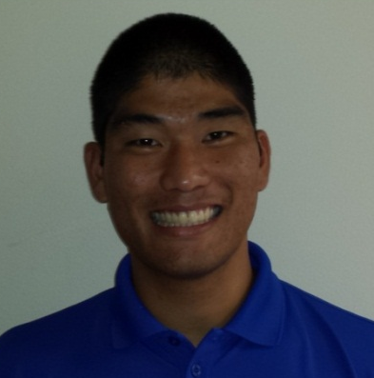
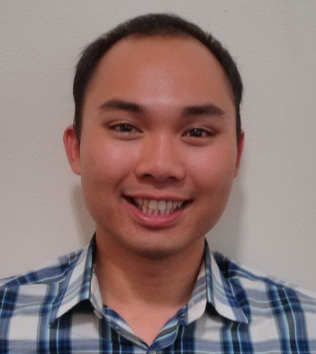
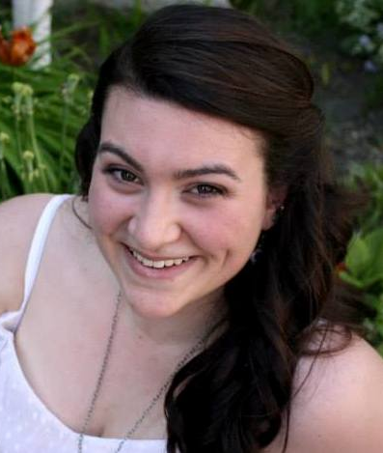
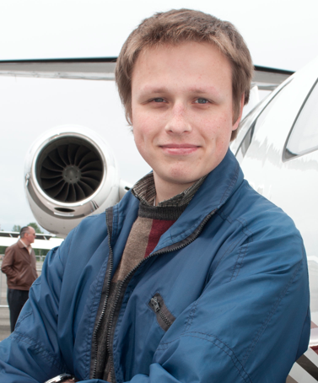
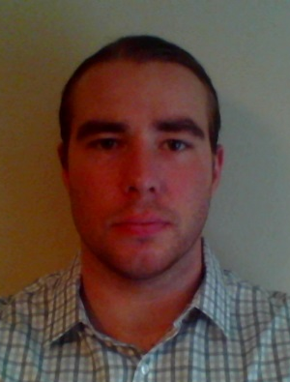
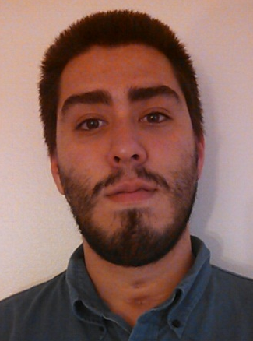
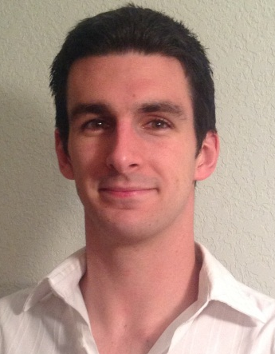
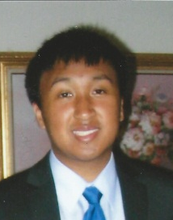
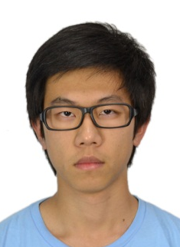
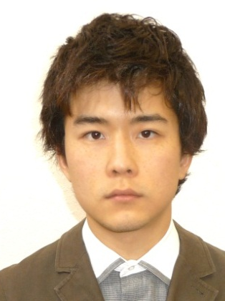
Team Introduction
Christopher Lum PhD
Research Scientist
Lt. Kevin Ueunten
Masters Student
Bao Le
Masters Student
Madison Peck
BS Alumni
Taras Eremenko
BS Alumni
Matt Davis
Senior
Federico Alvarez
Senior
Al Creigh
Junior
Daniel Ablog
Junior
Yuguan Pan
Junior
Noel Kimber
Senior
August 30, 2013
University of Washington

Slide 4
User Story Overview
ICOMC2 CAPlugin Team
 | Committed Stories |  | Stretch Stories
 | Number of Stories | Total Story Points | Number of Stories | Total Story Points
Accepted Status | 12 | 29 | 0 | 0
Descoped Status | 5 | 20 | 0 | 0
Impeded Status | 0 | 0 | 0 | 0
Total: | 17 | 49 | 0 | 0
First sprint for CAPlugin team, so only had 2 weeks of actual development.
Using mapping of XS > 1, S > 2, M > 3, L > 5, XL > 8
August 30, 2013
University of Washington

Slide 5
001 – Perforce Server Setup
Development Champion: Chris Lum
Content
As a project manager, I would like a Perforce server and depot setup so I can manage all files related to this project
Size
S
Definition of Done
[X] Perforce server setup at UW (including P4Admin)
[X] Users accounts created and setup for all students working on project
[X] Depots setup for both documentation and for code
[X] Initial check-ins of code and file structure
August 30, 2013
University of Washington

Slide 6
002 – Perforce Visual Client
Development Champion: Chris Lum, Al Creigh, Kevin Ueunten, Bao Le, Madt Peck, Matthew Davis, Taras Eremenko, Daniel Ablog, Yuguan Pan
Content
As a software developer, I would like a Perforce client installed on my machine and would like to be comfortable with its use so I may sync files and make code changes.
Size
S
Definition of Done
[x] P4V (perforce visual client installed on machine, either go to Perforce’s website or download appropriate (64-bit or 32-bit from http://faculty.washington.edu/lum/JCATI/ )
[x] Attended discussion/training with CL regarding Perforce operation and concepts
[x] Successfully create and sync relevant workspaces (both documentation and code)
[x] Successfully check something into the depot
August 30, 2013
University of Washington

Slide 7
003 – Forward State Estimator Feature Level Design
Development Champion: Kevin Ueunten
Content
As a software and algorithm developer, I would like a completed feature level design of the forward state estimator so I can identify key ideas and features of the algorithm.
Size
L
Definition of Done
[x] Literature review of relevant prior art relevant to forward state estimation.
[x] Look into “Probabilistic Robotics” by Thrun, Burgard, Fox (particularly chapter 5)
[x] Feature level design completed, presented to research group, reviewed, and checked into perforce.
[x] Identify key inputs necessary to perform the forward state estimation (rank them in order of importance)
[x] Discuss how to parameterize conflict entities (3D position, velocity, radius, standard deviations, etc.)
[x] Document the desired inputs/outputs of the estimator
August 30, 2013
University of Washington

Slide 8
012 – Air Traffic Controller Interaction
Development Champion: Al Creigh
Content
As an algorithm designer, I would like to interact and interview air traffic controllers so that I can have an idea of how they detect potential conflicts between aircraft.
Size
M
Definition of Done
[x] Contact an air traffic controller and setup and interview/meeting with them
[x] Coordinate with Al Creigh who is in contact with Matt McCully Phone: 360-825-8995 Email: mattmccully@aol.com (an air traffic controller)
[x] Arrange visit to Auburn flight control center (include CL on this trip)
[x] Document interview process and present results to research group. Interview document is checked into Perforce.
August 30, 2013
University of Washington

Slide 9
024 – UW Project Infrastructure Step 1
Development Champion: Chris Lum
Content
As a project manager, I would like preliminary project infrastructure in place so that I may dedicate human resources towards the project.
Size
M
Definition of Done
[x] Recruit students and personnel to work on the project
[x] Setup email distribution list
[x] Setup software infrastructure including Perforce, file structures, user stories, documentation, etc.
[x] Setup regular meeting times
[x] Setup lab space in AERB139 for student to work in. Facilitate getting keys to students
[x] Organize training lectures to get students up to speed on tools and skills needed for the project
August 30, 2013
University of Washington

Slide 10
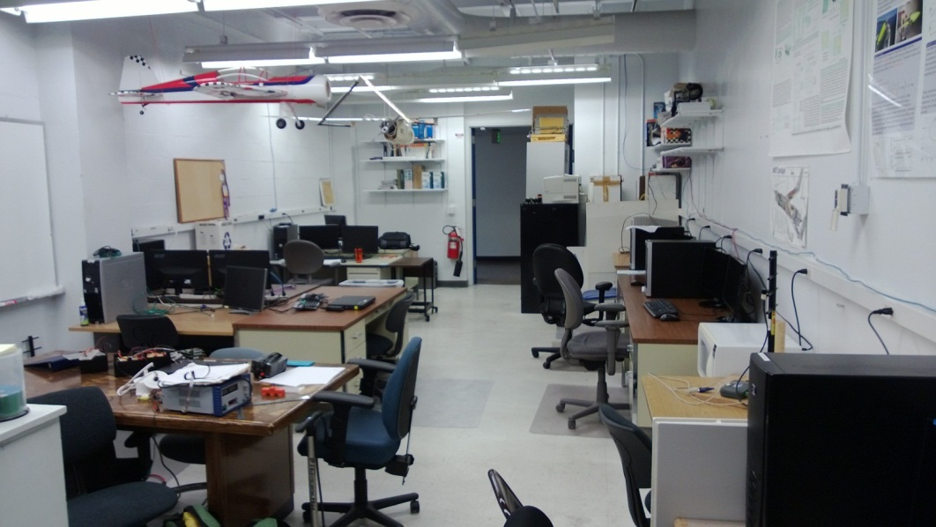
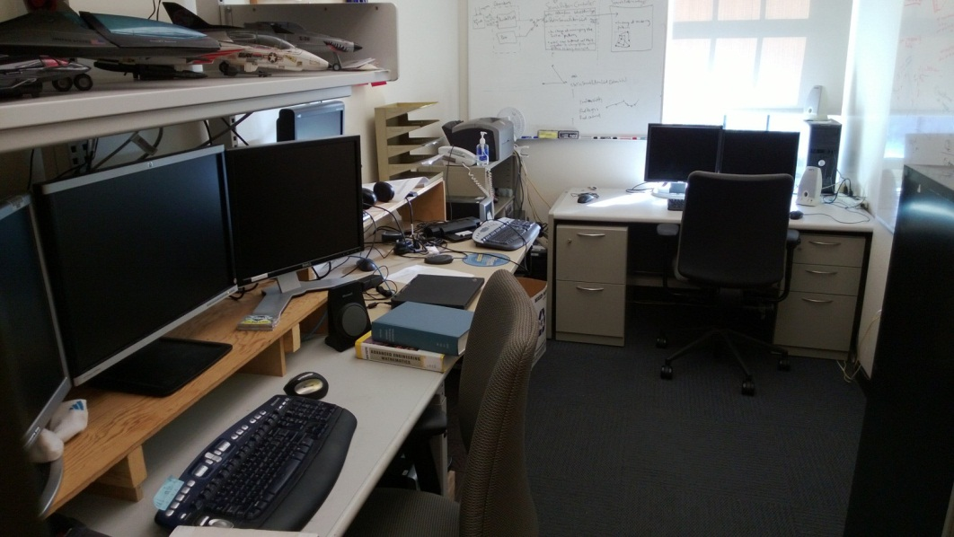
024 – UW Project Infrastructure Step 1
We currently have two spaces setup and available.
AERB 139 (6 students)
GUG 317B (3 students)
Search and rescue plugin developed in GUG317B (secure location that has already passed security inspection by Insitu and UW).
AERB139 is general lab with other projects and students.
August 30, 2013
University of Washington

Slide 11
Next Steps
We are rapidly approaching the point where we may be blocked without Insitu resources.
In the immediate future, we’d like to request
  Laptops
  Developer software (visual studio)
  ICOMC2 software (ICOMC2 2.0, Partner’s program SDK, SA2Plugin_VS2010.sln, UW.sln)
Potential trip down to Insitu on 09/17 would be a good time to pick up hardware.
Hardware
Developer Laptops | 5
2nd monitor for developer laptops | 5
Docking stations for developer laptops | 5
USB keyboards | 5
USB mice | 5
Partners Program
ICOMC2 Partners Program Membership (Premier level) | 1
ICOMC2 2.0 | 5
ICOMC2 External Developers SDK | 5
Participation in developer training and certification program | 5
Software
Microsoft Visual Studio | 5
Microsoft Office | 5
Matlab | 2
Personnel
Access to technical ICOMC2 resources | 0.25
Limited access to an SQA assest once plug-in nears completion | 0.25
Ability to contact ICOMC2 core team members with questions | 0.25
Miscellaneous
Insitu External Contractor (EXT) status restored for Chris Lum | 1
Access to Insitu Web-Ex | 1
Copy of the SA2Plugin_VS2010.sln and associated source code | 1
Copy of the UW.sln and associated source code | 1
Internship earmarked for a UW student during summer 2014 | 1
August 30, 2013
University of Washington

