Slide 1
A Collision Warning System for the Insitu Common Open-mission Management Command and Control (ICOMC2) System
External Demo
Sprint 1310
September 27, 2013

Slide 2
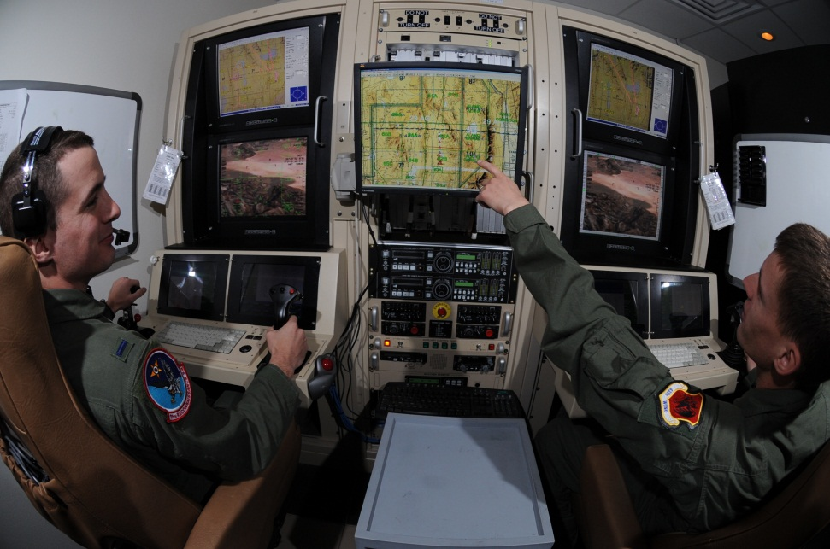
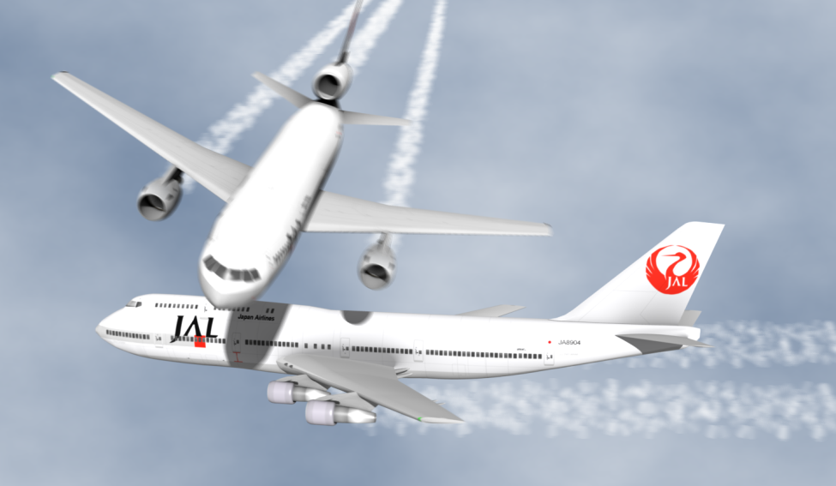
Project Goal
Create a collision warning system for the ICOMC2 system so operators are aware of potential conflicts and can direct the system to deconflict flight paths.
September 27, 2013
University of Washington
University of Washington

Slide 3
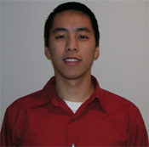
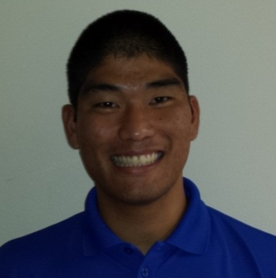
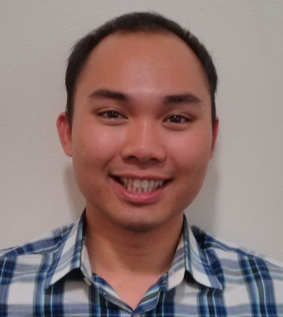
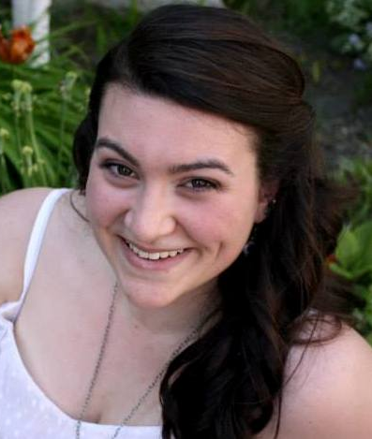
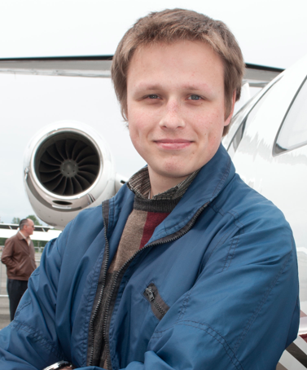
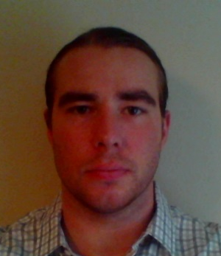
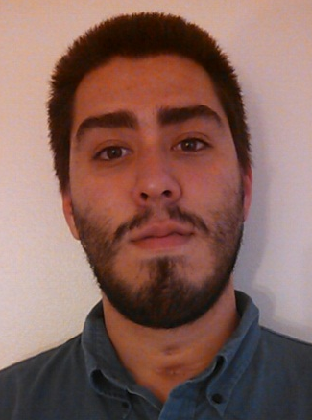
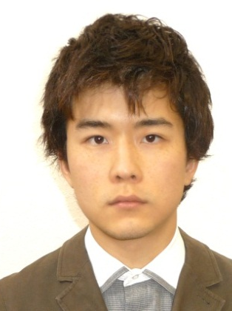
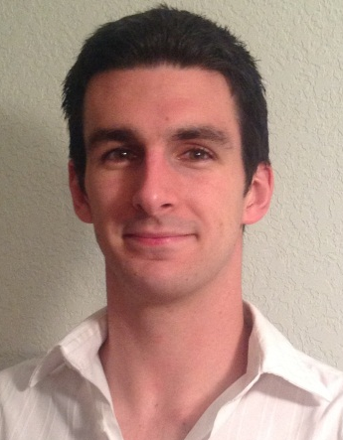
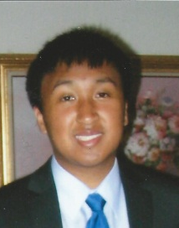
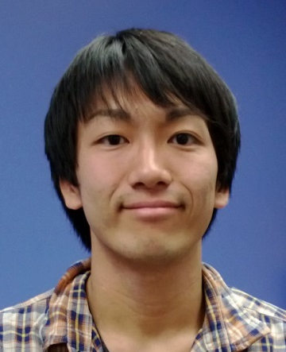
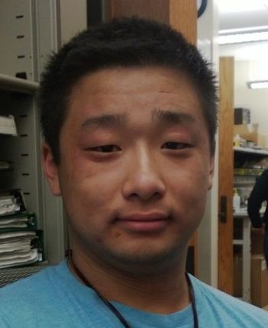
Team Introduction
Christopher Lum PhD
Research Scientist
Lt. Kevin Ueunten
Masters Student
Bao Le
Masters Student
Madison Peck
BS Alumni
Taras Eremenko
BS Alumni
Matt Davis
Senior
Federico Alvarez
Senior
Noel Kimber
Senior
Al Creigh
Junior
Daniel Ablog
Junior
Keisuke Tsujita
Junior
Henry Qin
Sophomore
University of Washington
September 27, 2013

Slide 4
User Story Overview
ICOMC2 CAPlugin Team
 | Committed Stories |  | Stretch Stories
 | Number of Stories | Total Story Points | Number of Stories | Total Story Points
Accepted Status | 16 | 49 | 0 | 0
Descoped Status | 1 | 2 | 6 | 30
Impeded Status | 3 | 11 | 0 | 0
Total: | 17 | 49 | 6 | 30
Moved some tasks to user stories for next sprint.
Using mapping of XS > 1, S > 2, M > 3, L > 5, XL > 8
September 27, 2013
University of Washington

Slide 5
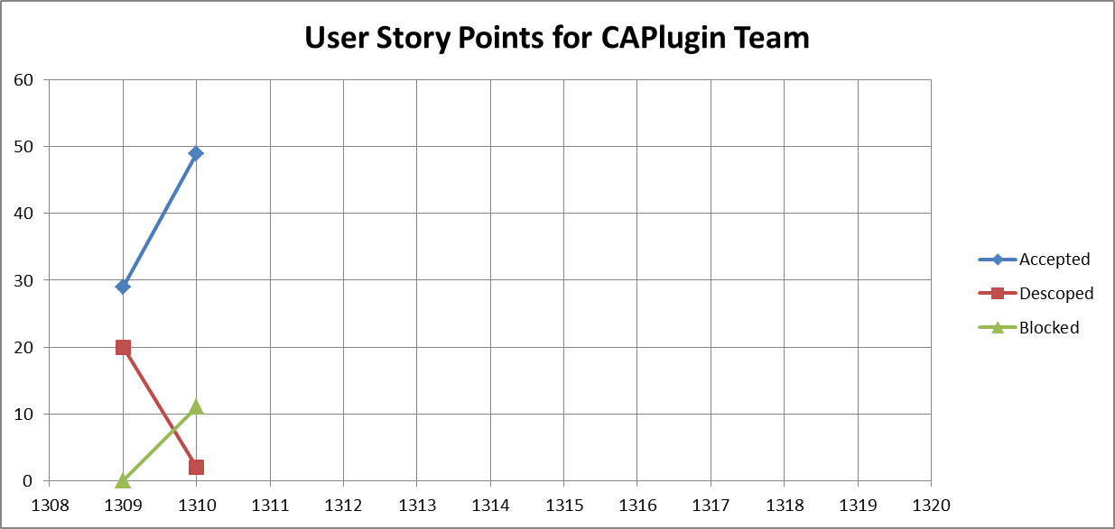
User Story Progression
Sprint 1309 was only a partial sprint
Sprint 1311 will be during fall quarter so we expect decrease in productivity.
Now blocked by lack of resources.
September 27, 2013
University of Washington

Slide 6
004 –Literature Review (Collision Avoidance)
Development Champion: Al Creigh
Content
As a project manager, I would like to perform a literature review of relevant prior art so I can ensure we do not infringe or repeat works by other groups.
Size
M
Definition of Done
[X] Literature review of relevant prior art related to collision avoidance (see work by Lalish et al)
[X] Literature review findings are documented in an electronic document and checked into Perforce
September 27, 2013
University of Washington

Slide 7
029 – Literature Review (Separation Management)
Development Champion: Al Creigh
Content
As a project manager, I would like to perform a literature review of relevant prior art related to separation management so I can ensure we do not infringe or repeat works by other groups.
Size
M
Definition of Done
[x] Literature review of relevant prior art related to collision avoidance (focus on separation management as opposed to active collision avoidance)
[X] Also look at literature review for separation management (as opposed to reactive collision avoidance)
[X] Literature review findings are documented in an electronic document and checked into Perforce
[X] Copies of relevant papers are checked into Perforce (hint: try to access papers via Google Scholar and other resources while you are on campus since the UW network will allow nearly unrestricted access to many online databases)
[X] Look up and document functionality and usage of Garmin 430, 530, and other relevant existing technology for collision awareness.
September 27, 2013
University of Washington

Slide 8
031 – Vehicle Class for R&D Matlab Prototype
Development Champion: Madison Peck
Content
As a software developer, I would like a class representing a vehicle so that I can use it in the Matlab simulation environment.
Size
M
Definition of Done
[x] Attend Matlab simulation framework discussion with CL.
[x] Review \\JCATI2013\JCATI2013\Research\Presentations\ 13_08_08_jcati_collision_warning.ppt for definition of conflict entities
[x] Talk with CL to review how ICOMC2 Core represents a vehicle (ie what types of information ICOMC2 Core maintains for us).
[x] Create a modular, standalone, class in Matlab which represents a vehicle.
[x] Class uses only SI units (no exceptions)
[x] Test this class for various edge and corner cases (these do not need to be true unit tests but should be able to cover the scenarios documented in user story 039)
[x] Integrate this class into the system in user story 026.
[x] Create document (powerpoint slides) describing operation (inputs and outputs) of the class. Document is checked into Perforce.
September 27, 2013
University of Washington

Slide 9
035 – Conflict Entity Class for R&D Matlab Prototype
Development Champion: Al Creigh and Daniel Ablog
Content
As a software developer, I would like a class representing a conflict entity so that I can use it in the Matlab simulation environment and as a prototype for the eventual C# class.
Size
M
Definition of Done
[x ] Attend Matlab simulation framework discussion with CL.
[x] Review \\JCATI2013\JCATI2013\Research\Presentations\ 13_08_08_jcati_collision_warning.ppt for definition of conflict entities
[x ] Talk with CL, KU, AC, and any others who have been involved with the modeling of vehicles as conflict entities
[x ] Create a modular, standalone, class in Matlab which represents a vehicle.
[x ] Class uses only SI units (no exceptions)
[x ] Class has a constructor which creates a conflict entity class based on the vehicle class (see user story 031).
[x ] Test this class for various edge and corner cases (these do not need to be true unit tests but should cover the scenarios documented in user story 039).
[ x] Integrate this class into the system in user story 026.
[ x] Create document (powerpoint slides) describing operation (inputs and outputs) of the class. Document is checked into Perforce.
September 27, 2013
University of Washington

Slide 10
026 – Matlab Simulation Framework
Development Champion: Kevin Ueunten and Federico Alvarez
Content
As a software developer, I would like a simulation environment in Matlab which can emulate the ICOMC2 simulation environment (on a very basic level) so I can use it to test various CA algorithms.
Size
L
Definition of Done
[X] Attend Matlab simulation framework discussion with CL.
[X] Review Forward State Estimator Feature Level Design so you have an idea of some of the features that the simulator must supply.
[X] Review \\JCATI2013\JCATI2013\Research\Presentations\ 13_08_08_jcati_collision_warning.ppt for definition of conflict entities and basis operation of system.
[X] Meet with CL to discuss other features of the ICOMC2 environment that the simulator should emulate.
[X] Create a basic simulation environment in Matlab which operates at a fixed time step (time step is user defined).
[X] Simulator uses only SI units (no exceptions)
[X] Simulator system uses vehicle class (see user story 031)
[X] Simulator system uses conflict entity class (see user story 035)
[X] Simulator system has hooks for calling other modules (such as the forward state estimator code, separation management code, etc.)
[X] Simulator system maintains state history traces (for replaying and logging missions)
[X] Simulator system has been tested with various common and uncommon (edge and corner cases) scenarios including all of the scenarios documented in user story 039.
[X] Movies saved of simulator in action.
[X] Create document (powerpoint slides) describing operation (inputs and outputs) of the simulator. Document has movies showing operation. Document is checked into Perforce.
September 27, 2013
University of Washington

Slide 11
039 – Simulation Test Plan Design and Documentation
Development Champion: Taras Eremenko
Content
As a software quality assurance engineer, I would like a set of test cases which will stress the system and exercise system functionality so that I can be confident that the system will perform as expected under these scenarios.
Size
M
Definition of Done
[x] Brainstorm with CL, KU, AC, DA, and any others who are involved with ATC interaction, algorithm design, or simulation design to understand features and functionality of system that we would like to stress
[x] Design realistic scenario involving 2 Integrator UAVs
[x] Design realistic scenario involving a mixture of UAVs and general/commercial aviation
[x] Design realistic scenarios which exercise collisions, safe passage, separation violation, and other features.
[x] Document test cases in an appropriate document and place these in \\JCATI2013\JCATI2013\TechnicalDataPackage\TestPlans
September 27, 2013
University of Washington

Slide 12
040 – Separation Management Feature Level Design
Development Champion: Matthew Davis and Madison Peck
Content
As a software and algorithm developer, I would like a completed feature level design of the separation management system so I can identify key ideas and features of the algorithm.
Size
L
Definition of Done
[x] Coordinate with development champion of 029 to review existing literature on separation management.
[x] Feature level design completed, reviewed, and checked into perforce. [x] Identify key inputs necessary to perform the separation management (rank them in order of importance)
[x] Document the desired inputs/outputs of the manager.
[x] Feature level design slides have recorded narrations and will run as a standalone presentation. In other words, a user can download the file, start the slideshow, and it will automatically play all narrations and slide transitions.
September 27, 2013
University of Washington

Slide 13
Non-Demoable Accepted User Stories
Story ID | Size | Primary Development Champion | Secondary Development Champion
023 – Search and Rescue Movie Capture | XS | Al Creigh
025 – Perforce Depot Backup | L | Federico Alvarez
027 – Forward State Estimator R&D Prototype | L | Kevin Ueunten | Bao Le
028 – Image Insitu Development Machines | M | Bao Le
034 – Review Journal of Aircraft Article | XS | Noel Kimber
036 – AFSL Website Update | M | Bao Le | Kevin Ueunten
037 – Team Contact Information Document | XS | Noel Kimber
041 – Perforce Visual Client (copy) | S | Noel Kimber
042 – Prepare for Sprint 1310 External Demo | S | Christopher Lum
24 accepted story points that will not be demonstrated due to time constraints.
September 27, 2013
University of Washington

Slide 14
Next Steps (Sprint 1311 Plans)
Implement features in C# class libraries in preparation for ICOMC2 2.0 release.
New team members online.
We are now blocked from making significant progress due to lack of resources. In the immediate future, we’d like to request
  Laptops
  Developer software (visual studio)
  ICOMC2 software (ICOMC2 2.0, Partner’s program SDK, SA2Plugin_VS2010.sln, UW.sln)
Hardware
Developer Laptops | 5
2nd monitor for developer laptops | 5
Docking stations for developer laptops | 5
USB keyboards | 5
USB mice | 5
Partners Program
ICOMC2 Partners Program Membership (Premier level) | 1
ICOMC2 2.0 | 5
ICOMC2 External Developers SDK | 5
Participation in developer training and certification program | 5
Software
Microsoft Visual Studio | 5
Microsoft Office | 5
Matlab | 2
Personnel
Access to technical ICOMC2 resources | 0.25
Limited access to an SQA assest once plug-in nears completion | 0.25
Ability to contact ICOMC2 core team members with questions | 0.25
Miscellaneous
Insitu External Contractor (EXT) status restored for Chris Lum | 1
Access to Insitu Web-Ex | 1
Copy of the SA2Plugin_VS2010.sln and associated source code | 1
Copy of the UW.sln and associated source code | 1
Internship earmarked for a UW student during summer 2014 | 1
September 27, 2013
University of Washington

