Slide 1
A Collision Warning System for the Insitu Common Open-mission Management Command and Control (ICOMC2) System
External Demo
Sprint 1311
October 25, 2013

Slide 2
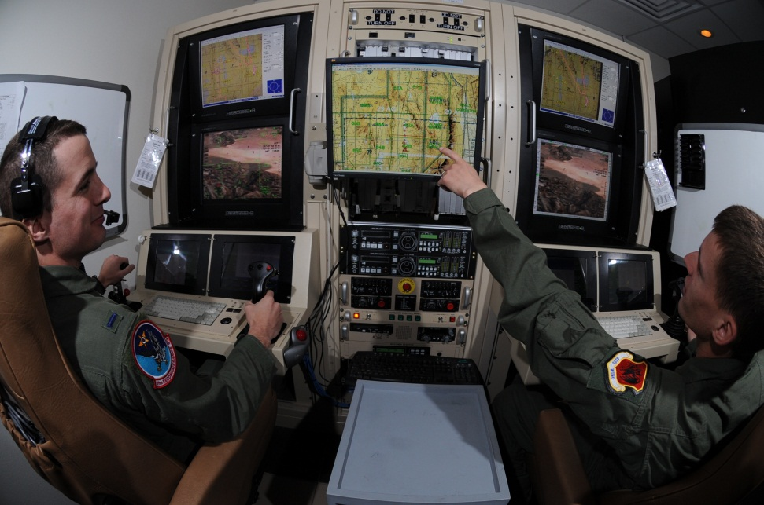

Project Goal
Create a collision warning system for the ICOMC2 system so operators are aware of potential conflicts and can direct the system to deconflict flight paths.
October 25, 2013
University of Washington
University of Washington

Slide 3
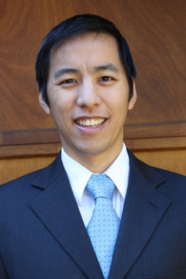
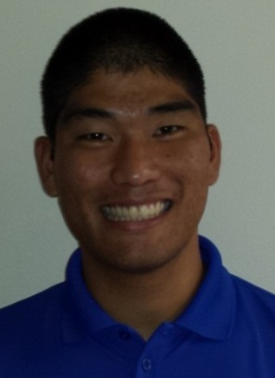
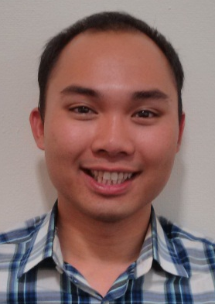
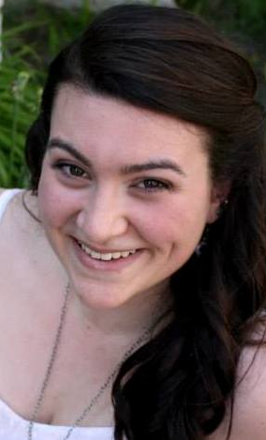
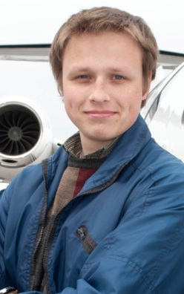
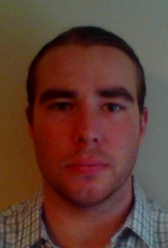
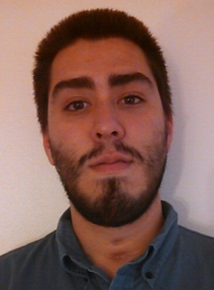
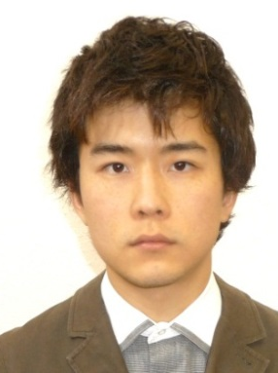
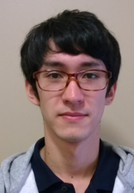
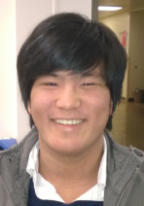
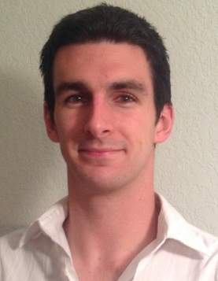
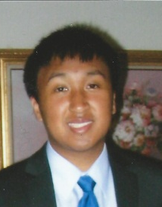
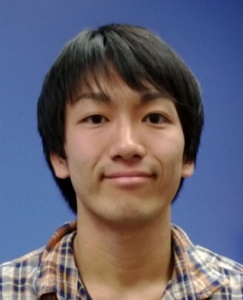
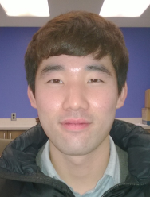
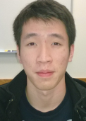
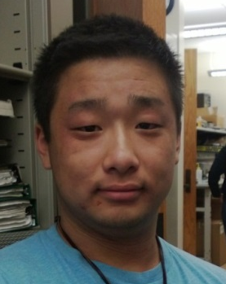
Team Introduction
Christopher Lum
Research Scientist
Lt. Kevin Ueunten
Masters Student
Bao Le
Masters Student
Madison Peck
BS Alumni
Taras Eremenko
BS Alumni
Matt Davis
Senior
Federico Alvarez
Senior
Noel Kimber
Senior
Dai Tsukada
Senior
Richard Fukutome
Senior
Al Creigh
Junior
Daniel Ablog
Junior
Keisuke Tsujita
Junior
Seunghyun Ko
Junior
Brian Chang
Junior
Henry Qin
Sophomore
University of Washington
October 25, 2013

Slide 4
User Story Overview
ICOMC2 CAPlugin Team
 | Committed Stories |  | Stretch Stories
 | Number of Stories | Total Story Points | Number of Stories | Total Story Points
Accepted Status | 21 | 56 | 0 | 0
Descoped Status | 6 | 21 | 13 | 65
Impeded Status | 6 | 18 | 0 | 0
Total: | 33 | 95 | 13 | 65
October 25, 2013
University of Washington

Slide 5
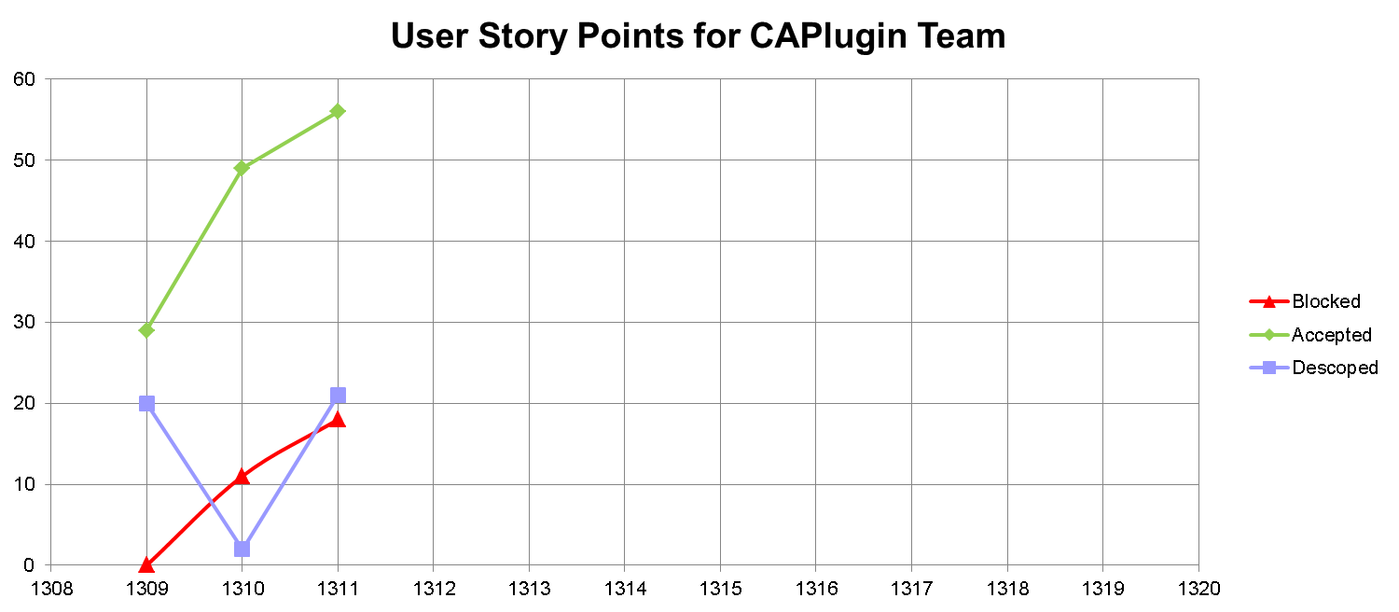
User Story Progression
Sprint 1311 overlapped fall quarter but team was actually able to increase velocity (4 new members helped increase production).
Several stories involved training exercises.
Lack of resources continues to block more stories.
October 25, 2013
University of Washington

Slide 6
Progress by Developer
We are now tracking individual developer progress.
Developer | 1309 | 1310 | 1311 | TOTAL
Kevin Ueunten | 7 | 10 | 6 | 23
Madison Peck | 2 | 3 | 15 | 20
Al Creigh | 5 | 10 | 3 | 18
Matthew Davis | 2 | 5 | 8 | 15
Christopher Lum | 7 | 2 | 4 | 13
Bao Le | 2 | 6 | 0 | 8
Richard Fukotome | 0 | 0 | 7 | 7
Federico Alvarez | 0 | 5 | 1 | 6
Noel Kimber | 0 | 5 | 0 | 5
Taras Eremenko | 2 | 3 | 0 | 5
Dai Tsukada | 0 | 0 | 3 | 3
Seunghyun Ko | 0 | 0 | 3 | 3
Brian Chang | 0 | 0 | 2 | 2
Daniel Ablog | 2 | 0 | 0 | 2
Henry Qin | 0 | 0 | 2 | 2
Keisuke Tsujita | 0 | 0 | 2 | 2
October 25, 2013
University of Washington

Slide 7
059 –C# Vehicle Class
Development Champion: Madison Peck
Content
As a software developer, I would like a class representing a vehicle so that I can use it in C# CAPlugin application.
Size
L
Definition of Done
[X] Discuss with development champion of user story 031 to get up to speed on the Matlab Vehicle class.
[X] Review \\JCATI2013\JCATI2013\Research\Presentations\ 13_08_08_jcati_collision_warning.ppt for definition of conflict entities
[X] Talk with CL to review how ICOMC2 Core represents a vehicle (ie what types of information ICOMC2 Core maintains for us).
[X] Create a modular, standalone, class in C# which represents a Vehicle. This should be a part of UW.sln in the UWCAPlugin project in the ‘Utilities’ folder.
[X] Class uses only SI units (no exceptions).
[X] Class provides a method to serialize itself (ie save itself to disk). See Chris Lum for details.
[X] Test that the output of the serialization can be used to recreate the object in Matlab (so we can use Matlab to analyze scenarios and make movies)
[X] Test this class for various edge and corner cases using an appropriate unit testing project (see Chris Lum for details regarding how to add this project to the solution)
[X] All public API of this class is documented.
[X] Create document (powerpoint slides) describing operation (inputs and outputs) of the class. Document is checked into Perforce.
October 25, 2013
University of Washington

Slide 8
061 – JCATI Quarterly Report
Development Champion: Christopher Lum
Content
As a project manager, I would like a quarterly progress report prepared so I can inform our sponsors about our progress.
Size
S
Definition of Done
[X] Coordinate with Chris Lum to discuss progress for the quarter.
[X] Obtain information from Patrick Gibbs about what information is to be included in the report (do not contact Patrick directly, coordinate with Chris Lum to obtain this information.
[X] Report draft completed by 10/25.
[X] Report due to JCATI on 10/31.
October 25, 2013
University of Washington

Slide 9
Not Demoable Accepted User Stories
STORY ID | SIZE | DEVELOPMENT CHAMP
006 – Software Developer Background Training (Algorithm and Back End) | L | Matthew Davis
020 – Perforce Visual Client (copy) | S | Henry Qin
033 – Unit Testing Background Training | L | Madison Peck
044 – FlexRotor Movie Capture | XS | Seunghyun Ko
049 - Literature Review (part 2) | M | Al Creigh
050 – Matlab Simulator Presentation | S | Kevin Ueunten
051 – Separation Notifier Feature Level Design (Part 2) | M | Matthew Davis
053 – Forward State Estimator Feature Level Design Update | M | Kevin Ueunten
056 – Perforce Visual Client (copy) | S | Keisuke Tsujita
057 – Perforce Visual Client (copy) | S | Dai Tsukada
062 – Prepare for Sprint 1311 External Demo | S | Christopher Lum
063 – Continuous Time, Dynamic Vehicle Model | XS | Kevin Ueunten
066 – New Team Member Orientation | XS | Federico Alvarez
067 – Perforce Visual Client (copy) | S | Seunghyun Ko
069 – Software Developer Background Training (Algorithm and Back End) (copy) | L | Madison Peck
076 – Software Developer Background Training (Algorithm and Back End) (copy) | L | Richard Fukotome
077 – Perforce Visual Client (copy) | S | Richard Fukotome
079 – WebEx Account Investigation | XS | Dai Tsukada
082 – Perforce Visual Client (copy) | S | Brian Chang
Developers are becoming trained in C# and unit testing.
October 25, 2013
University of Washington

Slide 10
Next Steps (Sprint 1312 Plans)
Implement features in C# class libraries in preparation for ICOMC2 2.0 release.
Software development familiarizing and training
  Unit testing
  WPF
  MVVM
  Event driven programming
Project publicity
  Marketing video
  Website updates
FAA airspace integration literature review and research
October 25, 2013
University of Washington

Slide 11
In-Kind Support Request
We are now blocked from making significant progress due to lack of resources.
  Computing Hardware (laptops)
    If gifted to UWAA, we can obtain VS2012 Pro Licenses from UW
  ICOMC2 Software
    ICOMC2 2.0
    Partner’s program SDK
    SA2Plugin_VS2010.sln
  Student Industry Exposure
    Internships for Winter, Spring, or Summer
    ICOMC2 operator and/or developer training
    Visits and/or tours of Insitu
October 25, 2013
University of Washington

