Slide 1
A Collision Warning System for the Insitu Common Open-mission Management Command and Control (ICOMC2) System
External Demo
Sprint 1312
November 22, 2013

Slide 2
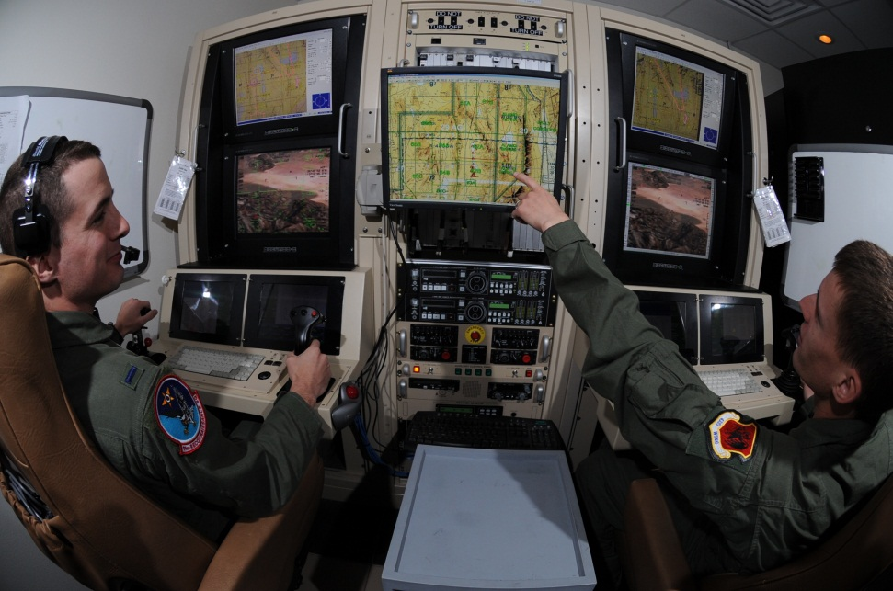

Project Goal
Create a collision warning system for the ICOMC2 system so operators are aware of potential conflicts and can direct the system to deconflict flight paths.
November 22, 2013
University of Washington
University of Washington

Slide 3
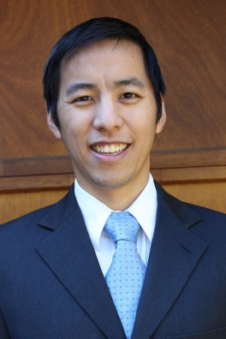
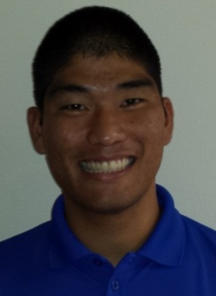
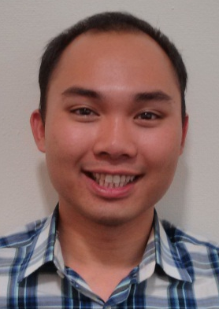
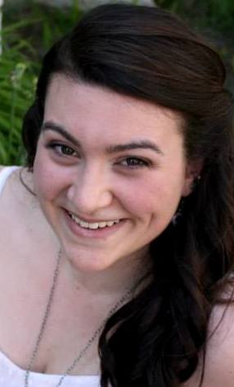
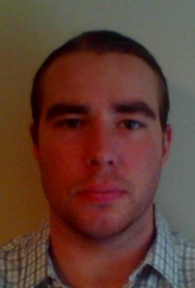
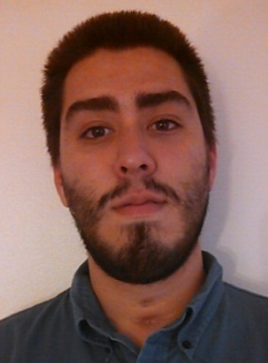
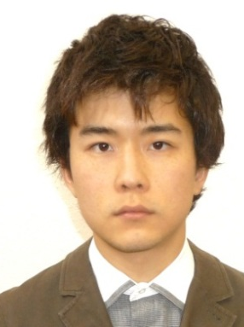
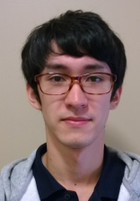
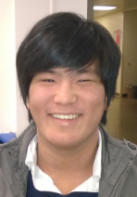

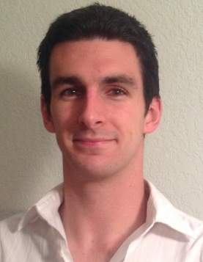
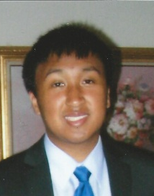
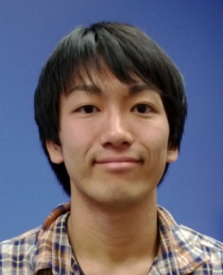
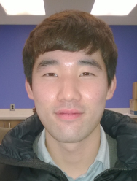
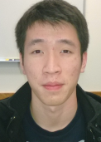
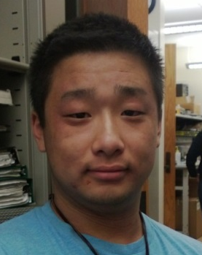
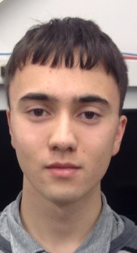
Team Introduction
Christopher Lum
Research Scientist
Lt. Kevin Ueunten
Masters Student
Bao Le
Masters Student
Madison Peck
BS Alumni
Matt Davis
Senior
Federico Alvarez
Senior
Noel Kimber
Senior
Dai Tsukada
Senior
Richard Fukutome
Senior
Taylor Campbell
Senior
Al Creigh
Junior
Daniel Ablog
Junior
Keisuke Tsujita
Junior
Seunghyun Ko
Junior
Brian Chang
Junior
Henry Qin
Sophomore
John Marshall
Sophomore
November 22, 2013
University of Washington

Slide 4
User Story Overview
ICOMC2 CAPlugin Team
 | Committed Stories |  | Stretch Stories
 | Number of Stories | Total Story Points | Number of Stories | Total Story Points
Accepted Status | 49 | 125 | 0 | 0
Descoped Status | 9 | 29 | 13 | 68
Impeded Status | 6 | 18 | 0 | 0
Total: | 64 | 172 | 13 | 68
36 stories (91 points) involved training.
November 22, 2013
University of Washington

Slide 5
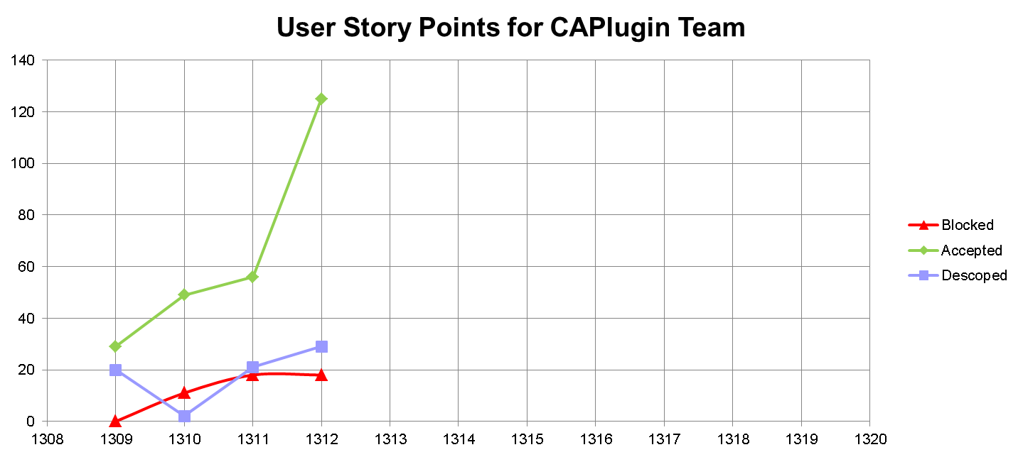
User Story Progression
Large variation is due to many members finishing training stories in this sprint.
Lack of resources continues to block more stories.
November 22, 2013
University of Washington

Slide 6
Progress by Developer
Developer | 1309 | 1310 | 1311 | 1312 | TOTAL
Kevin Ueunten | 7 | 10 | 6 | 11 | 34
Madison Peck | 2 | 3 | 15 | 4 | 24
Al Creigh | 5 | 10 | 3 | 6 | 24
Matthew Davis | 2 | 5 | 8 | 8 | 23
Christopher Lum | 7 | 2 | 4 | 10 | 23
Bao Le | 2 | 6 | 0 | 11 | 19
Richard Fukotome | 0 | 0 | 7 | 7 | 14
Noel Kimber | 0 | 5 | 0 | 9 | 14
Daniel Ablog | 2 | 0 | 0 | 12 | 14
Federico Alvarez | 0 | 5 | 1 | 7 | 13
Brian Chang | 0 | 0 | 2 | 9 | 11
Keisuke Tsujita | 0 | 0 | 2 | 9 | 11
Dai Tsukada | 0 | 0 | 3 | 6 | 9
Seunghyun Ko | 0 | 0 | 3 | 6 | 9
Henry Qin | 0 | 0 | 2 | 7 | 9
Taras Eremenko | 2 | 3 | 0 | 0 | 5
John Marshall | 0 | 0 | 0 | 3 | 3
Taylor Campbell | 0 | 0 | 0 | 0 | 0
November 22, 2013
University of Washington

Slide 7
060 –C# ConflictEntity Class
Development Champion: Federico Alvarez
Content
As a software developer, I would like a class representing a conflict entity so that I can use it in C# CAPlugin application.
Size
L
Definition of Done
[x] Discuss with development champion of user story 035 to get up to speed on the Matlab ConflictEntity class.
[x] Review \\JCATI2013\JCATI2013\Research\Presentations\ 13_08_08_jcati_collision_warning.ppt for definition of conflict entities
[x] Talk with CL to review how ICOMC2 Core represents a vehicle (ie what types of information ICOMC2 Core maintains for us).
[x] Create a modular, standalone, class in C# which represents a ConflictEntity. This should be a part of UW.sln in the UWCAPlugin project in the ‘Utilities’ folder.
[x] Class uses only SI units (no exceptions).
[x] Class provides a method to serialize itself (ie save itself to disk). See Chris Lum for details.
[x] Test that the output of the serialization can be used to recreate the object in Matlab (so we can use Matlab to analyze scenarios and make movies)
[x] Test this class for various edge and corner cases using an appropriate unit testing project (see Chris Lum for details regarding how to add this project to the solution)
[x] All public API of this class is documented.
[x] Create document (powerpoint slides) describing operation (inputs and outputs) of the class. Document is checked into Perforce.
[x] Retroactively perform a code review.
November 22, 2013
University of Washington

Slide 8
089– UW Solution Unit Testing Spreadsheet Backlog
Development Champion: Kevin Ueunten & Bao Le
Content
As a software quality assurance engineer, I would like to document all the unit tests that have been previously written in the UW solution so I have a place to lookup if a certain piece of code has been tested.
Size
S
Definition of Done
[x] Look at the unit test spreadsheet (\\JCATI2013\UWSDK\UWSDK\UnitTests\unit_tests.xlsx) and fill out entries for all unit tests that have been previously written for the following unit tests projects
[x] test_UWFunctionsFileIO
[x] test_UWFucntionsKML
[x] test_UWFunctionsLists
November 22, 2013
University of Washington

Slide 9
129 – Visual Studio 2012 Unit Test Workflow
Development Champion: Christopher Lum
Content
As a software quality assurance engineer, I would like to determine an efficient workflow for creating unit tests in Visual Studio 2012 Professional so I can unit test code written in this environment.
Size
M
Definition of Done
[X] Meet with Chris Lum to discuss the context and background of this story.
[X] Read the document UW.sln\UnitTests\creating_unit_tests.docx which describes our method for creating unit tests in VS2010.
[X] Ensure that you have VS2012 Professional installed and updated to the latest release on your Windows 7 machine.
[X] Generate an efficient workflow for creating unit tests in VS2012 (see notes)
[X] Update UW.sln\UnitTests\creating_unit_tests.docx with this new information (do not erase the old description, instead make another section describing how to create unit tests in VS2012 Professional).
November 22, 2013
University of Washington

Slide 10
047 – JCATI Marketing Video Production
Development Champion: Henry Qin and Daniel Ablog
Content
As a marketing representative, I would like a marketing video highlighting what we are trying to accomplish with this project so that we can publicize our efforts about this project.
Size
L
Definition of Done
[x ] Coordinate with Chris Lum and JCATI program manager, Patrick Gibbs, regarding video content and message.
[x ] Watch several professional produced videos/interviews of the same type (for example search the UW website for other similar videos).
[ x] Create survey to answer the following questions from all team members (some of the answers can be used in the video)
[x ] Create a marketing style, “feel good” video describing our efforts with this project.
November 22, 2013
University of Washington

Slide 11
145 – Unity Game Engine Research
Development Champion: Madison Peck & Richard Fukutome
Content
As a project manager, I would like to research the Unity game engine to assess its potential to be used for visualization purposes in our project.
Size
M
Definition of Done
[X] Research Unity game engine ( http://unity3d.com/ ). We are specifically interested in
[X] How is Unity used within the game development community
[X] How can this be used to render/draw scenes (like aircraft colliding)
[X] Can the rendering be driven by externally generated data (ie from the Separation Notifier)
[X] Talk with Nathaniel Guy (AA Grad student) about Unity (he may come to one of our group meetings so talk with Chris Lum about this before contacting him)
[X] Download and install Unity engine
[X] Watch tutorials located at http://unity3d.com/learn/tutorials/modules
[X] Use Unity engine to produce a movie of something.
[X] Present results and inform group about Unity.
November 22, 2013
University of Washington

Slide 12
Next Steps (Sprint 1313 Plans)
Implement features in C# class libraries in preparation for ICOMC2 2.0 release.
Software development familiarizing and training
  WPF
  MVVM
  Event driven programming
Project publicity
  Marketing video
  Website updates
FAA airspace integration literature review and research
1313 coincides with Winter break at UW, what are Insitu’s plans?
  Start 11/25, end 12/20?
November 22, 2013
University of Washington

Slide 13
In-Kind Support Request
We are now blocked from making significant progress due to lack of resources.
  Computing Hardware (laptops)
    If gifted to UWAA, we can obtain VS2012 Pro Licenses from UW
  ICOMC2 Software
    ICOMC2 2.0
    Partner’s program SDK
    SA2Plugin_VS2010.sln
  Student Industry Exposure
    Internships for Winter, Spring, or Summer
    ICOMC2 operator and/or developer training
    Visits and/or tours of Insitu
  12/12 or later would be an ideal time to make a trip to Insitu.
November 22, 2013
University of Washington

