Slide 1
A Collision Warning System for the Insitu Common Open-mission Management Command and Control (ICOMC2) System
External Demo
Sprint 1401
January 17, 2014

Slide 2
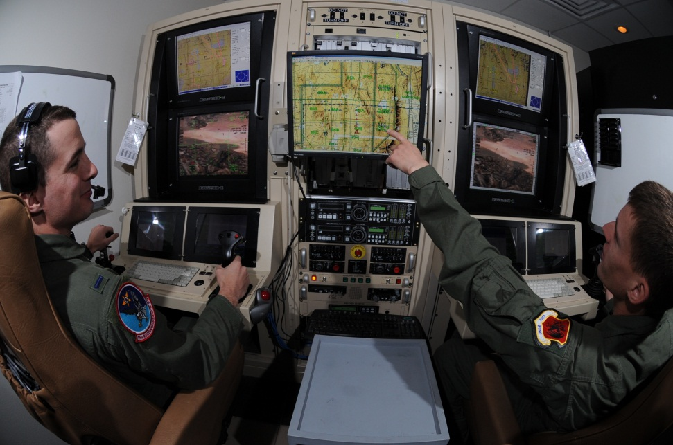
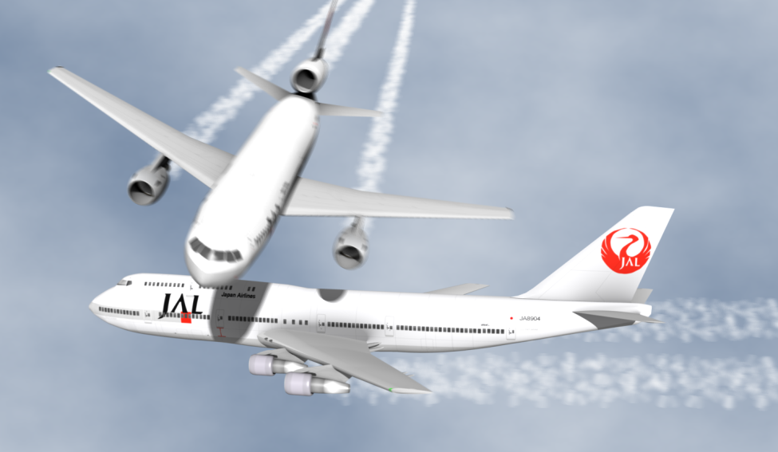
Project Goal
Create a collision warning system for the ICOMC2 system so operators are aware of potential conflicts and can direct the system to deconflict flight paths.
January 17, 2014
University of Washington

Slide 3
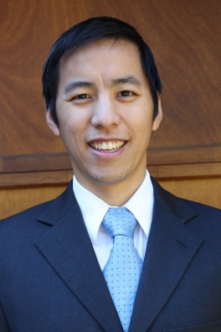
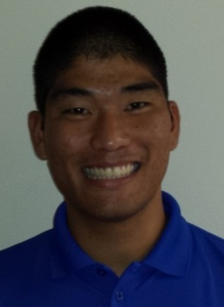
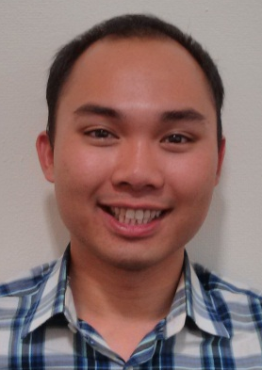
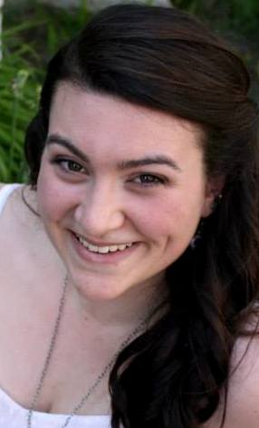
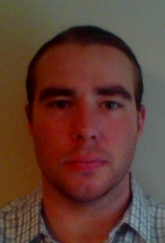
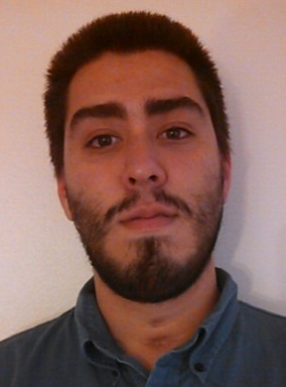
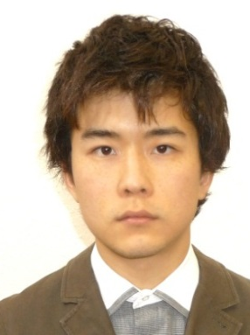
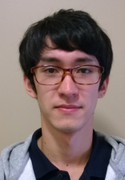
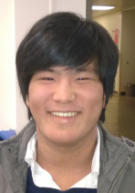

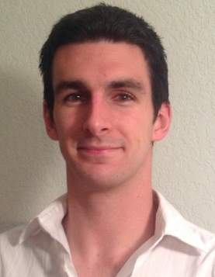
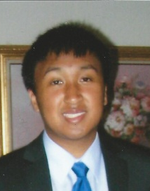
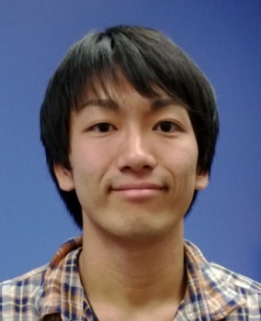
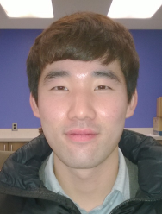
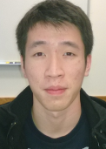
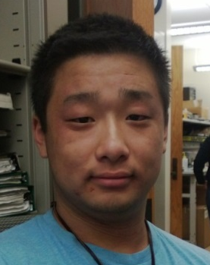
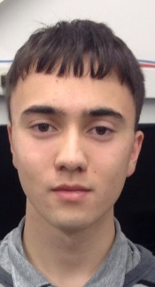
Team Introduction
Christopher Lum
Research Scientist
Lt. Kevin Ueunten
Masters Student
Bao Le
Masters Student
Madison Peck
BS Alumni
Matt Davis
Senior
Federico Alvarez
Senior
Noel Kimber
Senior
Dai Tsukada
Senior
Richard Fukutome
Senior
Taylor Campbell
Senior
Al Creigh
Junior
Daniel Ablog
Junior
Keisuke Tsujita
Junior
Seunghyun Ko
Junior
Brian Chang
Junior
Henry Qin
Sophomore
John Marshall
Sophomore
January 17, 2014
University of Washington

Slide 4
User Story Overview
ICOMC2 CAPlugin Team
 | Committed Stories |  | Stretch Stories
 | Number of Stories | Total Story Points | Number of Stories | Total Story Points
Accepted Status | 23 | 68 | 0 | 0
Descoped Status | 21 | 62 | 16 | 42
Impeded Status | 9 | 24 | 0 | 0
Total: | 53 | 154 | 16 | 42
First half of sprint 1401 was during winter break.
January 17, 2014

Slide 5
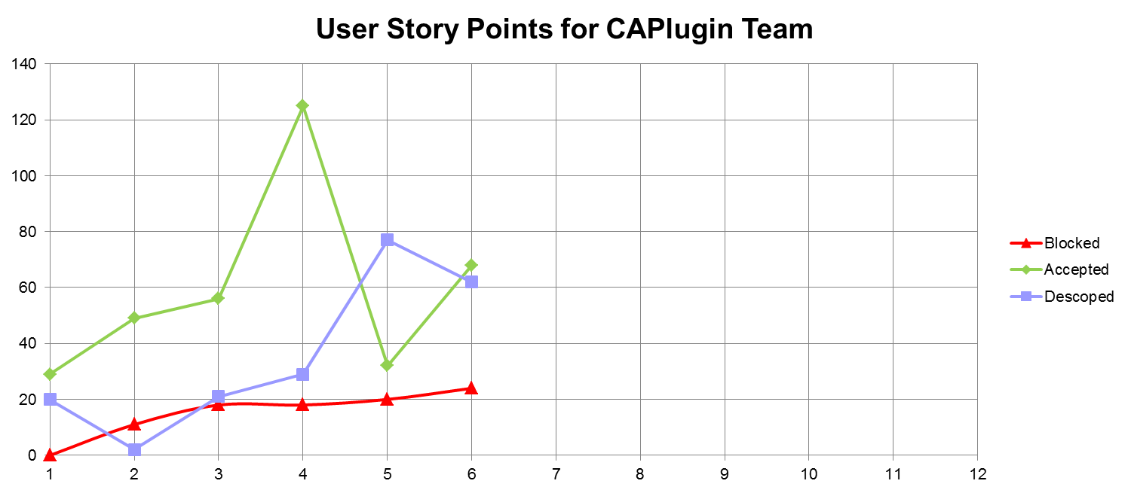
User Story Progression
1309 | 1310 | 1311 | 1312 | 1313 | 1401 | 1402 | 1403 | 1404 | 1405 | 1406 | 1407
Halfway through project.
Lack of resources continues to block more stories.
January 17, 2014

Slide 6
Progress by Developer
Developer | 1309 | 1310 | 1311 | 1312 | 1313 | 1401 | TOTAL
Christopher Lum | 7 | 2 | 4 | 11 | 3 | 16 | 43
Kevin Ueunten | 7 | 10 | 6 | 11 | 0 | 3 | 37
Madison Peck | 2 | 3 | 15 | 4 | 0 | 9 | 33
Al Creigh | 5 | 10 | 3 | 6 | 0 | 3 | 27
Federico Alvarez | 0 | 5 | 1 | 7 | 8 | 6 | 27
Matthew Davis | 2 | 5 | 8 | 8 | 2 | 0 | 25
Bao Le | 2 | 6 | 0 | 11 | 0 | 0 | 19
Noel Kimber | 0 | 5 | 0 | 9 | 5 | 0 | 19
Daniel Ablog | 2 | 0 | 0 | 12 | 2 | 3 | 19
Henry Qin | 0 | 0 | 2 | 7 | 7 | 3 | 19
Keisuke Tsujita | 0 | 0 | 2 | 9 | 0 | 7 | 18
Richard Fukotome | 0 | 0 | 7 | 7 | 0 | 0 | 14
Seunghyun Ko | 0 | 0 | 3 | 6 | 0 | 5 | 14
Brian Chang | 0 | 0 | 2 | 9 | 0 | 2 | 13
Dai Tsukada | 0 | 0 | 3 | 6 | 0 | 3 | 12
Taylor Campbell | 0 | 0 | 0 | 0 | 0 | 8 | 8
Taras Eremenko | 2 | 3 | 0 | 0 | 0 | 0 | 5
Robert McSwain | 0 | 0 | 0 | 0 | 5 | 0 | 5
John Marshall | 0 | 0 | 0 | 3 | 0 | 0 | 3
January 17, 2014

Slide 7
085 – FAA National Airspace Integration Research and Literature Review
Development Champion: Federico Alvarez
Content
As a project member, I would like to perform research into the FAA’s mandate to integrate UAS into the National Airspace so that I can ensure that we are addressing the appropriate problems with our system and use this mandate to motivate our research.
Size
M
Definition of Done
[x] Literature review of relevant prior art UAS integration into the National Airspace
[x] Literature review findings are documented in an electronic document and checked into Perforce
[x] Present results to group
[x] Incorporate feedback from group presentation into literature reviews.
[x] Create a standalone document from these literature reviews which concisely and accurately summarizes the FAA mandate. This document should be designed for external consumption (ie Insitu). Items to include
[x] What does this mandate require from UAS?
[x] What is the exact timeline and plans for integration?
[x] Where are the relevant documents/links to source material
[x] Record narrations (voiceovers) on slides (see Chris, Kevin, or Matt about how to do this)
January 17, 2014

Slide 8
177 – Literature Review (STANAG-4586)
Development Champion: Kevin Ueunten
Content
As a project member, I would like to perform research into STANAG-4586 so that I can be aware of the details of this protocol and how it may apply to our plugin.
Size
M
Definition of Done
[X] Coordinate with Chris Lum to discuss STANAG-4586 and how it relates to ICOMC2.
[X] Search public documents (mainly internet) about STANAG-4586. See if you can find a document describing all STANAG-4586 messages and their structure.
[X] Literature review findings are documented in an electronic document and checked into Perforce along with other relevant documents.
[X] Present results to group
[X] Incorporate feedback from group presentation into literature reviews.
[X] Create a standalone document from these literature reviews which concisely and accurately summarizes STANAG-4586. Items to include
[X] What is STANAG-4586?
[X] Who uses STANAG-4586?
[X] How is this related to ICOMC2?
[X] Where can we find more information about STANAG-4586?
[X] What are the relevant messages that might be useful for our plugin?
January 17, 2014

Slide 9
158 – Risk Assessment Website Re-Activation
Development Champion: Keisuke Tsujita
Content
As a project manager, I would like to re-activate the risk assessment website so I can use it for various parts of this research and also so other interested parties can use the tool.
Size
M
Definition of Done
[x] Meet with Chris Lum to discuss the scope of the project.
[x] Meet with Nathan Powell from the NDCL and ask him about what needs to be done to re-activate the web-server.
[x] Re-activate and ensure that basic website functionality is restored.
[x] Email link of website to Chris Lum once everything is basically functional.
January 17, 2014

Slide 10
198 – Conflict Calculator Feature Level Design
Development Champion: Christopher Lum
Content
As a software and algorithm developer, I would like a completed feature level design of the conflict calculator so I can identify key ideas and features of the algorithm.
Size
L
Definition of Done
[X] Literature review of relevant prior art relevant to conflict calculator.
[X] Feature level design completed, presented to research group, reviewed, and checked into perforce.
[X] Identify key inputs necessary to perform the conflict calculator (rank them in order of importance)
[X] Document the desired inputs/outputs of the calculator
January 17, 2014

Slide 11
187 – Collision Detection Engine (Part 1)
Development Champion: Christopher Lum
Content
As an algorithm designer, I would like develop part of the collision detection engine which can estimate the probability of a conflict if given appropriate information about two aircraft so that I can use it to begin building the collision detection engine.
Size
L
Definition of Done
[X] Create algorithms to calculate overlap of two 1D Gaussians (for example altitude)
[X] Create algorithms to calculate overlap of two 2D Gaussians (for example planar positions)
[X] Create software implementation of these algorithms.
[X] Create automated unit tests for these algorithms.
[X] Design scenarios which illustrate two aircraft with Gaussian distributions and compute the probability of airspace instruction. Perform numerical simulation to show that the algorithm is accurate.
January 17, 2014

Slide 12
146 – Unity Scripting or Module for Automatic Scenario Visualization
Development Champion: Madison Peck
Content
As a project manager, I would like to use the Unity game engine to visualize various conflict scenarios so that I can produce visually pleasing movies.
Size
L
Definition of Done
[X] Coordinate with development champion of 145 – Unity Game Engine Research to become familiar with the Unity game engine ( http://unity3d.com/ ).
[X] Generate some dummy data to visualize (in other words, create some data that would have been generated by another entity like the separation notifier).
[X] Use Unity to visualize this scenario. This should be done in an automatic fashion (use scripting or other tools). The goal is that we can use this script over and over again on various data sets.
[X] Document what type of data is required for your script to function.
[X] Present results to group.
January 17, 2014

Slide 13
Not Demoable Accepted User Stories
STORY ID | SIZE | DEVELOPMENT CHAMP
090 – UW Solution Unit Testing Spreadsheet Backlog (Group 3) | S | Brian Chang
095 – UW Solution Unit Testing Spreadsheet Backlog (Group 8) | S | Keisuke Tsujita
099 – UW Solution Unit Testing Spreadsheet Backlog (Group 12) | S | Seunghyun Ko
104 – UW Solution Missing Unit Testing Creation (Group 4) | M | Dai Tsukada
107 – UW Solution Missing Unit Testing Creation (Group 7) | M | Henry Qin
132 – Unit Testing Background Training (copy) | M | Al Creigh
135 – Unit Testing Background Training (copy) | M | Federico Alvarez
141 – Unit Testing Background Training (copy) | M | Seunghyun Ko
159 – Risk Assessment Website Testing | S | Keisuke Tsujita
163 – Software Best Practices Poster and Presentations (Session 1) | M | Madison Peck
168 – Seattle Area Game Developers Association Meetings | XS | Madison Peck
176 – Unity Asset Generation (Helper) | M | Daniel Ablog
186 – Sprint 1401 Administration | M | Christopher Lum
188 – System Components High Level Design | M | Christopher Lum
193 – Perforce Visual Client (copy) | S | Taylor Campbell
194 – Developer WebEx Account Setup (Group 16) | XS | Taylor Campbell
195 – Software Developer Background Training (Algorithm and Back End) (copy) | L | Taylor Campbell
Working on creating automated unit tests for entire public API.
Developing in-house SQA capabilities.
October 25, 2013
University of Washington

Slide 14
Next Steps (Sprint 1402 Plans)
Implement features in C# class libraries in preparation for ICOMC2 2.0 release.
Finish unit testing all public API of existing code base.
Software development familiarizing and training
  WPF
  MVVM
  Event driven programming
Obtain ICOMC2 software and hardware
  Setup lab environment with multi-vehicle operations.
  Familiarize operators and testers with environment and system.
Visit Insitu
January 17, 2014

Slide 15
In-Kind Support Request
We are now blocked from making significant progress due to lack of resources.
  Computing Hardware (laptops)
    If gifted to UWAA, we can obtain VS2012 Pro Licenses from UW
  ICOMC2 Software
    ICOMC2 2.0
    Partner’s program SDK
    SA2Plugin_VS2010.sln
  Student Industry Exposure
    Internships for Winter, Spring, or Summer
    ICOMC2 operator and/or developer training
    Visits and/or tours of Insitu
January 17, 2014

