Slide 1
Probabilistic Conflict Calculator
January 17, 2014

Slide 2
Component Goals
Inputs
  Positions of aircraft
  Statistical information about the confidence of their locations
Output
  Probability that another aircraft will breach your airspace.
Aircraft parameters
Statistical properties
Probability of conflict
Conflict Calculator
User settings
Goals
  Provide mathematically conservative guarantees of analysis.
  Allow user defined settings for analysis confidence intervals.
  Perform calculations quickly without iterative numerical routines.
January 17, 2014
University of Washington

Slide 3
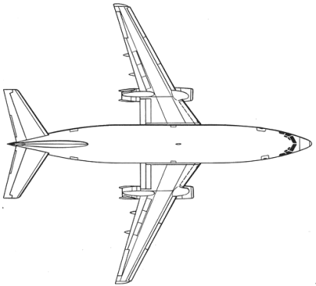

Mathematical Modeling
Model aircraft altitude as a 1D Gaussian/Normal distribution.
Model aircraft planar position as 2D Gaussian/Normal distribution.
Conservatively over-bound distribution integrals to obtain closed form probability calculations.
f_{B}(x)
f_{A}(x)
μ_{B}
b_{B}
μ_{A}
Aircraft A
Aircraft B
January 17, 2014
University of Washington

Slide 4
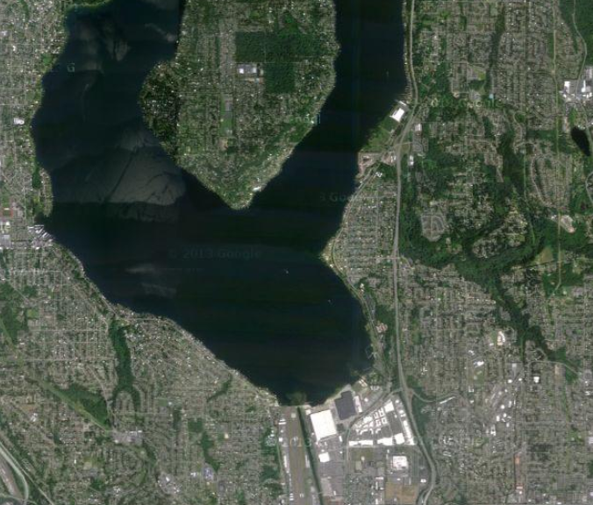
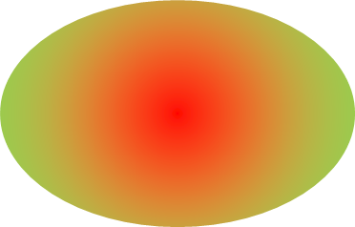
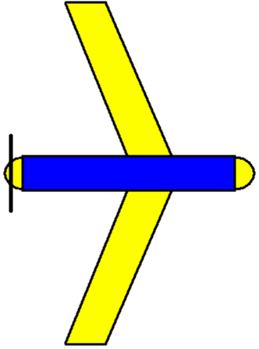
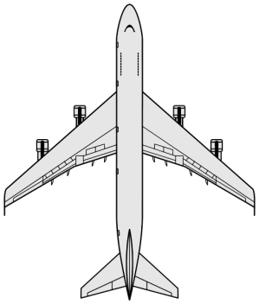
Component Usages
Analyze potential conflicts of aircraft engaged in
  Free flight
  Orbits
  Path following
Create a map which conveys areas of potential conflicts.
Provide a mathematically sound tool to perform temporal predictions in the face of stochastic system variables.
Handle degraded GPS or position information gracefully.
January 17, 2014
University of Washington

