Slide 1
Entity Manager and
Multi-Vehicle Probabilistic Conflict Calculator
February 14, 2014

Slide 2
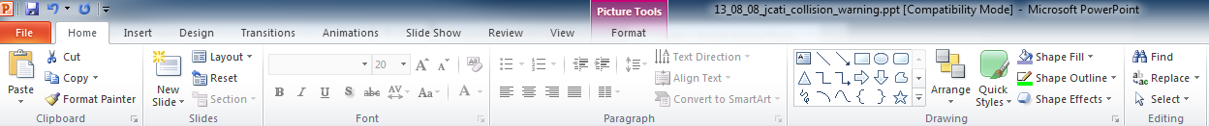
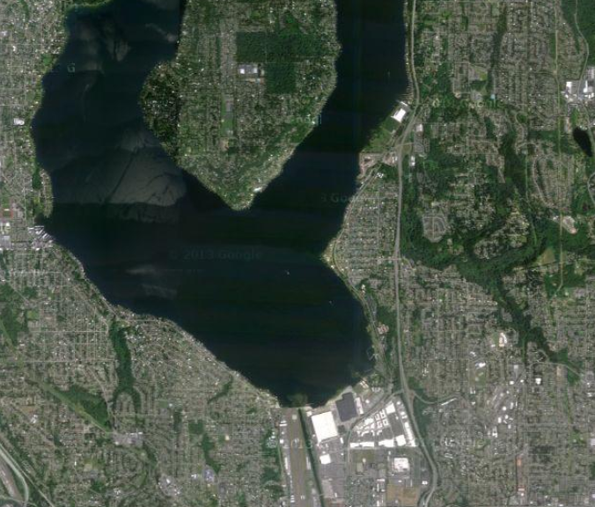
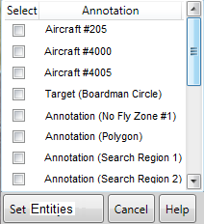

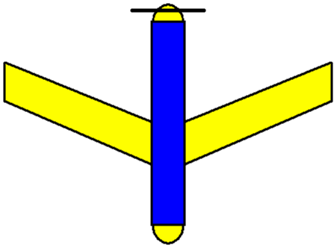
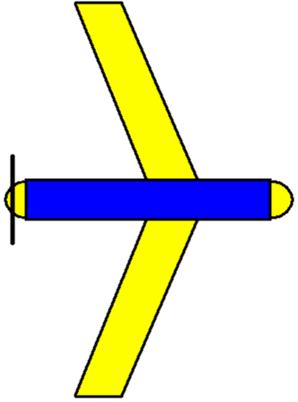
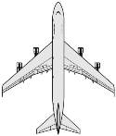
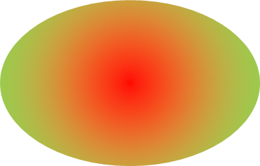
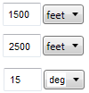
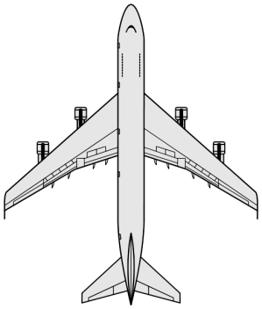
Operational Scenario
Select Conflict Entities
Committed Conflict Entities
#205
#4000
#4005
Entity Properties
#4000
Collision Radius:
Std. Dev. Position:
Std. Dev. Heading:
Is Controllable
Run Analysis
#4005
February 14, 2014

Slide 3
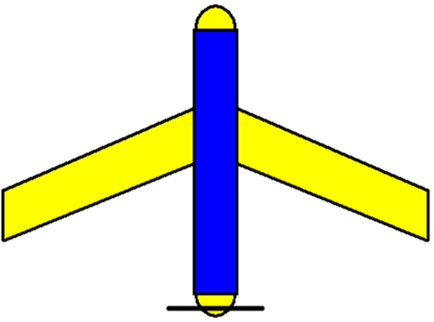
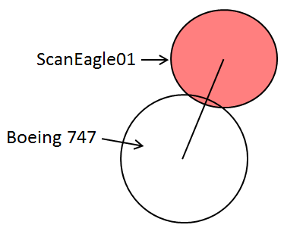
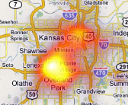
Plug-In Structure and Components
Estimate future states of entities based on current states and/or active routes.
Estimate position probability distributions at future states
Maintain list of conflict entities.
Conflict entity contains information that the plug-in uses for calculations (such as conflict radius, aircraft geometry, GPS certainty, etc.)
This does not maintain user settings (this is done by the settings controller)
Maintain user settings such as
  Map transparency
  Calculation update rate
Does not maintain information which is used by engineering calculations (this is done by the entity manager)
Primary key into ICOMC2
User Settings Controller
Forward State Estimator
#4000
#4005
CoT03
Plug-in specific information
Compute probability of conflicts with other entities
Conflict Calculator
Entity Manager
Group Predictive Module
Maintain Plug-in State
Low level, last line of defense against conflicts.
Only operates on current data (no predictive capabilities).
Only notifies about immediate proximity violations.
  Visual map display
      Conflict probability map
      Separation notifier display
  Audio warnings and notifications
  Input controls so operator can change plugin settings and operation
    Example: TextBox to change GPS certainty (this makes a change to data in the entity manager)
    Example: Slider to change map transparency (this makes a change to the user settings controller)
Separation Notifier
Outputs
Inputs
Group Spatial Separation
Operator Interface
February 14, 2014

Slide 4
Component Goals
Inputs
  Spatial and statistical information about entities of interest
  Desired perspective entity
Output
  Information that will help operator become aware of conflicts from the point of view of the perspective entity.
Aircraft parameters
Dictionary of conflict probabilities
Statistical properties
Group Conflict Calculator
User settings
Goals
  Provide a mathematical, closed form, and conservative guarantees of analysis.
  Allow user to quickly identify which entities are potentially in conflict.
  Generate a prioritized list of impending conflicts.
February 14, 2014
University of Washington

Slide 5
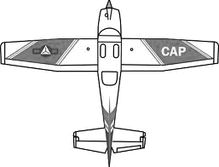
Example
Scenario
  5 Entities (ScanEagle, Integrator, 747, Cessna 172, Cursor On Target (restricted airspace)
  Operator is in charge of the ScanEagle
    Will other entities breach my airspace?
    Will my aircraft breach any one else’s airspace?
  What if operator switches perspective to another entity?
Cessna01
Hawaiian343
Integrator02
ScanEagle01
CursorOnTarget01
February 14, 2014
August 8, 2013
University of Washington

Slide 6
Example (ScanEagle01’s Perspective)
Prioritized probabilities that other entities will breach my airspace.
Entity ID | Probability | Threat
CursorOnTarget01 | 1 | Low
Cessna01 | 0.998 | High
Integrator02 | 0 | Low
Hawaiian343 | 0 | Low
Prioritized probabilities that I will breach another entity’s airspace.
Entity ID | Probability | Threat
Cessna01 | 0.999 | High
Hawaiian343 | 0.773 | High
CursorOnTarget01 | 0.123 | Medium
Integrator02 | 0 | Low
February 14, 2014
University of Washington

