Slide 1
User Interface Research for CAPlugin
Dai Tsukada dat@uw.edu
Christopher Lum lum@uw.edu
February 14, 2014

Slide 2
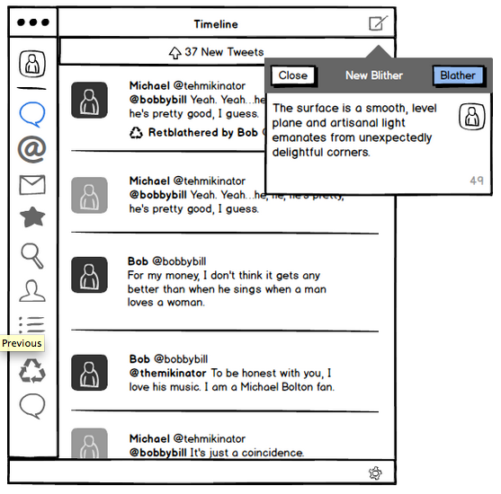
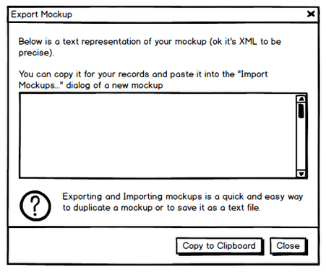
Workflow of this research
Conduct Focus Group
Insitu operators
Other UAS operators and pilots
Mockup UI prototypes
Balsamiq
Research Suitable UI Controls
WPF research
Prototype of UI
CAPlug-In

Slide 3
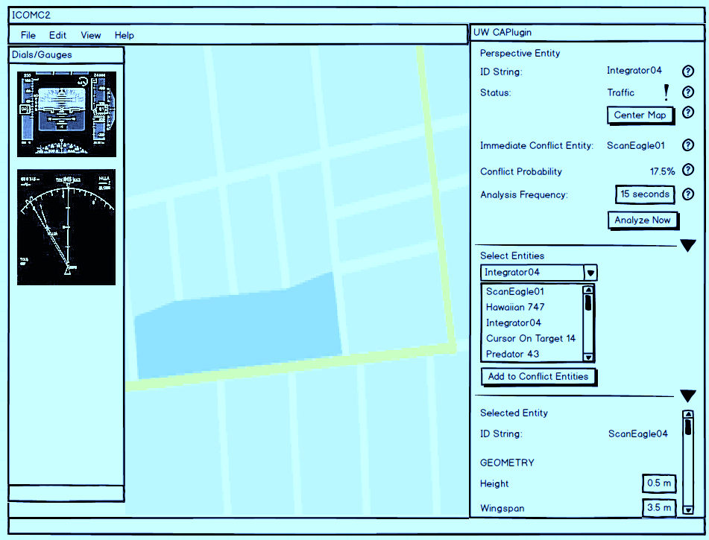
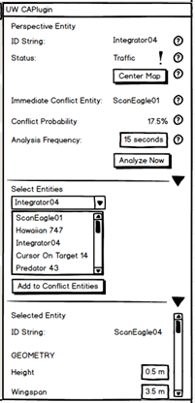
UI Prototype (Complete UI)
Perspective Entity
Assess current and predicted situation from the point of view of the perspective entity
Manage Entities
Allow user to manage the vehicles that the plug-in is keeping track of.
Edit Entities
Set various parameters for plug-ins vehicles

Slide 4
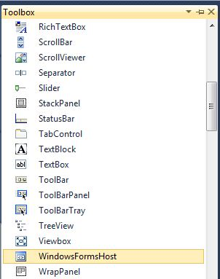
UI Controls Research
Research Focus
How to provide easy and intuitive control for operators
Study appropriate controls for each UI section in the CAPlug-In
Implement the UI in prototype WPF application
Test and validate the usability of UI control

