Slide 1

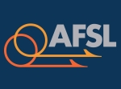

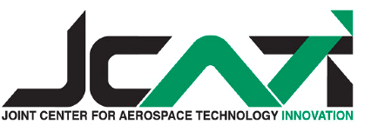
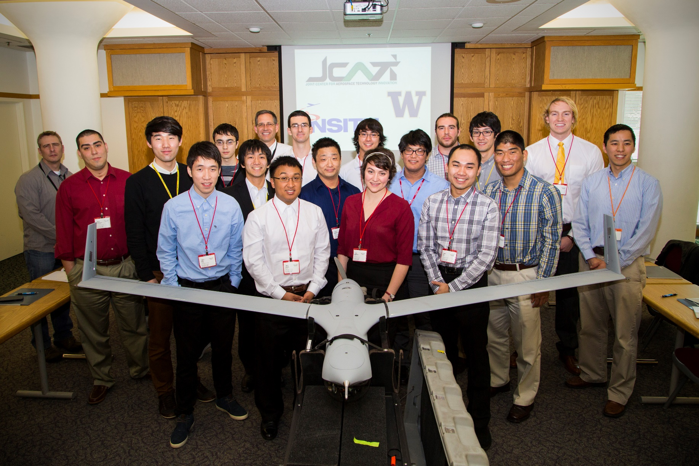
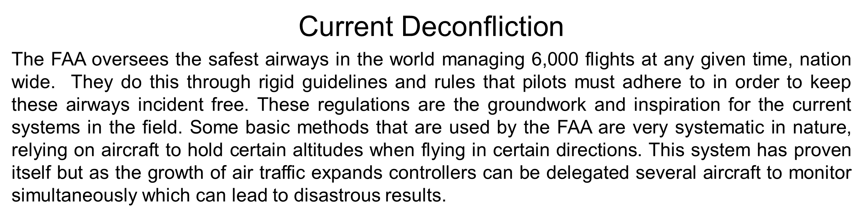
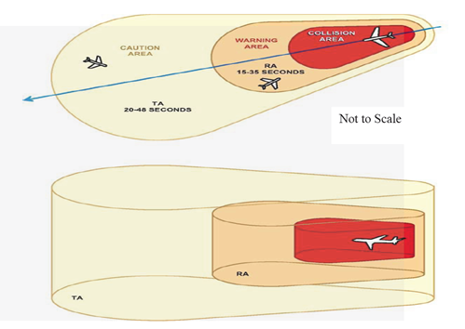
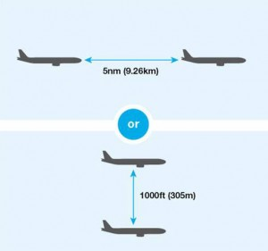
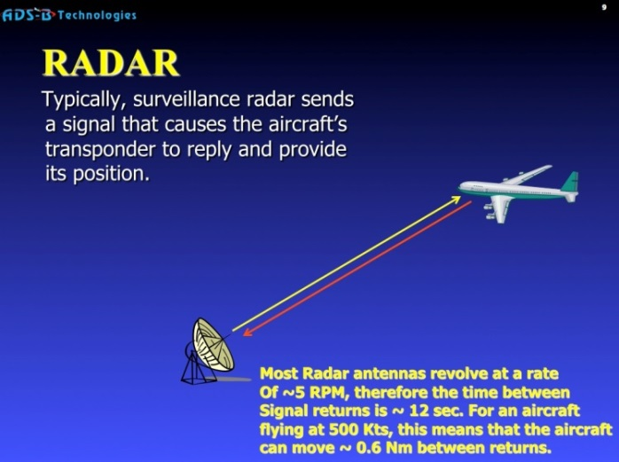
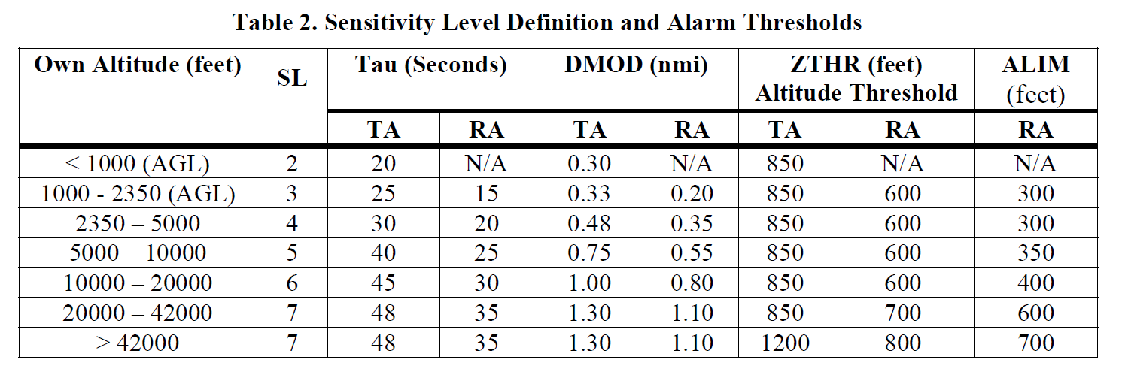
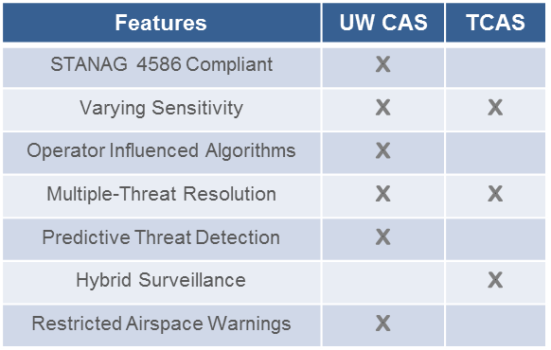
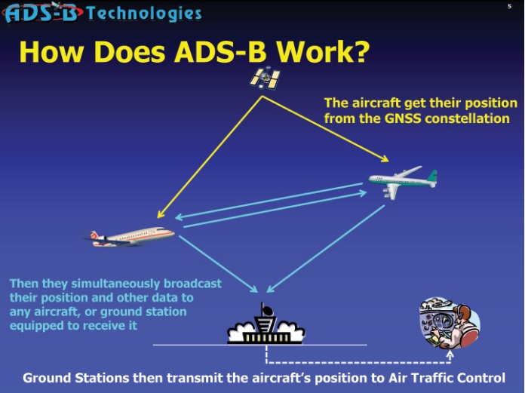
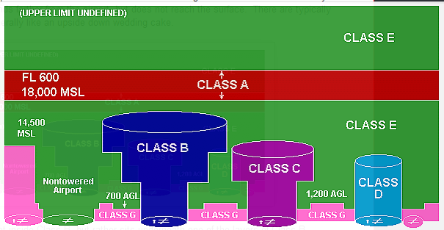
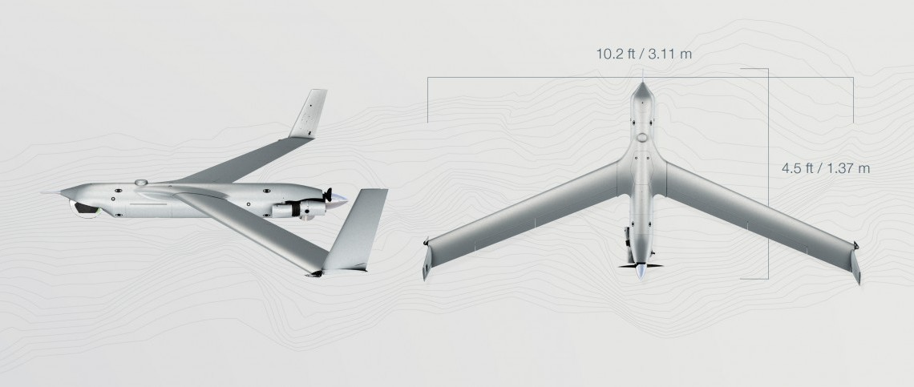
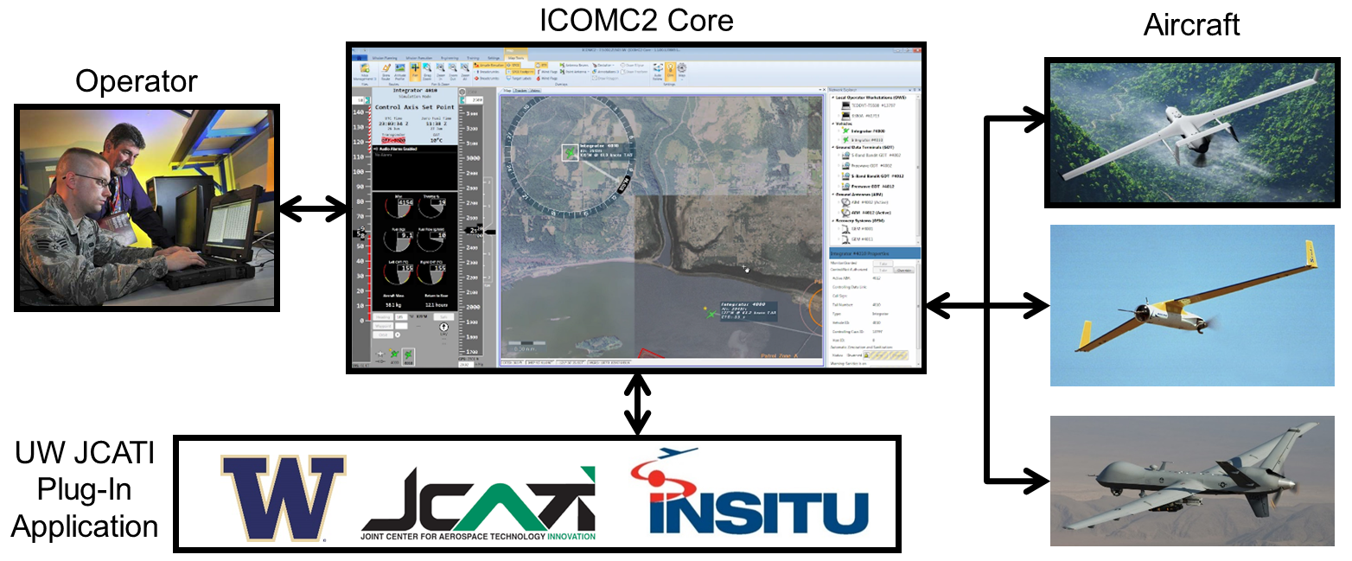
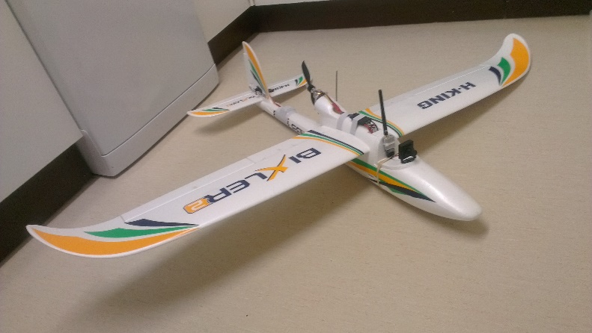
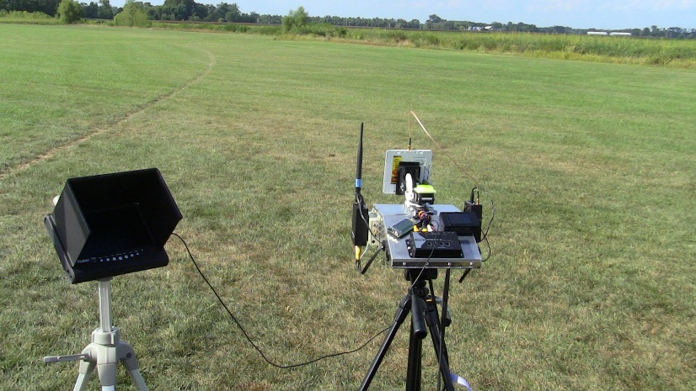
Impact of Current Technologies on Situational Awareness Conflict Resolution Systems
A.A.Creigh, C.W. Lum, N. Kimber, F. Alvarez, J. Vagners
Autonomous Flight Systems Laboratory
University of Washington
Seattle, WA USA
ABSTRACT
As Unmanned Aerial Vehicle (UAV) technology advances there will be a growing need for ways to avoid collisions in densely populated areas. Before starting to build our own collision avoidance system, it was important to look into the current systems and technologies being produced in this area now. Flight controllers perform these tasks on a everyday basis with multiple aircraft at a time. The goal of this system is to mimic or even replace the duties of a flight controller with an automated warning system. Commercial airlines have also seen this necessity and began to produce their own systems as well to enhance collision avoidance, these systems were also investigated in order to understand how they function in order to give inspiration to the research.
Future FAA Requirements
By September 30th, 2015 a mandate is to be passed regarding the process of integrating UAS and UAV technology into the United States airspace. Currently no commercial companies can use these products over US airspace except a few very small cases. One of the major required components for this integration is the existence of a collision avoidance system. This is closely related to the FAA mandated “Sense and Avoid” capability. Many consider this the “holy grail” of collision awareness systems as it would provide not only warnings and ways to resolve those conflicts, but would also execute those resolutions autonomously. Currently this technology does not exist.
Current Collision Awareness Systems
Joint Center for Aerospace Technology Innovation
The Washington Joint Center for Aerospace Technology Innovation allowed students to gain research exposure to the following fields
  software engineering
  autonomous systems
  verification and validation
  engineering development cycles
  stochastic processes, etc.
  Other educational achievements associated with this project include
  24 students involved
  133 research credits, 2 masters thesis
  5 students placed into industry
TCAS
The most prominent system that is used in todays commercial airlines around the world is the Traffic Collision Avoidance System. The current research project draws inspiration from existing systems such as TCAS. The TCAS uses ground radar and transponders to relay information between aircraft. It requires that all aircraft have compatible components in order to operate. As two aircraft with functioning TCAS approach each other, they begin to interrogate the other aircraft for desired information, such as distances and closure rates. Using various algorithms, the TCAS then addresses the aircraft with either a Resolution Advisory or a Traffic Advisory.
Figure 9: This picture was taken in Hood River Oregon on site at Insitu after one of our external demos with management.
The need for automation in these tasks is paramount, even more so as pilotless aircraft expand into the airways around the world. In the world of aviation there are two separate flight rules. Visual Flight Rules (VFR) and Instrument Flight Rules (IFR). Most UAS do not have a pilot on board we must rely on IFR to avoid contact with objects where as VFR relies on the pilot’s own ability to see around his aircraft to avoid contact. One of the largest concerns when flying IFR is maintaining separation in dark or poor weather conditions in which pilots are unable to see other aircraft.
The funding provided by JCATI gave students at UW a hands on experience with a major UAV manufacturer. Not only was the research team given hands on experience in producing industry level code development, it also provided a important piece of technology for the aerospace industry. These two factors are key pieces in ensuring a rich future in Washington's aerospace industry as well as ensuring the ones that will be filling those gaps in the future have the tools needed in the work force. Product managing was a pivotal part in the experience, monthly sprint schedules were set up and weekly meetings helped contribute to the success that this research provided. With development champions and user stories each research student took responsibility for a piece of the project until it was completed. Funding for projects of this nature are important to the future of aerospace and keep a close contact between industry expectations and the educational systems looking to place those students in the aerospace industry.
Figure 4: These 3-D volumes show the theoretical boundary areas that the TCAS encompasses and how the time frames change with TA and RA resolutions.
Figure 1: Shows a pictorial depiction of basic aircraft separation in flight control
Comparison of Current system VS UW Plug-In
Currently the process for avoiding aircraft is systematic, the FAA states that all airline traffic is to maintain 5nm horizontal and 1000ft vertical separation. It is the flight controller’s duty to ensure all aircraft in their zone adhere to these conditions. If an issue arises the air traffic controller will then give instructions to the aircraft to change course. As well, changes in velocity may be used to deconflict. A system to provide warnings to the controller of pending conflicts is needed and would greatly reduce flight controller workload.
Figure 5: Basic example of how radar functions
ADS-B
The Automatic Dependent Surveillance – Broadcast (ADS-B) is a system that is intended to work in radar deprived conditions. Systems like the TCAS require radar stations to properly function, where as with the ADS-B it can function outside of these areas. It relies on special ADS-B zones that have been placed in specific spots to increase it’s effectiveness. The information is also available at all times rather then radar based which can become degraded with time. The FAA has mandated all aircraft by 2020 have a ADS-B.
Taking what we had discovered from the current systems and implementing our own unique approach to the collision system problem a comparison of the two can be made. One thing that the UW collision plug-in does that sets it apart from the TCAS is it utilizes a predictive measure in order to foresee possible conflicts in the future. The TCAS relies on only what the current situation is with closure rates and distances. This gives us a more reliable result. One fault found in the TCAS is it’s inability to recognize restricted airspaces. This is a huge
Airspaces in the US
There are 7 different types of airspace in the US with only 6 being used. Each of these airspaces have their own guidelines and flight rules that apply to them. These airspaces are important as some have restrictions to what types of aircraft maybe be flown in each different class. As technology in collision awareness systems expands we not only want to avoid other aircraft but also certain “no-fly zones” or restricted airspace.
Insitu ICOMC2
Our industry partner in this project is Insitu Inc. They produce multiple different types of UAV platforms as well as UAS systems. There two most well know aircraft are the ScanEagle and Integrator. These aircraft are controlled by Insitu's Common Open-mission Management Command and Control (ICOMC2) software. This ground station is a user friendly control platform to control any STANAG4586 compatible system. With this approach the ICOMC2 will not be limited to Insitu products alone.
Figure 6: Example of how the ADS-B system works and its ability to communicate between aircraft.
necessity in automation technology and can be utilized for not only airspace but also terrain or sensitive boundaries such as country borders or military bases. Most current and future systems have the ability to handle multiple aircraft conflicts. Even the current systematic procedures used by the FAA are setup to handle this. The increased air traffic will require a streamlined and efficient collision system.
No-fly zones are of great interest and the ability to recognizes these zones and avoid them is required in current aviation. The system being developed in this research will be required to recognize certain areas dictated by the controller as places to avoid. The system will be able to warn the operator of not only impeding conflicts with other aircraft but also areas in which the UAV or aircraft should not be operating.
CONCLUSIONS AND FURTHER RESEARCH
This research is a fundamental first step towards achieve fully autonomous, multi-vehicle collision avoidance. The ability to autonomously avoid or warn operators on impending conflicts can help alleviate human error as the US airspace begins to grow. In the United States we are far behind the curve when it comes to integrating UAS and UAV technology into the commercial industry. In Japan they have been using automated helicopters to crop dust fields for many years. Many other countries and organizations have already begun to push forward with integration of these systems into their airspaces. As the US begins to implement steps to do the same, abilities like the UW collision awareness system will be pivotal pieces in ensuring the public safety.
The ICOMC2 utilizes the ability to grab different types of plug-ins such as the collision awareness plug-in in order to complete a required task. With this ability you can tailor you UAS system to exactly what the mission entitles or requires.
Figure 2: This shows the basic structure of airspace classes in the US. Notice how the cylinder diameter gets larger as the elevation increases.
Growing Civilian Availability
Almost all UAS stem from the same basic setup. The primary component is an aircraft which is controlled by an onboard computer, that then sends signals back to what is called a ground station. This requires line of sight in order to operate. This technology is becoming more and more available to the civilian public and it is estimated there are tens of thousands of “hobbyist” UAV pilots in the United States now.
Figure 7: A graphical model of Insitu’s most prominent aircraft the ScanEagle
REFERENCES
Le, B. Probabilistic Estimation of State via Propagation of Error for a Collision Warning System. Thesis, University of Washington William E. Boeing Department of Aeronautics and Astronautics. Seattle, WA.
"Automatic Dependent Surveillance-Broadcast (ADS-B)." Automatic Dependent Surveillance-Broadcast (ADS-B). N.p., n.d. Web. 18 Apr. 2014.
"Insitu." ICOMC2 -. N.p., n.d. Web. 18 Apr. 2014.
"TCAS II Version 7.1." TCAS 7.1. N.p., n.d. Web. 18 Apr. 2014.
"Unmanned Aircraft Systems (UAS)." Unmanned Aircraft Systems (UAS). N.p., n.d. Web. 17 Apr. 2014.
Other plug-ins such as the RF link analysis and search plug-in can be used to augment the system’s capabilities.
Figure 3: A example of a civilian UAV with multiple mile range capabilities with live video feed.
Figure 4: A example of a civilian UAS ground station that is required to communicate with the UAV while in the air. It captures telemetry and video signals
Figure 8: Example of the ICOMC2 and it’s ability to control multi UAV aircraft.

