Slide 1
146
C# application
(generates/outputs data)
Data files
(text or binary files)
Unity scripting or module which reads data and generates automatic animation/keyframes
Movie file

Slide 2
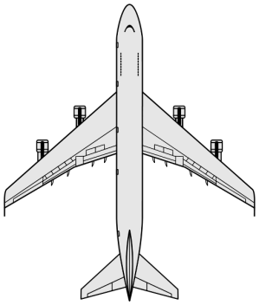
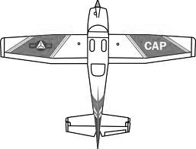
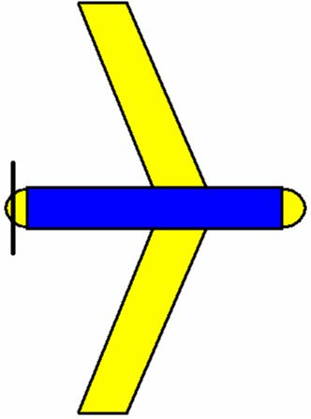
232
Flight path for Cessna01
Flight path for Integrator02
Hawaiian343
Cessna01
Integrator02
ScanEagle01
CursorOnTarget01

Slide 3
248
z
2D Polygon defined in the XY plane and the volume is extruded in the z direction
y
x

Slide 4
255
z
3D volume restricted airspace
What is probability that entity is inside the restricted airspace?
Position distribution
y
x

Slide 5
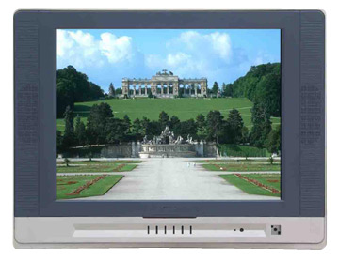
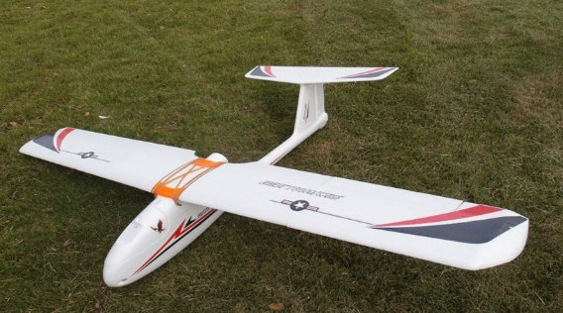
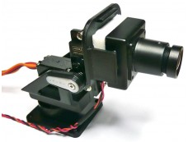
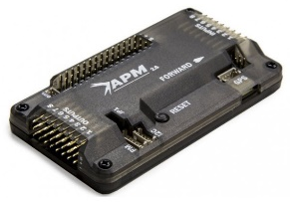
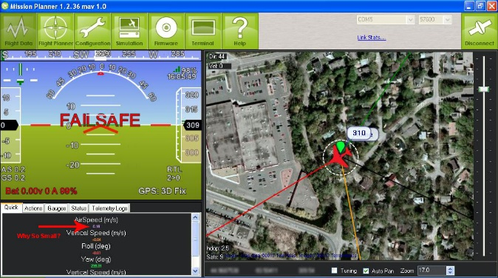
333
Uno5800 v2 Receiver
Analog Capture Card
Operator Camera View
Visual Anchoring Algorithm
Image Processing System
APM Mission Planner Communication System
Skywalker 1900
FoxTech Camera
APM 2.6
UAS
APM Mission Planner
Ground Station

Slide 6

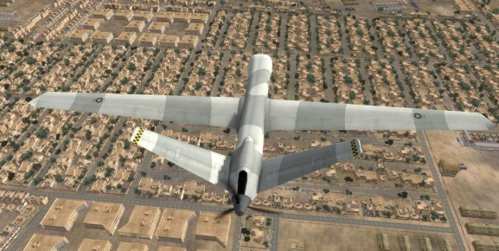
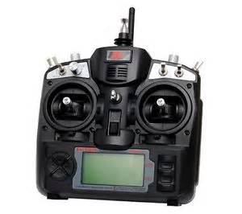
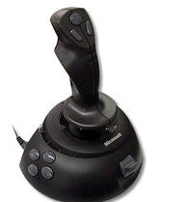
333
Aircraft Plant Simulation
Matlab/Simulink
Scenario Visualization
X-Plane 10

Slide 7
453
r_{d}
Vision System
d_{v}
u
x
y
Inner Loop Orbit Controller
RCAM Plant Model
APM 2.6 Sensor Model
r_{d} = desired orbit radius (specified by operator)
d_{v} = distance from aircraft to anchor point as determined by the visual camera system
u = plant control input vector [aileron; elevator, rudder, throttle 1; throttle 2]
x = plant state vector [u; v; w; p; q; r; phi; theta; psi; PN, PE, PD]
y = sensor measurements (remove position information to simulate GPS denied

Slide 8
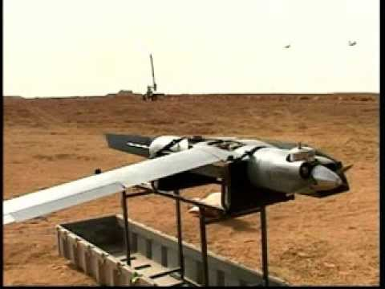
521
Example of a ScanEagle box/cradle that holds the UAV at waist height

Slide 9
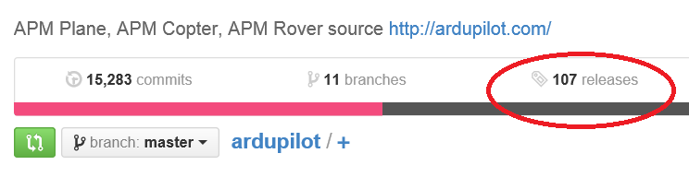
566
Figure 7: Make a release at the stable point

Slide 10
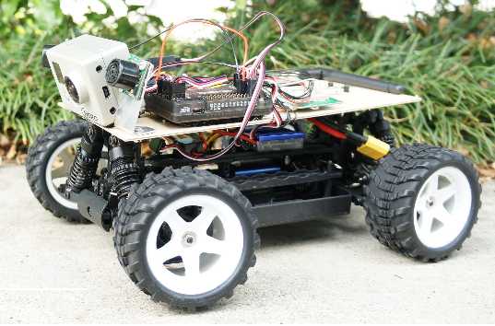
569
Figure 8: Example of a hobby-grade autonomous ground vehicle.

Slide 11
882
ATC
Broadcasts information and instructions to PIC
Yaesu FTA550
Airband HAM radio
GCS Operator
Handles volume of Mission Planner announcements
PIC
Control transmissions to ATC.
AFSL Common Audio Pool
Flight operations crew can freely communicate internally.
GCS
Mission Planner will make announcements and broadcast status updates.
Co-Pilot
In charge of tuning ATC radio.
Observer
Calls out surrounding traffic.

